Slide 1
Attributes

Slide 2
Attributes
Def: A quality or characteristic inherent in or ascribed to something.
In LIMS - A field created by Lab/LIMS administrators (as needed) and used to store various details about LIMS objects.
Attributes can set to be inherited for certain objects.
  Eg. From Plate to Plate during an aliquot/transfer

Slide 3
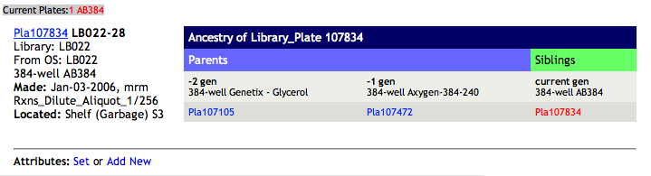
Defining Attributes
Only lab administrators can create new attributes.
Lab techs can only set values for already defined attributes.

Slide 4
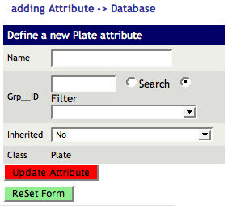
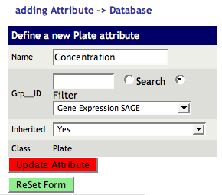
Defining Attributes Cont’d
Attribute names CANNOT have spaces in their names, use ‘_’ to separate words.
Currently attribute inheritance is only implemented for Plates.

Slide 5
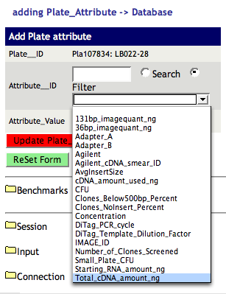
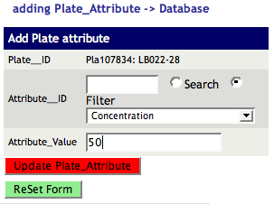
Setting Attribute Values
Select desired attribute from the dropdown list and enter a value for it.

Slide 6
Attributes in Protocols
2 types of attributes in protocols
  Plate Attributes - applied to each plate in the current plate set (inheritable)
  Prep Attributes - applied to the current protocol step (not inheritable)

Slide 7
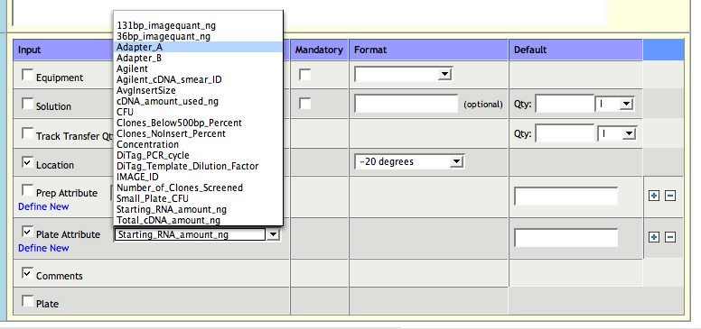
Attributes in Protocol Setup
Select the desired attribute from the dropdown menu and set a default if applicable.
Multiple attributes can be added to a protocol stop by pressing the ‘+’ button
‘-’ will remove the current attribute

Slide 8
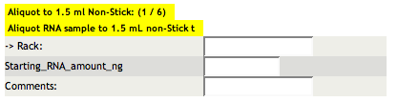
Attributes in Protocols
Within protocol attributes are prompted for in the same way as other information
Prep attributes: the value entered is applied to all plates in the current plate set.
Plate attributes: user can enter multiple values separated by ‘,’ and each value will get assigned to the respective plate in order.

Slide 9
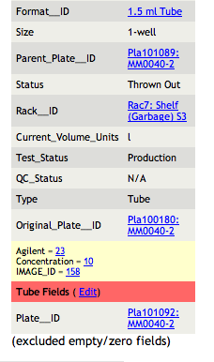
Viewing Attributes
Object attribute values can be viewed on the objects homepage along with other object details.
Attributes are highlighted on light yellow background
_x0003_

Slide 10
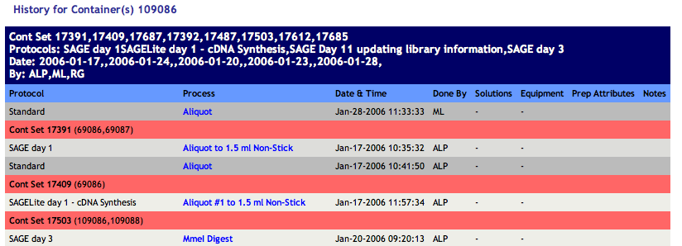
Viewing Attributes Cont’d
Prep attributes can be viewed on the Plate/Tube History page in the “Prep Attributes” column for each protocol step.

Slide 11
Attribute Caveats
When defining new attributes please ensure that all spaces in the attribute’s name are replaced by ‘_’
Currently only Plate/Tube attributes can be inherited.
Attribute details cannot be modified once they are created (consult LIMS staff if this issue arises)

