Slide 1
LIMS Generic Search Page

Slide 2
Description
Provide an interface for the user to easily search for information stored in the LIMS, based on defined views
Provide views and reports generated by input from the user.
  The user chooses the filtering options and which output fields to be displayed

Slide 3
Navigation
User can navigate to the View Home page
  Displays a list of available views
  Displays a view if the view is specified
Need to navigate from the main page to display the list of available views

Slide 4
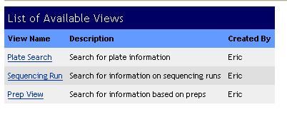
Navigation
Click here to view a specific search page

Slide 5
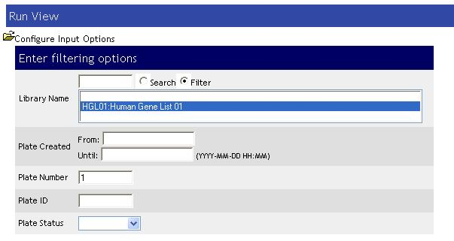
Search Page: Run View
Choose from a list of filter options:

Slide 6
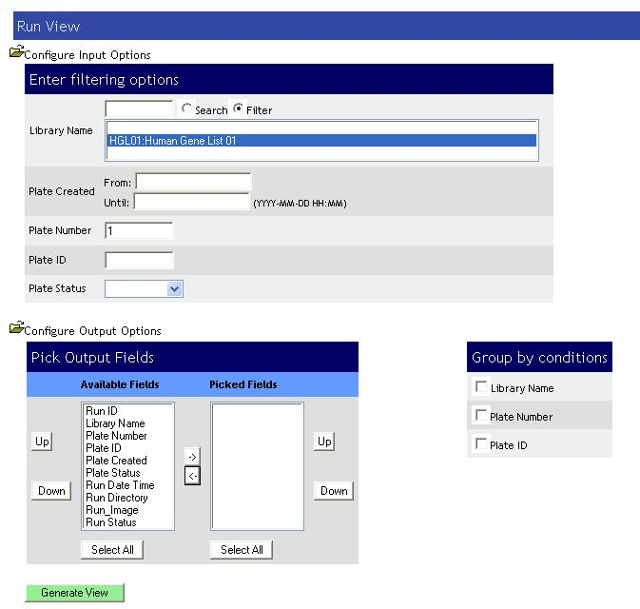
Search Page: Prep View
Expand
to view output
options

Slide 7
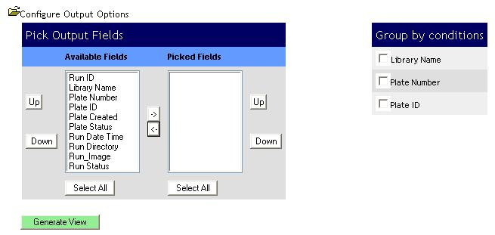
Search Page: Run View

Slide 8
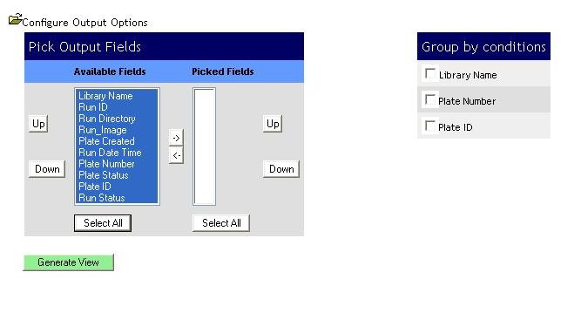
Search Page: Run View
Move to picked fields
list
Select some or all fields from the available
Field list

Slide 9
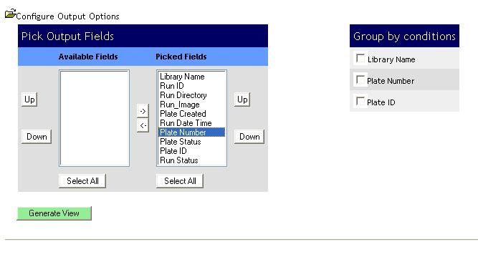
Search Page: Run View
Change the order
of the output
Click to Generate the Summary

Slide 10
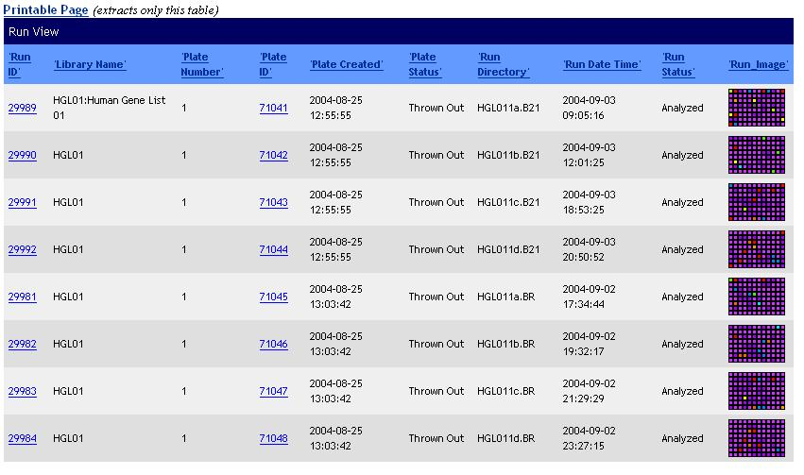
Search Page: Run View

