Slide 1
30 day Readmission Risk
An evidence-based proposal for targeted post-discharge support
Executive Presentation
Kavishna Ranmali Kalamba Arachchi
Should the hospital pilot a model that helps prioritize scarce transition-of-care support?
Recommendation : proceed only as a monitored supportive-outreach pilot

Slide 2
A Risk Score can help focus support at discharge
Proposed workflow
DISCHARGE
Score available
REVIEW
Clinicians confirm need
SUPPORT
Offer added follow-up
LEARN
Measure outcomes
Potential services:
Discharge counselling
Early appointment confirmation and care-management calls

Slide 3
Evidence : Large and Historical
Data scope :
130 hospitals
Care period : 1998 – 2008
Patients in analytic cohort : 69, 973
30-day readmission prevalence : 8.97%
Strengths :
Public, deidentified multicenter dataset
Heldout test of 13, 995 patients
Preprocessing & threshold selection was done on training-only set
Constraints:
Historical data, so may not match current care
Readmission patterns outside network may be missed
No socioeconomic labels and coarse demographic labels used

Slide 4
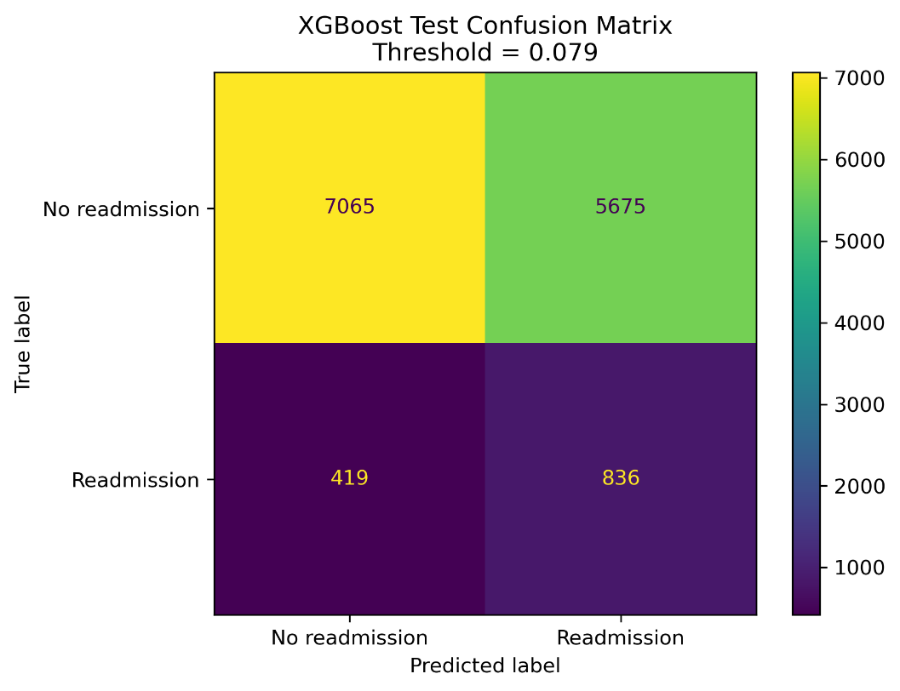
The model finds two-thirds of early readmissions
Heldout test performance :
66.6 % of early readmissions identified
12.8% of alerts were true readmissions
Average Precision (AP) : 0.183
Model is 2.04x the prevalence-level AP baseline
What this means:
The model provides moderate ranking value
A low threshold favours sensitivity
Many alerts will not result in a readmission
The operating point must match outreach capacity

Slide 5
Current threshold flags 46.5% of test population
6,511 patients flagged for outreach
(46.5% of test cohort)
Capacity question : How many patients can the hospital contact, and what is the cost-benefit analysis of such interventions?

Slide 6
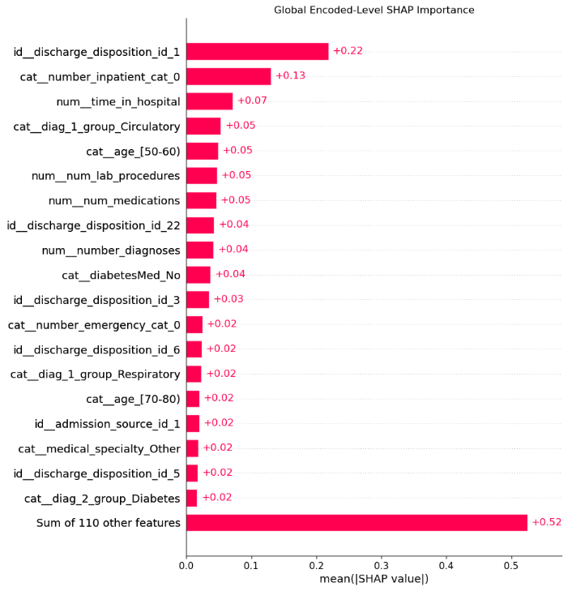
Discharge setting and prior utilization drive risk ranking
Discharge to home
Leading Signals :
Discharge destination
Previous inpatient use
Length of stage

Slide 7
Age disparity requires explicit mitigation & monitoring
Largest concern:
Older patients are flagged much more often, including older patients who are not readmitted.
Required response:
Prospective subgroup validation
Confidence intervals and intersectional analyses
Monitor access, uptake and outcomes
Fairness risk at selected threshold

Slide 8
A prospective pilot should test clinical & economic value
A proposed workflow for evaluation
1. LOCAL VALIDATION : confirm data mapping, calibration, subgroup performance
2. SILENT TRIAL : Generate scores to test workflow & stability (no care action performed yet)
3. CONTROLLED PILOT : Offer low-risk support and compare readmission, uptake and workload
4. SCALE : Expand only if benefits, fairness and costs meet target
The model can help prioritize who received extra support, but it cannot determine who deserves care

