Slide 1
Ran Li’s web apps

Slide 2
Menu
Tweet Talk
Digital Flipbook
Egrader
Current work -- web crawler

Slide 3
Tweet Talk
Tweet Talk is an Internet browser extension meant to enhance the online-news reading experience. It allows the reader to gather outside information from experts concerning the article they are currently reading without navigating away from it.
The goal of Tweet Talk is to provide the reader with a variety of informed viewpoints, through the use of Twitter, as they consume the news.
Screen cast: https://dl.dropboxusercontent.com/u/65792684/Tweet%20Talk.m4v.zip
Google Play link: https://chrome.google.com/webstore/detail/tweet-talk/oehghphfhmkilamcljmkealnanmmnofj?utm_source=gmail

Slide 4
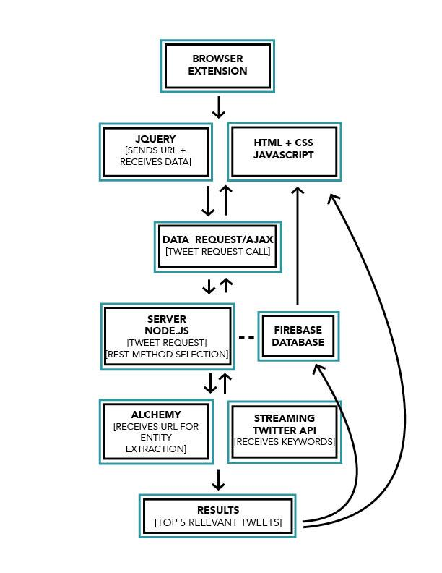
How it works

Slide 5
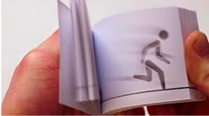
Digital Flipbook
Digital Flipbook is a web app that can support people drawing online.
It always starts with a blank frame, it has pencil, eraser, animation, save and share to others functions.
Tools: HTML5, JavaScript, CSS

Slide 6
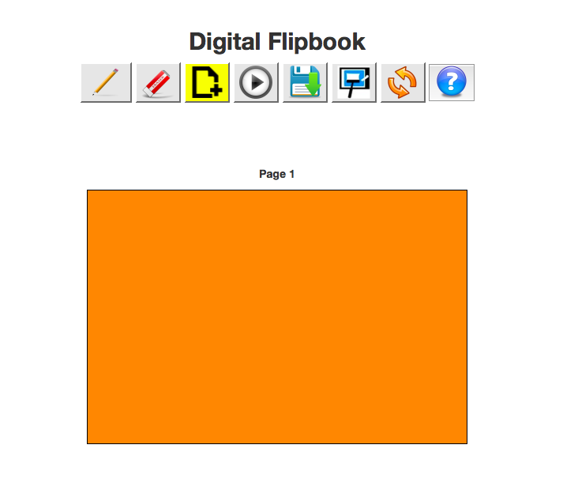

Slide 7
Egrader
The design for e-Grader consists of three tasks. The main task is grading center.
The first task is grading center. TA can press the corresponding enter button to get in.
The second part is Statistics Analysis design for professors. Professors can get in to this interface after pressing the corresponding enter button.
The third part is Student center designed for students. After logging into this page, student can check the homework they submitted.
*Egrader is a totally front-end work with HTML, JavaScript, CSS, JQuery. It works well in Safari, Firefox

Slide 8
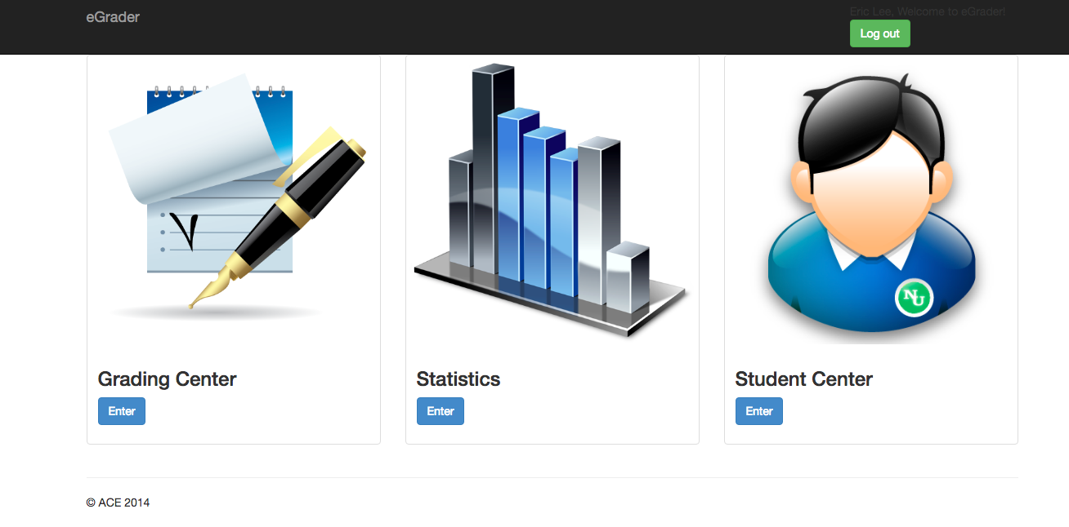
Main page of Egrader

Slide 9
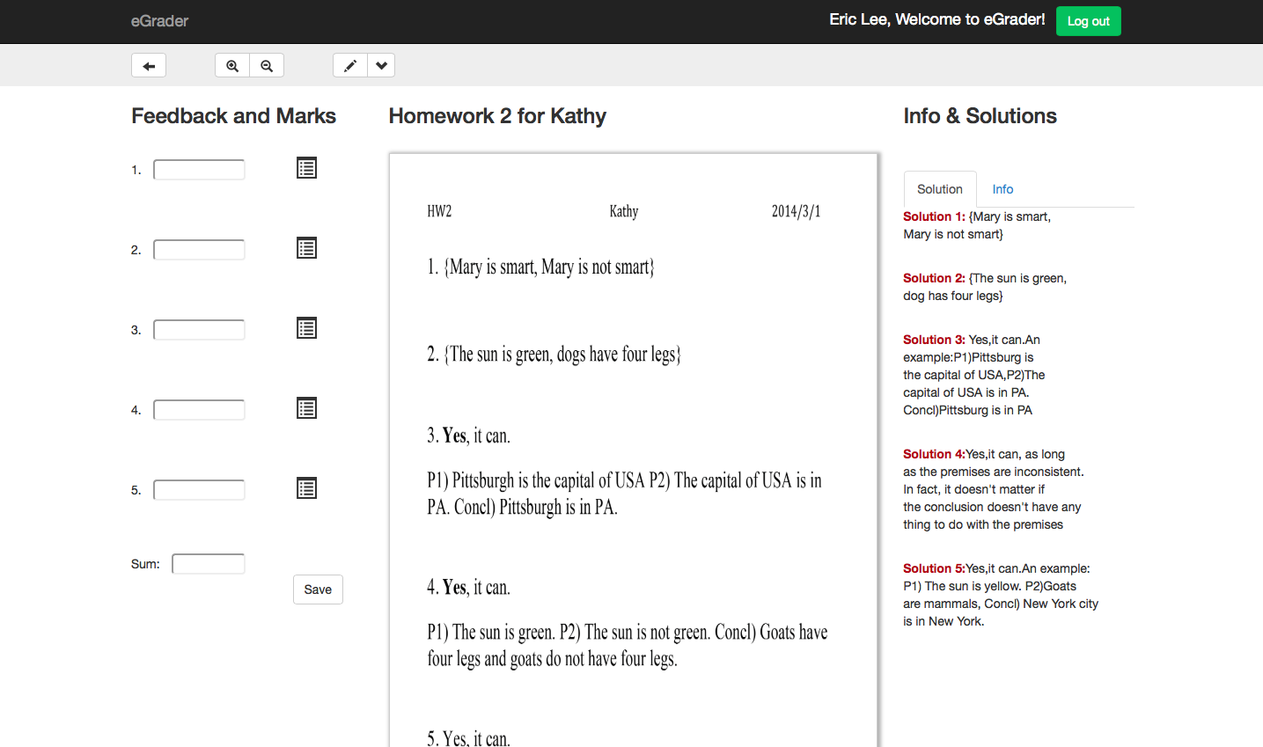
Grading Center

Slide 10
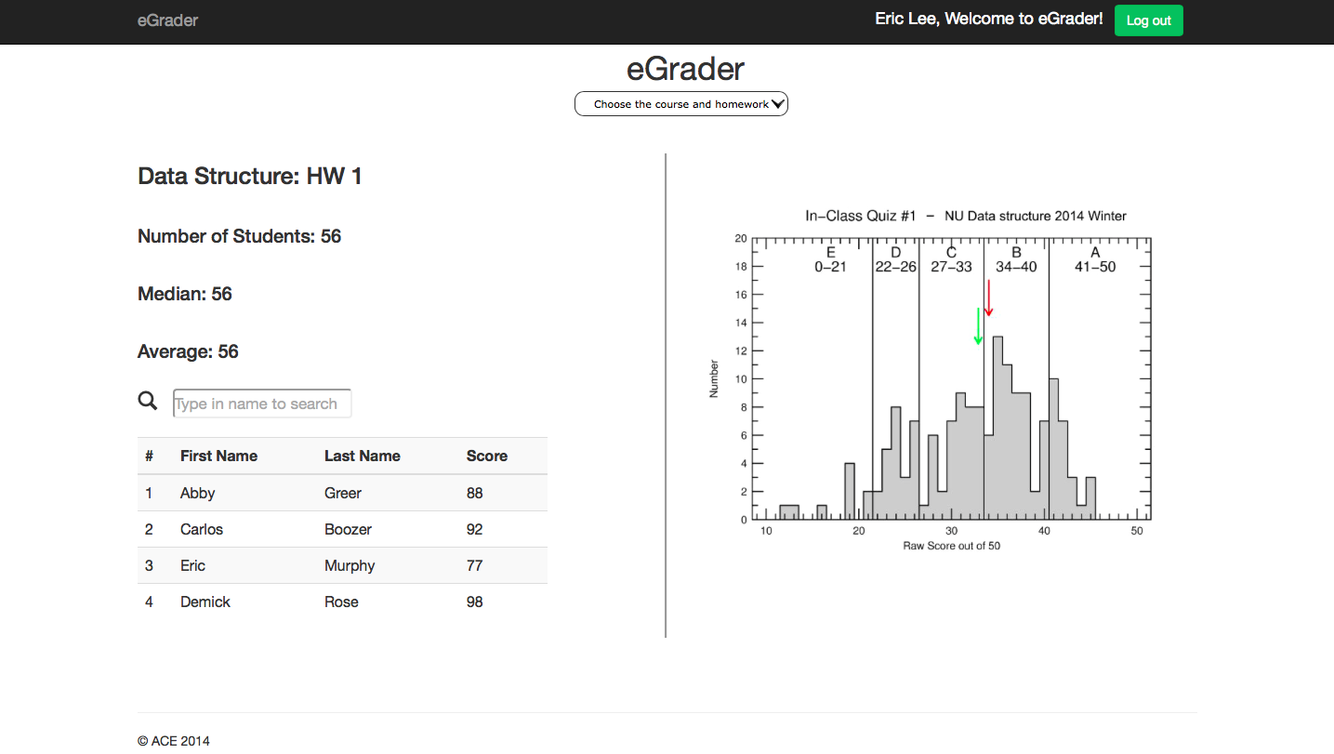
Statistics

Slide 11
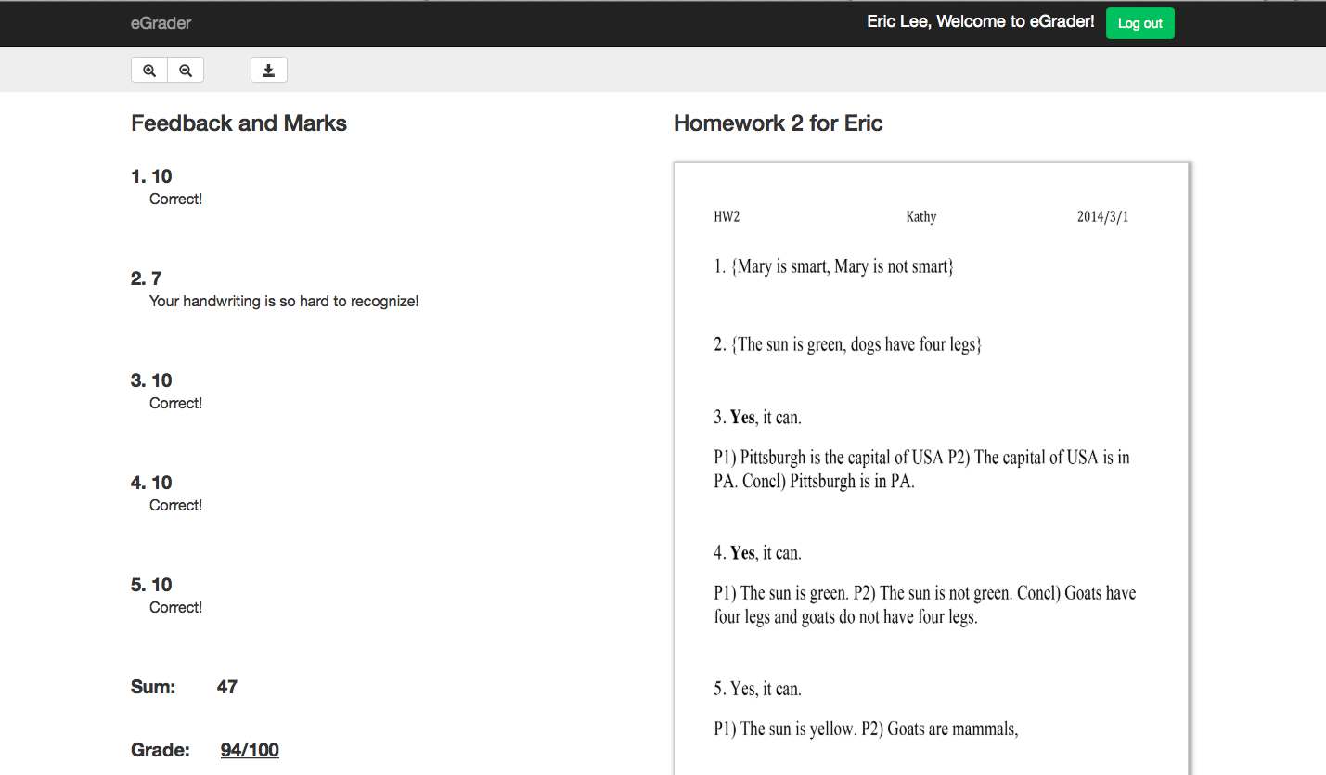
Student Center

Slide 12
Current Work--- web crawler
Web crawler can parse “the old website event information” and write the information into the new website.
The work has three parts:
Parse the old website page and save into the json file (Python, BeautifulSoup lib)
Analysis the new website page structure
Write the json into the corresponding positions in the new webpages (HTML, JQuery, JavaScript, CSS)
***In this project, I just have the last step need to be finished. If you interested in this project, I can send the finished code to you by next Monday.

