Slide 1
projects

Slide 2
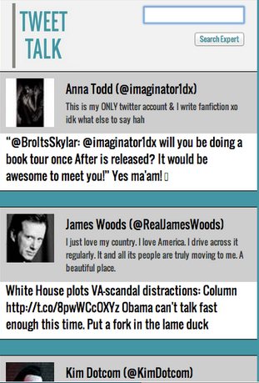
Tweet talk
Tweet Talk is a browser extension that enhances the news reading experience. Tweet Talk allows readers, looking at an online article, to expand their knowledge of its topic by providing expert opinions, links to related articles, and information from experts talking about that topic.
tweet_talk chrome extension

Slide 3
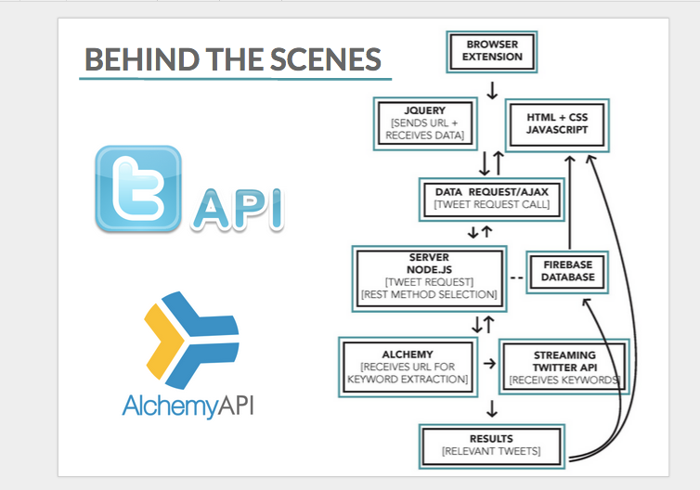

Slide 4
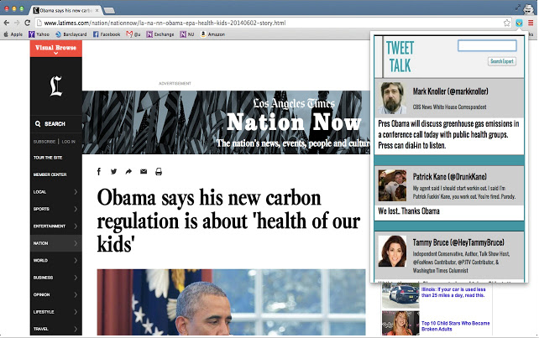

Slide 5
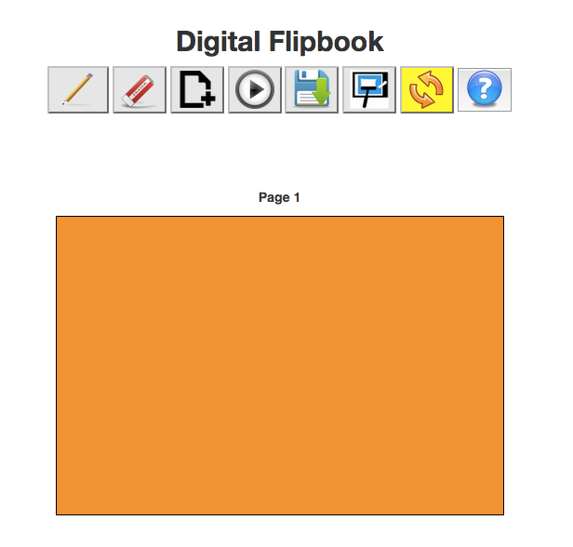
Digital flipbook
digital_flipbook
(safari works well)

Slide 6
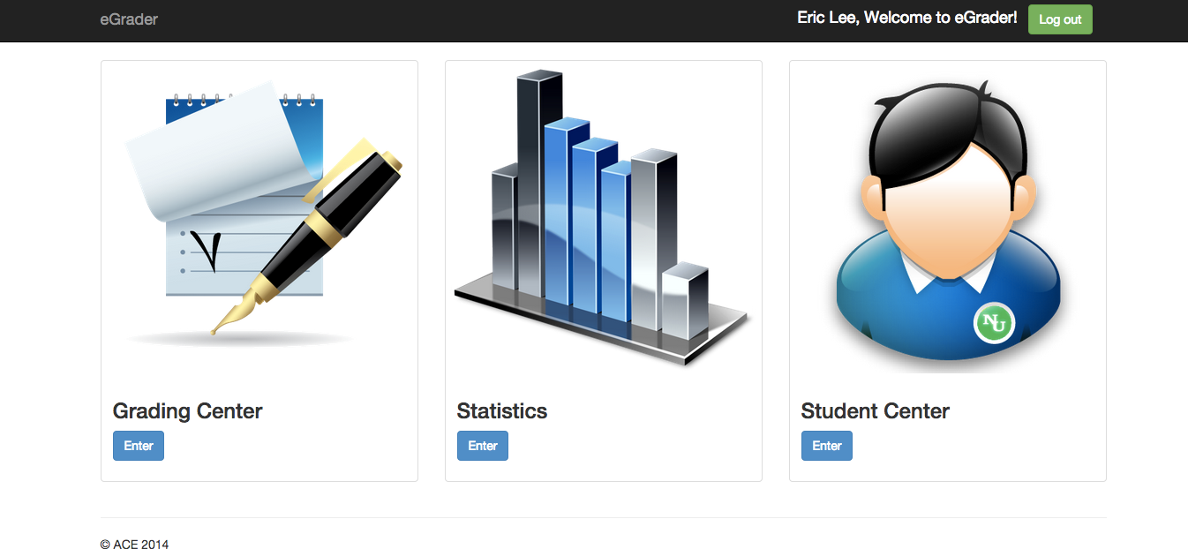
Egrader
Egrader is an web app working for mentor, professor and students.

Slide 7
Group Dine
Group Dine is an web app to help you decide where to eat.
Story: We have three people, A like Indian food, B like Chinese food and C like American food, and nobody knows where to grab the food, Group Dine can help you to solve this issue.

Slide 8
Email filter
Using bayesian classifier to build a filter model to classify spam emails and regular emails.

