Slide 1
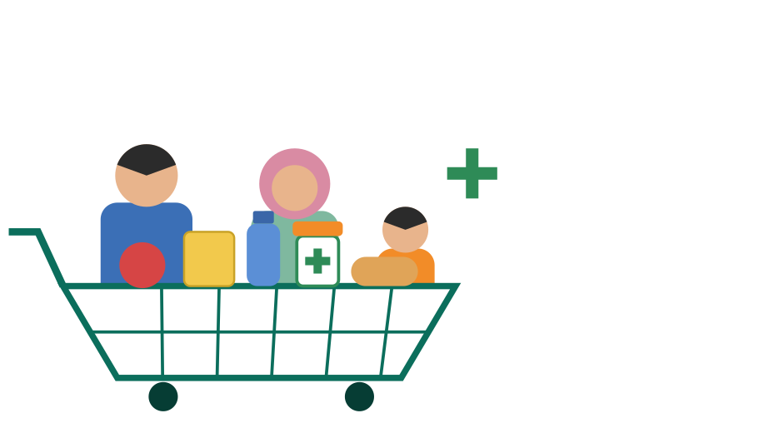
KIFAYA PHARMACY SUPERMARKET | CAMPAIGN PROPOSAL
11.11
Mega Sale
Health and savings, under one roof.
Wednesday, 11 November 2026 | Karachi, Pakistan
Campaign period: 16 October - 30 November 2026
Estimated total: PKR 5,853,500 (illustrative)

Slide 2





A 30-day plan from teaser to repeat shopping
CAMPAIGN OVERVIEW
Name and slogan
Target customers
Objectives
11.11 Mega Sale
Sehat bhi, Bachat bhi.
"Everyday Savings. Everyday Wellness."
Families, parents of young children, elders and caregivers, young professionals, students, offices and clinics.
Grow November visits and basket size, build a trusted health-and-savings image, win bulk orders and grow loyalty members.
Five sale categories
Grocery & Staples
Personal Care & Beauty
Baby & Mother Care
Health & Wellness
Home Care & Snacks

Slide 3
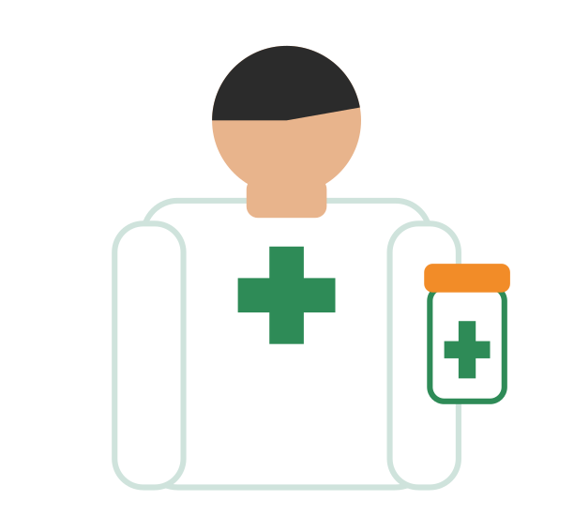
What makes a pharmacy campaign different
PHARMACY GUARDRAILS
1
Approved offers only
Only categories approved by management and the in-charge pharmacist are advertised. Confirm local drug-regulation rules (DRAP / provincial) first.
2
No prescription-medicine ads
Public ads never promote prescription medicines, and discounts are not used to push medicine purchases.
3
No health claims
Posters and creators talk about convenience, savings and care, never cures or results. Health camps are awareness only.
4
Ready for pressure
Calm reply notes for stock-outs and long queues, plus a staffed WhatsApp line from 11 to 15 November.

Slide 4

One recognisable look across every touchpoint
CREATIVE SYSTEM
5 social posters + captions
Website / app banner
5 x PKR 25,000 = PKR 125,000
PKR 40,000
5 email drafts
Branding and creative direction
5 x PKR 15,000 = PKR 75,000
PKR 100,000
Urdu and English together, large logo, bright green-and-orange palette, one call to action.
Creative subtotal: PKR 340,000

Slide 5
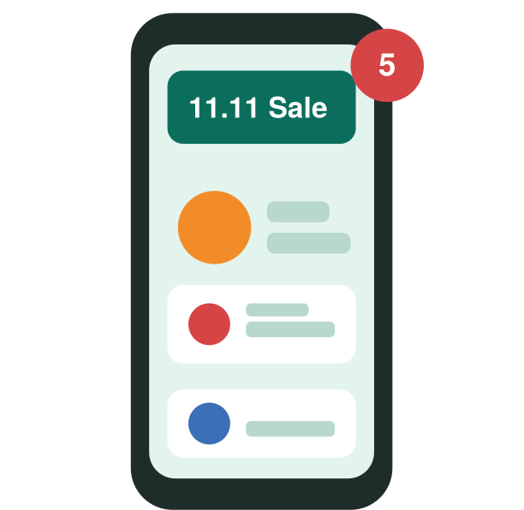
Measurable reach for Karachi shoppers
DIGITAL MEDIA
1
Reach
Paid ads on Facebook, Instagram and TikTok around each branch.
2
Capture
Google Search, Maps and YouTube ads, plus an 11.11 landing page or WhatsApp order link.
3
Respond
Reels, countdowns, WhatsApp broadcasts and SMS only to customers who agreed to receive them.
1,000,000
250,000
150,000
1,400,000
PKR paid media
PKR setup and management
PKR targeting and reporting
PKR digital subtotal

Slide 6

Influencers and PR make the sale a local story
TRUST AND LOCAL REACH
Service | Illustrative cost
12 Karachi micro-influencers (family, home, budget, wellness lifestyle) | PKR 300,000
2 mid-size Karachi creators (2 x PKR 150,000) | PKR 300,000
PR release (English + Urdu), media briefing, local publicity allowance | PKR 250,000
Influencer and media subtotal: PKR 850,000
Rules for creators
Community angle
Store tour, unique codes, paid-partnership labels, and approval before posting. No medical claims.
Add a story such as a donated ration or hygiene pack. Size is for management to decide.

Slide 7
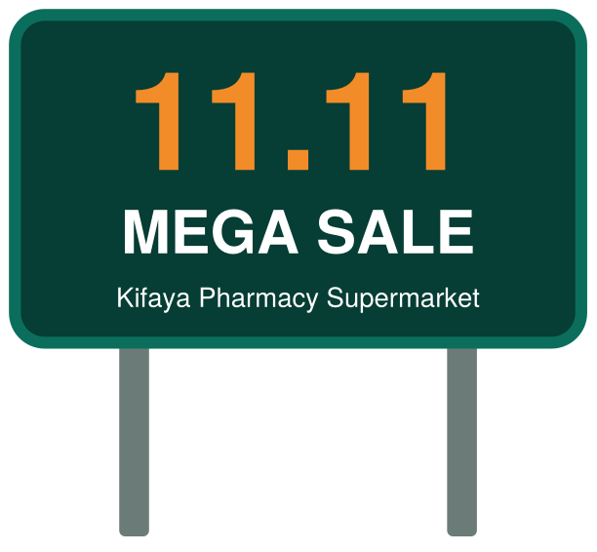
Put 11.11 in the path of Karachi shoppers
OUTDOOR VISIBILITY
Media rental
Design and printing
Installation / removal
PKR 600,000
PKR 150,000
PKR 50,000
Outdoor subtotal: PKR 800,000
Where: high-traffic shopping streets, branch catchments, bus stops and nearby markets.
Message: "11.11 Mega Sale", dates, store name and one short line, in Urdu and English with a big logo.
Scan: QR code or WhatsApp number only where people can stop, such as bus stops.
Final week: switch to a countdown such as "Only 3 days to go".

Slide 8

Win large, repeat orders and fill slow weekday hours
B2B OUTREACH
Item | Cost
Offer sheets, brochures and printing | PKR 100,000
Sales visits, transport and staff time | PKR 150,000
Samples and Trade Day (5 November) | PKR 150,000
B2B subtotal: PKR 400,000
Target businesses
Clinics and small hospitals (everyday non-prescription supplies), offices, schools, hotels, restaurants, caterers and small shops.
Execution
Business order desk or WhatsApp number, offer sheet, samples and a Trade Day on 5 November. Prices and discounts to be confirmed by management.

Slide 9
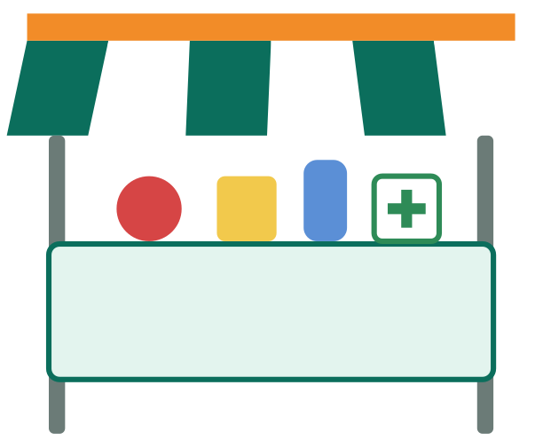
Make the sale tangible before it starts
POP-UPS AND HEALTH CAMPS
5 stalls x 5 days = PKR 800,000
Key risks: permits, trained staff, crowd control, weather, traffic and security. Coupon values and prizes need management confirmation.
Invite
Engage
Convert
About 5 branded stalls for 5 days at nearby markets, universities, offices and housing societies, with permission.
Free wellness-awareness checks run by qualified staff, samples of grocery and personal-care items, spin-the-wheel, quiz and kids corner.
Collect names and WhatsApp numbers with permission, hand out flyers or coupons, run an in-store event day and capture content.

Slide 10
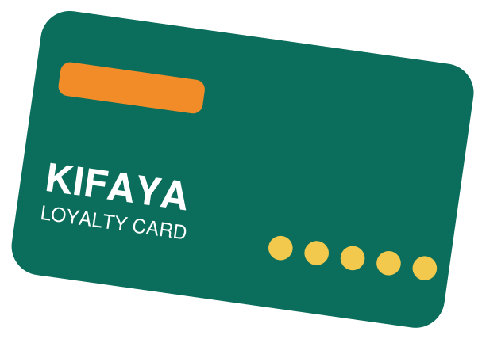
Turn 11.11 shoppers into repeat customers
RETENTION
At checkout
1
Free loyalty or membership card; capture details with permission.
After the sale
2
Thank-you message within 24 hours, feedback survey, follow-up promotion and a come-back voucher.
Retention budget
Keep the relationship
3
PKR 500,000
Birthday messages, monthly offers, opt-in refill reminders and a first loyalty report.
Reward rules and voucher value remain for management to confirm.

Slide 11
Five phases from planning to retention
ROADMAP
1
2
3
4
5
Plan
Teaser
Countdown
Sale
Retain
16-23 Oct
24 Oct - 2 Nov
3-10 Nov
11-15 Nov
16-30 Nov
Confirm offers, dates, billboards, creators, content and tracking. Pharmacist sign-off on offers.
Billboards live, press release, first creator and digital posts, B2B visits.
Media briefing 4 Nov, Trade Day 5 Nov, pop-ups, daily countdown, higher ad spend.
Launch day, live posts, in-store event, bulk deliveries, sampling, fast replies.
Thank-you messages, remarketing, surveys, vouchers and the final results report.
Measure: shoppers, average basket size, bulk orders, new loyalty members, coupon or creator-code use, reach and repeat visits.

Slide 12
PKR 5,853,500 before any management changes
ILLUSTRATIVE COST SUMMARY
DIRECT CAMPAIGN EXPENSES
PKR 5,090,000
AGENCY SERVICE FEE (10%)
PKR 509,000
CONTINGENCY ALLOWANCE (5%)
PKR 254,500
GRAND TOTAL
PKR 5,853,500

Slide 13

Approval turns the estimate into a November campaign
APPROVAL
Final estimated budget
Payment schedule
Expected benefits
PKR 5,853,500
40% advance: PKR 2,341,400
40% before launch: PKR 2,341,400
20% after completion: PKR 1,170,700
Stronger awareness, measurable reach, more store visits, bulk-order leads and repeat engagement. Results are not guaranteed.
Proposal valid for 15 days from presentation.
Client approval: ______________________________ Date: ______________
All amounts are illustrative estimates for an academic proposal, not vendor quotations. Offers, discounts, coupon values and rewards require management confirmation.

