Slide 1
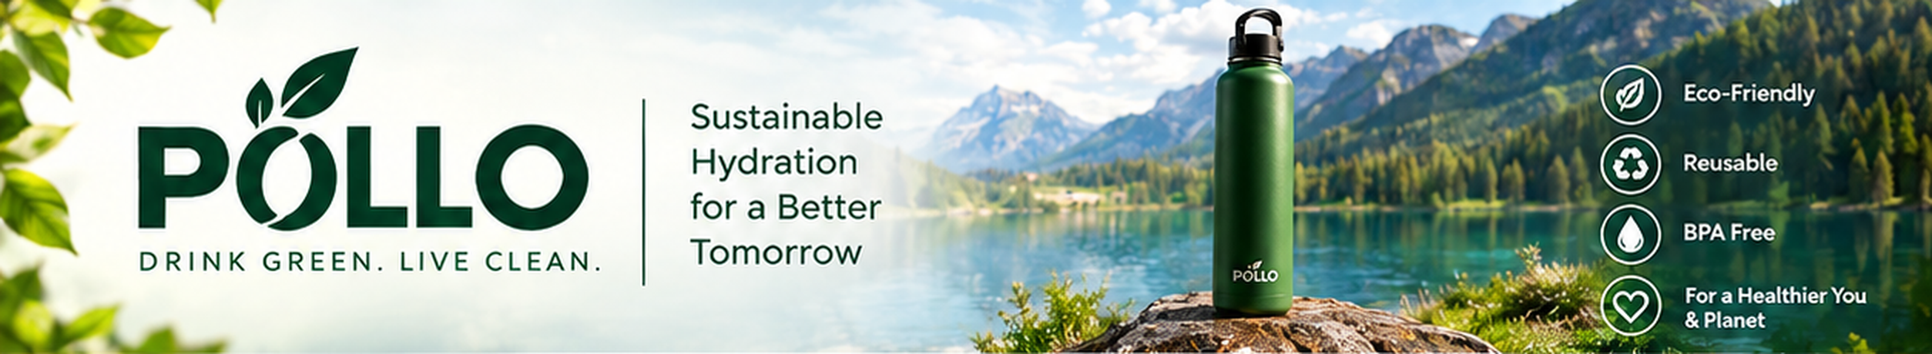
Brand Overview & Marketing Collaboration
Sustainable hydration for a better tomorrow
5
1,000
4 weeks
colours
unit launch run
launch to distribution
Notes:
Opening slide: PÓLLO brand, tagline "Drink Green. Live Clean." and the headline numbers of the proposed launch.

Slide 2




A bottle that is good for you and for Earth
Eco-Friendly
Reusable
BPA Free
Healthier You & Planet
Durable stainless steel, built to last and kind to the planet.
Same water. Less waste. More impact with every refill.
Safe for your health and safe for daily use.
Good for you. Great for Earth.
Sustainable Hydration for a Better Tomorrow

Slide 3
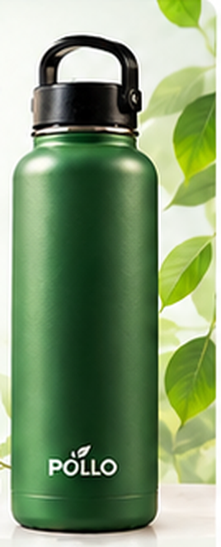




Built for everyday adventures
BPA-Free
Safe for your health
Stainless Steel
Premium quality and durable
Leak-Proof
Carry it anywhere
Lightweight
Easy to carry, every day
Multiple Colours
Find your perfect style
Available in 5 colours
Green
Blue
Black
Pink
White

Slide 4



Why choose PÓLLO? Small changes, big impact
Reduces Plastic Waste
Better Health
Eco-Friendly Materials
One bottle replaces hundreds of single-use plastic bottles.
BPA-free and safe for daily use.
Durable stainless steel, built to last.
For Every Lifestyle
A Cleaner Planet
Good for you.
Great for Earth.
Work, school, gym, travel and adventures.
Together for a sustainable future.

Slide 5
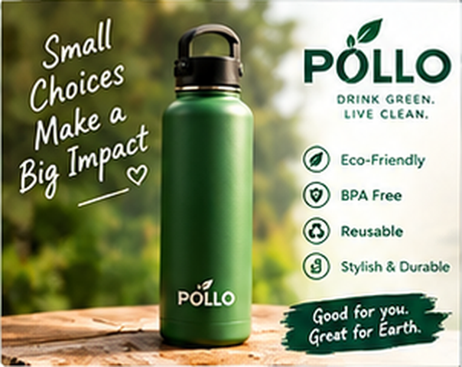
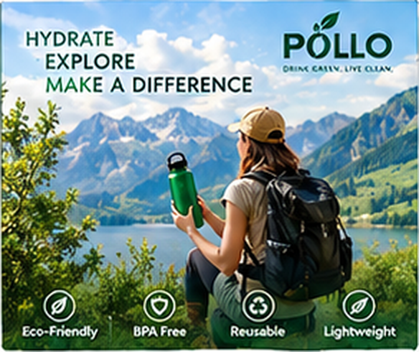
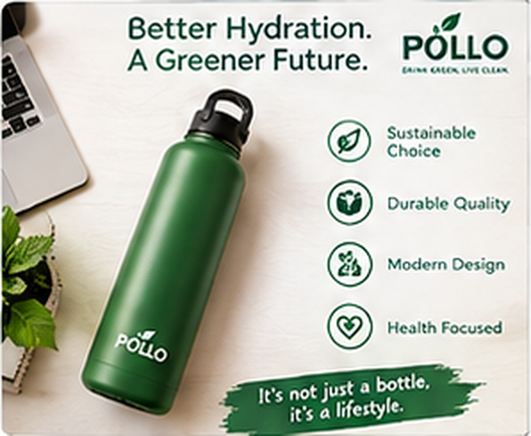
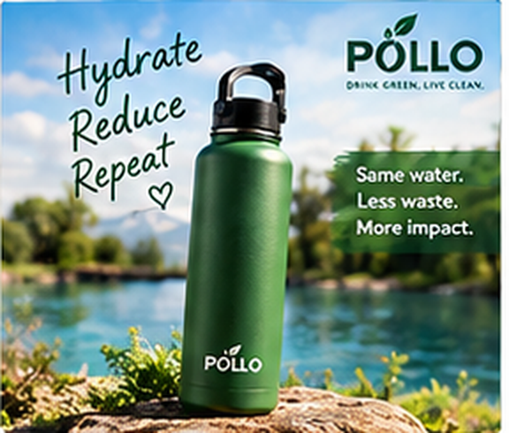
One message across four social platforms
Instagram
Facebook
LinkedIn
TikTok
Small choices make a big impact! Choose PÓLLO, the eco-friendly bottle that keeps you hydrated and helps reduce plastic waste.
Whether you are at the gym, university or on your next adventure, PÓLLO is your perfect companion.
At PÓLLO we believe in sustainable solutions for everyday life, with bottles for people who care about health and the planet.
Hydrate. Reduce. Repeat. PÓLLO: because a better planet starts with you.
#EcoFriendly #GreenLiving
#SustainableLiving #Adventure
#Sustainability #GreenBusiness
#GoGreen #CleanPlanet

Slide 6
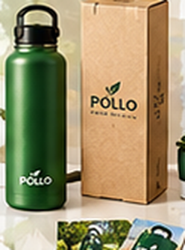



Proposal for a marketing collaboration
Brand Overview
Sustainable · Stylish · Durable
Product Mock-ups
Bottle, packaging and branded materials (attached)
Pricing & Costing
Estimated budget on the next slide
Campaign Timeline
4 weeks, from launch to promotion
Let's build a greener future together.

Slide 7
Estimated launch budget: PKR 2.3 million
Item | Unit cost (PKR) | Quantity | Total (PKR)
PÓLLO water bottle (500 ml) | 1,800 | 1,000 | 1,800,000
Custom branding / logo | 250 | 1,000 | 250,000
Packaging (eco box) | 150 | 1,000 | 150,000
Marketing materials (digital + print) | 100 | 1,000 | 100,000
Total estimated cost |  |  | 2,300,000
Total estimate
2,300,000
PKR
For 1,000 bottles, about PKR 2,300 per unit all-in.
Note: prices are estimates and can be adjusted based on final requirements and quantity.

Slide 8



Four weeks from design to distribution
Week 1
Week 2
Week 3
Week 4
Design finalisation and approval
Production and packaging
Marketing material creation
Launch and distribution
Together for a cleaner planet

Slide 9

Ready-to-send bid email
Subject: Proposal – PÓLLO Eco-Friendly Water Bottle | Marketing Collaboration
Dear Sir/Madam,
I am writing on behalf of PÓLLO, an eco-friendly water bottle brand, to propose a marketing collaboration with your esteemed organisation. We believe our sustainable and stylish products align well with your audience.
Attached is our detailed proposal with brand mock-ups, key features, costing and project timeline. We would be happy to discuss it at your convenience.
Best regards,
PÓLLO Marketing Team
Attach:
Proposal deck
Brand mock-ups
Costing sheet
4-week timeline

Slide 10


Let's build a greener future together
Drink Green. Live Clean.
Review the proposal and mock-ups
Confirm budget and quantity
Kick off Week 1 design approval

