Slide 1





SCIENCE MEETS CIRCUITS
Routing & Security
Router basics,routing protocols,and security basics
Notes:
1

Slide 2



PRESENTER
Rana Haitham
DEPARTMENT
ECE Level 300
POSITION
Network Camp Instructor
CONTACT
ranahythmhsny@gmail.com
Notes:
1

Slide 3
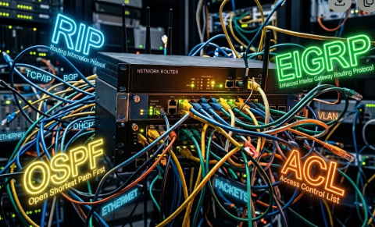

BOOT SEQUENCE
AGENDA
01
Router Basics
What is router ? ,router hardware ,router modes & basic configuration.
02
Routing
Routing types,static route & default route.
03
Dynamic route
admin. distance ,Types dynamic route,RIP,EIGRP,OSPF.
04
Access control list (ACL)
ACL types ,ACL configuration
AGENDA
Notes:
2

Slide 4
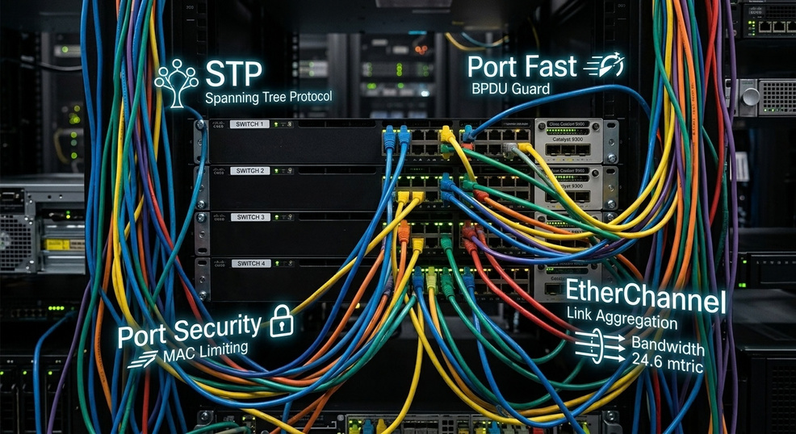
BOOT SEQUENCE
AGENDA
05
Spanning Tree Protocol (STP)
STP, port fast , & port security.
06
Etherchannel & DHCP snooping
Notes:
2

Slide 5
Router Basics
01
What is router?
A router is a network device that forwards data packets between different computer networks,
directing Internet traffic to ensure data reaches its correct destination
02
Router components
  Serial ports: Connect WAN links and routers.
  Console port: Used for initial router configuration.
  Auxiliary port: Allows remote dial-in management.
  FastEthernet ports: Connect high-speed LAN devices.
  Power switch & Power card connection: Supplies and controls power.
Notes:
2

Slide 6
Router Basics
BOOT SEQUENCE
03
Router Hardware
  ROM: Read-only memory that contains the bootstrap program, power-on self-test
(POST) diagnostics, and a mini-IOS for recovery.
  Flash Memory: Non-volatile memory used to store the router's operating system
(Cisco IOS) image file and system files.
  RAM: Volatile memory that stores the running configuration file (running-config),
routing tables, and ARP cache while powered on.
  NVRAM: Non-volatile memory that stores the permanent startup configuration file
(startup-config) and configuration register.
Notes:
2

Slide 7

Router Basic configuration
MODULE 01
User EXEC Mode
Global Configuration Mode
  Description: Basic view-only mode for simple diagnostics.
  Prompt: Router>
  Description: Used to modify global system-wide settings.
  Prompt: Router(config)#
Router modes
Privileged EXEC Mode (Enable Mode)
Specific Configuration Modes (Submodes)
  Description: Provides full diagnostic (show/debug) and management access.
  Prompt: Router#
  Description: Submodes used to configure specific interfaces, lines, or protocols.
  Prompts: Router(config-if)#, Router(config-line)#, Router(config-router)#
MODULE 01
Notes:
3

Slide 8

MODULE 02
Routing
Static Route
Dynamic Route
Manual (configured by the administrator).
Configured automatically via protocols.
Saves CPU, RAM, and bandwidth.
Consumes processing power and bandwidth.
Small or simple networks.
Medium to large, complex networks.
Manual rerouting required on link failure.
Automatic failover and instant rerouting.
Notes:
4

Slide 9
Routing
Administrative Distance (AD)
Definition: A numerical value (0 to 255) used by routers to measure
the trustworthiness of a routing source.
Rule: The lower the AD value, the more trusted the route.
Common AD Values:
Directly Connected: 0 EIGRP: 90
Static Route: 1 OSPF: 110
RIP: 120
Autonomous System (AS)
  Definition: A collection of networks under a single administrative domain (e.g., a company, university, or ISP).
  Protocol Classification:
    IGP (Interior Gateway Protocols): Used within an AS (OSPF, EIGRP, RIP).
    EGP (Exterior Gateway Protocols): Used between different AS across the Internet (BGP).

Slide 10
FIELD LOG
Exterior
  Used between different Autonomous Systems (AS).
  Example: BGP (Border Gateway Protocol)
Distance Vector
  Metric: Hop Count
  Examples: RIP, RIPv2
Link-State
Dynamic Route
  Metric: Bandwidth & Speed
  Examples: OSPF
Hybrid
Interior
  Metric: Composite Metric (Bandwidth + Delay)
  Examples: EIGRP
  Used within a single Autonomous System (AS).
GALLERY
Notes:
5

Slide 11
FIELD LOG
Routing protocols
RIP &RIPv2
EIGRP
OSPF
  Administrative Distance (AD): 120
  Subnetting (VLSM) Support:
RIPv1: No (Classful)
RIPv2: Yes (Classless)
  Multicast IP:
RIPv1: Broadcast (255.255.255.255)
RIPv2: 224.0.0.9
  Update Interval: Periodic every 30 seconds
  Administrative Distance (AD): 90
  Subnetting (VLSM) Support: Yes (Classless)
  Multicast IP: 224.0.0.10
  Update Interval: Triggered / Partial updates (Only when topology changes)
  Administrative Distance (AD): 110
  Subnetting (VLSM) Support: Yes (Classless)
  Multicast IP: 224.0.0.5 (All Routers) / 224.0.0.6 (DR/BDR)
  Update Interval: Triggered / Partial updates (Refreshed every 30 minutes)
GALLERY
Notes:
5

Slide 12
FIELD LOG
OSPF Operation & Core Concepts
OSPF Process & LSA
DR & BDR Election
Router ID Selection
  LSA
Routers exchange link-state
advertisements to share link status
and network topology.
  LSDB
All LSAs combine into a shared
topology map.
  SPF
Dijkstra’s algorithm runs on the
LSDB to find the shortest path.
  Purpose: Reduce routing-update traffic on multi-access broadcast networks.
  1 · Interface priority
Highest wins; default 1. Priority 0 is
ineligible for DR or BDR.
  2 · Router ID
Highest wins when priorities tie.
  Manual: Configured with the router-id command.
  Loopback: Highest IP on an active loopback interface.
  Physical: Highest IP on an active physical interface.
GALLERY
Notes:
5

Slide 13








FIELD LOG
ACCESS-Control List
Standard ACL
Extended ACL
  Number Range: 1 – 99
  Filtering Basis: Filters traffic based ONLY on Source IP Address.
  Control Action: Permits or Denies the entire packet/traffic (cannot filter specific protocols or port numbers).
  Placement Strategy: Placed as CLOSE TO DESTINATION as possible.
  Types & Naming: Available as both Numbered ACL and NamedACL.
  Number Range: 100 – 199
  Filtering Basis: Filters based on Source IP, Destination IP, Protocol (TCP/UDP), and Port Numbers.
  Control Action: Granular control (can block specific services like HTTP/Port 80, SSL/Port 22, etc.).
  Placement Strategy: Placed as CLOSE TO SOURCE as possible.
  Types & Naming: Available as both Numbered ACL and NamedACL.
GALLERY
Notes:
5

Slide 14

FIELD LOG
Spanning Tree Protocol & Port Security Essentials
Spanning Tree Protocol (STP)
STP PortFast
Port Security
  Purpose: Prevents Layer 2 switching loops in redundant network topologies by blocking redundant paths dynamically.
  Root Switch Election:
    Switch with the Lowest Bridge ID (BID) becomes Root.
    Bridge ID = Priority + MAC Address.
  Root Port (RP) Selection:
    Chosen on non-root switches based on the Lowest Path Cost to the Root Switch.
  Purpose: Accelerates edge port convergence for end-user devices (PCs, Printers, Servers).
  Functionality:
    Bypasses Listening and Learning states.
    Immediately places access ports into the Forwarding state upon connection.
  Key Advantage: Reduces network downtime and DHCP lookup delays.
  Purpose: Protects Layer 2 switch ports against unauthorized device connections.
  Functionality: Restricts access based on MAC addresses (Static, Dynamic, or Sticky).
  Violation Actions:
    Shutdown: Disables port completely upon violation.
    Restrict / Protect: Drops unauthorized traffic and logs alerts.

Slide 15
FIELD LOG
EtherChannel & DHCP Security
EtherChannel
DHCP Security (Attack & Solution)
  Definition: Link-aggregation technology that combines multiple physical Ethernet links into a single logical high-speed link.
  Core Purpose:
    Increases total bandwidth and provides link redundancy.
    Load-balances traffic across physical links.
  Key Advantage: Prevents STP topology recalculations when an individual physical link in the bundle fails.
  The Threat — DHCP Spoofing:
    A rogue (unauthorized) DHCP server responds to client requests with malicious IP settings, redirecting traffic (Man-in-the-Middle attack).
  The Solution — DHCP Snooping:
    Layer 2 security mechanism that filters untrusted DHCP messages.
    Designates switch ports as Trusted (legitimate DHCP server) or Untrusted (end-user ports).
    Builds a Binding Database to validate network hosts and block malicious responses.

Slide 16
FIELD LOG
Recap & Summary
Router Basics & Routing Protocols
Traffic Control & Security (ACLs)
Switch Security
Router Operations & Initial Setup Configuration.
Routing Protocols Covered:
RIPv2, EIGRP, and OSPF.
  Access Control Lists: Standard vs. Extended ACLs.
  Configuration using Numbered and Named ACLs.
Loop Prevention: STP & STP PortFast.
Switch Hardening: Port Security & DHCP Snooping against DHCP Spoofing.
Performance: EtherChannel for Link Aggregation.

Slide 17




FIELD NOTE
Quick Knowledge Check
Q1 · ROUTING PROTOCOLS
Q2 · ACCESS CONTROL LISTS
Which routing protocol uses Area concepts and calculates paths using Dijkstra's algorithm?
Where should a Standard ACL be placed for optimal traffic filtering?
  A) RIPv2
  B) EIGRP
  C) OSPF
  A) As close to the Source as possible.
  B) As close to the Destination as possible.
Answer: C
Answer: B
Q3 · LAYER 2 & STP
Q4 · SWITCH SECURITY
What is the main advantage of enabling STP PortFast on access ports?
Which security feature mitigates Rogue DHCP servers and DHCP Spoofing attacks?
  A) Increases bandwidth.
  B) Immediately transitions ports to Forwarding state, bypassing Listening/Learning.
  A) Port Security
  B) DHCP Snooping
  C) EtherChannel
Answer: B
Answer: B

Slide 18

ANY QUESTIONS?
system.query( ) awaiting input...
( don't be like Chrome — ask before you fall behind )
Q & A
Notes:
7

Slide 19
THANK YOU
Notes:
8

