Slide 1
Tape Drive System
Modeling, Analysis & Identification
Soft Sensing and System Identification
Exercise 1, 2 & 3
Rana Sanjideh | 571482

Slide 2
Presentation Outline
01
02
System Description
Part 1 — Simulation
Physical model, parameters, and equations of motion
Simulink behavior with parameter and input variations
03
04
Part 2 — Identification
Part 3 — ARX & FIR
Linearity, transfer function, stability, step response
Parametric model identification and validation

Slide 3
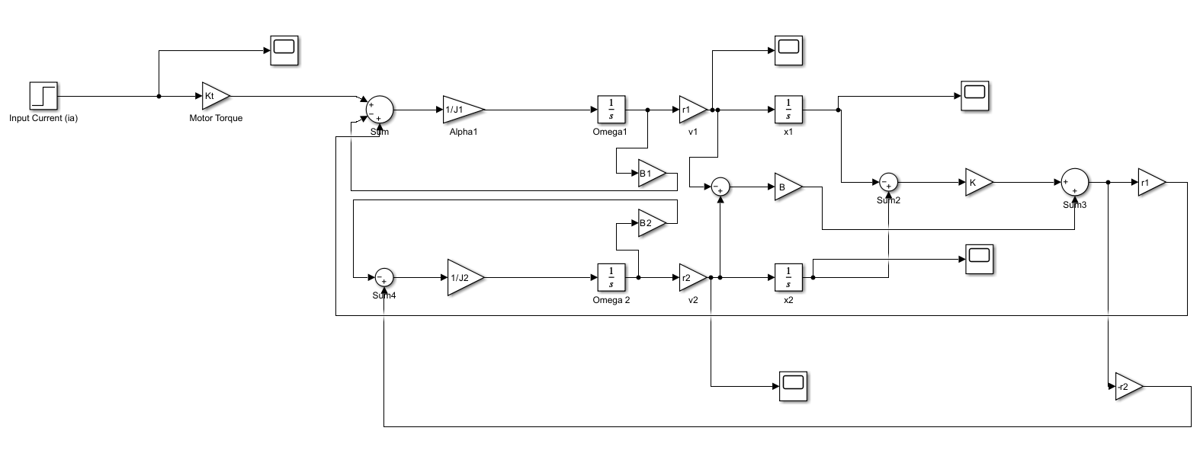
The Tape Drive System
Key Components
M
Motor
Drives the capstan via input current iₐ
C
Capstan Wheel
Active inertia J₁ = 5×10⁻⁵ kg·m²
T
Elastic Tape
Spring K = 2×10⁴ N/m, damper B = 20
I
Idler Wheel
Passive inertia J₂ = 2×10⁻⁵ kg·m²
Figure: Simulink Block Diagram

Slide 4
Mathematical Model — Equations of Motion
Capstan (Active)
Idler (Passive)
Angular Velocity:
Angular Velocity:
Linear Velocity:
Linear Velocity:
v₁ = r₁·ω₁
v₂ = r₂·ω₂
Position:
Position:
dx₁/dt = v₁
dx₂/dt = v₂
Driven by motor torque (Kₜiₐ).
Main actuator of the system.
No motor input — driven only
by the elastic tape coupling F_c.
Coupling force: F_c = K(x₂ − x₁) + B(ẋ₂ − ẋ₁)

Slide 5
PART 1
Simulink Simulation
System behavior across parameter
and input signal variations

Slide 6
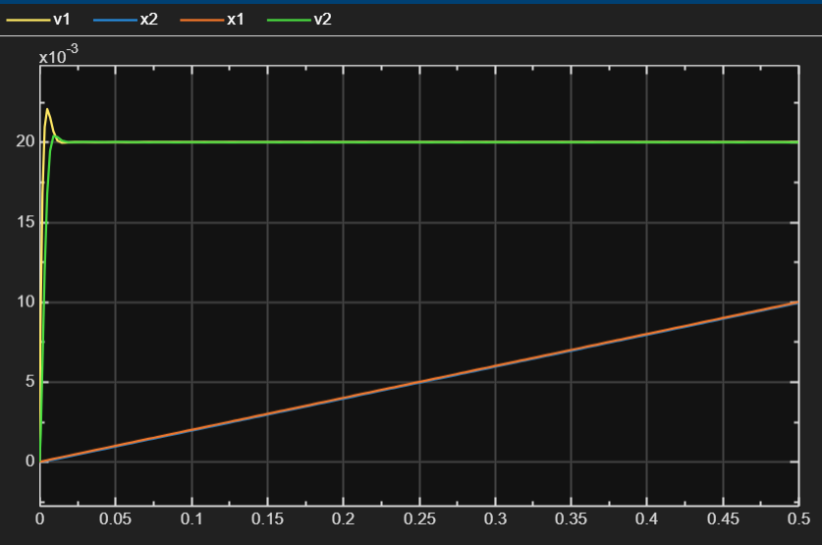
Baseline Response — 1A Step Input
Key Metrics
0.020 m/s
Steady-State
2.2 ms
Rise Time
10.37 %
Overshoot
10.2 ms
Settling Time
Baseline Scope: v₁, v₂, x₁, x₂ (1A step input)

Slide 7
Parameter Sensitivity Tests
Test 1 — Soft Spring
Test 2 — Heavy Idler
K = 10,000 N/m
J₂ = 4×10⁻⁵ kg·m²
Effect:
Effect:
Slower rise, larger spring stretch, slower v₂
v₂ rise time doubled, gap maximized
Test 3 — High Damping
Test 4 — Low Damping
B = 40 N/(m·s)
B = 10 N/(m·s)
Effect:
Effect:
Overshoot reduced to ~10%, smoother v₂
Overshoot >30%, more oscillations, longer settling

Slide 8
PART 2
System Identification
Transfer function, stability, and
linearity verification

Slide 9
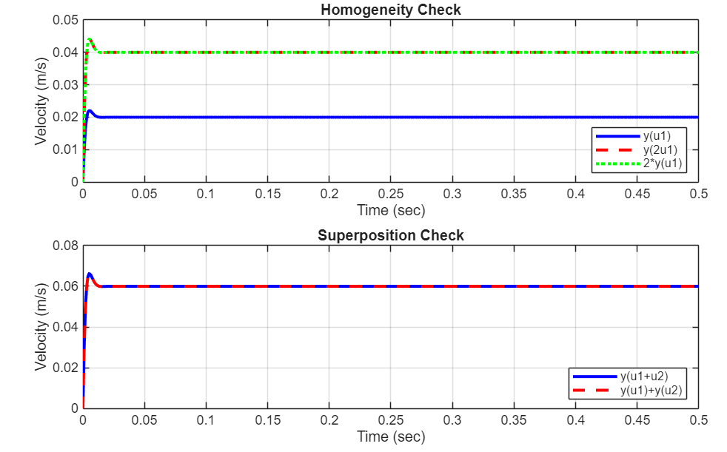
Linearity Verification
Linearity Verification
A system is linear if it satisfies both properties:
Homogeneity
Superposition
y(2u) = 2 · y(u)
y(u₁+u₂) = y(u₁) + y(u₂)
Double the input
→ double the output
Sum of inputs
→ sum of outputs
MATLAB Test
u1 = ones(size(t)); y1 = lsim(sys_speed, u1, t);
u2 = 2*ones(size(t)); y2 = lsim(sys_speed, u2, t);
error = max(abs(y2 - 2*y1)); % should be ≈ 0
✓ Max error ≈ 0 → System is LINEAR (homogeneity and superposition both hold)

Slide 10
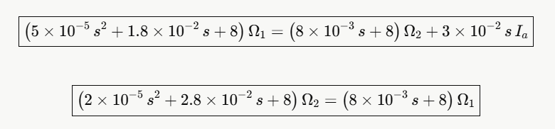

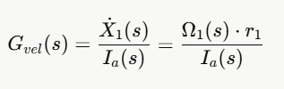
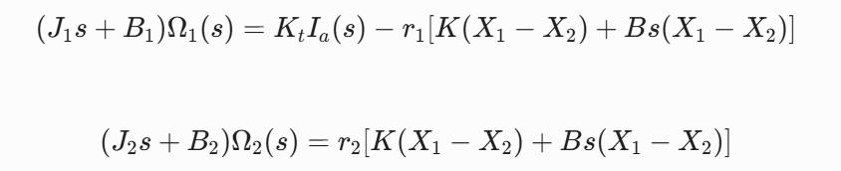
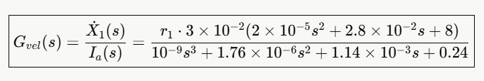
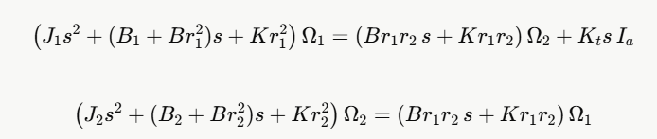
Transfer Function & Stability
Apply Laplace transform to the equations of motion
G(s) = X˙1​ (s) / Iₐ(s)
S-Domain ODEs
General Transfer Function
Capstan and Idler
Numerical Transfer Function
s = −400 rad/s
s = −1000 rad/s
Poles:

Slide 11
PID Controller – Theory
C(s) = Kp + Ki / s + Kd · s
Proportional (Kp)
Integral (Ki)
Derivative (Kd)
Reacts to current error
Faster response
Eliminates steady-state
error over time
Predicts future error
Reduces overshoot
Closed loop: sys_cl = feedback( C(s) × G_vel(s) , 1 )

Slide 12
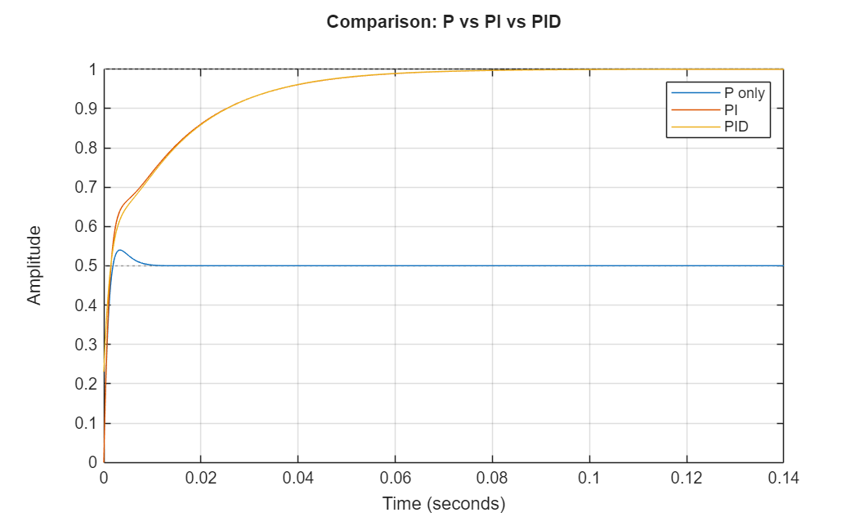
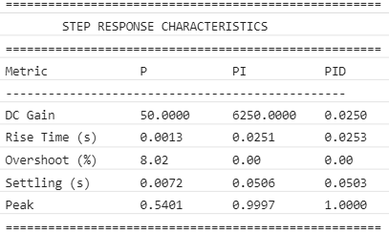
Manual PID Design – Step by Step
1
Start with Kp only
DC gain = 0.02 → Kp = 1/0.02 = 50
Fast response, but steady-state error remains
2
Add Ki (remove error)
τᵢ ≈ 4/ωn = 0.008 → Ki = Kp/τᵢ = 6250
Eliminates steady-state error
3
Add Kd (reduce overshoot)
τd ≈ 1/(4ωn) = 0.0005 → Kd = 0.025
Damps oscillation, improves response

Slide 13
Identified Model & Approximation Results
Identified Model & Approximation Results
sys_id = sys_speed — Identified model is IDENTICAL to theoretical model
Identified (sys_id)
Theoretical (sys_speed)
from tfest on simulation data
derived from physics equations
12s + 4800
=
12s + 4800
s2 + 760s + 240000
s2 + 760s + 240000
Fit across all input types:
Step Input
Sine w=10
Sine w=489
Sine w=5000
100%
100%
100%
100%
Poles: 2 Zeros: 1 Free coefficients: 4 FPE: 9.26e-29 MSE: 9.04e-29

Slide 14
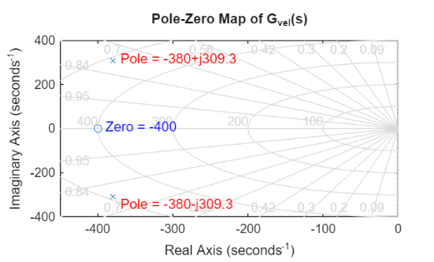
Stability Analysis
Stability Analysis
Characteristic equation: s² + 760s + 240000 = 0
Pole 1
Pole 2
Zero
s₁ = −380 + j309.3
s₂ = −380 − j309.3
z = −400
Left half plane ✓
Left half plane ✓
Near poles → simplifies
✓ All poles have NEGATIVE real part (−380) → System is STABLE
Complex poles → damped oscillatory response (overshoots then settles)

Slide 15
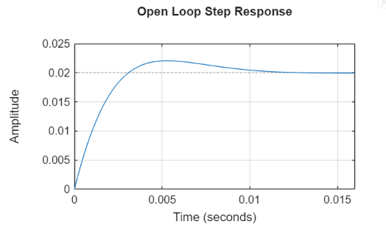
Step Response
10.37%
10.2ms
2.1ms
0.0200
Settling Time
Rise Time
Overshoot
Gain

Slide 16
PART 3
ARX & FIR Models
Data-driven parametric model identification
and validation

Slide 17

ARX & FIR Model Identification
ARX Model — na=8, nb=8, nk=1
FIR Model — 50-Tap Filter
A(z)y(t) = B(z)u(t) + e(t) y(t) + a₁y(t-1)+...+ aₙₐy(t-nₐ) = b₁u(t-1)+...+ bₙᵦu(t-nᵦ) + e(t)
y(t) = B(z)u(t) — no feedback y(t) = b₀u(t) + b₁u(t-1) + ... + bₙu(t-n) + e(t)
Model Order
na=8, nb=8
Filter Taps
50 coefficients
Sample Time
Ts = 0.001 s
Sample Time
Ts = 0.001 s
Free Coefficients
16 parameters
Feedback
None (FIR)
Fit (estimation)
99.21%
Fit (validation)
99.18%
MSE
9.821e-09
Peak coeff.
9.93e-03
Validation Results
ARX Fit
FIR Fit
Residual Test
Bode Match
99.18%
99.18%
White ✓
Aligned ✓

Slide 18
Key Findings & Conclusions
01
02
03
Simulation
Identification
Models
Spring K dominates coupling
Idler J₂ controls sync time
Damping B sets overshoot
Bandwidth ~78 Hz
System is linear (verified)
Stable (all poles ≤ 0)
ωₙ = 490 rad/s, ζ = 0.776
2nd-order model: 99% fit
ARX fit > 99.21%
FIR fit > 99.18%
Both validate G(s)
Ready for control
Three complementary approaches deliver complete system understanding for robust control design

Slide 19
Thank You
Questions & Discussion
Rana Sanjideh | 571482 | rana.sanjideh@studenti.unime.it

