Slide 1

End-Sem ML Project Presentation
TOPIC: Classification of Tweets in Hindi Language
Submitted By:
Akash Rawat
MT21005
Shubham Rana
MT21092
Parul Sikri
MT21065

Slide 2
Table of Contents
Section 01: Problem Statement
Section 02: Data Analysis
Section 03: Data Preprocessing
Section 04: Methodology Used
Section 05: Results
Section 06: Conclusion & Future Work
Section 07: Contribution
Section 08: References

Slide 3

1. PROBLEM STATEMENT
.
Twitter is considered a valuable
platform for companies to advertise their products and make users aware of their brand.Some companies use Twitter as a medium to provide sup-
port to their customers and receive valuable consumer feedback and suggestions to make their services better..
Twitter serves as a residence for online abuse, hostile communication, defamation, and fake news. It is a matter of concern that needs special attention. there is a dire need to stop abusive, offensive, defamatory, and fake tweets on Twitter. It is crucial to identify all such tweets because not all negative tweets are hostile, harsh, or objectionable.
We will try to develop a Multi-label classification of tweets in Hindi language into the following labels: Offensive,Hate,Defamation,Fake,Non-hostile etc...
INSERT LOGO HERE

Slide 4
2. DATA ANALYSIS
The dataset being used for this project is taken from the CONSTRAINT 2021 contest. The Training set and Test set all are taken from CONSTRAINT 2021. The given dataset consisted of tweets, and the multi-class labels suggesting whether the tweet is fake, hate, offensive, defamation, or non-hostile.
Text

Slide 5
TWEET CLASSIFICATION
01
Offensive tweets are those which try to insult a person or a business using disrespectful ,hurtful and rude words.
02
Hate tweets are those which show hatred towards a person or a specific group onthe grounds of their race,religious beliefs,etc.
03
Defamation tweets are those which try to destroy/damage the reputation of an individual or a group in public.
04
Fake tweets are those which are false or not genuine.
Non-hostile tweets are those
which do not involve any hostility.
It involves a lot of behaviors, actions, thoughts and feelings.[2]

Slide 6
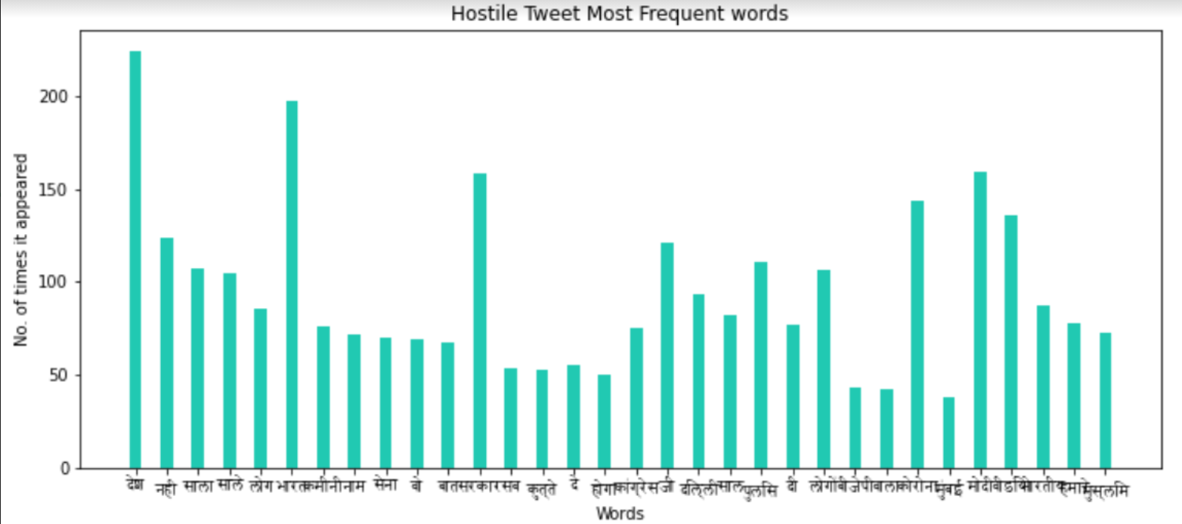
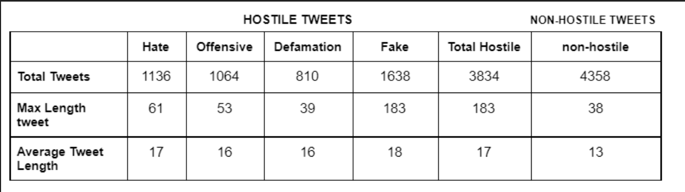
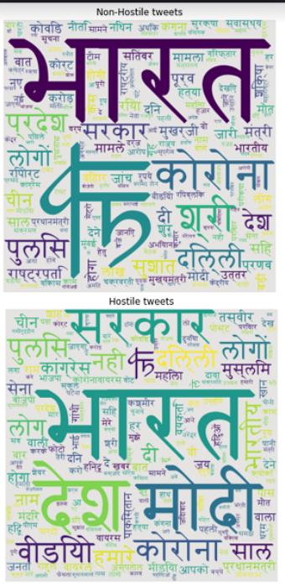
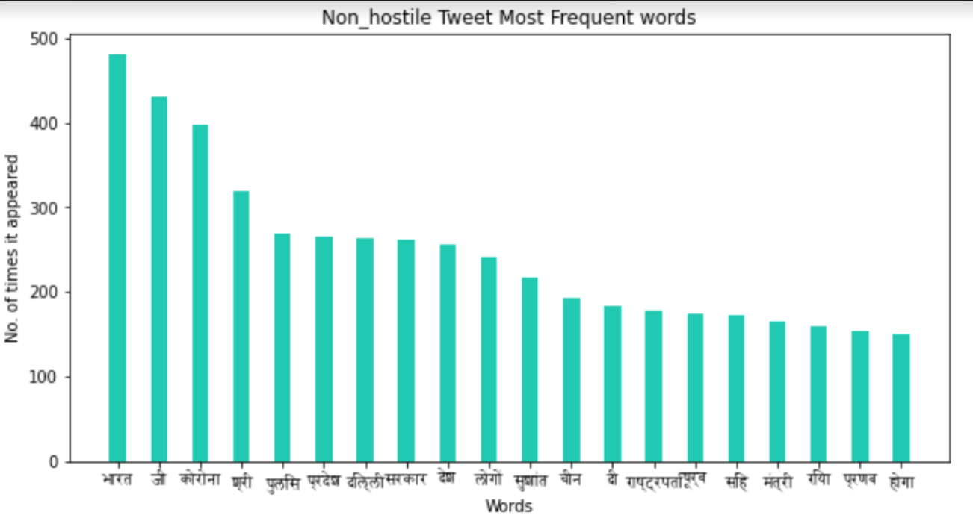

Slide 7
3. DATA PREPROCESSING
Removal of url links
Removal of @ mention
Removal of all characters other than Devana-
gari characters
Removal of all the special characters:
Removal of emojis
Removal of stop-words

Slide 8
4. METHODOLOGY USED
01
04
COUNT VECTORIZER
WORD2VEC
02
TF-IDF
05 M-BERT
03
06 LSTM
RNN

Slide 9
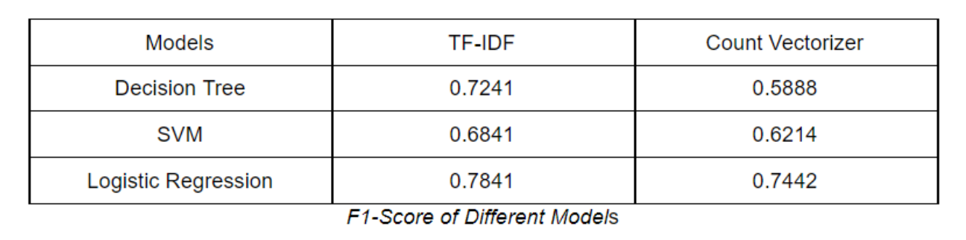
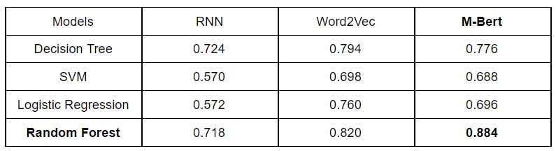
5. RESULTS
WEIGHTED F1 SCORE OF THE BASELINE MODELS
WEIGHTED F1 SCORE OF THE MODELS

Slide 10
6. CONCLUSION AND FUTURE WORK
M-Bert with random forest classifier outperformed RNN, Word2vec and LSTM with different models. With M-Bert and random forest classifier, we got the highest weighted F1-score = 0.884. For M-Bert, we have used the ”Hindi Electra Model”, it is very lightweight and is pretrained on a vast corpus of data and works well on low memory. However, Word2Vec and LSTM models also performed significantly good.
Tweet analysis for Non-hostile and hostile such as fake, defamation, hate and offensive news detection has a lot of scopes and is becoming more prevalent these days. On a larger scale, this paper’s idea can be used to classify the multi-label comments on various social media platforms such as Instagram, Twitter, Facebook, etc., especially for the Hindi language, as it is becoming more prevalent.

Slide 11
7. CONTRIBUTION
Akash Rawat: Exploratory data analysis, data pre-processing,and implemented LSTM.
Parul Sikri: Baseline model, RNN and Word2vec implementation.
Shubham Rana: Literature Survey, Baseline model, and M-Bert implementation.
LINK FOR THE BLOG:
https://medium.com/@parulsikri/classification-of-tweets-in-hindi-language-26da9f86260a
LINK FOR THE CODE AND DATASET:
https://drive.google.com/drive/folders/16t1Vwek6focjQEJxDiqiETV4Uks0wb0O

Slide 12
8. REFERENCES
M. Bhardwaj, M.S. Akhtar, A. Ekbal, A. Das, T. Chakraborty. Hostility Detection Dataset in Hindi. URL: https://arxiv.org/abs/2011.03588
N. Vashistha, A. Zubiaga. Online Multilingual Hate Speech Detection: Experimenting with Hindi and English Social Media. URL: https://www.mdpi.com/2078-2489/12/1/5
V. K. Jha, H. Poroli, Vinu P. N, V. Vijayan , Prabaharan P. DHOTRepository and Classification of Offensive Tweets in the Hindi Language.https://doi.org/10.1016/j.procs.2020.04.252
S. Kamble, A. Joshi. Hate SpeechDetection from Code-mixed Hindi-English Tweets Using Deep Learning Models. URL: https://arxiv.org/abs/1811.05145
S. Kaur, P. Kumar, P. Kumaraguru. Automating fake news detection system using multi-level voting model. URL: https://link.springer.com/article/10.1007/s00500-019-04436-y
H. Ahmed, Hadeer, I. Traore, S.Saad. Detection of Online Fake News Using N-Gram Analysis and
Machine Learning Techniques.URL:https://link.springer.com/chapter/10.1007%2F978-3-319-69155-8_9

Slide 13
THANK YOU

