Slide 1
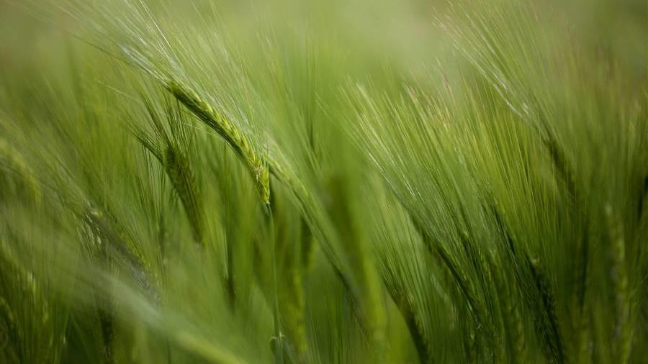
presentation

Slide 2
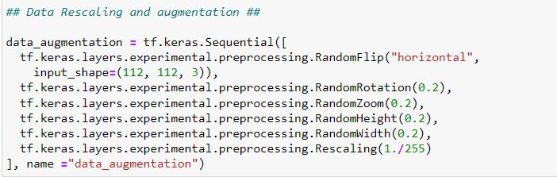
Data prepressing
DATA RESCALING AND AUGMENTATION :
RESIZE DATA INTO (112,112)

Slide 3
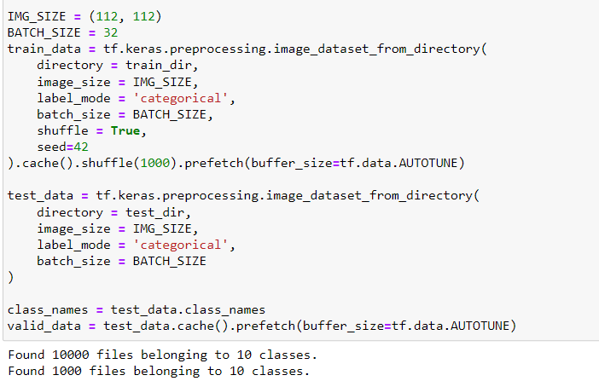
Data prepressing
DATA SHUFFLE AND PREFETCH :

Slide 4
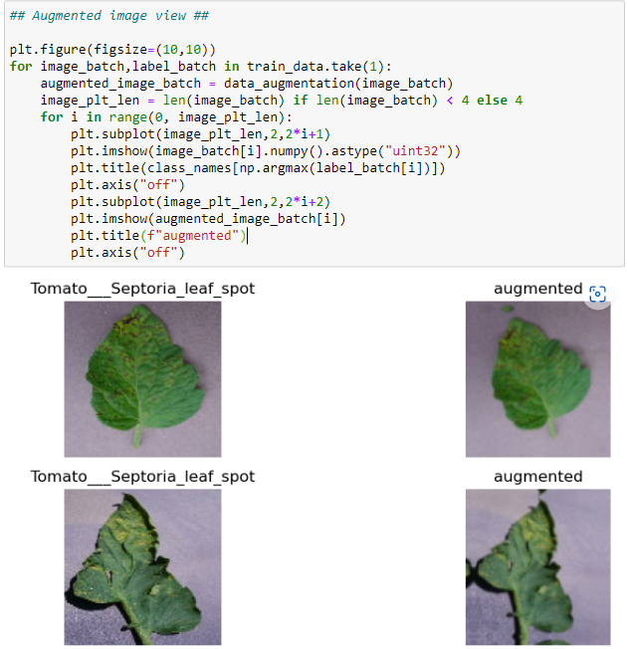
Data prepressing
DATA AUGUMENTATION :

Slide 5
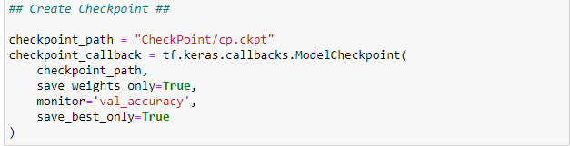
CREATING MODEL
CREAT CHECKPOINT :
TO SAVE THE BEST WEIGHTS TO BE TRAINED IN PRETRAINED MODEL

Slide 6
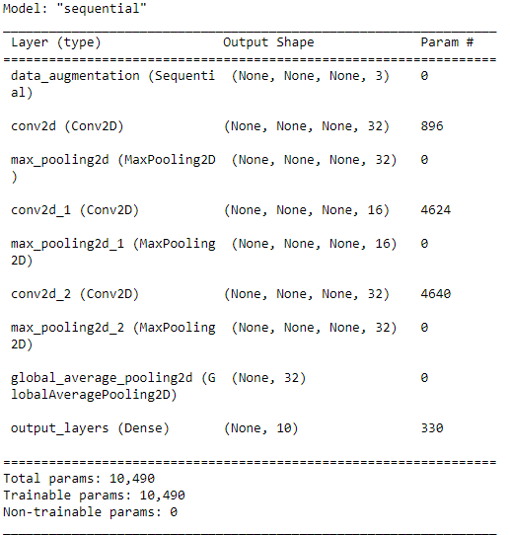
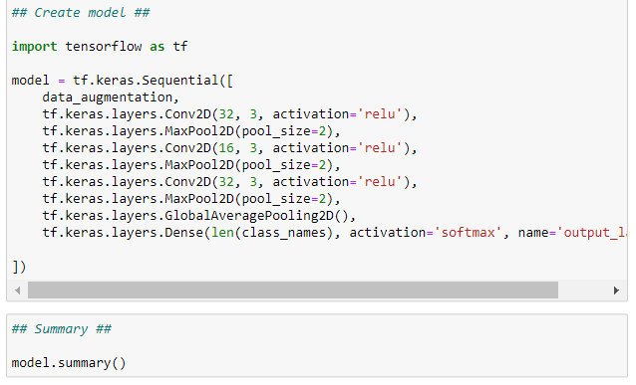
CREATING MODEL
CREAT CNN MODEL :
THE CNN MODEL WILL TRAIN THE DATA AND PUT THE BEST WEIGHTS INTO CHECKPOINTS .

Slide 7
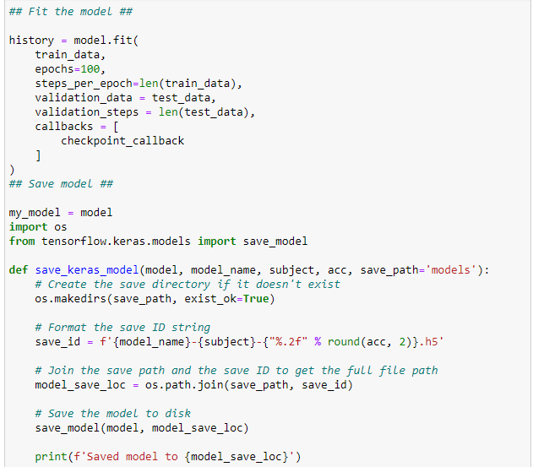
CREATING MODEL
FIT AND SAVE THE MODEL :

Slide 8
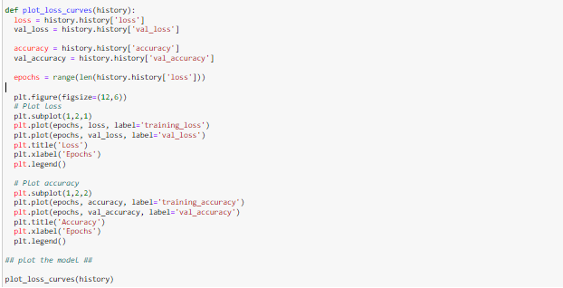
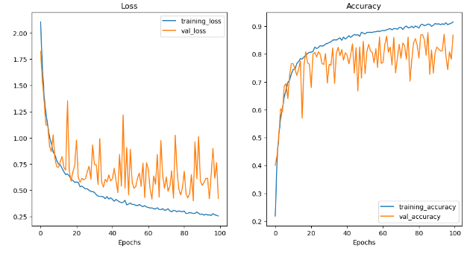
CREATING MODEL
PLOT MODEL :
DIAGRAMS FOR THE LOSS AND THE ACCURANCY
LOSS : 0.42
ACCUANCY : 0.86

Slide 9
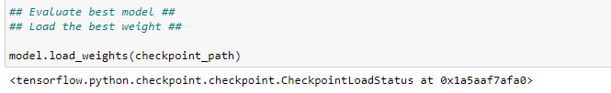
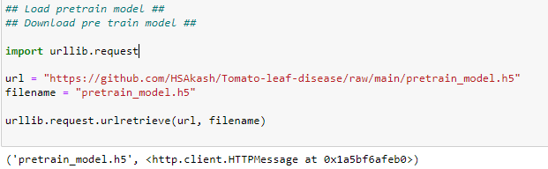

CREATING MODEL
DOWNLOAD THE PRETRAINED MODEL AND LOAD IT :
IT WILL USE THE BEST WEIGHTS IN THE CHECKPOINT AND TRAIN THEM TO IMPROVE THE ACCURANCY .

Slide 10
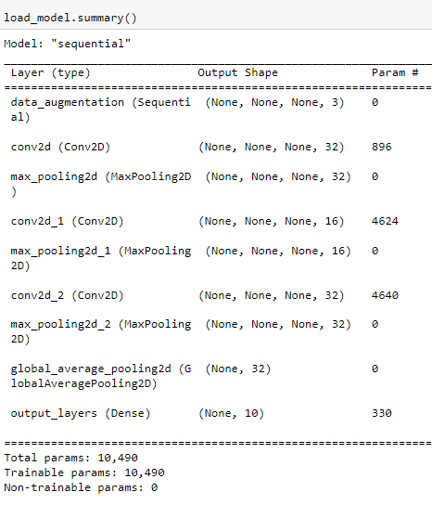
CREATING MODEL
INCEPTION V2 MODEL:
IT CONSISTS OF NUMBER OF CNN MODELS THAT RUN PRALLEL

Slide 11
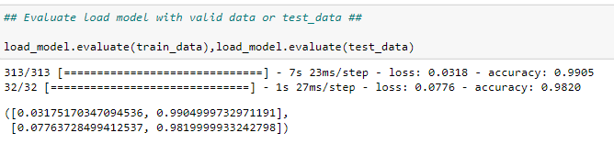
CREATING MODEL
EVALUATE DATA BY PRETRAINED MODEL:
ACCUANCY OF TRAIN DATA : 0.99
ACCURANCY OF TEST DATA : 0.98

Slide 12
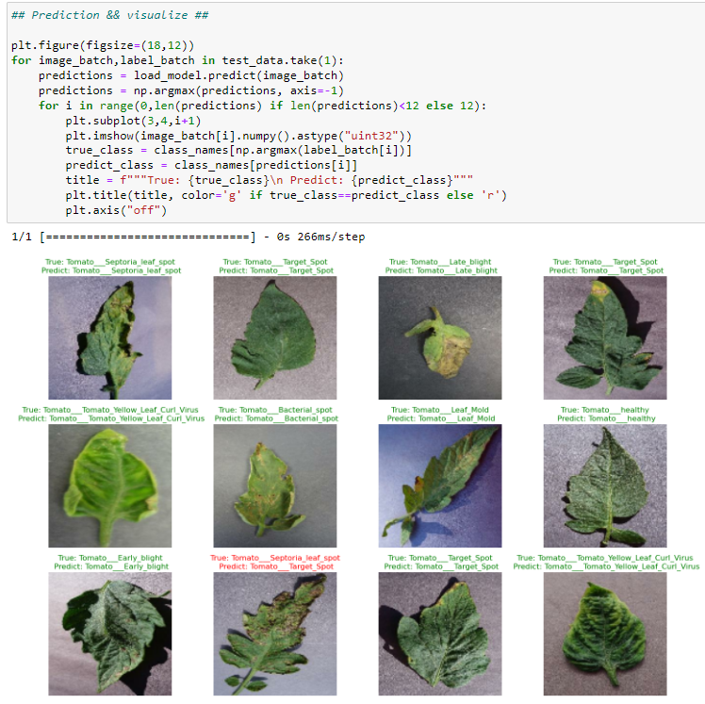
PREDICTION
PREDICT AND VISUALIZE THE DATA :
IN THIS FUNCTION THE WRONG PRIDECT WILL BE IN RED COLOR WHILE THE RIGHT PREDICT WILL BE IN GREEN COLOR .

Slide 13
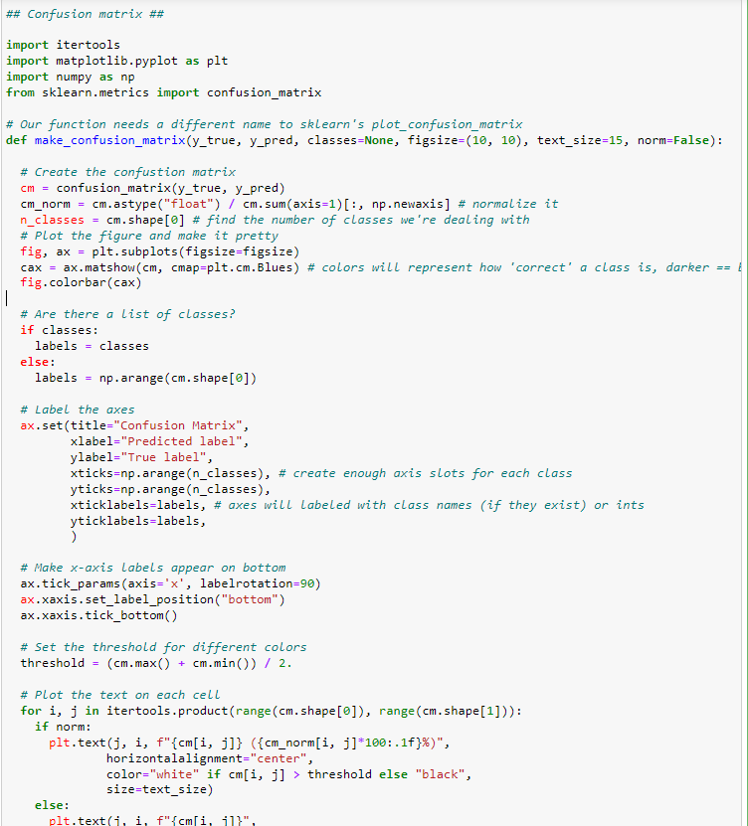
Confusion matrix
Confusion matrix :
Show me that the accuracy of the model by labels

Slide 14
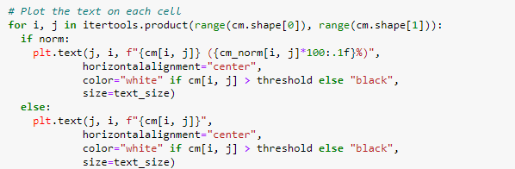
Confusion matrix
Confusion matrix :
Show me that the accuracy of the model by labels

Slide 15
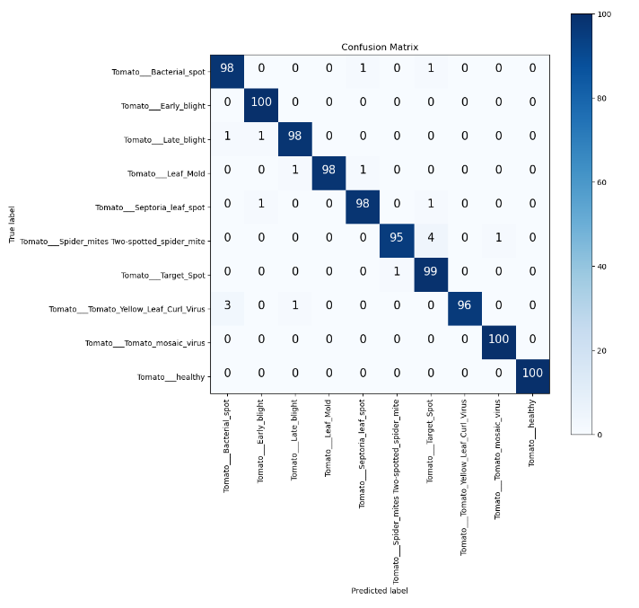
Confusion matrix
Confusion matrix :
Show me that the accuracy of the model by labels

Slide 16
Optimization
USING CNN MODEL :
THE HYPERPRAMETERS THAT USED .
before

Slide 17
Optimization
USING THE PRETRAIND MODEL:
AFTER GETTING BEST WEIGHTS FROM CNN MODEL AFTER TRANING AND ITS HYPERPRAMETERS .
AFTER

Slide 18
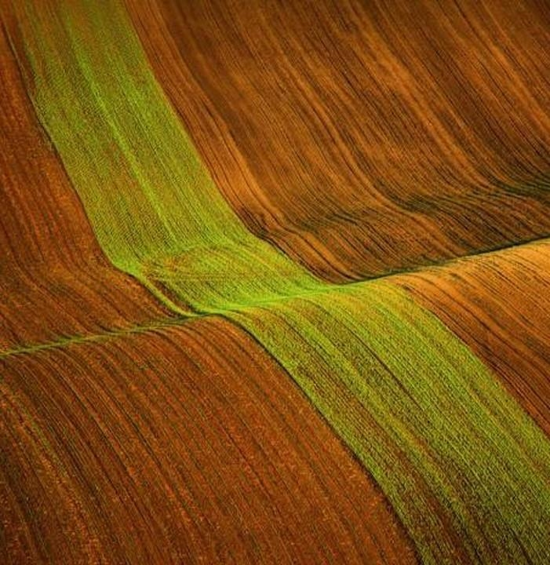
Thank you

