Slide 1

DATA ANALYTICS REPORT
Salary Data Analysis
Uncovering workforce compensation patterns through large-scale data processing and advanced visualization frameworks.

Slide 2

Technical Framework
01 // INITIALIZATION
02 // PIPELINE
03 // VALIDATION
Infrastructure
Data Acquisition
Integrity Check
Deployment of a robust SparkSession configured for high-concurrency salary data processing and schema management.
Automated ingestion pipeline utilizing inferSchema to preserve data fidelity across diverse numerical and categorical fields.
Real-time structural validation using printSchema() to ensure consistency before analytical operations.

Slide 3

Data Integrity
PROTOCOL
DESCRIPTION
OUTCOME
Null Removal
dropna()
Ensures statistical consistency
Eliminating incomplete records via
Deduplication
dropDuplicates()
Prevents artificial bias in results
Removing redundant rows using
Verification
Comprehensive null-count checks across columns
Confirms dataset integrity

Slide 4

Workforce Metrics
375+
Diverse
High
TOTAL EMPLOYEES
ROLE SPECTRUM
EXPERIENCE MATURITY
A vast dataset representing a global population of professionals across multiple sectors.
Identification of unique job titles reflecting the complexity of the modern workforce.
Significant professional maturity serving as a critical variable in compensation modeling.

Slide 5

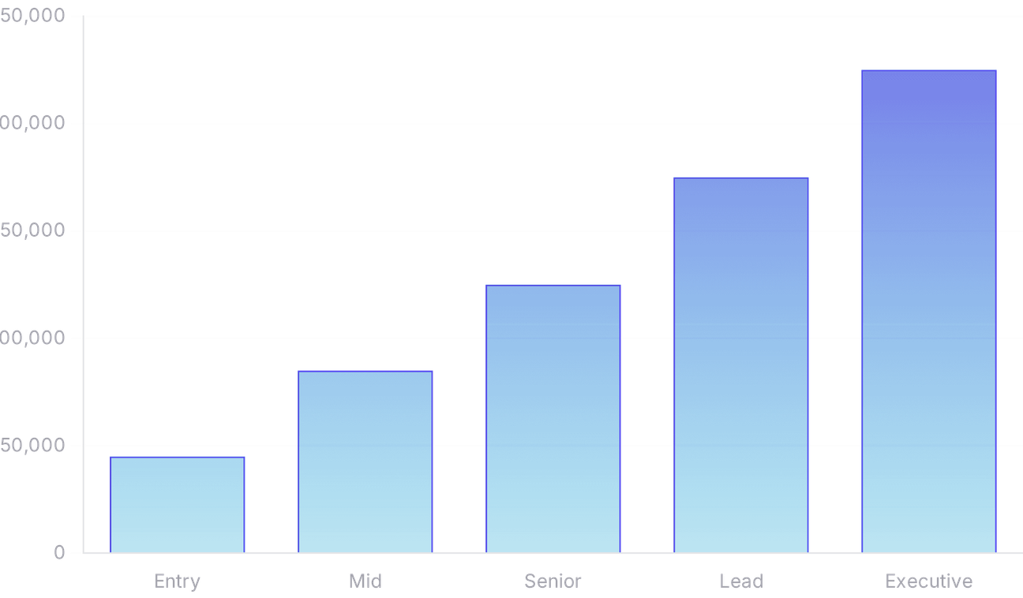
Compensation Benchmarks
AVERAGE SALARY
$115,326
MAXIMUM SALARY
$250,000
MINIMUM SALARY
$350

Slide 6

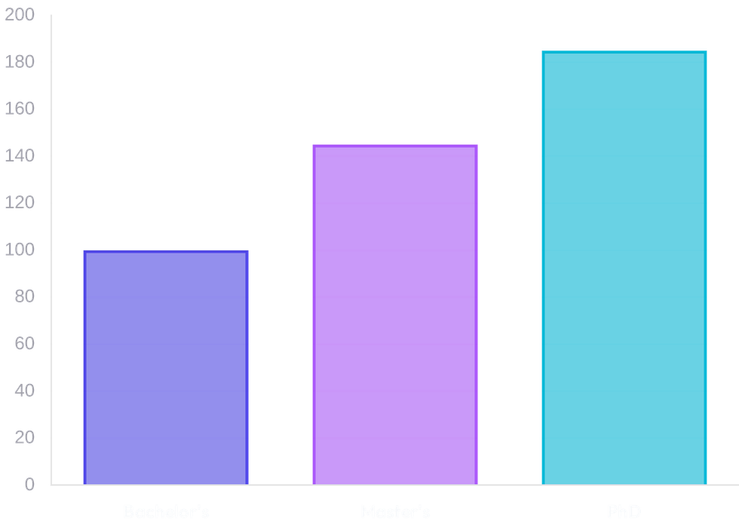
Academic Impact
EDUCATION LEVEL
STRATEGIC INSIGHT
Bachelor's
Serves as the foundational entry-point for professional career growth.
Master's
Provides a significant salary premium and access to specialized roles.
PhD
Commands the highest earning tier, reflecting deep domain expertise.

Slide 7

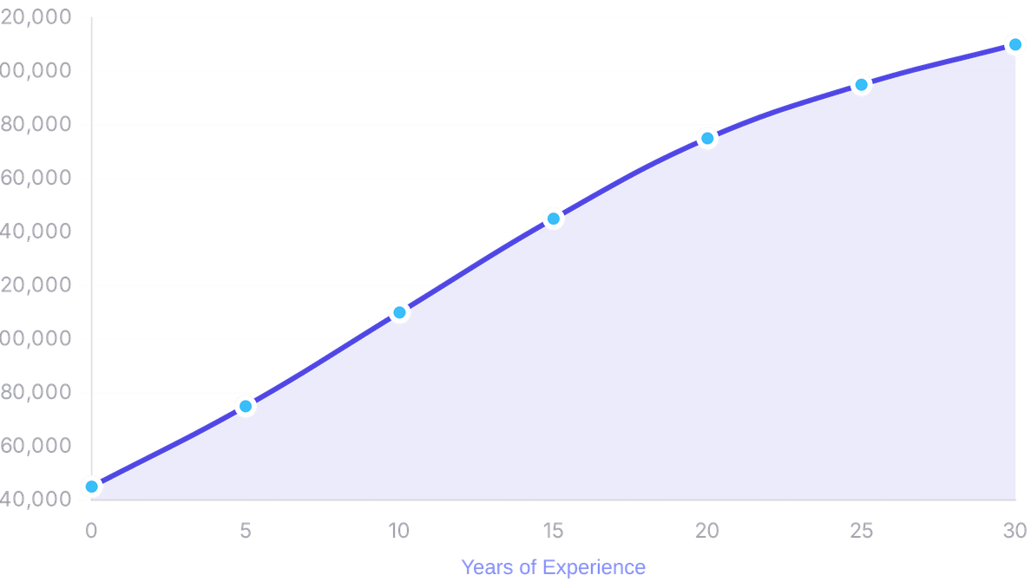
Experience Analysis
0.93
CORRELATION COEFFICIENT
A powerful positive correlation between years of professional experience and salary growth.
Consistent
GROWTH TRAJECTORY
Accumulation of skills and industry knowledge translates into predictable compensation increases.

Slide 8

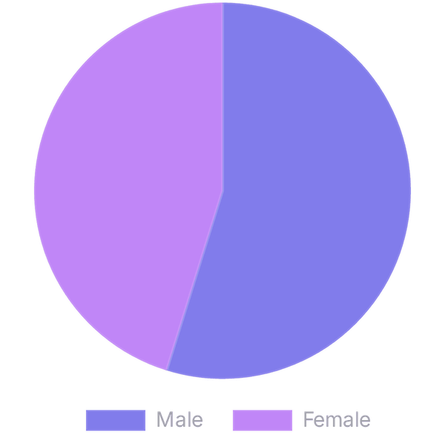
Equity Assessment
AVERAGE SALARY COMPARISON
WORKFORCE COMPOSITION
Data-Driven Parity
Evaluating the distribution of salaries across genders to identify patterns of equity or disparity within the global workforce.
EQUITY OBSERVATIONS
Transparent Insights
Combining average salary metrics with composition data to provide a clear view of current compensation structures.

Slide 9

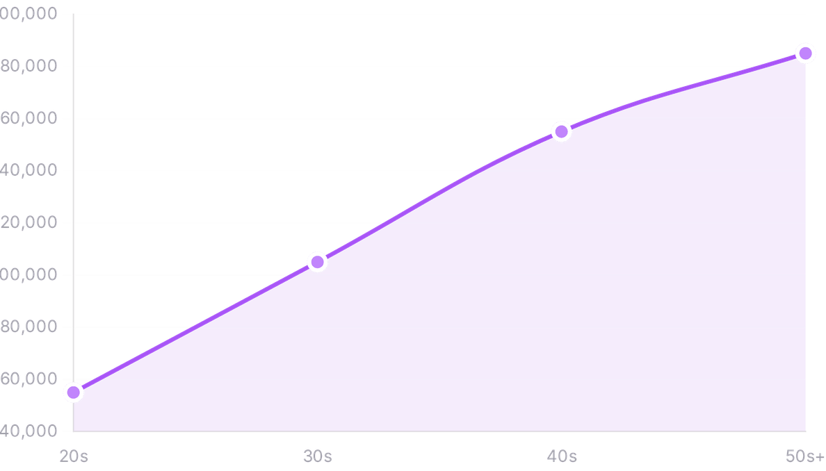
Career Lifecycle
LIFE CYCLE EARNINGS
Tracking compensation evolution from early-career roles in the 20s to senior leadership positions in the 50s and beyond.
PEAK EARNING YEARS
Identifying the age groups that command the highest market value and observing shifts in professional transition.
STRATEGIC GUIDANCE
This lifecycle perspective offers valuable guidance for long-term career planning and economic stability.

Slide 10

Market Value Roles
RANK
JOB TITLE CATEGORY
EARNING POTENTIAL
MARKET DEMAND
01 - 03
Executive Leadership & Specialized Tech
Exceptional
Critical
04 - 07
Senior Management & Engineering
High
High
08 - 10
Data Science & Technical Lead
Above Average
Growing

Slide 11

Strategic Insights
01
02
03
Experience is the Primary Driver
Education as a Catalyst
Scalable Data Intelligence
Academic achievement serves as a significant catalyst for higher earning trajectories, with PhD holders commanding the highest market premiums.
Utilizing PySpark allows for the transformation of raw workforce data into actionable insights that inform both individual career choices and corporate strategies.
The analysis confirms that professional tenure remains the single most influential factor in determining salary levels, with a 0.93 correlation coefficient.

Slide 12

Future Roadmap
PHASE 01
PHASE 02
PHASE 03
Predictive Modeling
Expanded Datasets
Continuous Monitoring
Integration of Spark MLlib to develop predictive algorithms for salary forecasting based on multi-dimensional professional inputs.
Incorporating regional economic indicators and cost-of-living indices to provide a more nuanced global compensation perspective.
Establishing automated data pipelines for real-time tracking of workforce trends and shifting market dynamics.
END OF REPORT // STRATEGIC WORKFORCE ANALYTICS

