Slide 1

Library Management System Database Project
CMPE343 – Database Management Systems
Cyprus International University
Team members:
Rana Adam-22311309
Craig Byakola-22213831

Slide 2
Project Overview
Design and implementation of a relational database
Manages books, authors, members, staff, borrowing, and returns
Uses SQL

Slide 3
Project Objectives
Store library data efficiently
Maintain relationships using foreign keys
Support management queries and reports

Slide 4
Entities (Tables)
Author
Book
Member
Staff
Borrow
Return

Slide 5
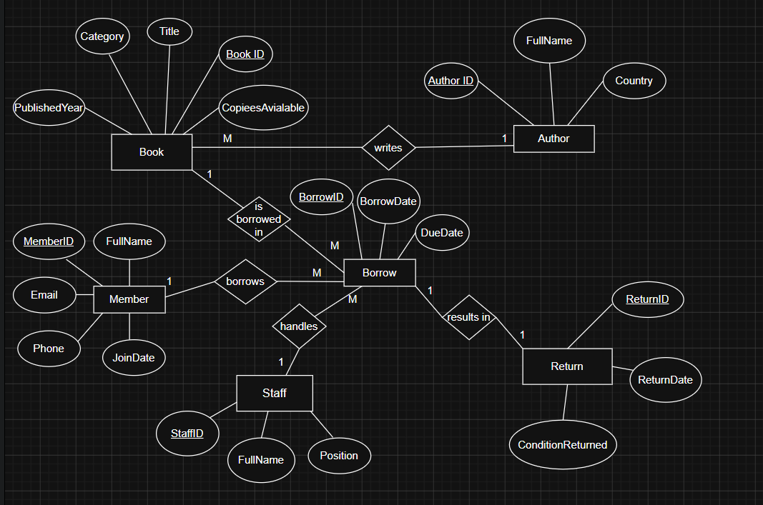
ER Diagram:
Author → Book
(1-to-many)
Staff → Borrow
(1-to-many)
Member → Borrow
(1-to-many)
Book → Borrow
(1-to-many)
Borrow → Return
(1-to-1)

Slide 6
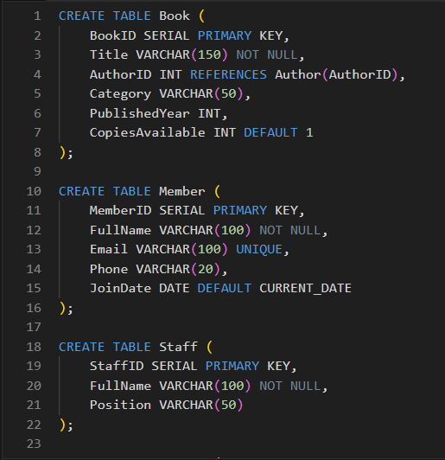
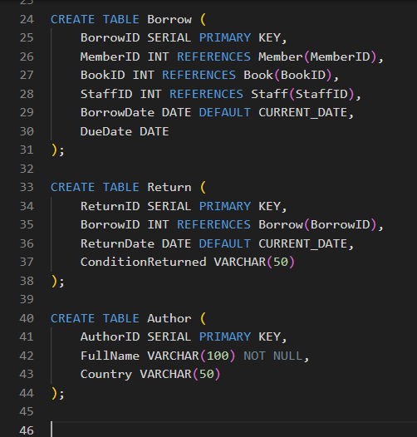
DDL – Table Creation
Primary keys using SERIAL
Foreign keys for relationships
Constraints and default values applies

Slide 7
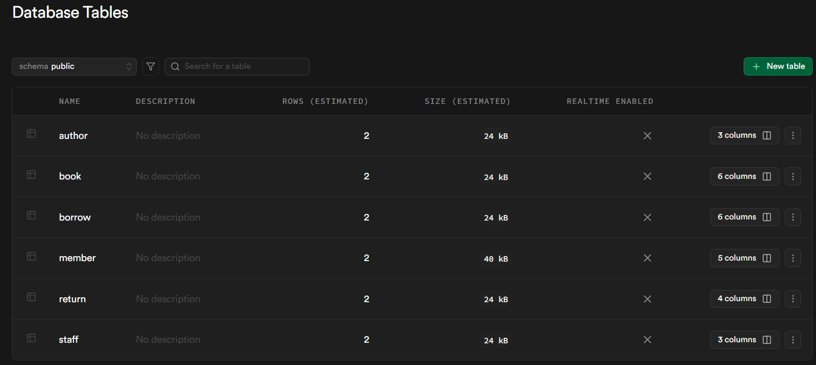
Result:

Slide 8
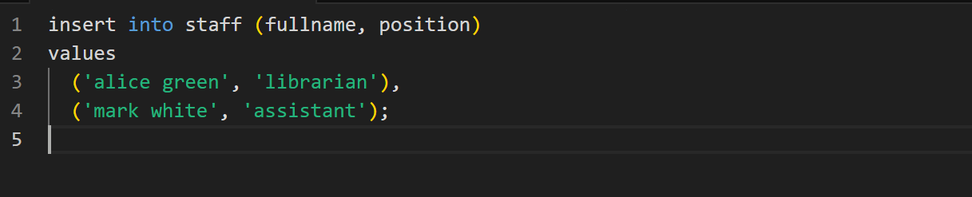
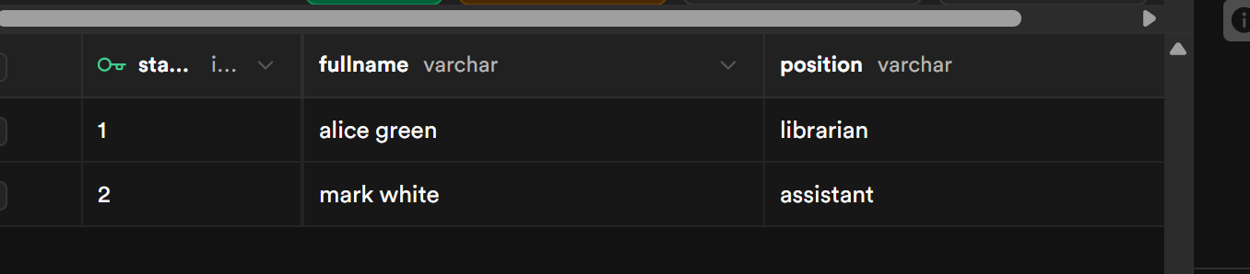
DML – Insert Operations

Slide 9
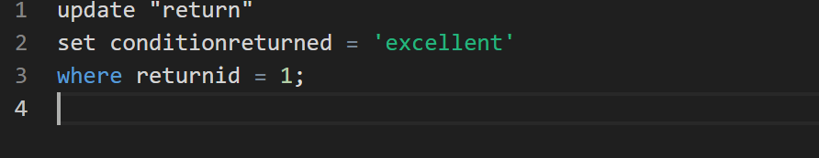

DML – Update & Delete

Slide 10
Sample Insert Example
INSERT INTO book (title, authorid, category)
VALUES ('1984', 1, 'fiction');

Slide 11
Queries – Overview
15 queries created
Joins, subqueries, functions
Statistical and management-focused

Slide 12
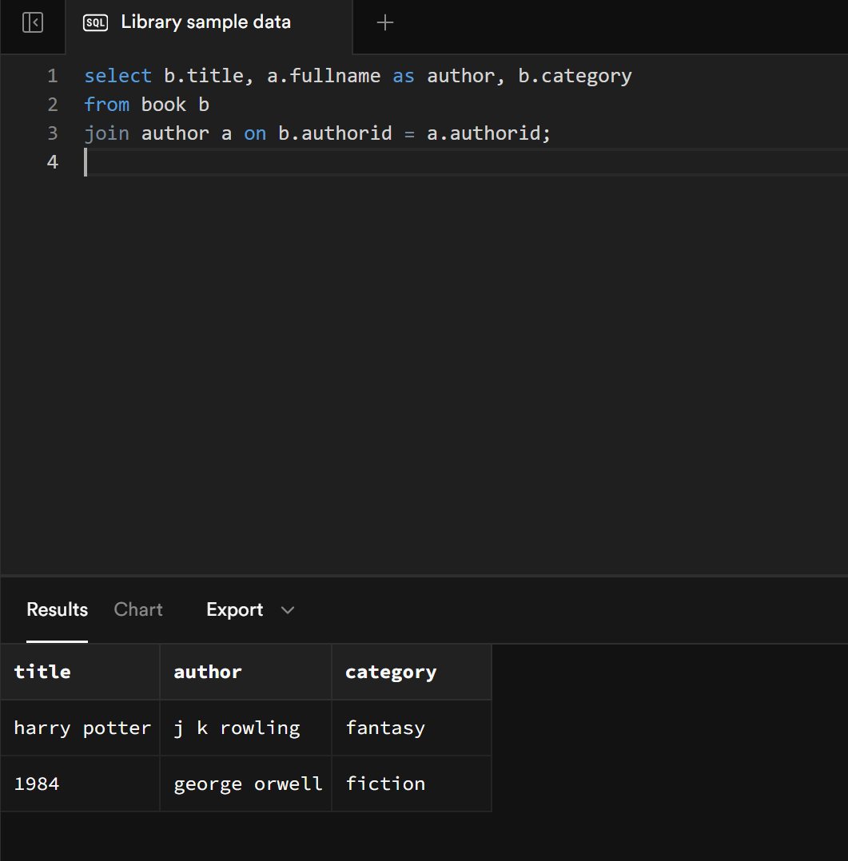
1. List all books with their authors

Slide 13
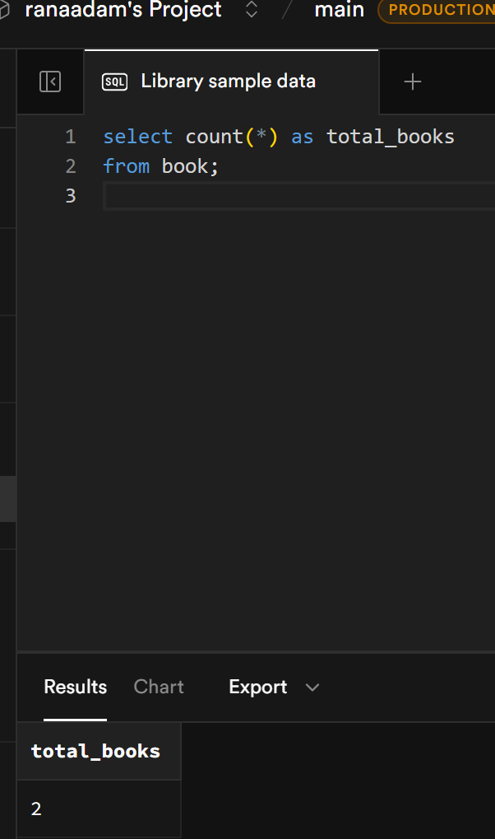
2. Count total numbers of books

Slide 14
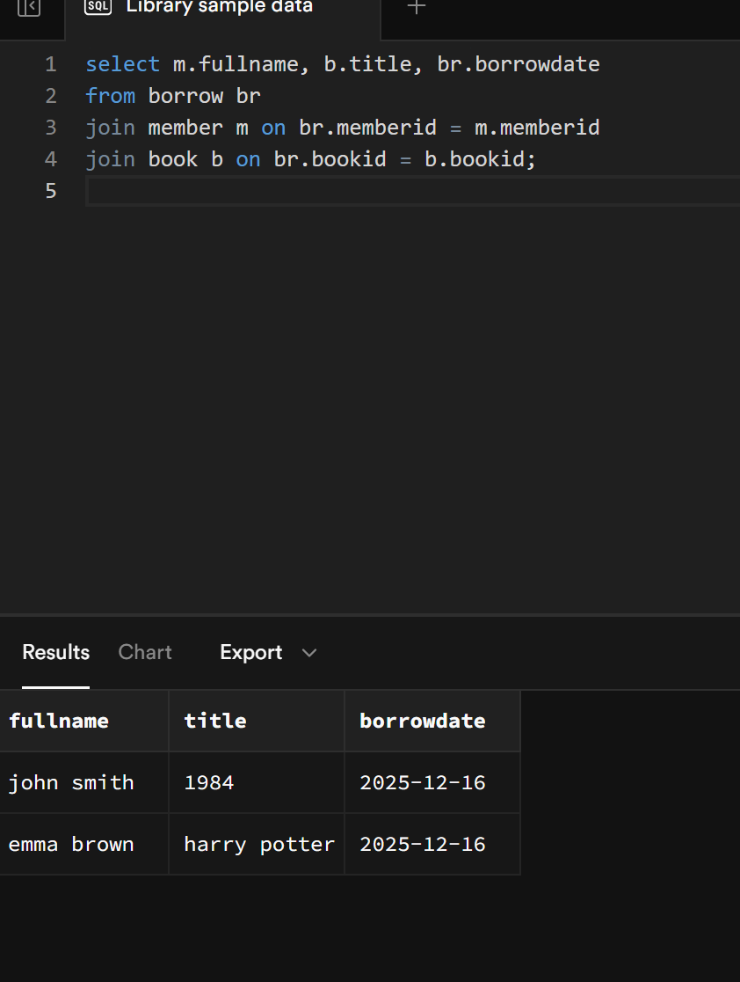
3. . Show members who borrowed books (JOIN)

Slide 15
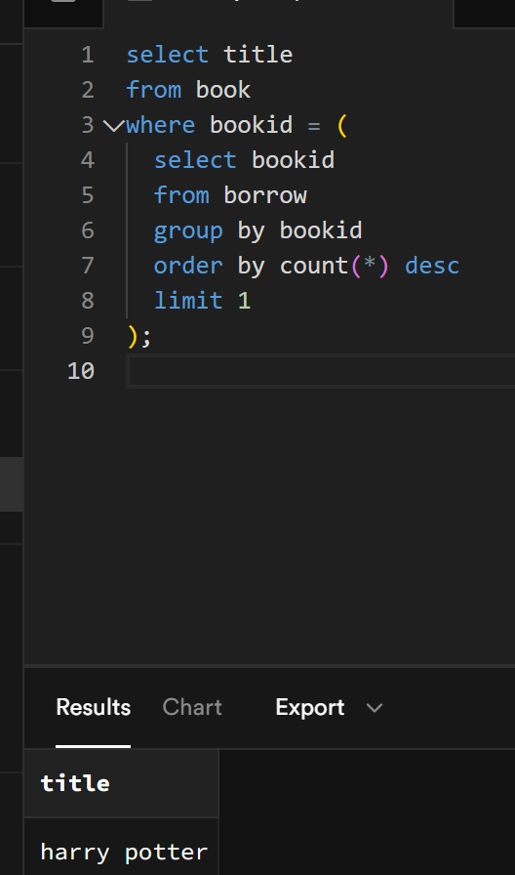
4.Find the most borrowed book

Slide 16
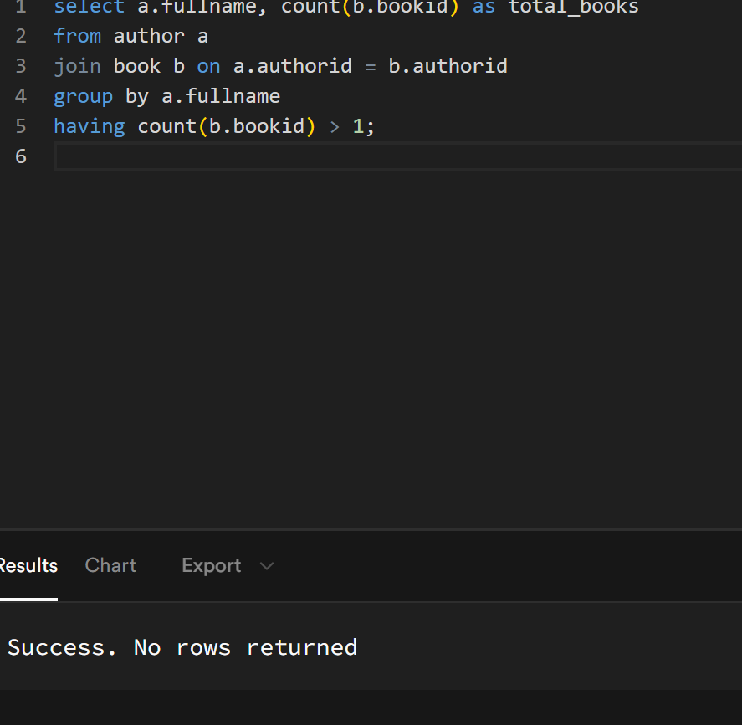
5. Show authors who have written more than one book (SUBQUERY + GROUP BY)

Slide 17
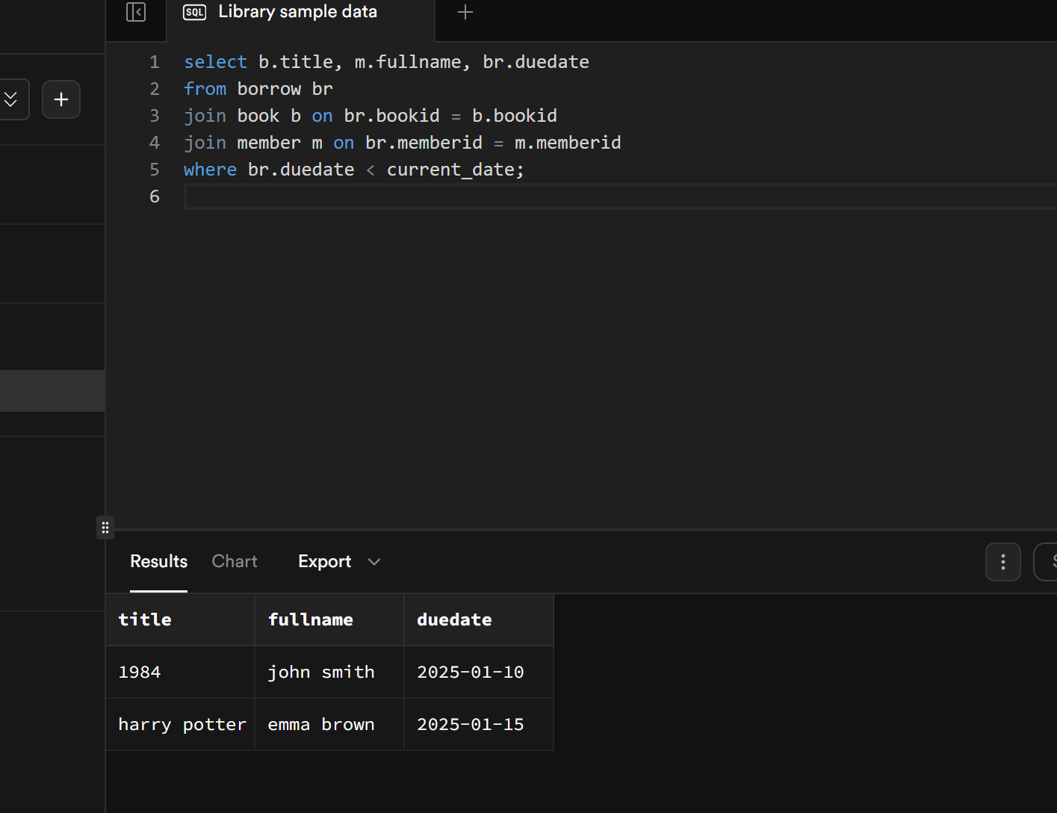
6. Show overdue books (due date < today)

Slide 18
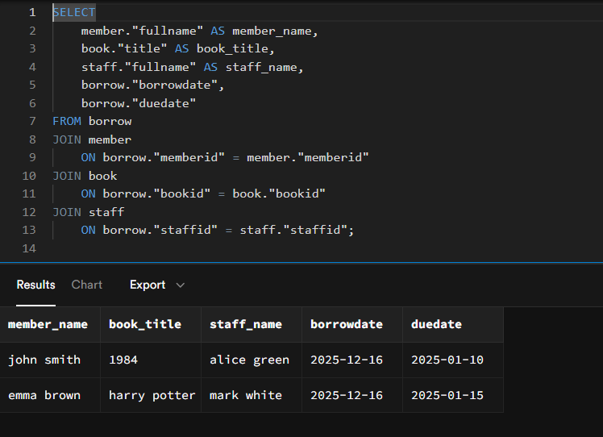
7. Display all Borrowed books with members and staff details.(JOIN)

Slide 19
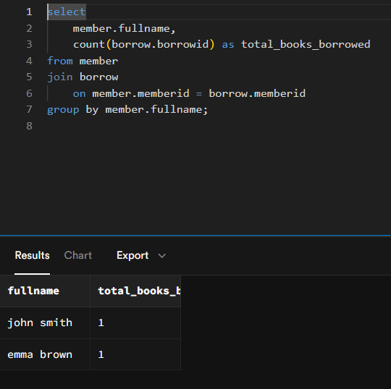
8. Display Total number of books borrowed per member (count + group by).

Slide 20
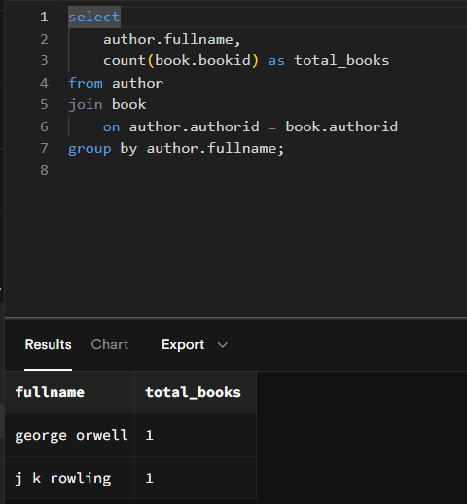
9. Display number of books written by each author (join + count).

Slide 21
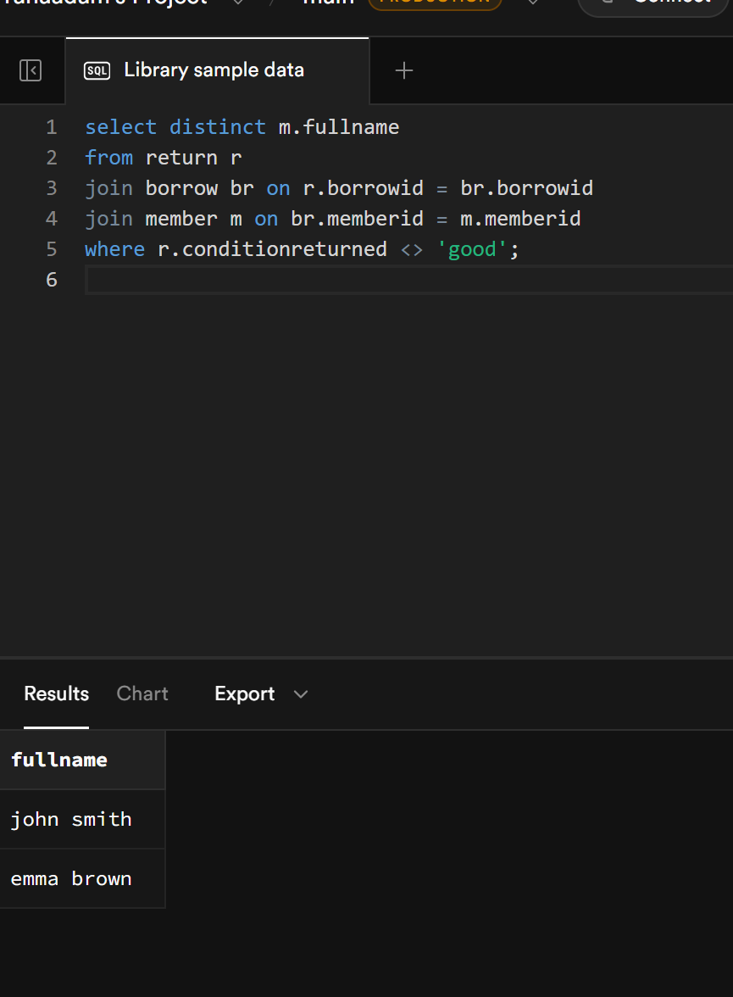
11. Show members who have returned damaged books.

Slide 22
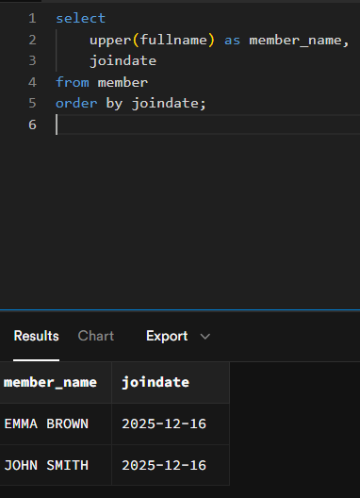
12. Display members in uppercase ordered by join date (string + order by).

Slide 23
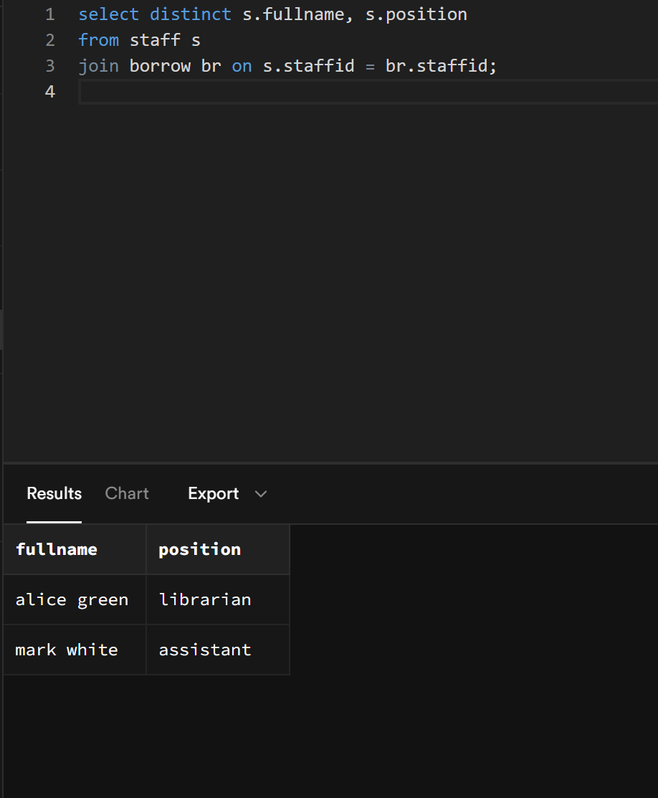
13. Show staff who Handled Borrowing.

Slide 24
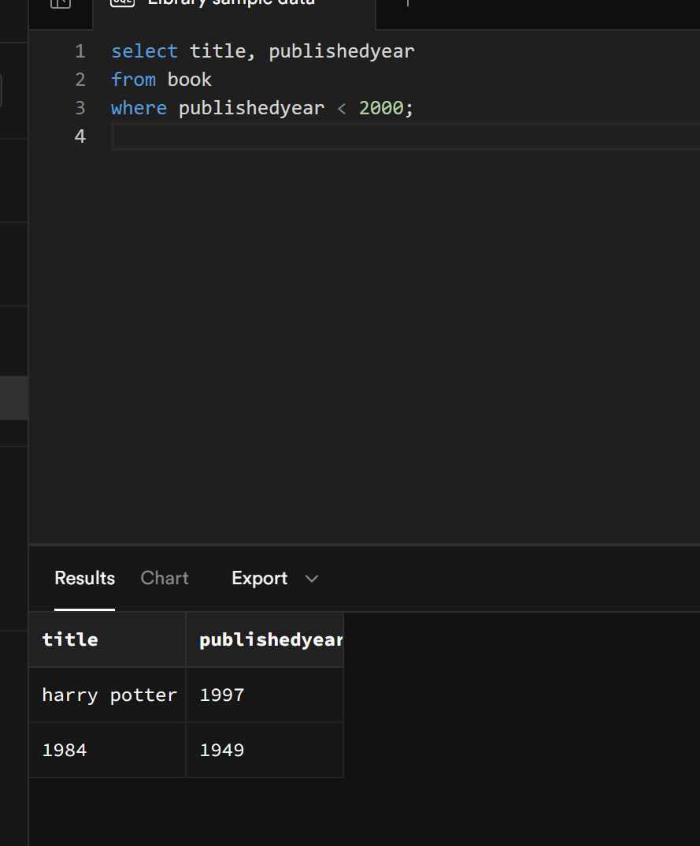
14. Find books published before the year 2000.

Slide 25
Platform & Tools
Supabase
GitHub for version control

Slide 26
Conclusion
Meets all project requirements
Scalable database design
Thank you!

