Slide 1
JSON
JSON stands for JavaScript Object Notation

Slide 2
JSON
JSON is a lightweight format for storing and transporting data
JSON is often used when data is sent from a server to a web page
JSON is "self-describing" and easy to understand

Slide 3
Why Use JSON?
The JSON format is syntactically similar to the code for creating JavaScript objects. Because of this, a JavaScript program can easily convert JSON data into JavaScript objects.
Since the format is text only, JSON data can easily be sent between computers, and used by any programming language.
JavaScript has a built in function for converting JSON strings into JavaScript objects:
JSON.parse()
JavaScript also has a built in function for converting an object into a JSON string:
JSON.stringify()

Slide 4
You can receive pure text from a server and use it as a JavaScript object.
You can send a JavaScript object to a server in pure text format.
You can work with data as JavaScript objects, with no complicated parsing and translations.

Slide 5
JSON is built on two structures:
A collection of name/value pairs. In various languages, this is realized as an object, record, struct, dictionary, hash table, keyed list, or associative array.
An ordered list of values. In most languages, this is realized as an array, vector, list, or sequence.
These are universal data structures. Virtually all modern programming languages support them in one form or another. It makes sense that a data format that is interchangeable with programming languages also be based on these structures.

Slide 6
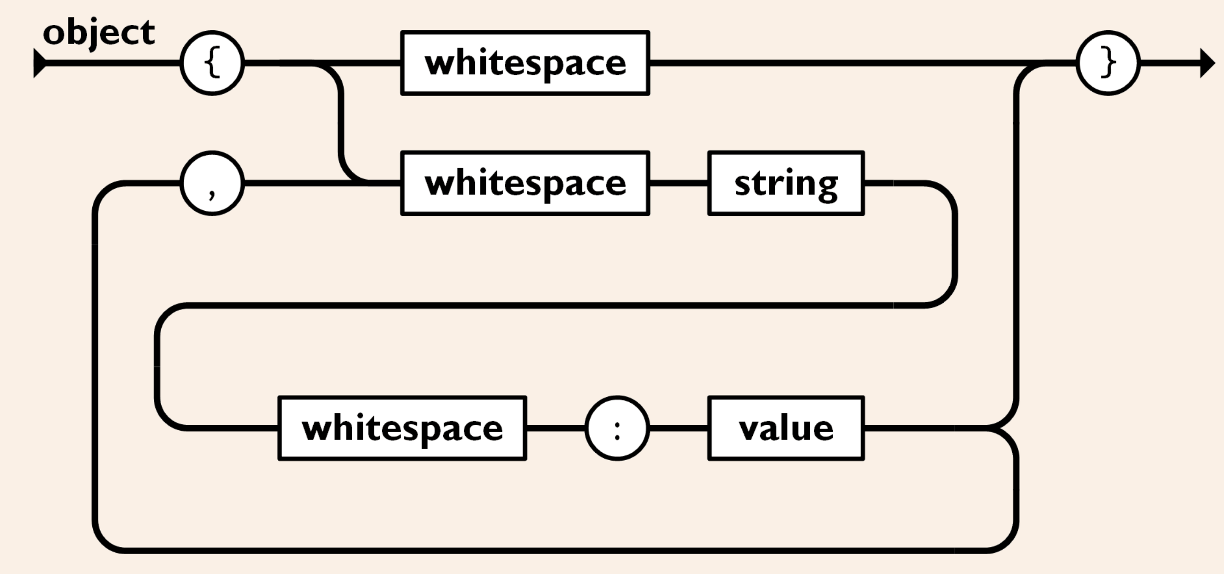
In JSON, they take on these forms:

Slide 7
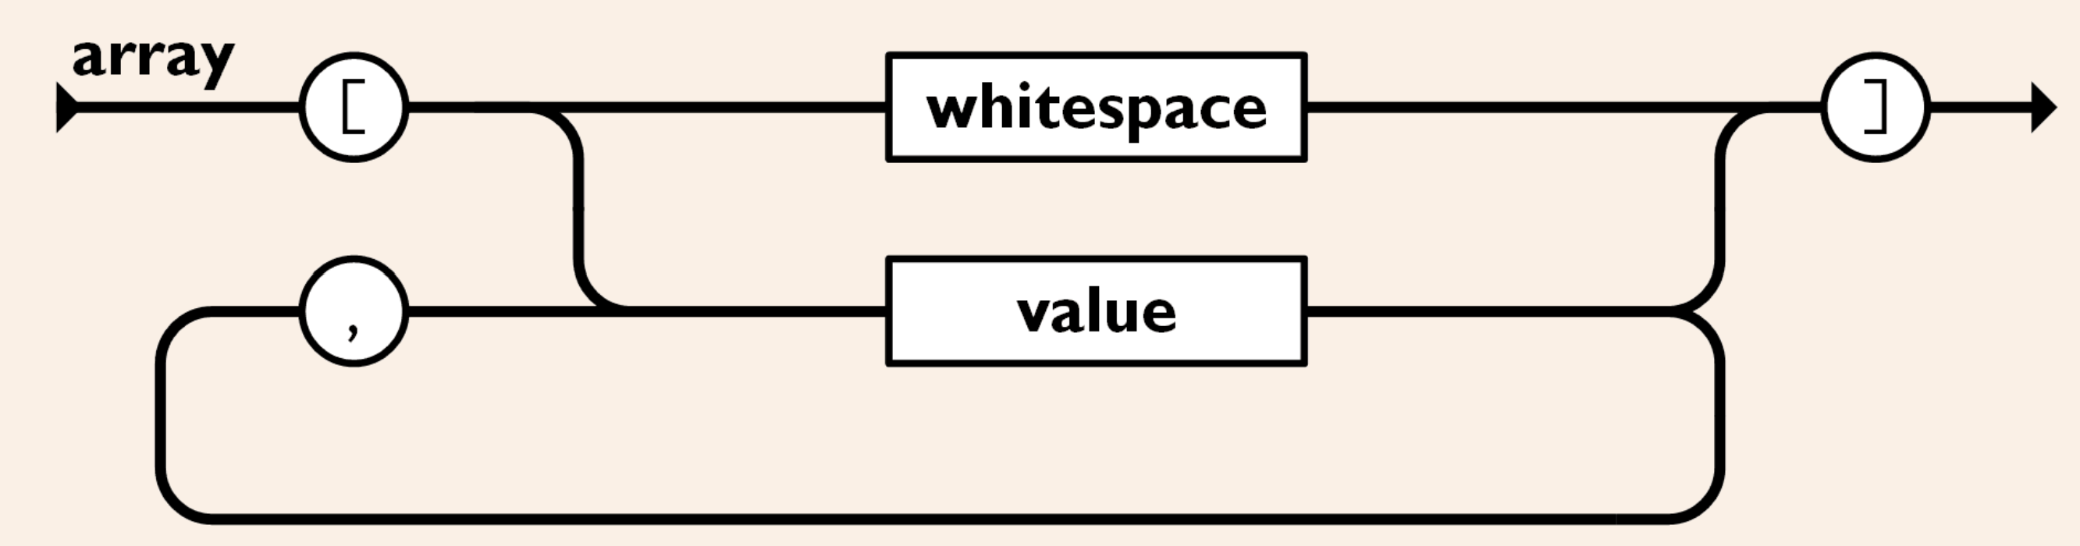
An array is an ordered collection of values. An array begins with [left bracket and ends with ]right bracket. Values are separated by ,comma.

Slide 8
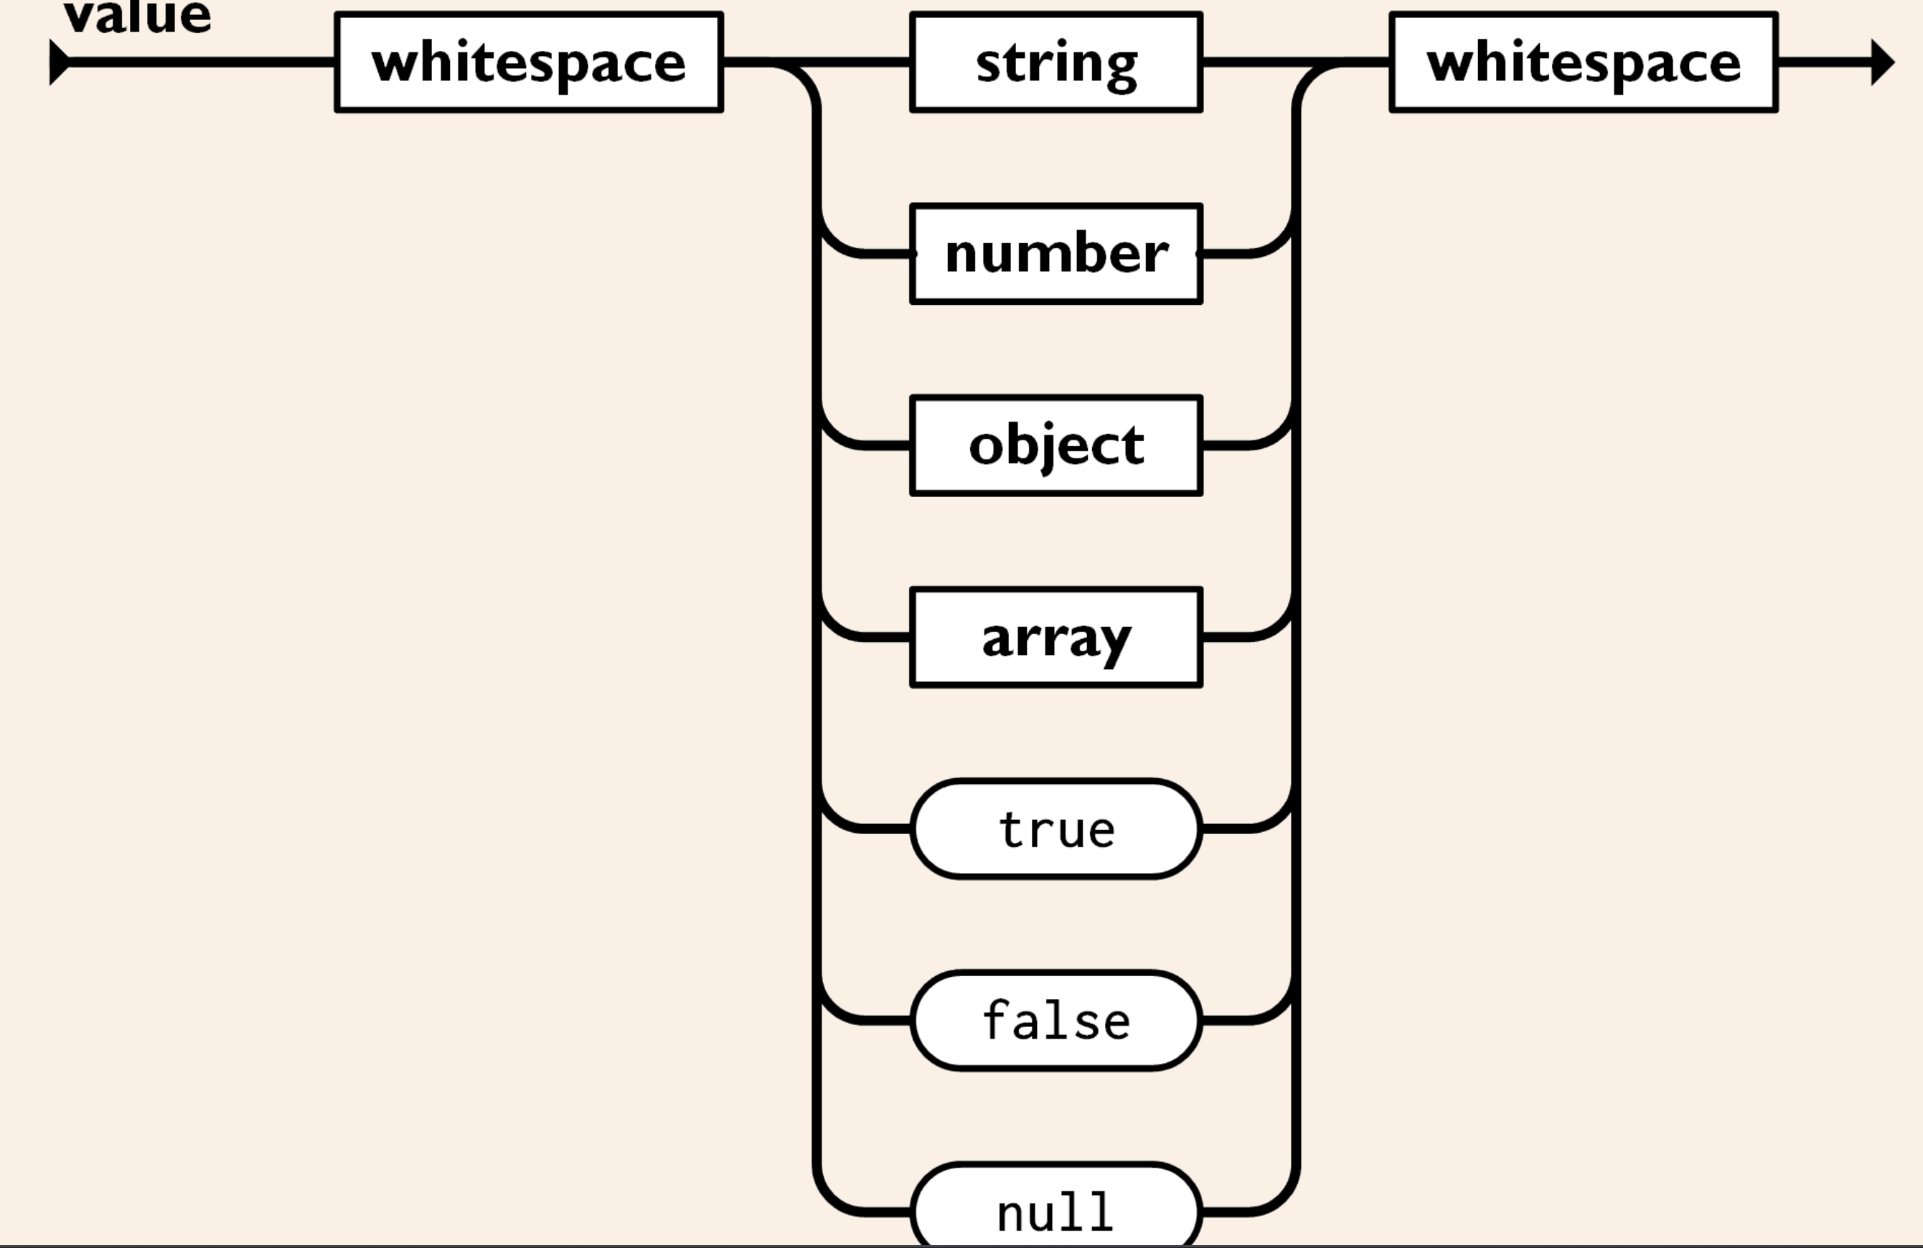
A value can be a string in double quotes, or a number, or true or false or null, or an object or an array. These structures can be nested.

Slide 9
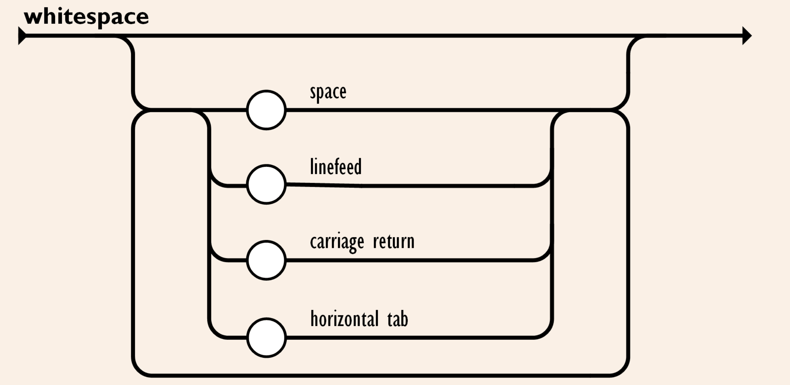
Whitespace can be inserted between any pair of tokens. Excepting a few encoding details, that completely describes the language.

