Slide 1

SECURE CODING REVIEW
CodeAlpha Cyber Security Internship
PREPARED BY: Muhammad Awais
TASK 2: Secure Coding Review

Slide 2

Introduction
Secure Coding is the practice of writing software in a way that protects applications from security vulnerabilities and cyber attacks.
Many Security breaches occur because developers unintentionally introduce weaknesses into their code
The purpose of this code is to identify security flaws in a simple application and provide recommendations to make the code more secure.
2
Notes:
© Copyright Showeet.com – Free PowerPoint Templates

Slide 3

Project OBJECTIVES
Identify Secure vulnerabilities in a source code
Analyze the risks associated with insecure coding.
Implement secure coding techniques
Improve Application security
Learn best practices for secure software development.
3
Notes:
© Copyright Showeet.com – Free PowerPoint Templates

Slide 4
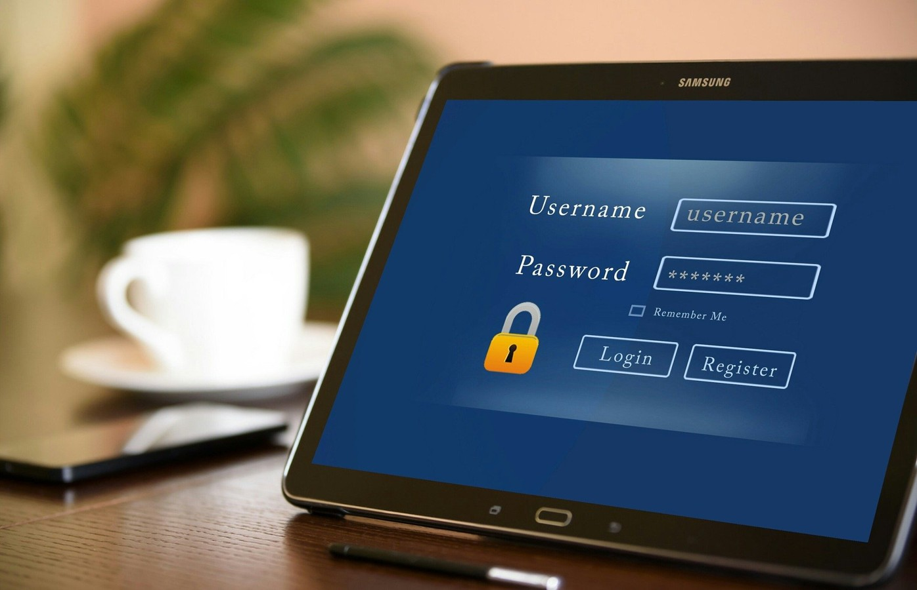
Vulnerable LOGIN SYSTEM
The following Login System Contains Multiple security weaknesses.
Features:
Accept username and password.
Check credentials directly in code
Provide access when credentials match
However, the implementation is insecure and can expose sensitive information.
4

Slide 5
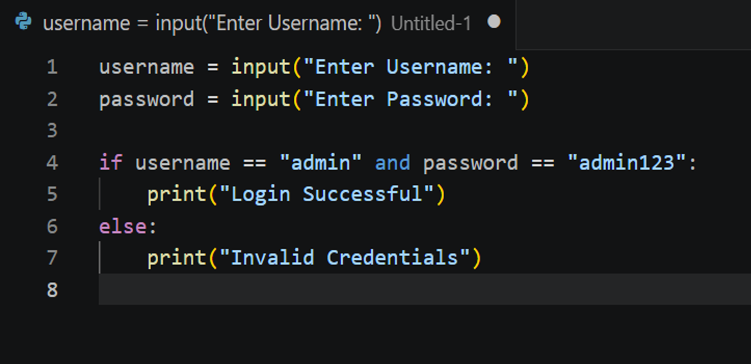
Balanced scorecard slide 7
Vulnerable Code
username = input("Enter Username: ")
password = input("Enter Password: ")
if username == "admin" and
password == "admin123":
print("Login Successful")
else:
print("Invalid Credentials")
5

Slide 6
Balanced scorecard slide 7
VULNERABILITY 1- HARDCODED CREDENTIALS
Risks:
Anyone will access to the code can see the credentials.
Attackers can easily gin unauthorized access.
Credentials become difficult to manage and update
Description:
The username and password are directly written within inside the source code.
Example:
Username: admin
Password: admin123
Severity:
High
6

Slide 7
Balanced scorecard slide 7
VULNERABILITY 2- PLAIN TEXT PASSWORD STORAGE
Risks:
Password can be exposed if the source code is leaked.
Attackers can read passwords directly.
No protection is applied to sensitive data.
Description:
Password are stored and compared as plain text
Severity:
Medium
7

Slide 8
Balanced scorecard slide 7
VULNERABILITY 3 – LACK OF INPUT VALIDATION
Risks:
Unexpected input may cause application errors.
Can introduce security vulnerabilities in larger system
Makes applications less secure and reliable
Description:
The application accepts user input without validation.
Severity:
High
8

Slide 9
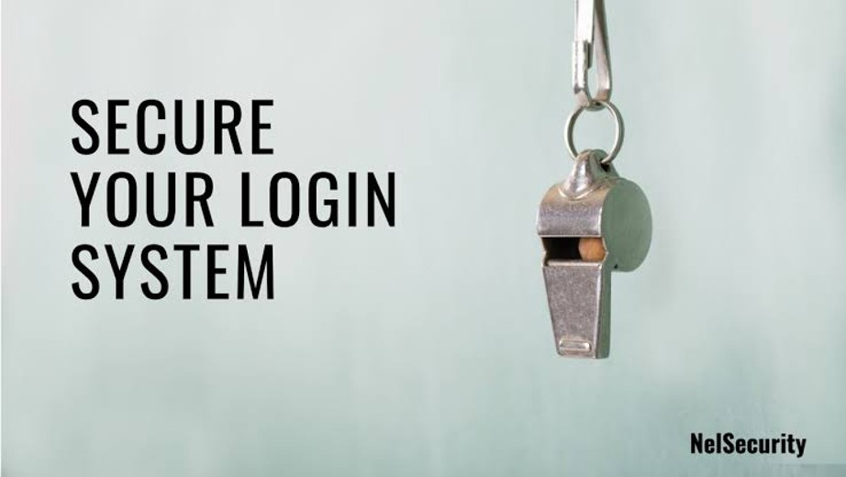
Balanced scorecard slide 3
SECURE LOGIN SYSTEM
To Improve Security:
Password hashing is implemented
Credentials are protected
Better Security are followed
This reduce the risk of credentials theft and unauthorized access
9

Slide 10
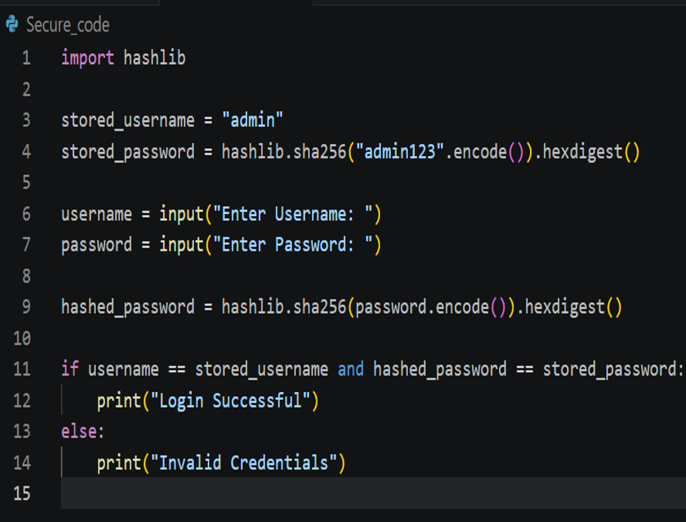
Balanced scorecard slide 7
Secure Code
import hashlib
stored_username = "admin"
stored_password = hashlib.sha256("admin123".encode()).hexdigest()
username = input("Enter Username: ")
password = input("Enter Password: ")
hashed_password = hashlib.sha256(password.encode()).hexdigest()
if username == stored_username and hashed_password == stored_password:
print("Login Successful")
else:
print("Invalid Credentials")
10

Slide 11

BENFITS OF SECURE CODE
ADVANTAGES:
Passwords are stored in hashed form.
Attackers cannot directly read passwords.
Better protection of user information.
Improved Application security
Follow secure coding principles
11

Slide 12
Balanced scorecard slide 4
RECOMMENDATIONS
Never hardcode password
Store passwords using hashing algorithms
Apply the principles of least privilege
Validate all user input
12

Slide 13
Balanced scorecard slide 11
CONCLUSION
Key Takeaways
This Project demonstrated how insecure coding practices can introduce security vulnerabilities
By Identifying weaknesses and implementing secure coding techniques, applications become more resistant to cyber attacks and data breaches.
Secure coding is an essential part of modern cybersecurity and software development.
13

Slide 14

THANK YOU

