Slide 1


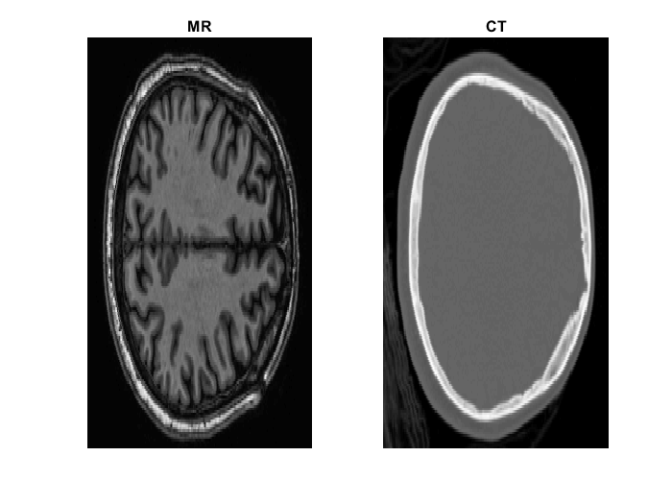
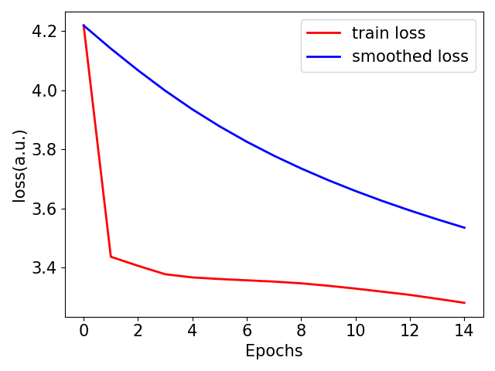
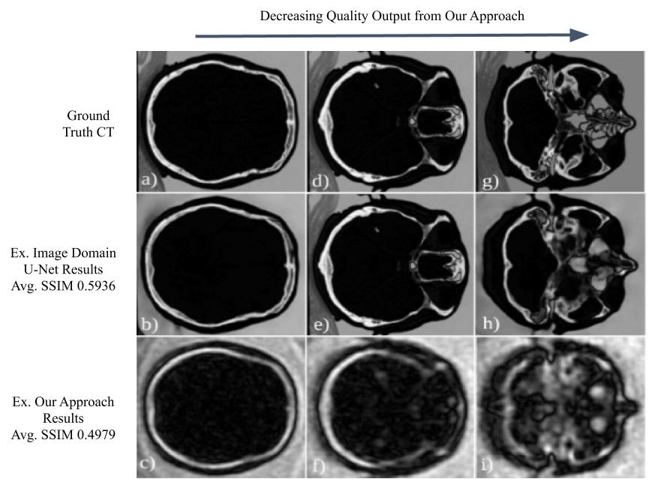
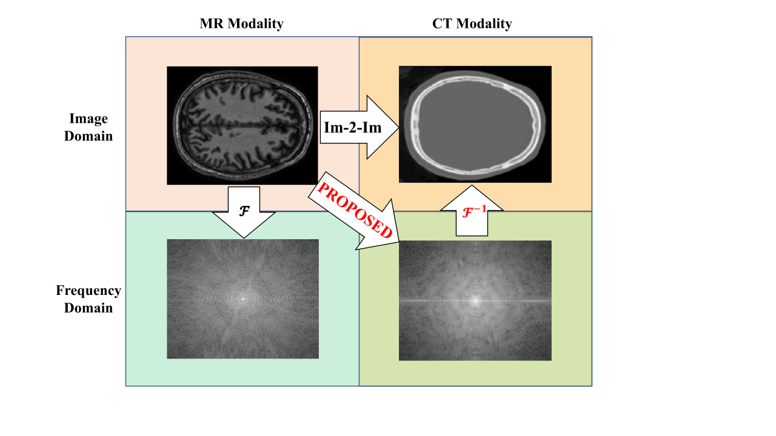
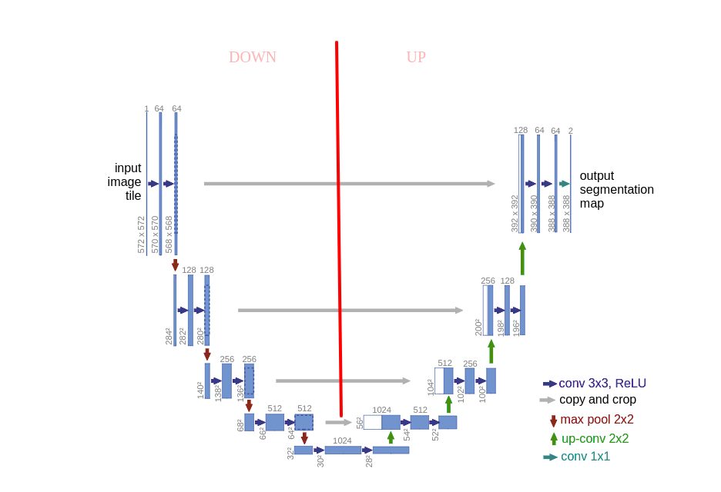

CT Image Synthesis from MRI Using a Novel Learned Cross-Modality Domain Transformation
Rana Banik$^{1}$, Jonathan B. Martin$^{1}$, Tahsin Reasat$^{2}$
Department of Biomedical Engineering, Vanderbilt University$^{1}$
Department of Electrical Engineering, Vanderbilt University$^{2}$
Vanderbilt University Institute of Imaging Science
BACKGROUND
METHODS: Pre-processing
RESULTS
Magnetic resonance imaging (MRI) is increasingly favored for use in radiotherapy treatment planning (RTP) due to its excellent soft-tissue contrast and lack of ionizing radiation, as compared to computed tomography (CT). However, MRI currently plays a limited role in RTP due to its limited ability to provide electron density information, a requirement for calculation of tissue attenuation and dose distribution during treatment. As a result, there is a strong incentive to synthesize CT images from MRI, which would enable MRI-only RTP. One promising emerging technique for CT synthesis is the use of convolutional neural networks (CNNs) to generate CT images from MR images. Currently, CNNs used for CT image synthesis work entirely in the image domain, with an image-domain MR input and an image-domain CT target (“Im-2-Im”) [1]. We propose a new approach for CT image synthesis, where the network is trained to predict the Fourier transform of CT images based on supervised learning (Fig 1). Our approach can be described as training the network to perform a pseudo-Fourier Transform (FT) on input MR images, where both a modality and domain transformation are learned simultaneously. CT images are then reconstructed using the inverse Fourier transform.
MR
CT
In our experiment, training the standard U-net with MR input and magnitude and phase images of CT as target, network reaches its’ optimum performance after 15 epochs(Fig. 4.). After that the train error does not decrease significantly and network starts overfitting.
Out of 20 subjects data, 16 were used for training. We performed simple hold-out validation method
Fig.2: Axial slice #100 from patient 5634 in MNI305 registered MR-CT space
Fig.4: Network performance in terms of train loss.
In medical image synthesis, 3D data are mostly preferred compared to 2D, as it can preserve structural and anatomical correlations in all the 3 axis. And most state-of-the-art methods use patch based medical image synthesis considering the memory and computational constraints[1]. But synthesis from k-space is very different as every cell(pixel) in k-space contributes to all the pixels in image domain.
In fthe requency domain the center of the 2D image contains the low frequency and DC components whereas the peripheral cells compose high frequency components. So, training with smaller patch method cannot be implemented in this case.
To train a 2D network, we took axial slices from each individual 3D images in both MR and CT.
Then the MR slices were padded with zeros to match the T1-weighted intensity value of air. And the CT images were padded with -1010 intensity which in Hounsfield unit value of air. After padding the image dimension became 192x224. The images were padded to make compatible with U-net architecture lowest resolution of 32x32 pixels.
To simulate k-space target for the network, we calculated the real and imaginary images of the CT image transforming it into frequency domain.
with 2 subjects and 2 subjects were used as set. Final CT images were reconstructed in inverse Fourier transformation. We learned that along with Im-2-Im synthesis, neural networks can also synthesize cross-modality domain transformed images.
METHODS: Proposed Synthesis Technique
Our goal is to estimate CT images from MR data and predict whole-brain MR-to-CT mapping.
Proven learned synthesis or image reconstruction methods transform directly from MR images to CT images [1], or MR k-space to CT k-space [2].
We propose a method wherein the network is trained to transform MR images to CT k-space.
We then use the inverse Fourier Transform to move from CT k-space to CT images.
EXPERIMENT: Network
Fig. 5. Results (left to right: best to worst slice reconstructions)
U-net has shown tremendous success in especially medical image segmentation. Standard U-net architecture also serves as a backbone for GANs, residual nets and other high-performance neural networks. A 2D u-net architecture is shown in Fig.3. It has analysis and synthesis paths which respectively down sample the images to high feature resolutions and then up sample them to target images.
Fig.1: Illustration of our proposed method of CT image synthesis. A nonlinear neural network synthesis is followed by a linear IFT to generate the CT images.
LITERATURE CITED
[1] D. Nie et al “Medical Image Synthesis with Deep Convolutional Adversarial Networks.” 2018
[2] Y. Han et al “k-Space Deep Learning for Accelerated MRI.” 2018
[3] O. Ronneberger, P. Fischer, and T. Brox, “U-Net: Convolutional Networks for Biomedical Image Segmentation,” May 2015.
METHODS: Dataset
Experiments were conducted on a dataset of T1-weighted MR and CT images acquired from twenty subjects for DBS(Deep Brain Stimulation) study.
The MR and CT data were in their native spaces with dimensions respectively 256x256x170 and 512x512x288. MR was in isometric voxel resolution 1mmx1mmx1mm and CT was in 0.4297mmx0.4297x0.625mm.
Both MR and CT images were registered to standard MNI305 template using FSL FLIRT software package and affine registration method.
After the registration process, MR and CT volumes’ dimension resulted in 172x220x156 and with isometric resolution of 1mmx1mmx1mm in common space resulting in paired MR-CT data.(Fig. 2.)
Fig.3: U-net architecture for 2D 3channel
images[3]
Contact
We implemented transfer learning weight initialization from VGG-11. The hyperparameters selected were, batchsize = 64, learning rate = 0.05, maximum epochs = 15.*
Mean squared error(MSE) was chosen as loss criteria. To update the network weights Adam optimizer was implemented. To match the 3 channels we modified the dataset class in PyTorch framework with 3 slices.
rana.banik@vanderbilt.edu
jonathan.b.martin@vanderbilt.edu
tahsin.reasat@vanderbilt.edu
B0104 VUIIS
1161 21st Ave S
Nashville, TN 37232
*the hyperparameters were varied and the best performing metrics are provided

