Slide 1

Local Business Management System
Presented By -
Team Name : Red Sox
Ameya Ranade(001561048)
Abhishek Palkar(001517206)
Shreya Bidarkar(001550684)

Slide 2
About Ecosystem
The purpose of our ecosystem is to establish a network that connects a local business not only with the end customers who stay in the same neighbourhood, but also with the supply chain relevant to that business. We have designed and developed an ecosystem which can work not only in Major Cities but also Small Cities. We have 5 zip codes for three cities , multiple zip codes for Boston and 2 for Indian cities: Pune which is major city and Aurangabad is a small city. This demonstrates the robustness of our Ecosystem. Our pursuit is to provides a means of income and employment opportunities.

Slide 3
Problem Statement
During times of crisis, such as the Covid-19 pandemic which began in 2020, local and small businesses are one of the most affected groups. They suffer heavy losses in terms of revenue during a crisis when governments enforce lockdowns, and their customers are in quarantine. In developing nations such as India, this translates to a local shop owner losing their source of income as well as losing access to their suppliers and the distribution network from whom they buy the products which are sold to their customers. During the Covid-19 pandemic, 41.3% of small business in the United States of America were temporarily closed.

Slide 4
Continue
Lack of revenue leads to the inability of local business owners to pay for their staff which leads to unemployment and further affects ability of small businesses to function. In India, local and small businesses employ approximately 110 million workers and contribute 30% of the country’s GDP.

Slide 5
Continue
Local retail stores such as clothing, electronics and hardware are also affected when government restrictions are enforced and their customers are not allowed to come in person to conduct in business. With no infrastructure in places to allow such stores to connect directly with their customers, they lose what business they could’ve conducted to corporations such as Amazon, Bestbuy etc.

Slide 6
Continue
With regard to the Covid-19 pandemic, the delivery men of companies such as Amazon or Door dash can become potential spreaders of the virus due to the large number of interactions they have with people in different areas. This creates a health hazard not only for those employed by large corporations to deliver products, but also to the communities where the deliveries take place

Slide 7
Continue
. In order to do this, we have identified the types of small and micro enterprises that constitute local and small business and categorized them as follows:

Slide 8
Approach Solution
We have designed and developed an ecosystem which can work not only in Major Cities but also Small Cities. We have 5 zip codes for three cities , multiple zip codes for Boston and 2 for Indian cities: Pune which is major city and Aurangabad is a small city. This demonstrates the robustness of our Ecosystem.

Slide 9
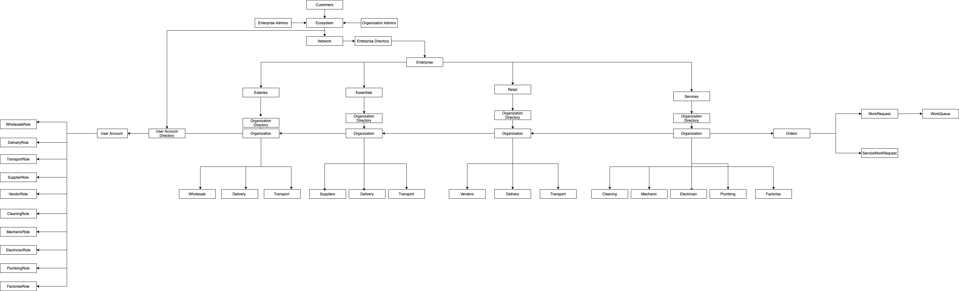

Slide 10
ENTERPRISE ADMINS
CUSTOMERS
ORG ADMINS
EECOSYSTEM
SERVICES
RETAIL
ESSENTIALS
EATERIES
CLEANING
DELIVERY
DELIVERY
DELIVERY
MECHANIC
VENDORS
SUPPLIERS
WHOLESALE
ELECTRICIAN
TRANSPORT
TRANSPORT
TRANSPORT
PLUMBING
FACTORIES

Slide 11
CUSTOMERS
ENTERPRISE ADMINS
EECOSYSTEM
ORG ADMINS
SERVICES
RETAIL
ESSENTIALS
EATERIES
CLEANING
DELIVERY
DELIVERY
DELIVERY
MECHANIC
VENDORS
SUPPLIERS
WHOLESALE
ELECTRICIAN
TRANSPORT
TRANSPORT
TRANSPORT
PLUMBING
FACTORIES

Slide 12
CUSTOMERS
ENTERPRISE ADMINS
EECOSYSTEM
ORG ADMINS
SERVICES
RETAIL
ESSENTIALS
EATERIES
CLEANING
DELIVERY
DELIVERY
DELIVERY
MECHANIC
VENDORS
SUPPLIERS
WHOLESALE
ELECTRICIAN
TRANSPORT
TRANSPORT
TRANSPORT
PLUMBING
FACTORIES

Slide 13
CUSTOMERS
ENTERPRISE ADMINS
EECOSYSTEM
ORG ADMINS
SERVICES
RETAIL
ESSENTIALS
EATERIES
CLEANING
DELIVERY
DELIVERY
DELIVERY
MECHANIC
VENDORS
SUPPLIERS
WHOLESALE
ELECTRICIAN
TRANSPORT
TRANSPORT
TRANSPORT
PLUMBING
FACTORIES

Slide 14
CUSTOMERS
ENTERPRISE ADMINS
EECOSYSTEM
ORG ADMINS
SERVICES
RETAIL
ESSENTIALS
EATERIES
CLEANING
DELIVERY
DELIVERY
DELIVERY
MECHANIC
VENDORS
SUPPLIERS
WHOLESALE
ELECTRICIAN
TRANSPORT
TRANSPORT
TRANSPORT
PLUMBING
FACTORIES

Slide 15
CUSTOMERS
ENTERPRISE ADMINS
EECOSYSTEM
ORG ADMINS
SERVICES
RETAIL
ESSENTIALS
EATERIES
CLEANING
DELIVERY
DELIVERY
DELIVERY
MECHANIC
VENDORS
SUPPLIERS
WHOLESALE
ELECTRICIAN
TRANSPORT
TRANSPORT
TRANSPORT
PLUMBING
FACTORIES

Slide 16
CUSTOMERS
ENTERPRISE ADMINS
EECOSYSTEM
ORG ADMINS
SERVICES
RETAIL
ESSENTIALS
EATERIES
DELIVERY
WHOLESALE
TRANSPORT
CLEANING
DELIVERY
DELIVERY
MECHANIC
VENDORS
SUPPLIERS
ELECTRICIAN
TRANSPORT
TRANSPORT
PLUMBING
FACTORIES

Slide 17
CUSTOMERS
ENTERPRISE ADMINS
EECOSYSTEM
ORG ADMINS
SERVICES
RETAIL
ESSENTIALS
EATERIES
DELIVERY
DELIVERY
SUPPLIERS
WHOLESALE
TRANSPORT
TRANSPORT
CLEANING
DELIVERY
MECHANIC
VENDORS
ELECTRICIAN
TRANSPORT
PLUMBING
FACTORIES

Slide 18
CUSTOMERS
ENTERPRISE ADMINS
EECOSYSTEM
ORG ADMINS
SERVICES
RETAIL
ESSENTIALS
EATERIES
DELIVERY
DELIVERY
DELIVERY
VENDORS
SUPPLIERS
WHOLESALE
TRANSPORT
TRANSPORT
TRANSPORT
CLEANING
MECHANIC
ELECTRICIAN
PLUMBING
FACTORIES

Slide 19
CUSTOMERS
ENTERPRISE ADMINS
EECOSYSTEM
ORG ADMINS
SERVICES
RETAIL
ESSENTIALS
EATERIES
CLEANING
DELIVERY
DELIVERY
DELIVERY
MECHANIC
VENDORS
SUPPLIERS
WHOLESALE
ELECTRICIAN
TRANSPORT
TRANSPORT
TRANSPORT
PLUMBING
FACTORIES

Slide 20
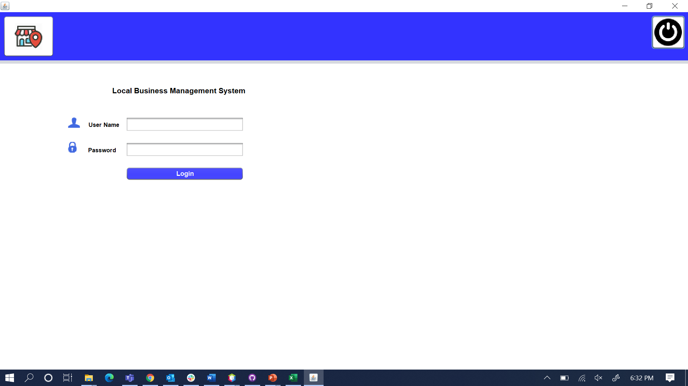
Screenshot Login Page

Slide 21
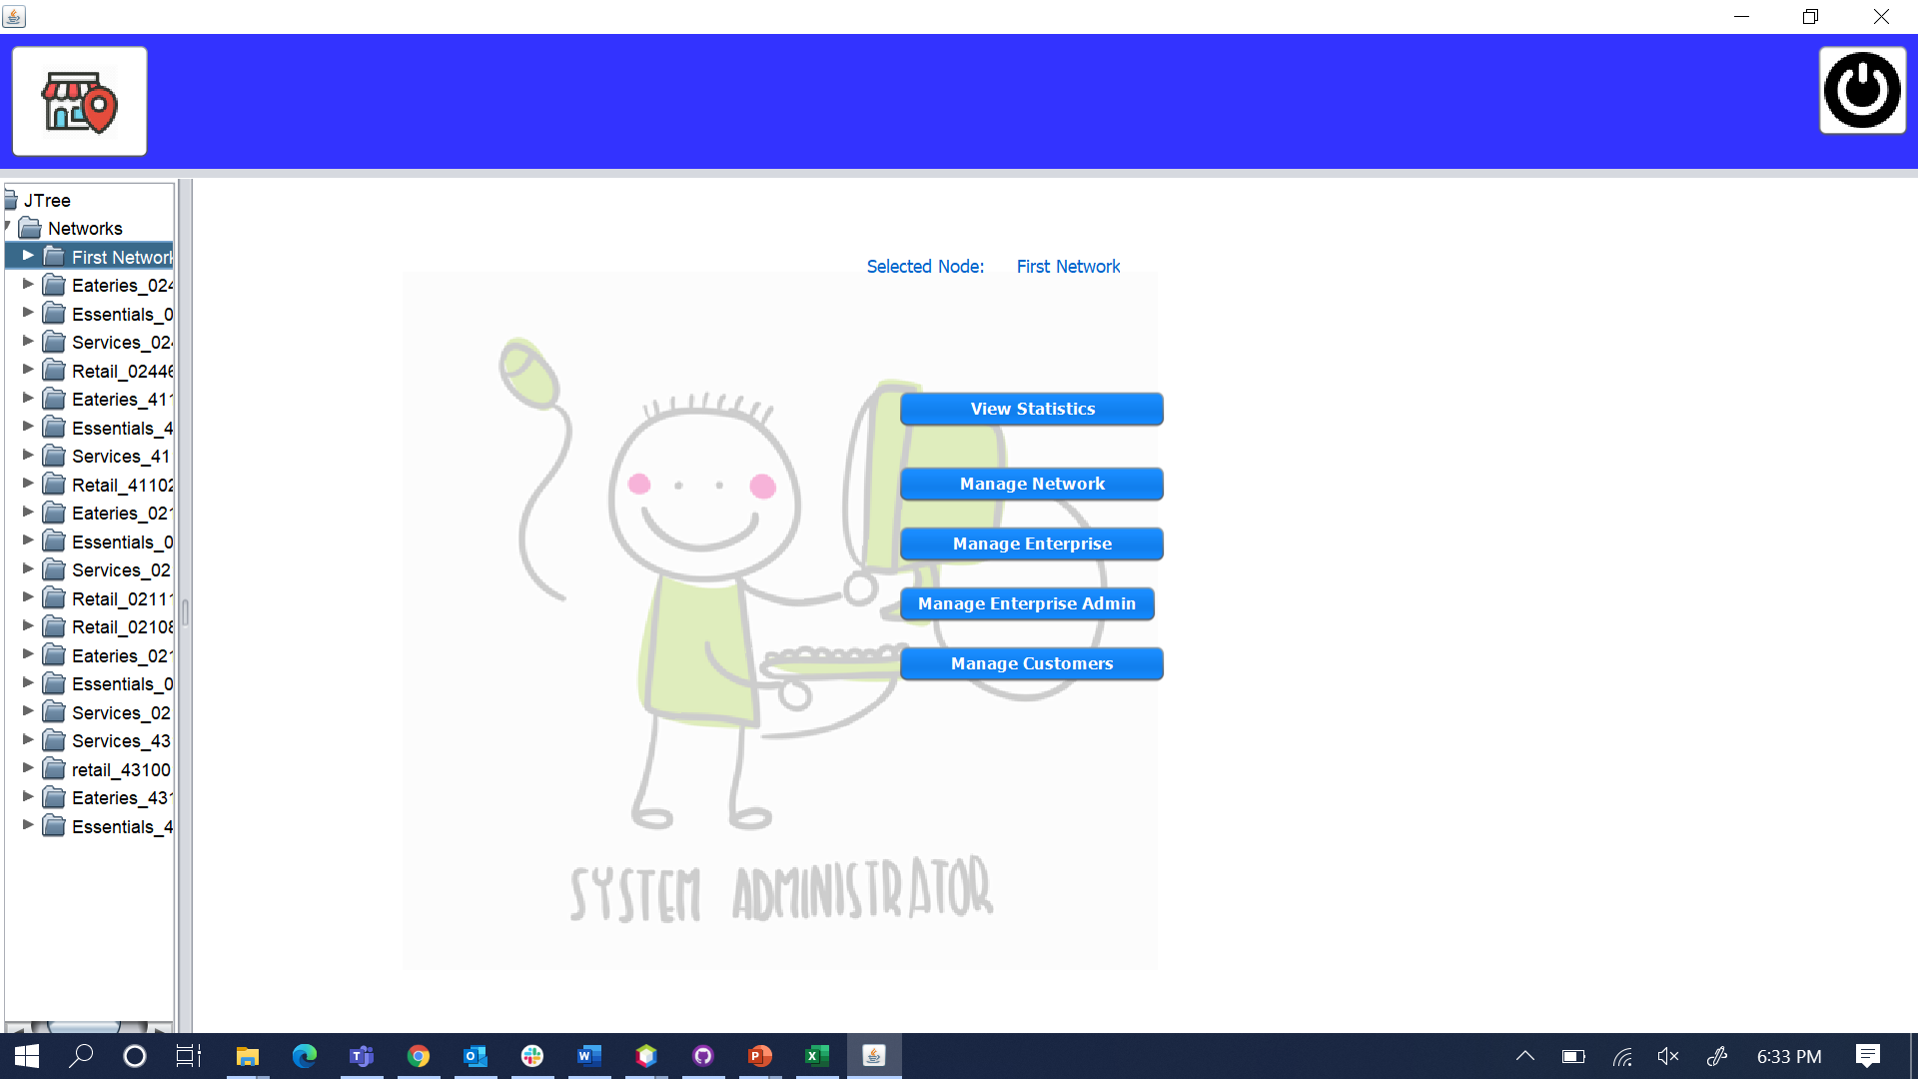
Screenshot System Admin Role

Slide 22
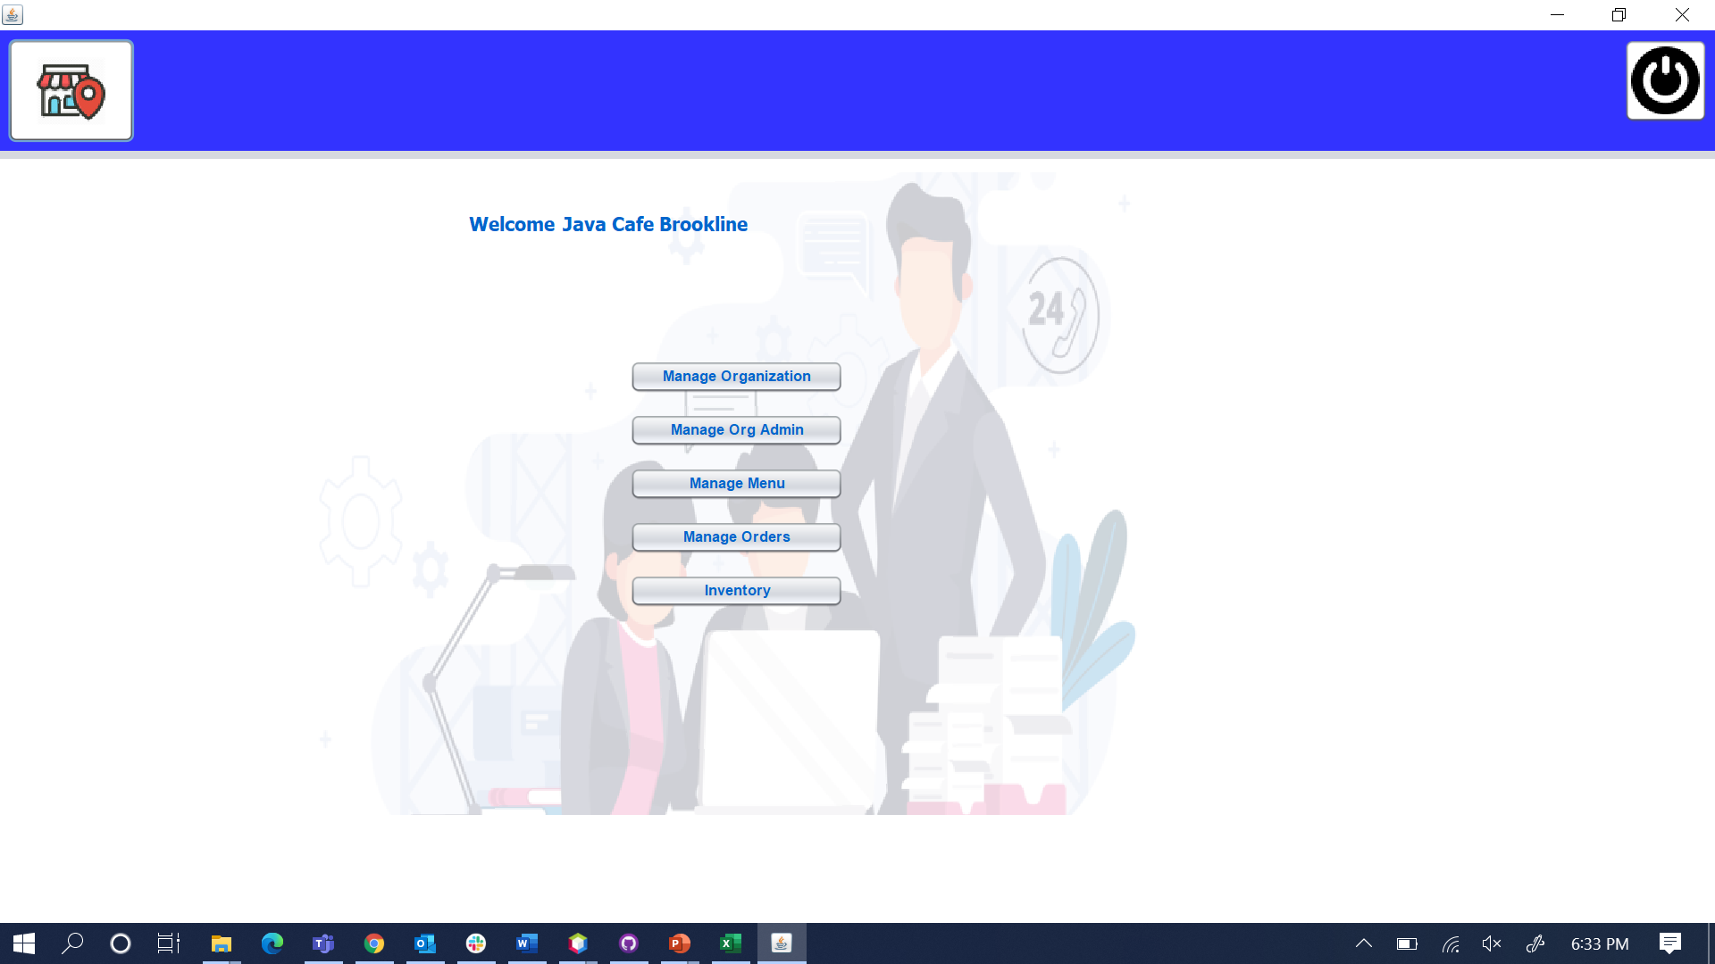
Screenshot Enterprise Admin Role

Slide 23
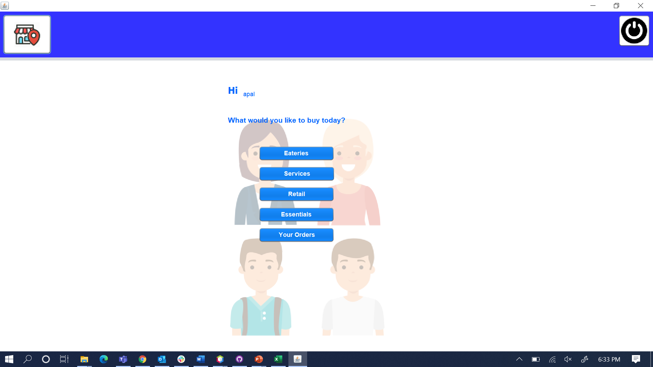
Screenshot Customer Role

Slide 24
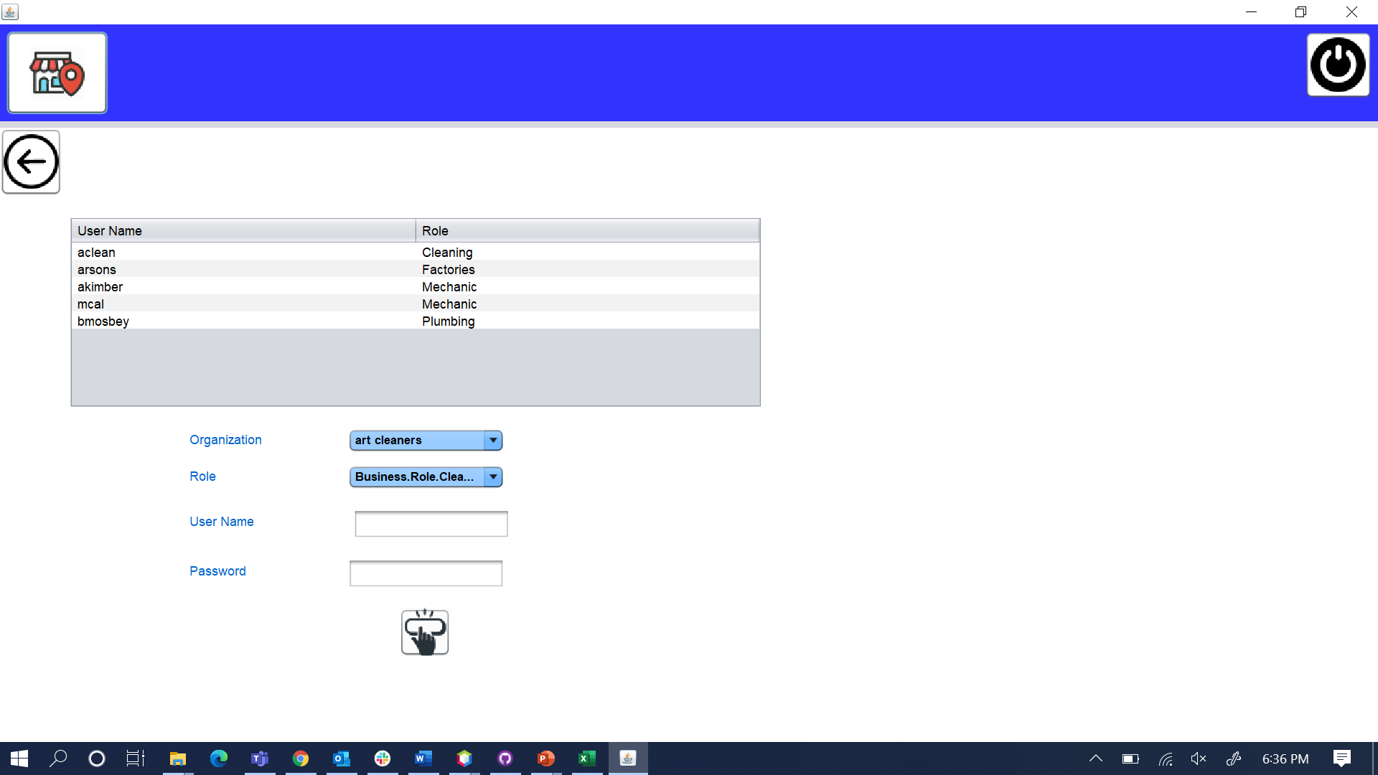
Screenshot Manage Organization Admin

Slide 25
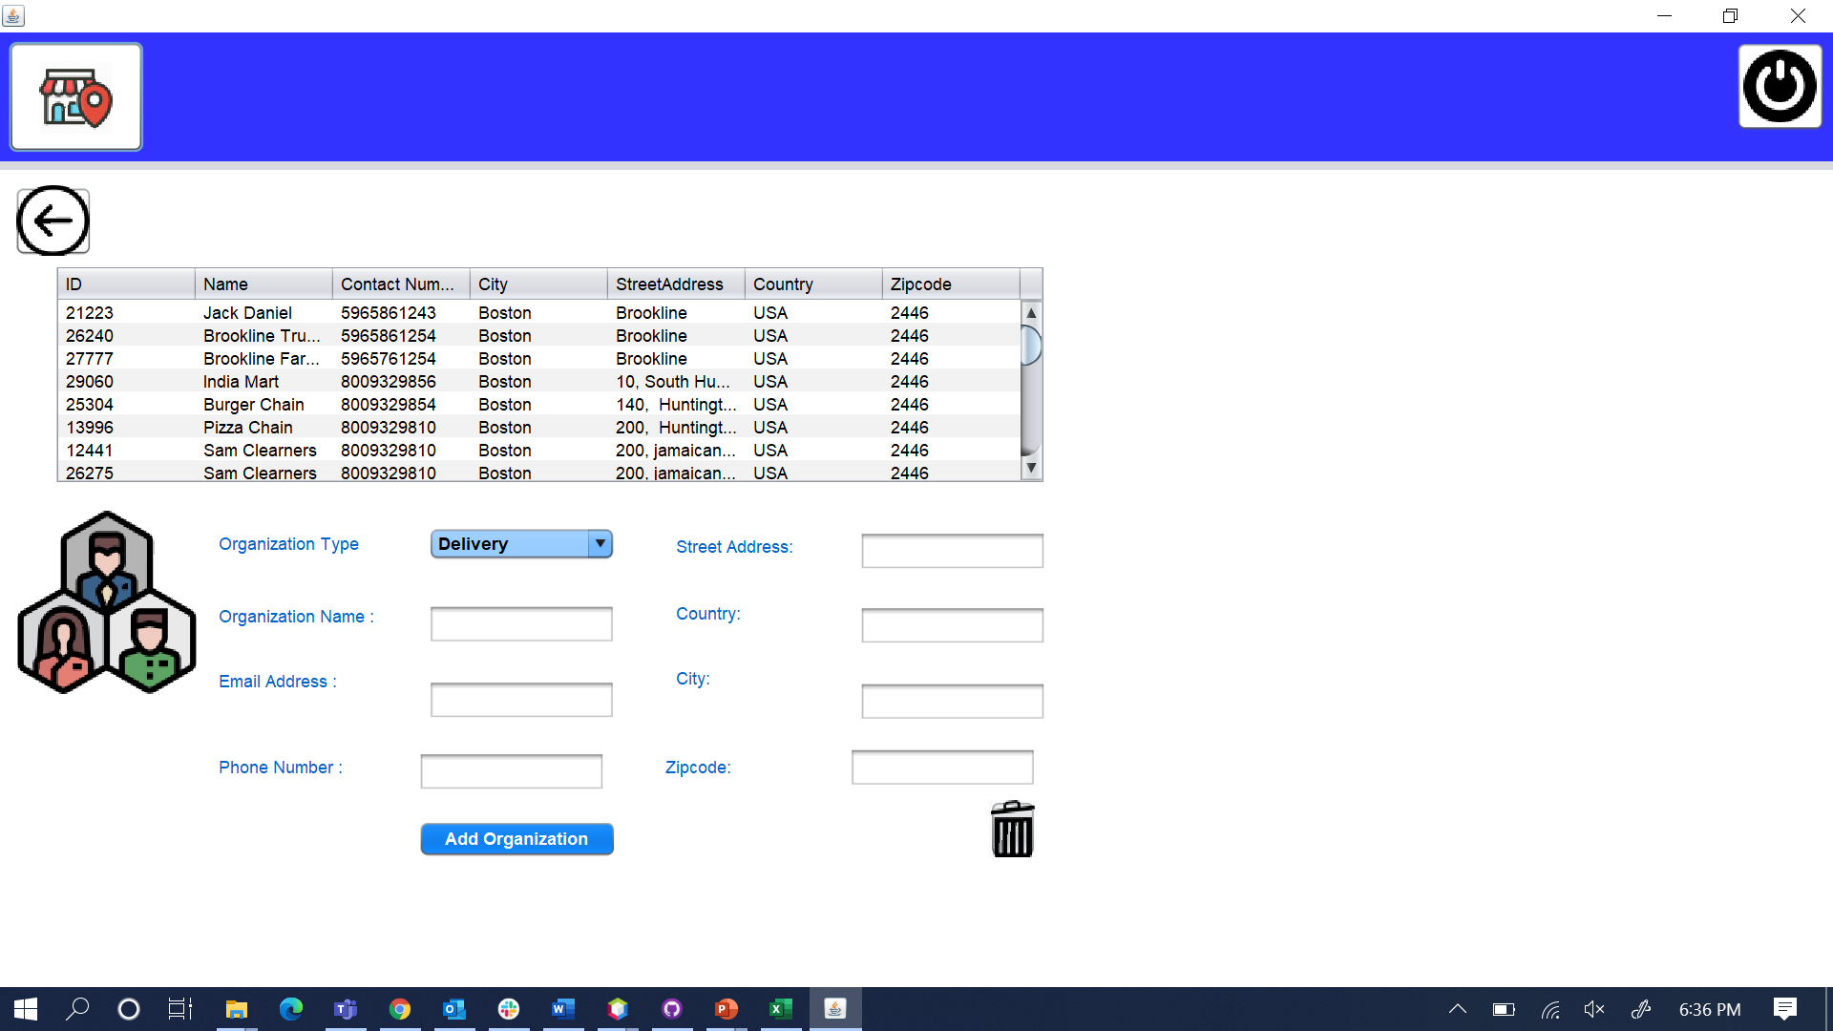
Screenshot Add Organization

Slide 26
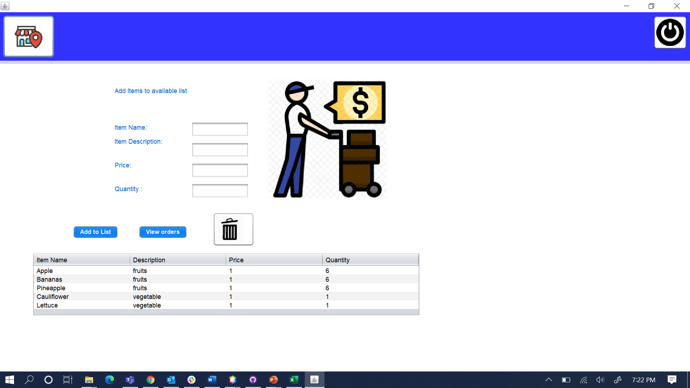
Screenshot Supplier Role

Slide 27
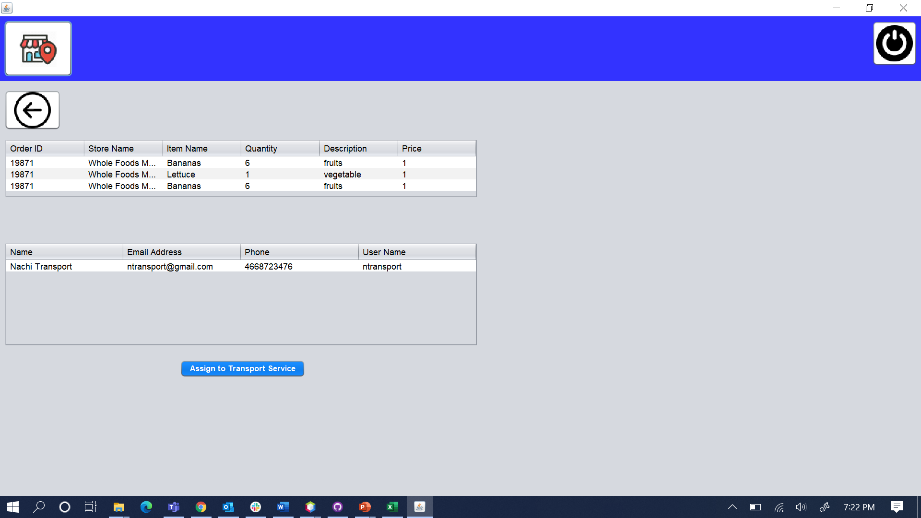
Screenshot Supplier Work Area

Slide 28

Thank You!

