Slide 1


Ai driven Mock Interview Video Intelligence
160121771071-Akshitha Lakavath
160121771072- Akshitha Thokala
160121771082 – Sai Snigdha Kondamadugu
Under the Guidance of:
Mrs.Swathi Tejah Yella

Slide 2
abstract
In today's world, while there are many diverse job opportunities, individuals often struggle to find platforms that allow them to practice and refine their interview skills based on specific job descriptions and interests.
This research introduces an AI-driven interview assessment platform designed to evaluate candidates' communication, confidence, and emotional intelligence.
This Ai Driven Mock Interview Intelligence empowers users to refine their interview skills, boost confidence, and receive constructive feedback.
It is a helpful tool for career development and interview preparation in an increasingly competitive job market.

Slide 3
Literature Survey
s.no | Title | Source | Year and Month | Keywords | Problem Domain | Methods and Accuracy | Limitations | Future works | Findings
1 | Qualitative Research Methods for Large Language Models: Conducting Semi-Structured Interviews with ChatGPT and BARD on Computer Science Education | Informatics | 2023 October | Large Language Models, Qualitative Research Interviews, Computer Science Education, | Artificial Intelligence, Machine Learning | qualitative content analysis following Mayring’s method. The focus was on qualitative applicability rather than statistical accuracy | Lack of Specificity, vast datasets | bias mitigation strategies, improve model consistency | Large language models like ChatGPT and BARD can provide general insights and serve as exploratory tools in qualitative research
2 | Q&AI: An AI Powered Mock Interview Bot for Enhancing the Performance of Aspiring Professionals | IEEE 2024 International Conference on Recent Advances in Electrical, Electronic, Ubiquitous Communication, and Computational Intelligence (RAEEUCCI) | June 2024 | AI-Powered Interviews,Mock Interviews, Performance Evaluation, Emotion Detection, Sentiment Analysis, Resume-based Question Generation | Deep learning, Natural language processing | BERT and ChatGPT generate interview questions; CNN detects emotions. | Limited dataset, Although the AI can generate questions, deeper understanding of nuanced responses might still need improvement. | Broader Dataset is needed for better question generation and response evaluation. | This system improves upon traditional mock interview tools by incorporating real-time facial expression and emotion analysis and resume based question generation.

Slide 4
3 | An Interactive Interview Bot for Human Resource Interviewing | 14th International Conference on Computing Communication and Networking Technologies (ICCCNT), held at IIT-Delhi | July 2023 | Interview, Chatbot, OpenCv, Face Emotion Recognition | NLP, Computer vision | Facial Expression Recognition (FER) training accuracy of 80% and a testing accuracy of 70% | Interview Results and job recommendation are not yet automated. | Development of automated report generation | interactive interview bot, emotion detection model with OpenCv. successfully enhances the assessment process by capturing emotional states during interviews, providing insights into candidates' reactions.
4 | Computer Vision Based Online Job Interview Proctoring for Campus Placement | 2024 11th International Conference on Computing for Sustainable Global Development (INDIACom) | February 2024 | Computer vision , Job Interview, Campus placement, YOLO,CNN | Computer vision | YOLOv3 achieves a precision of 0.98 in detecting malpractice. Overall accuracy 87% | The system does not detect every frame but inspects frames at intervals | exploring Yolov8 to improve accuracy and speed​. | introduces a unique algorithm that inspects every nth frame and dynamically modifies the inspection rate based on irregularities discovered.

Slide 5
Existing system
Existing AI-driven interview systems rely on datasets.
Many existing systems generate resume-based interview questions.
They primarily focus on non-verbal communication by capturing and classifying facial expressions, while deeper conversational analysis is often overlooked.
Some studies focus only on tone analysis, offering a partial view of candidate performance.
Automated interview results and job recommendations remain underdeveloped.

Slide 6
proposed system
The proposed system utilizes Gemini APIs to generate up-to-date interview questions based on job descriptions and required skills, ensuring relevance across roles.
It analyzes multiple aspects of candidate behavior to assess confidence levels.
The system provides automated interview results in the form of a scorecard, displaying the actual answers, candidate responses, and detailed feedback.
It highlights strengths and weaknesses in specific topics and presents progress tracking through graph analysis.
Identifying Weak Areas to Improve.

Slide 7
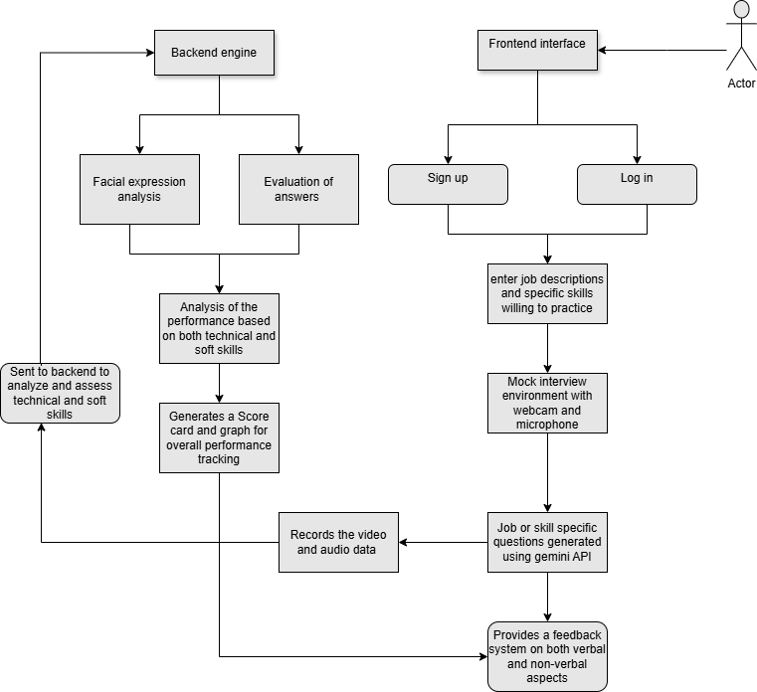

Flow chart
The proposed system utilizes Gemini APIs to generate up-to-date interview questions based on job descriptions and required skills, ensuring relevance across roles.
It analyzes multiple aspects of candidate behavior, including tone, posture, and facial expressions, to assess confidence levels.
The system provides automated interview results in the form of a scorecard, displaying the actual answers, candidate responses, and detailed feedback.
It highlights strengths and weaknesses in specific topics and presents progress tracking through graph analysis.
Job recommendation based on feedback.

Slide 8
Overall limitations of existing
Limited and Outdated Datasets: Many systems rely on outdated datasets, reducing the accuracy and relevance of the interview evaluation.
Scope Restricted to HR Rounds: Interview questions are often based on resumes, limiting the scope to HR-specific rounds and not covering technical or role-specific evaluations.
Focus on Non-Verbal Communication: Most systems primarily focus on facial expression analysis, neglecting deeper conversational aspects such as verbal content and context.
Tone-Centric Approaches: Some systems focus solely on tone analysis, providing an incomplete assessment of overall candidate performance.
Lack of Automation in Results : Automated generation of interview results.
Proctoring Gaps: Current systems may miss critical movements or activities that indicate malpractice, as they often inspect frames at intervals rather than continuously.

Slide 9
Advantages of proposed system
Up-to-Date Question Generation: Utilizes Gemini APIs to generate relevant and updated interview questions based on job descriptions and skills.
Interview Customization: Dynamically designs interviews based on the job role and candidate’s skills, ensuring relevance and precision in the assessment.
Holistic Evaluation: Combines verbal and non-verbal analysis for a more accurate and thorough evaluation of candidates' overall performance.
Automated Result Generation: Provides a detailed scorecard, including actual answers, candidate responses, feedback, and strengths and weaknesses analysis.
Real-Time Feedback and Progress Tracking: Provides instant feedback on interview performance, helping candidates identify areas for improvement, while offering graphical analysis and monitoring of performance progress over time.
Identifying Weak Areas to Improve.

Slide 10
Methodology
Next.js: interactive frontend interface to gather job descriptions and skills.
React: handles media permissions and streams from the webcam and microphone.
Gemini API (Generative AI): For generating relevant interview questions based on the provided job description and skills.
Drizzle ORM: Query Builder
Google Speech-to-Text: To convert spoken words into text for analysis.
OpenCV: To analyze confidence level during the interview.
Model Training:
Scikit-Learn, TensorFlow, PyTorch: For training models to evaluate candidate responses, sentiment analysis, or scoring.
Data: Training on a dataset of interview questions, responses, and evaluation criteria.

Slide 11
Methodology
LSTM, RNN, Transformers: For understanding the context and intent behind answers, or for complex scoring algorithms
Frameworks:
Node.js, Django, Flask: For handling API requests, storing interview data, and integrating various services.
Databases: SQL (MySQL, PostgreSQL) or NoSQL (MongoDB) for storing questions, responses, and scoring data.
D3.js or Chart.js: To create line plots or other charts that visualize this progress over time.
NLP (Sentiment Analysis): To evaluate feedback and responses, identifying trends and areas for growth.

Slide 12
Datasets
1) Why We Chose Gemini API for This Project
Real-Time Interview Questions: Ensures that questions are up-to-date and relevant to industry standards, providing a realistic interview experience.
Scalable Data Access: Supports high-volume data access without overwhelming local resources, keeping the project scalable as demand grows.
Optimized Data Usage: The API allows us to filter questions by topics, difficulty levels, and other criteria, focusing on specific skills and competencies.
Continuous Updates: Relieves us from the manual maintenance of a static dataset, as Gemini API keeps questions updated, consistent, and accurate.
2) Dataset for Confidence assessment
Images: 4754 JPEGs of 21 Indian candidates in interviews.
Label: Confidence (1 = confident, 0 = unconfident).
Features: Face direction, expressions, eye movement.
Use Cases: Face recognition, emotion detection, pose estimation.
Diversity: Varied lighting, backgrounds, ages, genders.

Slide 13
Problem Statement
Existing interview assessment systems lack real-time, comprehensive candidate evaluations and continuous proctoring to prevent malpractice. Our proposed AI-driven solution bridges these gaps by delivering adaptive interview formats, tailored feedback, and enhanced integrity in the evaluation process.

Slide 14
Thank You

