Slide 1
Webpage

Slide 2

Home
Home
Our Interests
Careers
Contact Us
Customer
Excellence
Innovation
We are a rapidly growing product and technology solutions company driven by our Customer’s Journey to be future ready.
We are an Product and Software services company headquartered in Bangalore, India.
We consistently deliver innovative and agile digital experiences to businesses.
Our key strengths are our people, driven by our core values of innovation, technical agility, operational excellence, engineering expertise, and quality focus.
.

Slide 3
Our Interests
Home
Our Interests
Careers
Contact Us
Product Development
HomeSpoon : Platform to facilitate quality home cooked food to patrons
DocFoster : Online clinic for remote medicine solutions
Technology Consulting
IOT : Integrating devices and software to deliver smart solutions
Data Analytics : Adding sense to data
Application Development
Mobile & Web : Seamless applications for everyday needs
Full Stack Development : Interactive Frontend & Robust Backend
Software Solutions : Customized software solution and product development
Managed Services
Application Maintenance :
QA & Testing :

Slide 4
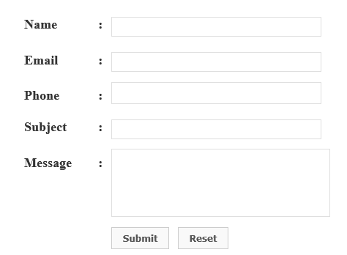
Careers
Home
Our Interests
Careers
Contact Us
If you have the fire we have the fuel: Lets Crank it UP!!!
Upload resume: Browse Button

Slide 5
Contact Us
Home
Our Interests
Careers
Contact Us
Let's connect and get things SIMPLIFIED

