Slide 1
RFID Based Bi-Directional Visitor Counter and Visitor Monitoring
Microprocessor and Microcontroller Practice Project
Ranadeep - EDM18B046
Praneeth - EVD18I021
Indra - ESD18I003

Slide 2
Abstract :
Our project is about designing a bi-directional visitor counter and visitor monitoring with radio frequency identification(RFID) based mechanism especially for shopping complex where we place a RFID tag on the assets/objects like trollies which are carried by the customers and mandatory for shopping and a RFID reader which is placed inside the shopping complex. With the tag on the trolly the reader keep on tracking the visitors path.
Novelty :
Many visitor counter systems use IR sensors for keeping the count of the visitors but this can’t make us to analyze the data. Since the RFID mechanism is best useful method for inexpensive nearby object tracing and tracking therefore we are using RFID mechanism in our project.
Objective :
The objective of this project is to keep a count and analyzing the data from the visitors with their path* like in a particular period of time on a day which items are most or least attracted by the people and which items are more or less on sale, where there is forming a large crowd. With this data the managers can make a better idea on sales and also increase the sales by keeping the offers on the attracted items and moving the items closer to the entrance which are more on sale and creating the space at the crowded items.
*Proximity sensors help will be taken for verifying the asset’s/visitors presence.

Slide 3
Research Paper - 1
Title :- The RFID Technology.
Author :- Davinder Parkash Chechi, Chandigarh University, Department of Electronics and Communication Engineering.
RFID tags are small objects that contain a chip and an antenna for wireless identification of the objects they are attached to (or embedded in) with the help of an RFID reader. Unlike barcode technology, RFID tags do not require line of sight from the tag to the reader and support read/write functionality. This is an Automatic identification (Auto-ID) technology by which any object can be identified automatically. RFID technology use automatic data capture system which helps in increasing system efficiency. Combination of tag and reader is used for identification purpose. A code is stored in RFID tag and this tag is attached to a physical object. Now object becomes unique identifiable. Then object transmit code from tag. In this way reader gets information about object. RFID offers much advantage over traditional identification device like barcode. To read the barcode, the barcode scanner needs to be in line of sight with the label. It means that the manual movement of the objects or scanner is necessary .RFID, on the other hand can read data from tag without line of sight. Also no alignment is necessary in RFID technology.
RFID Components :- A combination of RFID technology and computing technology is called RFID system. An RFID system consists of following components : 1. Tag/Transponder (electronic label). 2. Antenna (medium for tag reading). 3. Reader /Interrogator (read tag information). 4. Communication infrastructure (enable reader/RFID to work through IT infrastructure). 5. Application software (user database/application/ interface).
Link :- Research paper - 1 [International journal of Electronics, Communication and Instrumentation Engineering Vol.2, 2012, 109 - 120]

Slide 4
Research Paper - 2
Title :- RFID Based Centralized Patient Monitoring System Tracking.
Author :- Dr. S. Padmapriya M.E, PhD (Guide), 1 Indu Goel, 2 A.Sunitha, 3 P.Arul, Prathyusha Institute of Technology and Management.
This research paper is deals with RFID based patient monitoring system where the hospital administration keeps the record on patients by placing an RFID tag on them when they are admitted in the hospital and they are kept tracing at the medicines, beverages, food and at all upto discharging of the patients. With the help of GSM module installed in this system it sends the updates to registered caretakers and relatives. With the increasing population it has become important that the details of the patient are maintained in a proper manner. Sometimes it becomes impossible for the patient himself to remember the treatments underwent by him and proper details to be conveyed. According to the recent World Health Organization’s (WHO) publication regarding Patient safety, tens of millions i.e. roughly 1.4 million people around the world are injured or dead every year as a result of incorrect medical care.
Some of medical errors arise due to :-
Miscommunication
Physician order Transcription errors
Incomplete Patient Medical Records
Overcrowded Situation.
Components :-
RFID system
Microcontroller
GSM module
Link :- Research paper - 2 [IOSR Journal of Computer Engineering Vol.16, 2014, 8-15]

Slide 5
Research Paper - 3
Title :- RFID Based Tracking System
Author :- Prof. Gaurav G. Narkhede, MIT COE Pune, Electronics and Telecommunications Engineering.
RFID technology is an automatic identification technology that uses radio frequency signal(EM waves) to identify, track, locate, sort and detect variety of objects including people, vehicles, goods and assets.This technology can be used to track movement of assets through network of ideally placed radio frequency enabled scanning devices in a confined area.
Passive RFID tags have been used for this process, they have certainly less distance as compared of active RFID tags but in view of cost analysis using passive is the ideal case. A ultra high frequency(UHF) antenna is to be used maintaining good range of frequency, gain and polarization. Python platform is used for integrating the UHF RFID reader or antenna and in this section the data is read and verified from the database and uploaded to the server. The proposed system makes use of RFID technology to track the location of staff members and their respective laptops or instruments of any large organisation systematically. The tag information of the tags in the wireless range of reader gets stored in the server database. This indoor tracking system is based on the detection of a passive tag attached to an asset. Strong Security of the Confidential data and valuable assets of the organization are achievable within simple Asset tracking system design which uses RFID technology.
Components :-
A passive RFID transponder, UHF RFID reader, ADC converter, Raspberry Pi.
Link:- Research Paper - 3 [International Journal of Advanced Research in Computer and Communication Engineering Vol.6, 2017]

Slide 6
Plan
Our plan is to simulate this visitor monitoring in tinkercad if possible we will try to make hardware setup sample with one or two RFID tags. Since we need a range upto 15 meters our frequency of operation is ultra high frequency range (900-960MHz).
Components :-
Raspberry pi model 4 / Arduino Uno
RFID reader
RFID tags
Proximity sensor
Personal computer for analyzing data

Slide 7
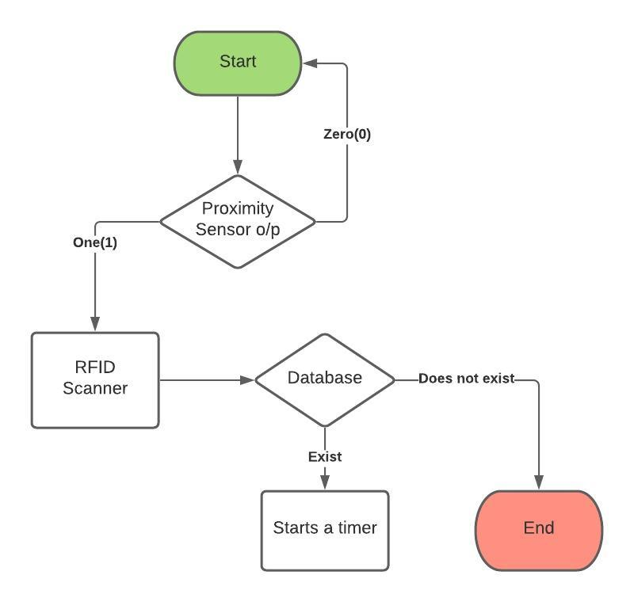
DESIGN:
Flowchart-1 (at entry and exit)

Slide 8
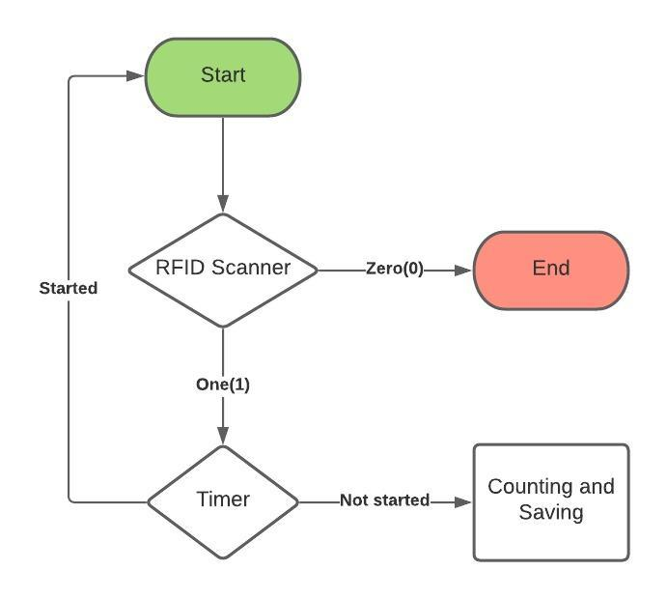
Flowchart-2 (Monitoring)

Slide 9
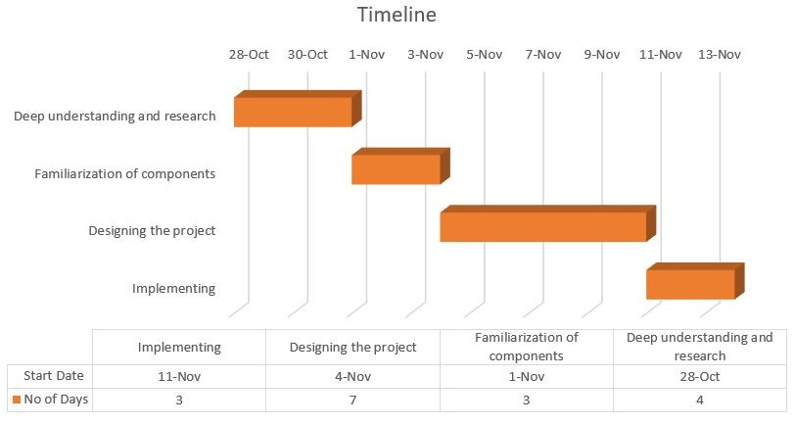
Timeline

Slide 10
THANK YOU

