Slide 1

Investigating the Influence of Social and Economic Factors on Student Dropout and Academic Achievement
Group 10
By: Rana Hamdan,Yashashri Kadam, Sree Sai Chitra Duvvapu

Slide 2


Table of contents
01
02
03
04
05
Introduction
Objective
EDA
Models
Conclusion

Slide 3


Introduction
Higher education institutions possess vast student data, offering opportunities for insights, knowledge enrichment, and efficient monitoring.
Academic success in higher education drives societal advancement, job creation, and economic growth. However, dropout rates and setbacks hinder these goals, affecting students, families, institutions, and society.
Addressing these challenges demands a thorough analysis of dropout trends and factors, including the influence of social and economic variables on student attrition.
Notes:
Higher education institutions hold extensive student data, providing ample opportunities for generating insights, enriching knowledge, and facilitating efficient monitoring. Academic achievement in higher education plays a pivotal role in advancing society, creating employment opportunities, and fostering economic prosperity. Yet, dropout rates and educational setbacks pose significant challenges to these goals, posing direct impacts on students, families, institutions, and broader society. Effectively addressing these challenges requires a comprehensive examination of dropout trends and the various factors contributing to them. This entails an investigation into the impact of social and economic variables on student dropout.

Slide 4
Data
Dataset :
This dataset provides a comprehensive view of students enrolled in various undergraduate degrees offered at a higher education institution
https://www.kaggle.com/datasets/thedevastator/higher-education-predictors-of-student-retention/data
4424 records and 35 variables :
Marital_status, Application_mode, Application_order, Course,Daytime_evening_attendance Previous_qualification, Nationality, Mother_qualification, Father_qualification, Mother_occupation, Father_occupation, Displaced, Educational_special_needs, Debtor,Tuition_fees_are_up_to_date, Gender, Scholarship_holder, Age_at_enrollment, International, (Curri_units_1st_sem_credited, enrolled, evaluations, approved, grade, woeval), (Curri_units_2nd_sem_credited,enrolled,evaluations,approved,grade,woeval), Unemployment_rate,Inflation_rate,GDP, Education_Status.
•Data cleaning/validation
Notes:
The dataset provides a comprehensive view of students enrolled in various undergraduate degrees offered at a higher education institution. It includes demographic data, socioeconomic factors, and academic performance information that can be used to analyze the possible predictors of student dropout and academic success. This data includes overall student performance at the end of each semester by assessing curricular units credited/enrolled/evaluated/approved as well as their grades. Finally, we have the unemployment rate, inflation rate, and GDP from the region which can help us further understand how economic factors play a role into student dropout rates or academic success outcomes. This powerful analysis tool will provide valuable insight into what motivates students to stay in school or abandon their studies for a wide range of disciplines such as design, education nursing journalism management social service, or technologies.
The dataset contains student records from the academic years 2008/2009 to 2018/2019 across 17 undergraduate degrees in diverse fields. It contains 4424 records with 35 attributes
The dataset contains no missing values. Several variable names contained spaces, requiring modification to function properly in SAS. Additionally, certain categorical variables exhibited numerous levels, with some reaching up to 35 levels. After assessing the frequency of these levels, these adjustments were implemented:
Marital status was consolidated from 6 levels to 3 (Single (1), Married (2) other (3)), while Nationality was streamlined from 22 levels to 2(Portuguese, NON Portuguese) Application mode transformed 18 levels to 3, and the course variable was condensed from 17 levels to 5. Previous qualifications were simplified from 17 to 2 levels, and both mothers' and fathers' qualifications were streamlined from 29 and 35 levels to 3, respectively. Mother and father occupations were also streamlined from 46 and 32 levels to 3 each.

Slide 5
Objective
Understand the relation between the variables and the target variables
Analyze and find best model to predict the educational status
(dropout or non-dropout)
Analyze and find the important variables for the target variables

Slide 6
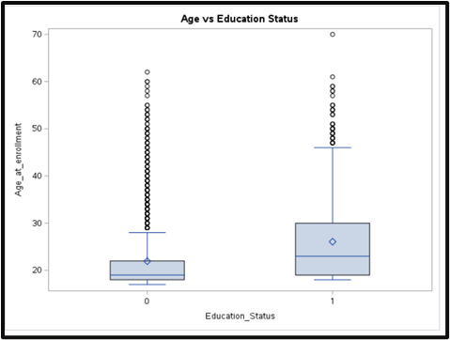
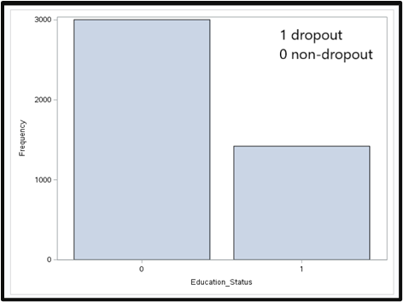
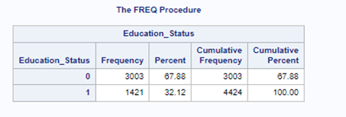
EDA
Notes:
The outcome variable, Education_Status, is a binary variable: 1 indicating dropout and 0 indicating non-dropout. The two classes show some imbalance. The non-dropout category, constituting 67.88% of the dataset, encompasses 3003 records out of 4424. Conversely, the dropout category represents 32% of the total records, with 1421 instances out of 4424.
The average age of dropout students (26.07) exceeds that of non-dropout students (21.07). Additionally, there is greater variability in age among dropout students compared to non-dropout students. Both distributions are positively skewed and exhibit numerous outliers. In the case of non-dropout students, ages above 30 are considered outliers, whereas for dropout students, the threshold is approximately 45.

Slide 7
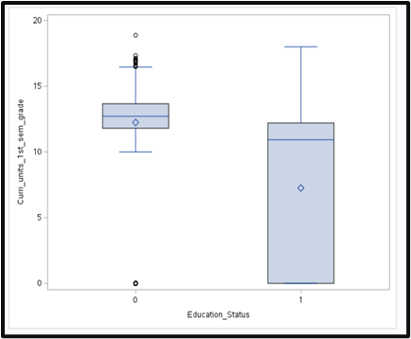
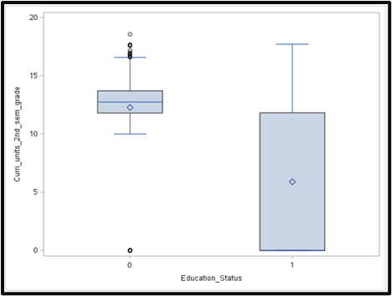
EDA Cont.
Notes:
The grades for dropout students seem to have more variability than non-dropout student.The grades for non-dropout have higher averages. There are a lot of outliers for non-dropout. Drop out student's grades have clear negative skewness while non-dropout seems more symmetrical.

Slide 8
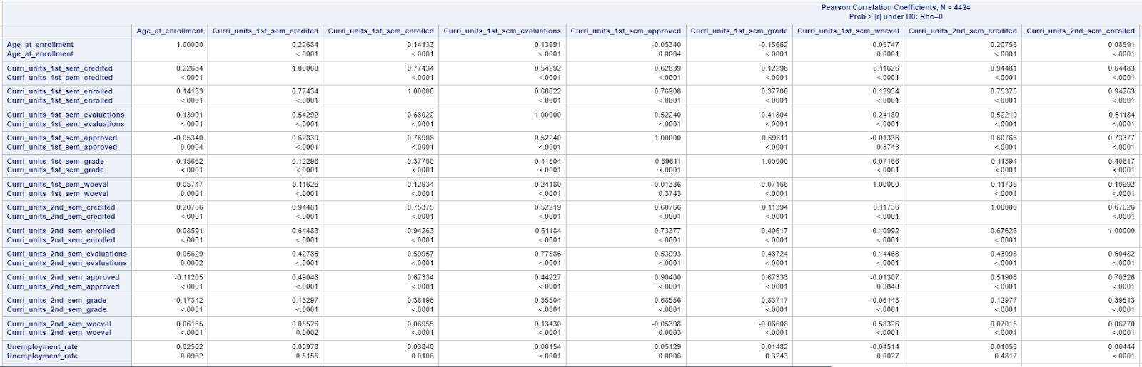
Correlation Matrix
Notes:
From the correlation matrix for identifying the correlation between the numerical variables which are 16 variables we could see there is a strong relationship between some of the variables:
Curricular units 1st sem (credited) and Curricular units 2nd sem (credited) (0.9448).
Curricular units 1st sem (enrolled) and Curricular units 2nd sem (enrolled) (0.9426).
Curricular units 1st sem (approved) and Curricular units 2nd sem (approved) (0.9040).

Slide 9
Model Selection - Education status Analysis
CART
Neural Network
Logistic regression
Notes:
Our target variable, 'Education_status', is categorical with two classes, representing the student's education status as either 'dropout' or 'not dropout'. Therefore, we approach this as a classification problem. We applied three models to our dataset to determine the best approach. We noticed that there are 6 variables in our dataset, were correlated but these variables showed as variable importance as important for models. We divided our dataset into an 80% training set and a 20% validation set for all the three models which we subdivided. We have a dataset with 67% of the data showing a status of 'not dropout', while 33% showed a status of 'dropout'.

Slide 10
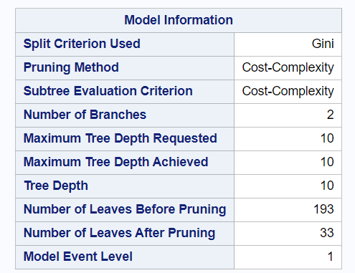
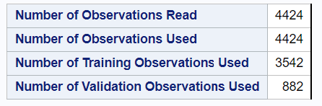
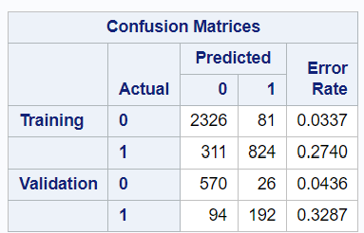
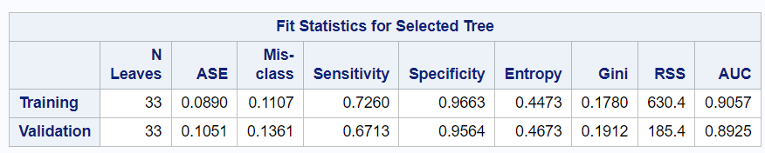
CART Model / Gini
Notes:
We began with the CART model, and we applied GINI measures for models with all variables. We found that GINI performed better, resulting in 33 leaves after pruning, with a good AUC and specificity and a moderate sensitivity. As well as there is increased in misclassification rate on validation set but it is not that significant so can say that there is no overfitting in the model.

Slide 11
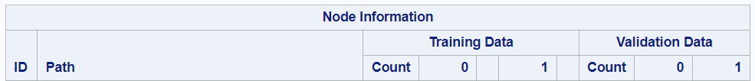
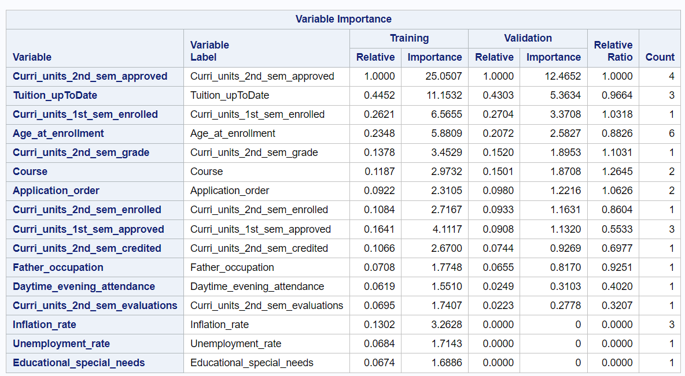
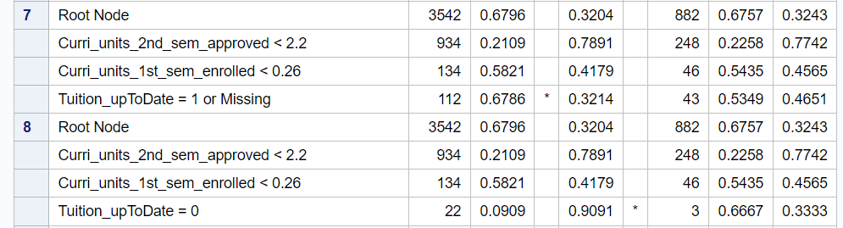
CART Model
Notes:
When interpreting the nodes information for node 7, if all conditions are true then there are 67% chances that student classified as non-dropout but if you see node 8 and all conditions are true then there are 90% chances that student is dropout as his education status.
We are using this variable importance from CART model to another CART model and NN model excluding last 3 variables.

Slide 12
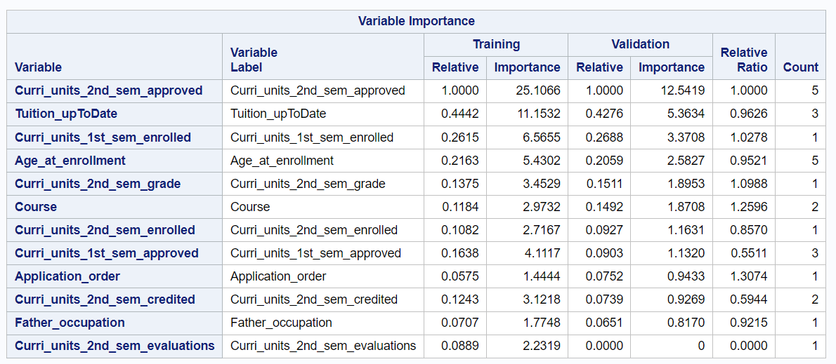
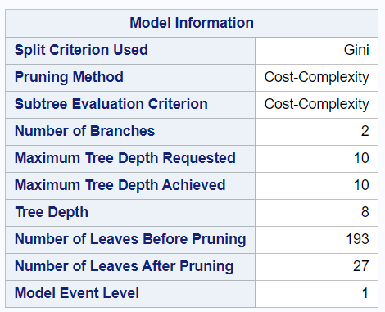
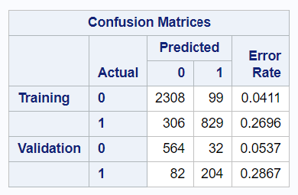
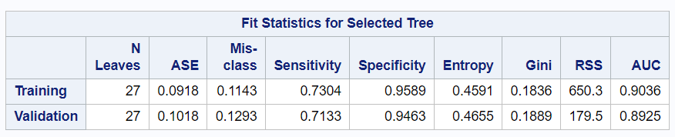
CART / Gini using Variable Importance
Notes:
In this model, the number of leaves after pruning decreases to 27 from 193. If we consider the performance of the model then it slightly improved as compared to previous model with drop in misclassification rate on validation set.

Slide 13
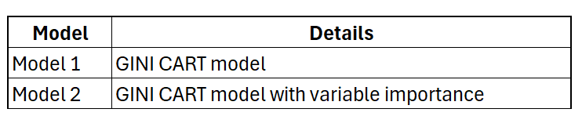
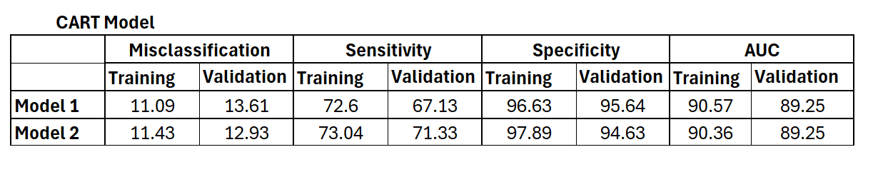
CART / Gini Results
Notes:
From this results we can conclude that GINI with variable importance and according to parsimonious, model 2 is good prediction model to find the results for dropout student from university. Both the model has almost same AUC results.

Slide 14
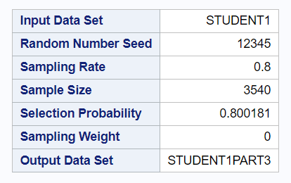
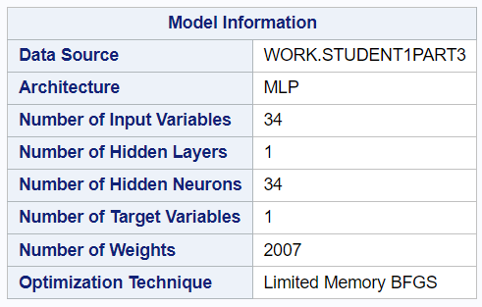
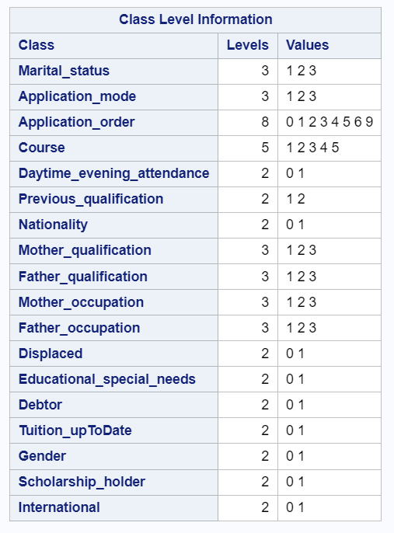
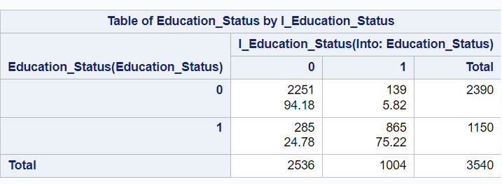
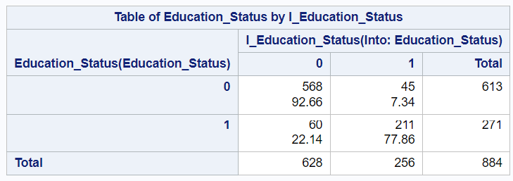
Neural Network - With all Variables

Slide 15
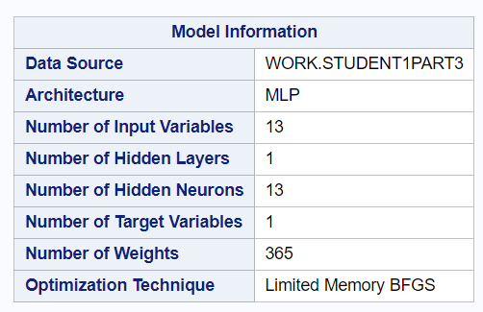
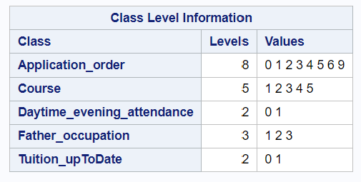
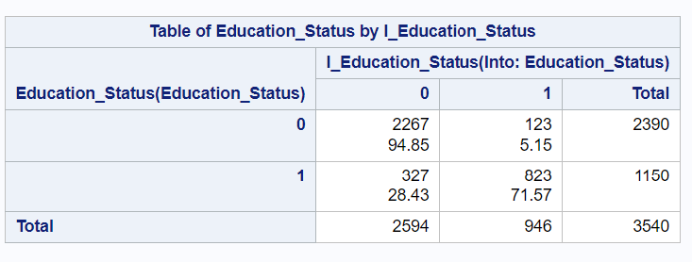
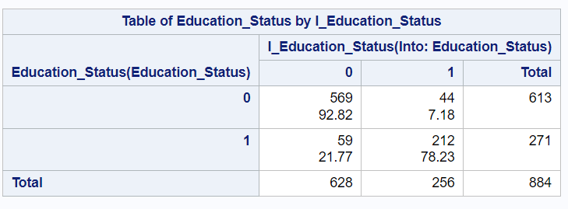
Neural Network with Variables Importance
Notes:
We used same variables which we used in CART variable importance model with 1 hidden layer and 13 neurons.

Slide 16
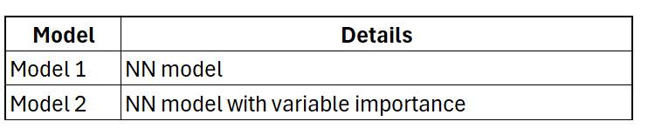
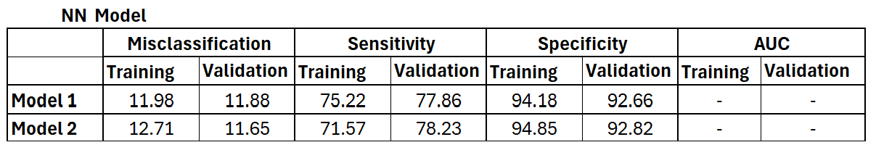
Neural Networks Results
Notes:
From this we can say that, model 2 is good model because it has less misclassified instances (i.e., incorrect predictions) as compared to model 1 on validation set. Sensitivity that is predicting who dropped out from university is higher on validation set in model 2. Specificity is also good in model 2.

Slide 17
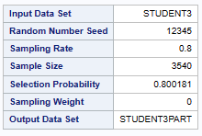
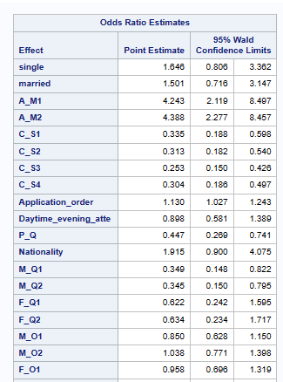
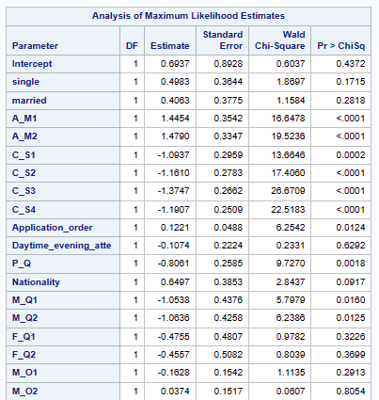
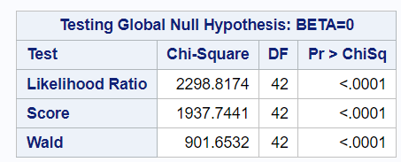
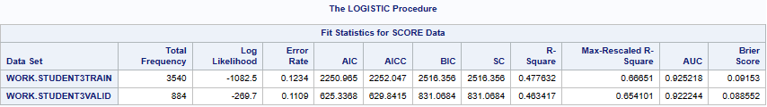
Logistic Regression Model Using All Variables
Notes:
Next model is logistic regression. Here again we used all variables. For evaluating logistic model we looked for Area under curve, Likelihood ratio and chi square test.
On the training set, the area under the curve (AUC) was 92.52%, which is considered good. On the validation set, the AUC slightly dropped to 92.22%, which is also considered good.

Slide 18
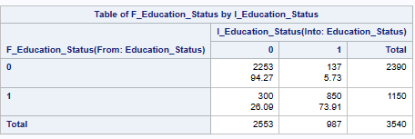

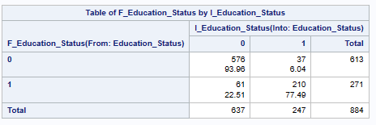

Logistic Regression Model cont.
Notes:
Specificity and sensitivity is also good for this model.
When interpreting the odds ratio estimate for the age variable, we could see that for every year increase in the the student age, the odds of their education status being dropped out from university increase by 4%.
If the student is a scholarship holder there is a 33 % chance less, that the student is going to drop out

Slide 19
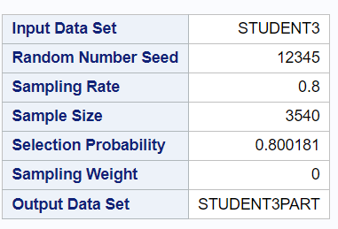
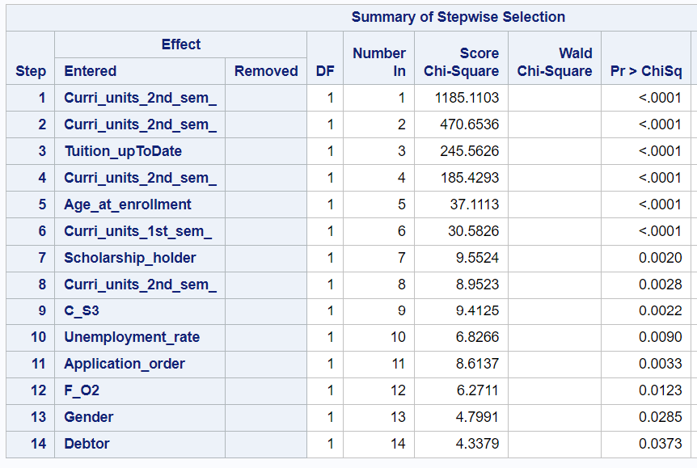
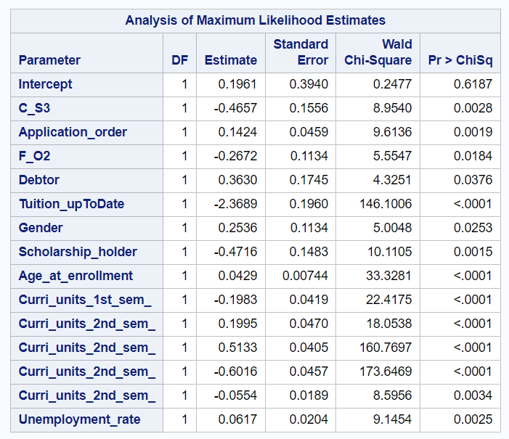
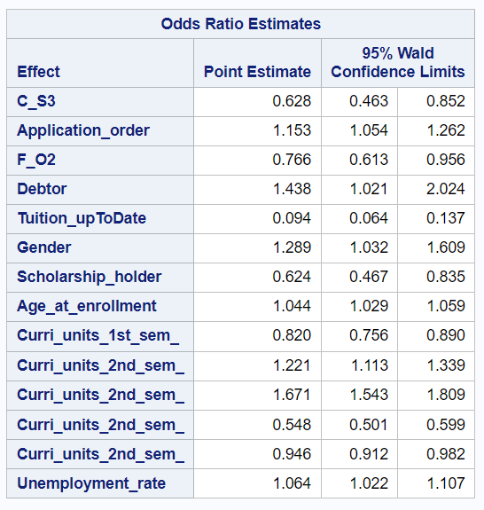
Logistic Regression Model Using Stepwise
Notes:
After applying stepwise section method we found following importance variables. This model used C_S3 and F_O2 to while building the model but we need to rebuild the model excluding those variable because it didn't take all dummy variables of those variables.

Slide 20
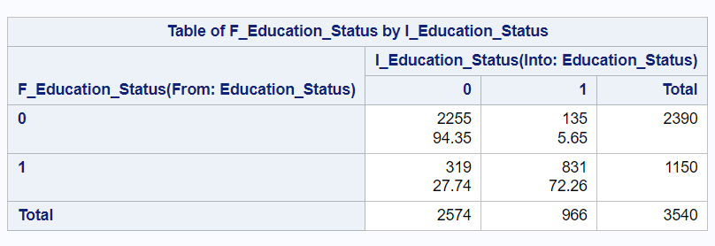
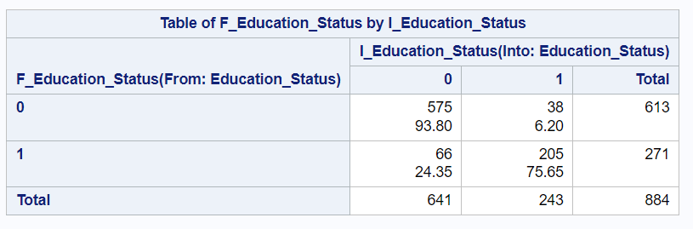
Logistic Regression Model cont.

Slide 21
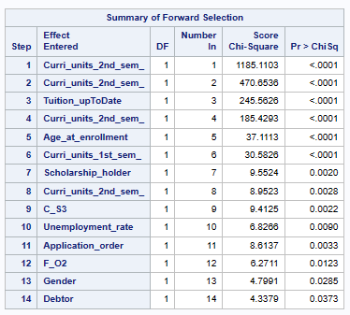
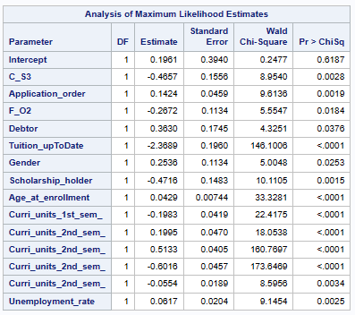
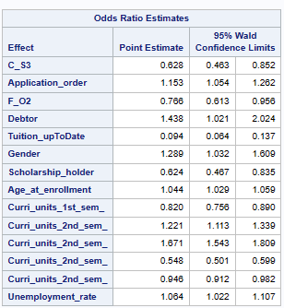
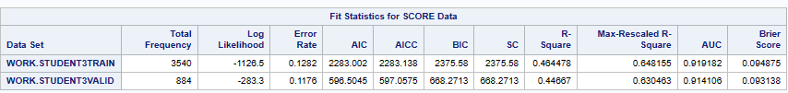
Logistic Regression Model Using Forward

Slide 22
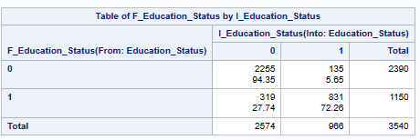
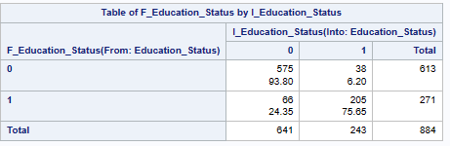
Logistic Regression Model cont.

Slide 23
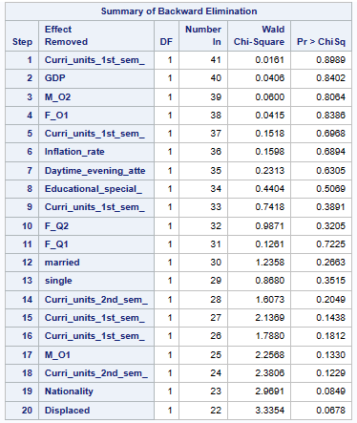


Logistic Regression Model Using Backward

Slide 24


Logistic Regression Model cont.

Slide 25


Logistic Regression Analysis -
Results
Notes:
From this we can say that, model 4 is good model because it has less error rate (i.e., incorrect predictions) as compared to other models on validation set. Sensitivity, specificity and AUC is also good for model 4 with less variables as compared to other models. So as per parsimonious model, we can say model 4 is best model in logistic regression.

Slide 26


Conclusion 1
Notes:
In conclusion summary, we prepared 2 conclusions.
In 1st conclusion we considered models with all variables. So, model 3 is showing good performance with less error rate, high sensitivity, specificity and AUC.

Slide 27


Conclusion 2
Notes:
By observing all the first 8 models and considering the performance metrics and parsimoniousness , we can conclude that model 8 has better performance in terms of less error rate, high sensitivity, high specificity and high AUC on validation set.But this model is not considering all dummy variables from father occupation, so we build new model with backward variable selection and removing father occupation variable. Finally we conclude that model 9 has shown better performance as the model is simple with less variables, low error rate,high sensitivity, specificity and AUC.
Imp Variables : Application_mode, Courses, application_order
previous_qualification, debtor, Tuition_uptodate, gender, scholarship_holder, international
age_at_enrollment Curri_units_1st_sem_approved Curri_units_2nd_sem_credited
Curri_units_2nd_sem_enrolled Curri_units_2nd_sem_evaluations
Unemployment_rate

Slide 28
Future Improvement
Increasing variables
Variables : transfer student, location, name of university, rank of school/university
Tracking their major history if any

Slide 30
Thanks
Questions?
Please keep this slide for attribution

