Slide 1

Determine best-fit topology for local network
Computer networks

Slide 2
Communication
Network
Switched
Broadcast
Communication
Communication
Network
Network
Circuit-switched Packet-Switched
Satellite
Packet Radio
Network
Network
Network
Network
Local
Network
Datagram
Virtual Circuit
Network
Network
2

Slide 3
Switched communication network
A communication network which uses switching for connection.
Circuit switched networks
Message switched networks
Packet switched networks

Slide 4
Circuit switching
A dedicated communications channel
Guarantees the full bandwidth of the channel
Remains connected for the duration of the communication session
The circuit functions as if the nodes were physically connected as with an electrical circuit.

Slide 5
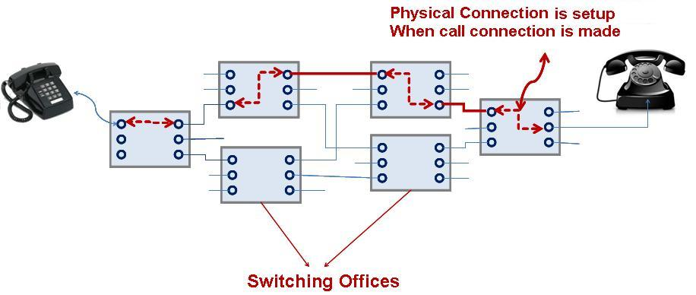
Circuit switching
e.g. early analog telephone network.

Slide 6
Integrated Services Digital Network (ISDN)
ISDN is the short form of Integrated Services Digital Network which was created as a communication standard for transmission of digital data, video, fax, etc along with voice signals over circuit switched PSTN (Public Switched Telephone Network) networks.
One ISDN line has a bandwidth carrying capacity of 128 Kbps and can carry two telephone calls (one in each channel) in the same line

Slide 7
Advantages of ISDN Lines
Voice quality (audio fidelity) is better than analog circuits
Can carry voice (calls), data (Internet), video (video conferencing) and fax information simultaneously
Can carry video communications in real time at both ends (128 Kbps both in the upstream and downstream)
It is a circuit switched network, so little or no data loss while transmitting data
Trouble-shooting is easier due to digital network and faults can be rectified faster
Network performance reliable and predictable
Suitable for remote Internet access
With ISDN, the call set and up tear down is faster than analog circuits
The latency is very less in Digital Circuits and hence it is suitable for transmitting latency sensitive applications like video, voice etc.
ISDN circuits can use a technique called ‘Channel Bonding’ to combine multiple lines and give a higher throughput.

Slide 8
packet switching
Divides the data to be transmitted into packets
Network links are shared by packets from multiple competing communication sessions
Resulting in the loss of the quality of service guarantees that are provided by circuit switching
E.g: X.25 and OSI model.

Slide 9
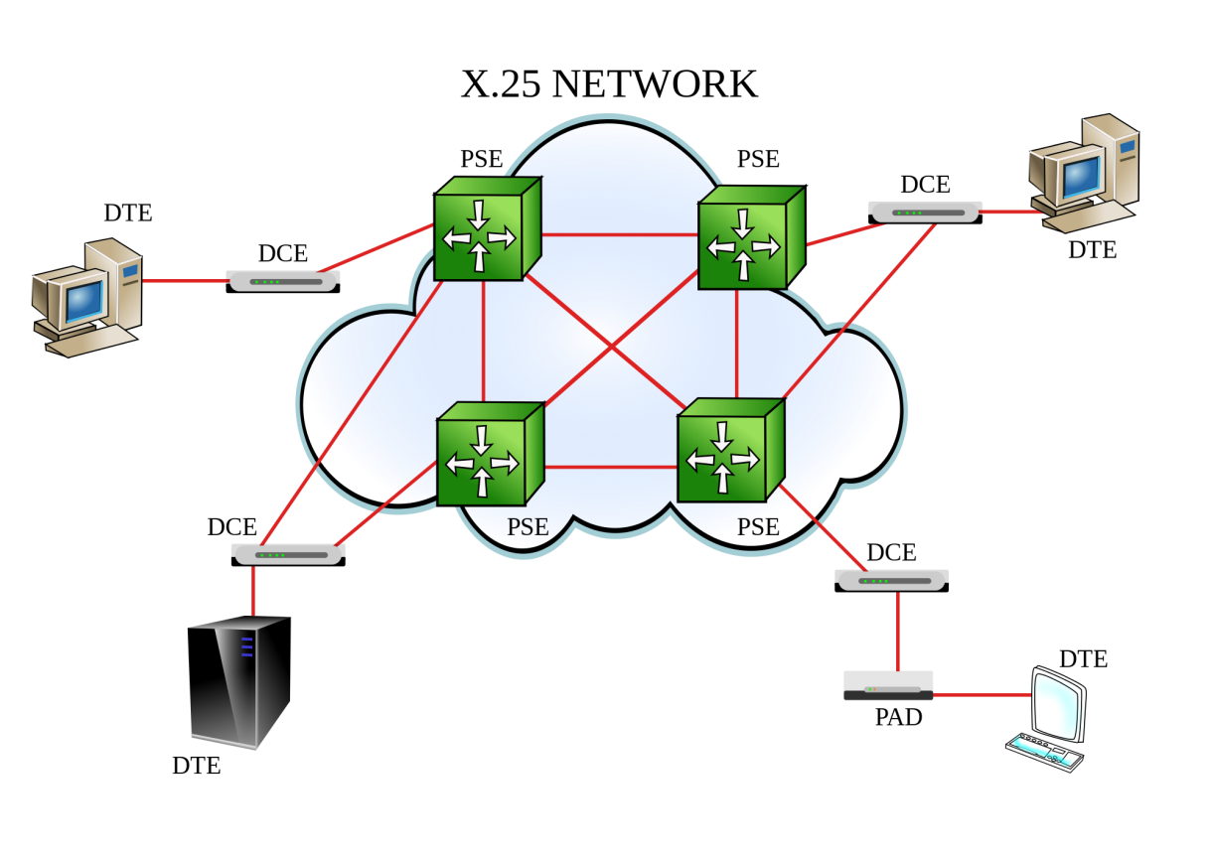
PSE: packet switching exchange
DCE: Data circuit-terminating equipment
DTE: Data terminal equipment

Slide 10
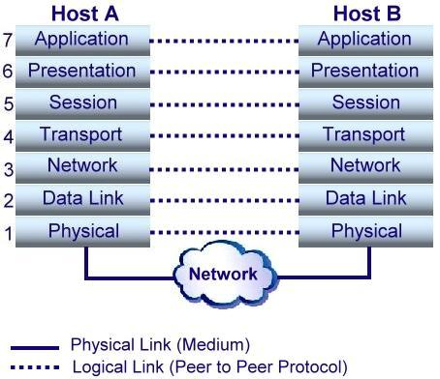
OSI reference model

