Slide 1


This is your presentation title
Rana khird

Slide 2
This is a slide title
design
data
Algorithms
Tools
communication

Slide 3
Roadmap
Cleaning data
researching
documentation
1
3
5
2
4
6
visualization
Model building
presentation

Slide 4
data

Slide 5
Desktop project
Netflix Movies and TV Shows About this Dataset: Netflix is one of the most popular media and video streaming platforms., it had many Subscribers globally.
This tabular dataset consists of listings of all the movies and tv shows available on Netflix, along with details such as - cast, directors, ratings, release year, duration, etc.

Slide 6
Recommendation system
Predicting Movie Genres

Slide 7
Visualization

Slide 8
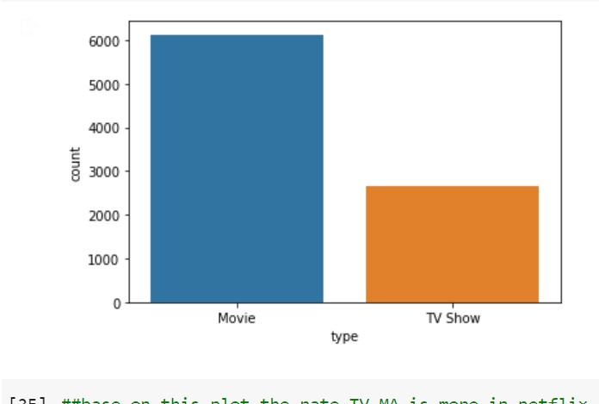
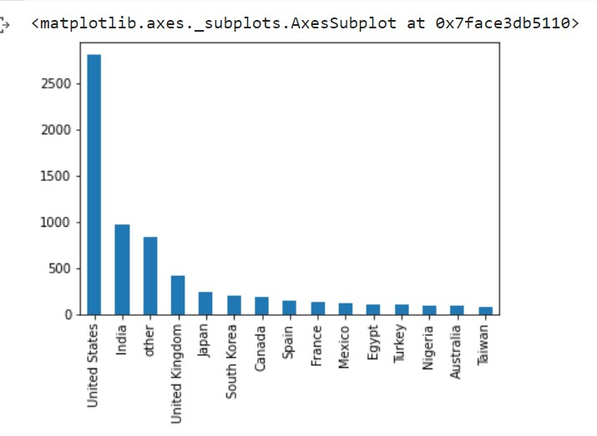
About this template
Visualization
Most type content
Countray with most content

Slide 9
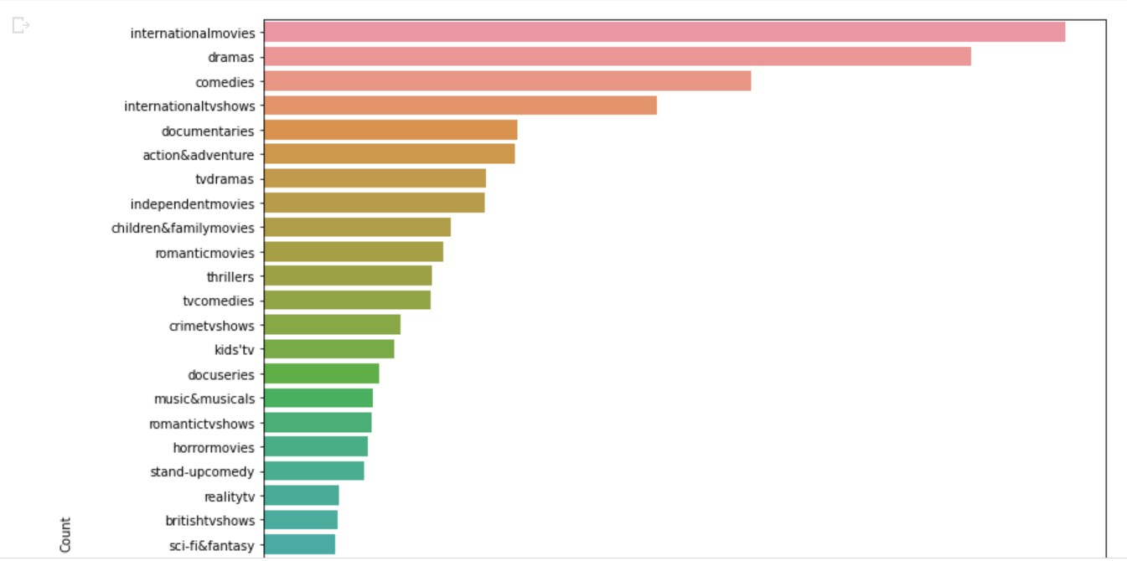
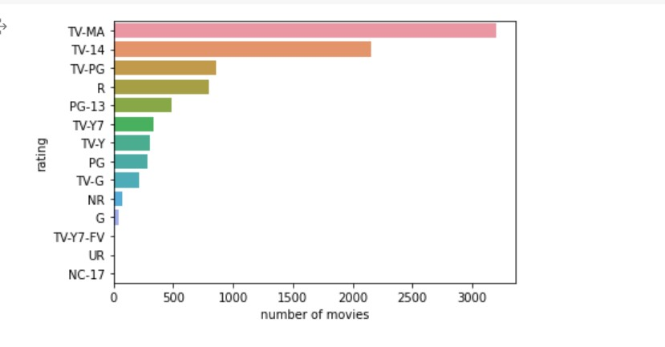
Visualization
The most preferred genre
The most preferred rating

Slide 10
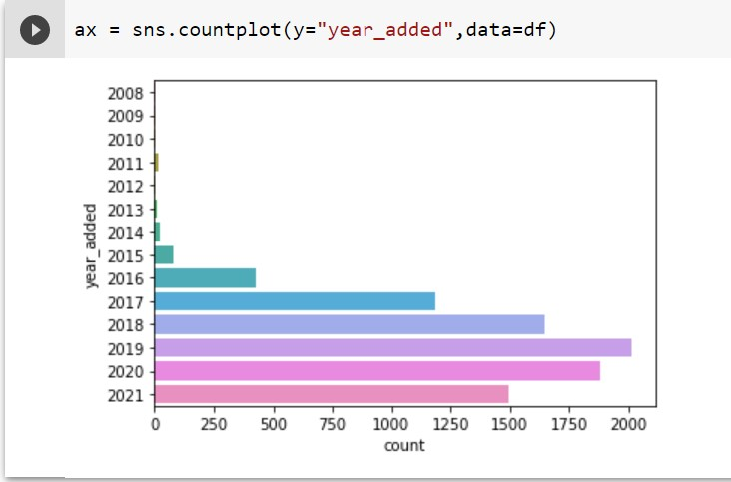
Visualization
The year that had a greater number of content released

Slide 11
Algorithms

Slide 12
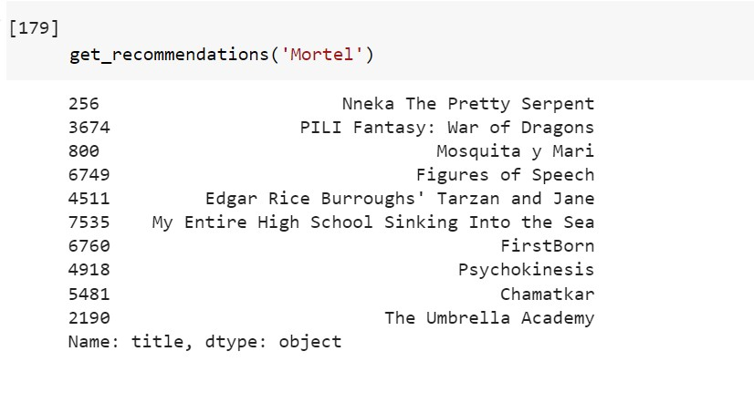
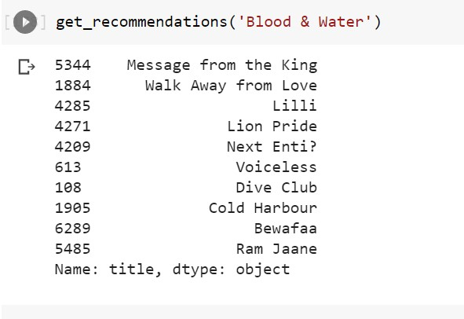
modeling

Slide 13
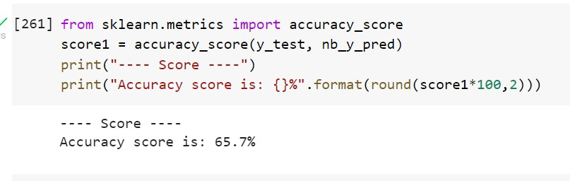
modeling

Slide 14
TOOLS
Data Processing: Pandas, Numpy
Modelling: sklearn
Visualization: Matplotlib, Seaborn

Slide 15
Thanks!
ANY QUESTIONS?

