Slide 1
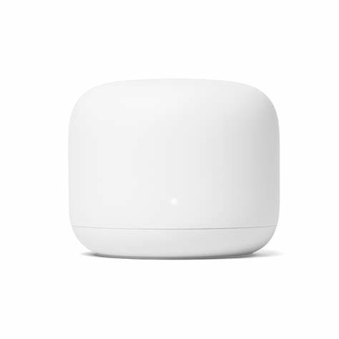
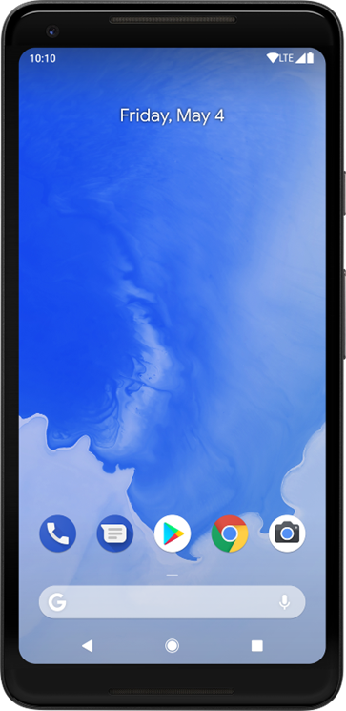
(Initiator)
(Responder)
Initial FTM request
ACK
FTM_1
t_{1_1}
t_{2_1}
1st FTM
Interchange
t_{3_1}
ACK
t_{4_1}
FTM_2
t_{1_2}
t_{2_2}
2nd FTM
Interchange
t_{3_2}
ACK
t_{4_2}
…

