Slide 1
Use Case: ViVE BI & Process Intelligence
Notes:
-

Slide 2

Project Overview
Goal: Implement entire BI & PI project lifecycle, culminating in building analytical reports and visualizations using ViVE.
Discuss ViVE uses for dataset
Plan, build, test and deploy phases
Demonstrate use of BI and PI dashboards in ViVE
Insights and Takeaways

Slide 3
Dataset: Purchase Order Handling Process
42
activities
75,000
purchase orders
250,000 items
1.5 million events
4 payment flows
van Dongen, B.F., Dataset BPI Challenge 2019. 4TU.Centre for Research Data. https://doi.org/10.4121/uuid:d06aff4b-79f0-45e6-8ec8-e19730c248f1

Slide 4
Payment Process Flows
Process | Invoice required | Payment based on goods receipt (instead of invoice) | Goods receipt required
3-way match after goods receipt | ✓ | ✓ | ✓
3-way match before goods receipt | ✓ |  | ✓
2-way match | ✓
Consignment |  | ✓ | ✓

Slide 5
Data Preparation and Process Flow
Build Cube
Test
Analyze
Clean
Build Schema
Visual Studio, SSAS
Multiple tools
ViVE Business Intelligence
SQL Server
Management Studio & Azure SQL Database
Python
Build
SQL Tables
Test
Analyze
SQL Server
Management Studio
ViVE Process Intelligence
Multiple tools

Slide 6
Business Intelligence v. Process Intelligence
What happened?
Business Intelligence
Which vendors were utilized most often?
Which purchased items represent the largest financial outlay?
Which payment flow is most commonly used?
Why did it happen?
Process Intelligence
What is the typical process flow?
How long does each process take on average? Minimum time? Maximum time?
At what stages are bottlenecks occurring?
What now?
BI + PI + Domain Info
Should specific items or vendors be placed in a different process?
Should a process be revised?
Can we remove some of the steps from a lengthy process?
Footer information

Slide 7
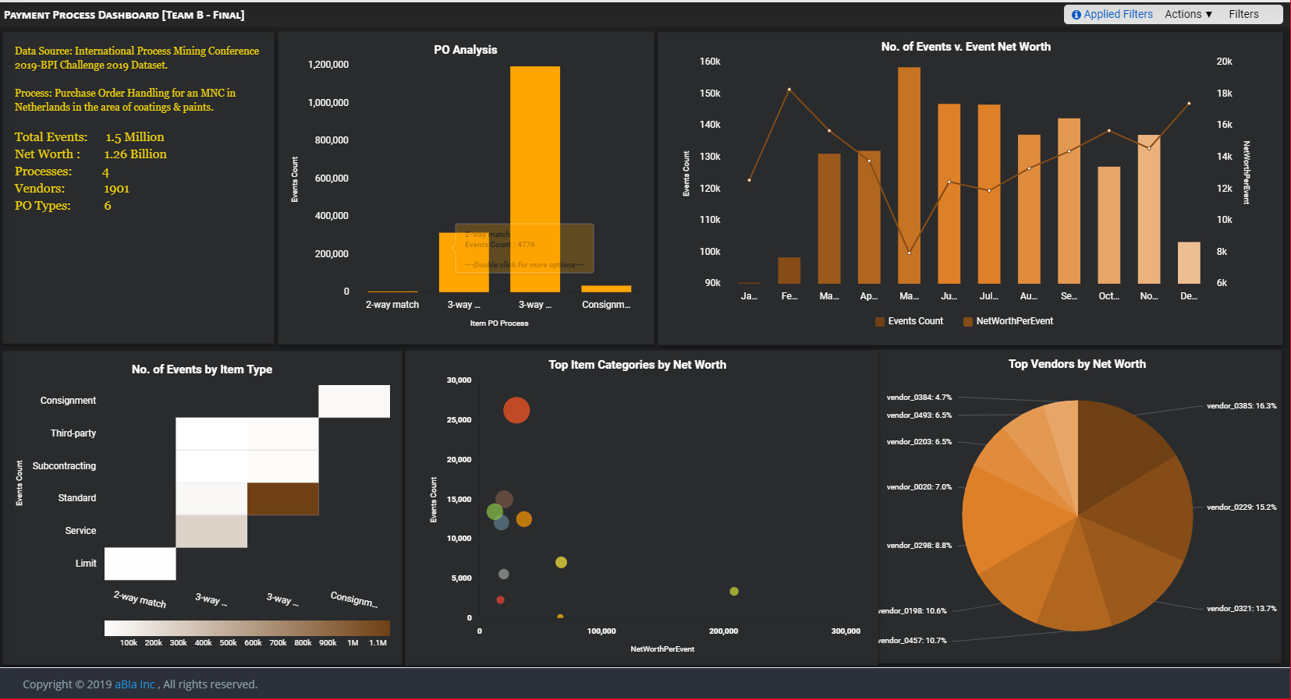

ViVE Demo

Slide 8

Insights
Maximum impact: Focus on 3-way match before goods receipt process or Latex & Monomers items
Start small: Focus on consignment process or Workforce Services items
Focus on data preparation and utilize domain knowledge
Consider business objectives when determining processes to examine

Slide 9
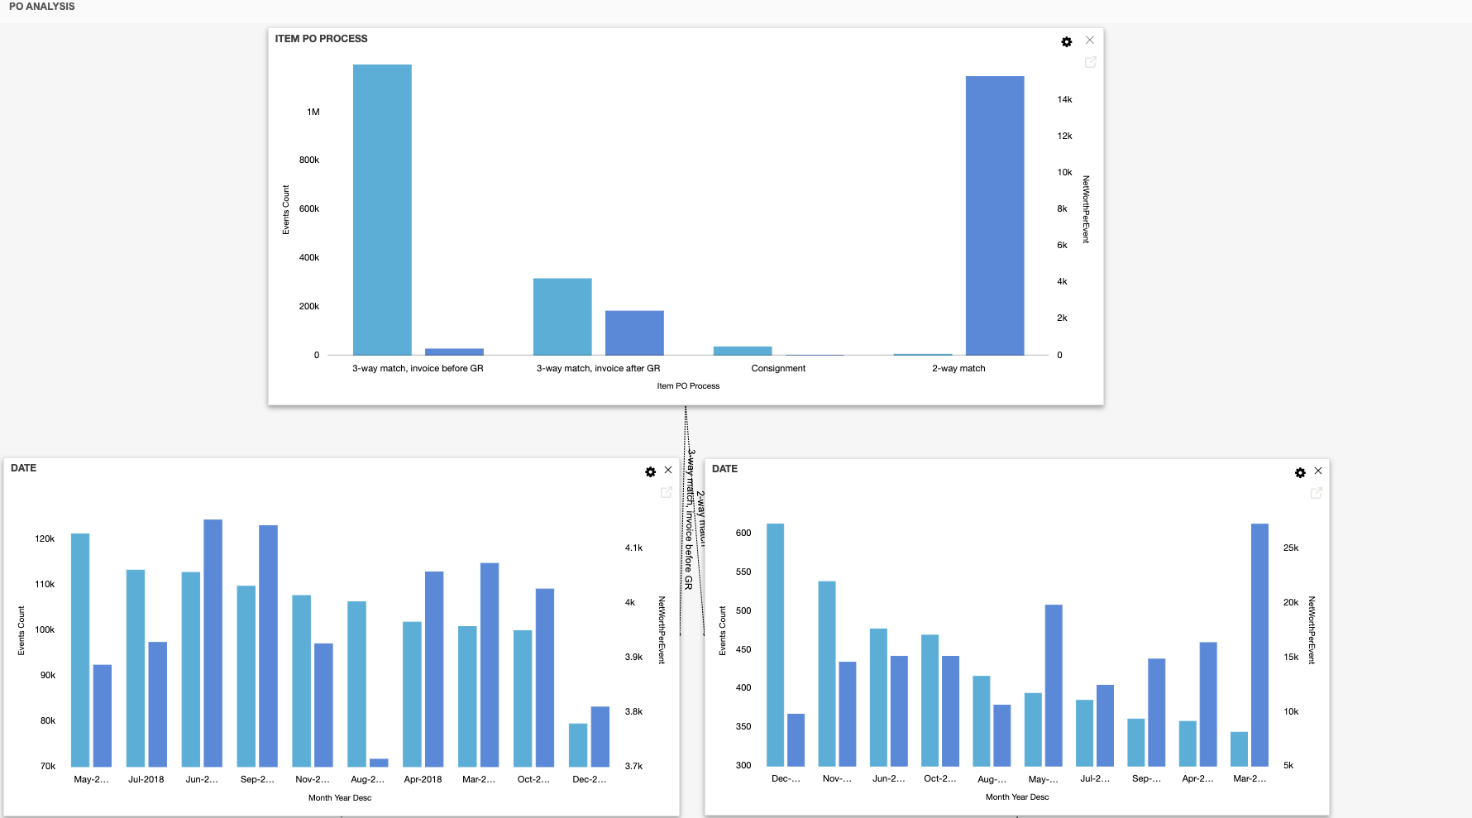
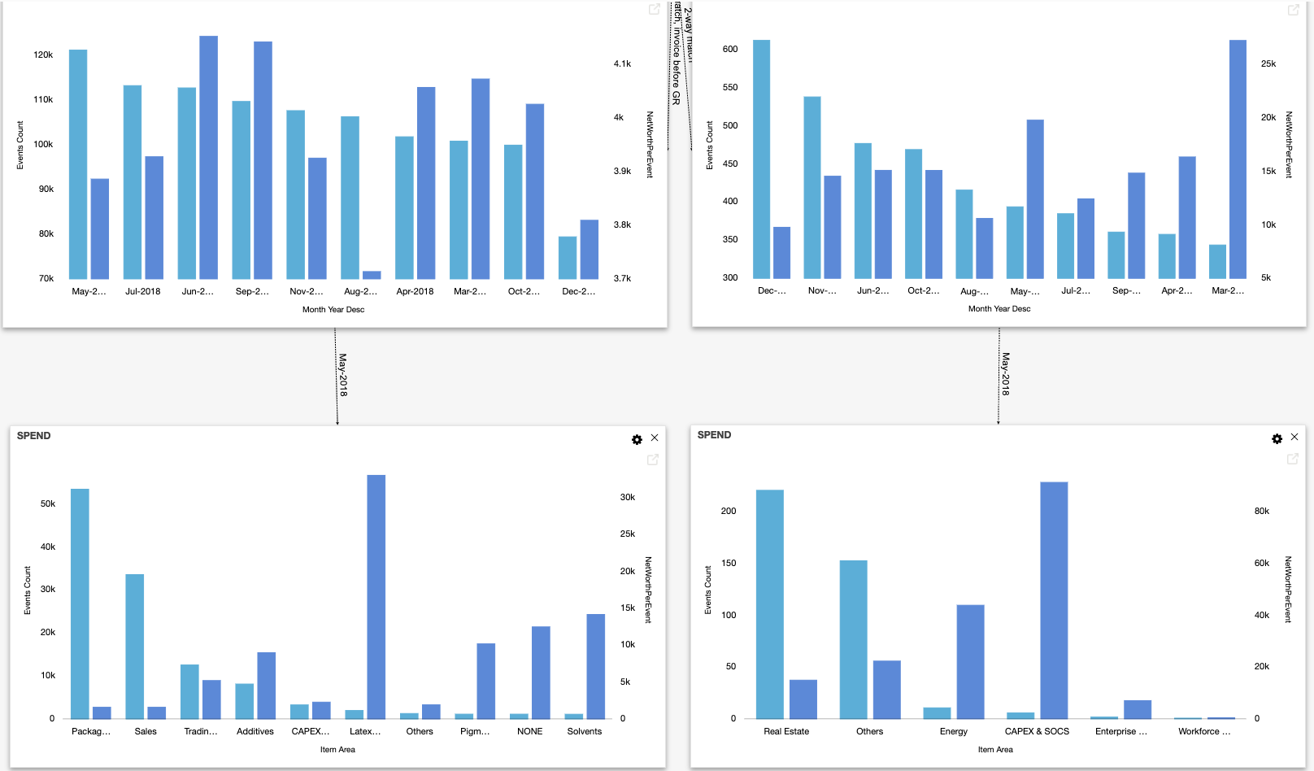

Slide 10
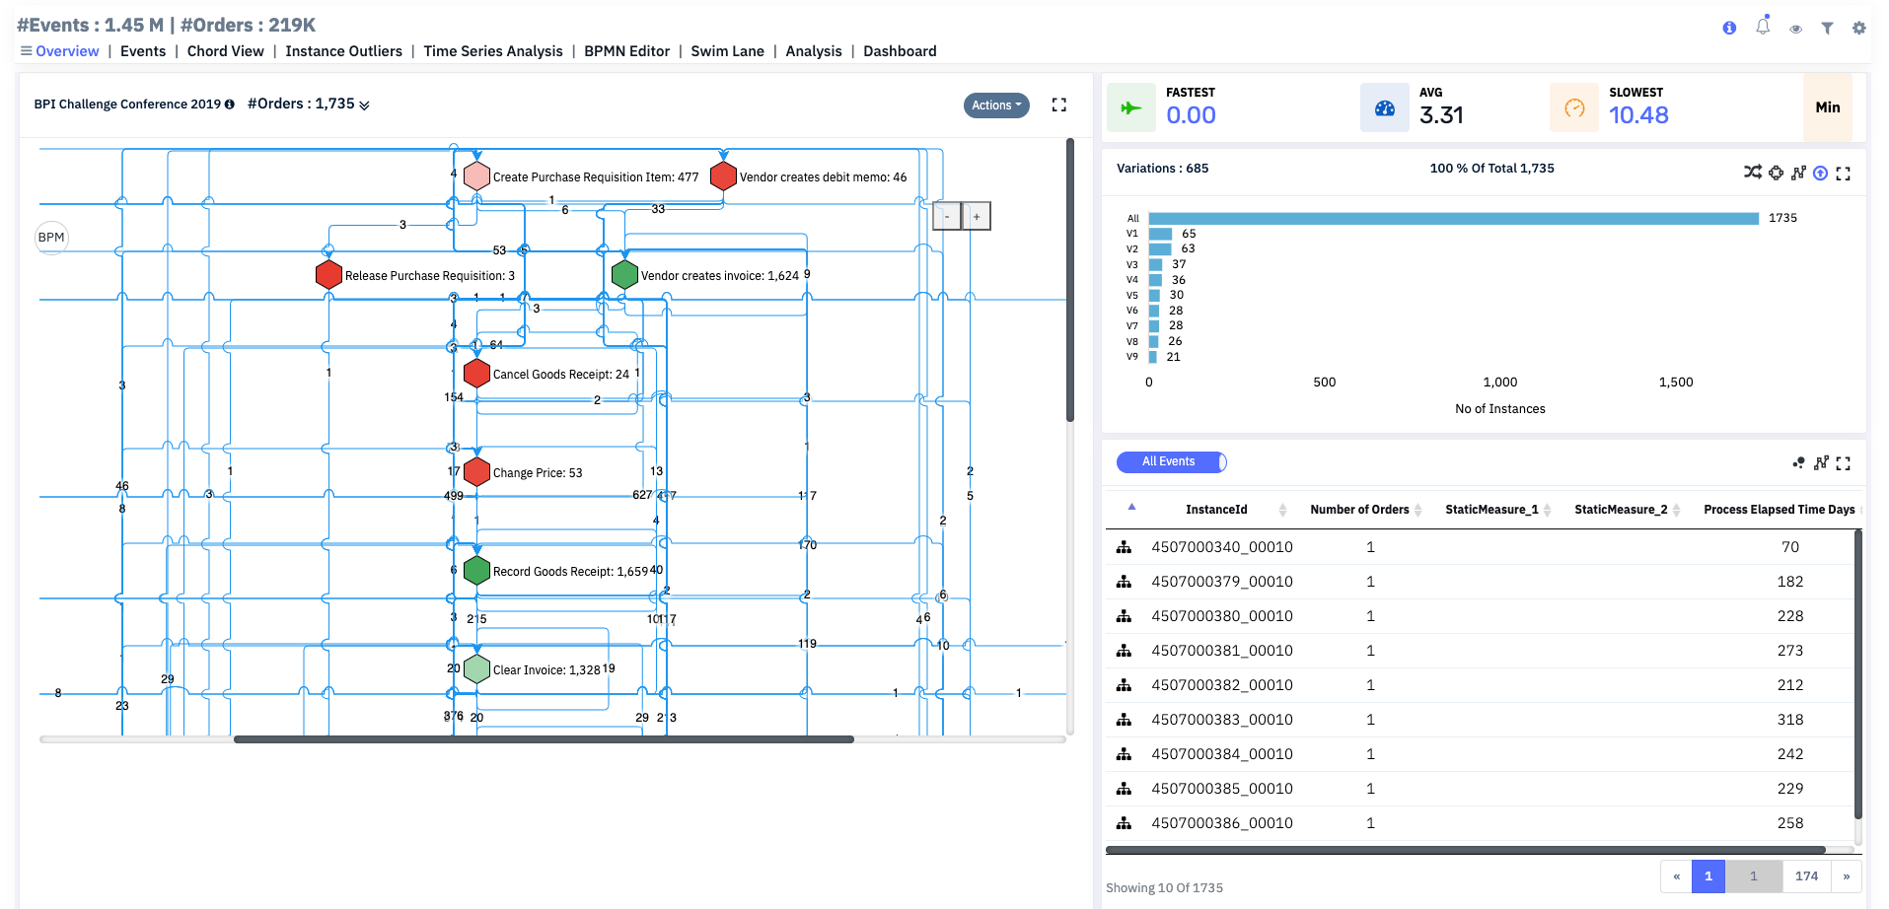

Slide 11
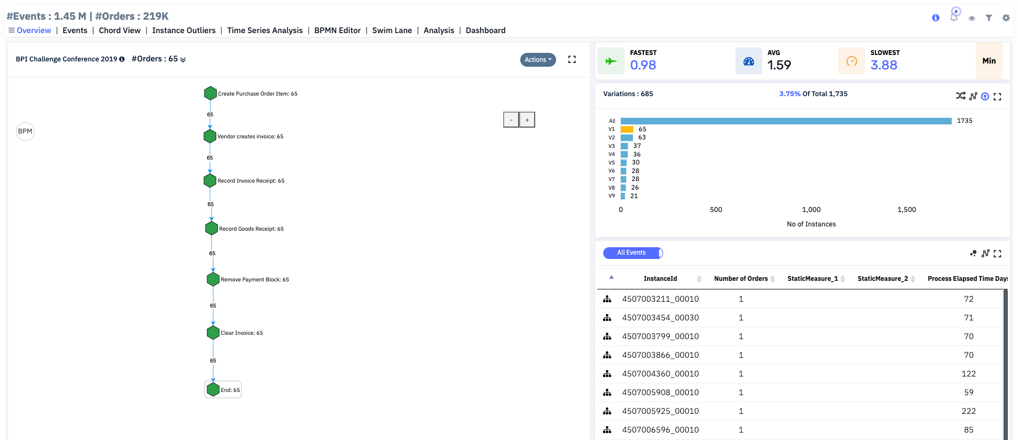

Slide 12
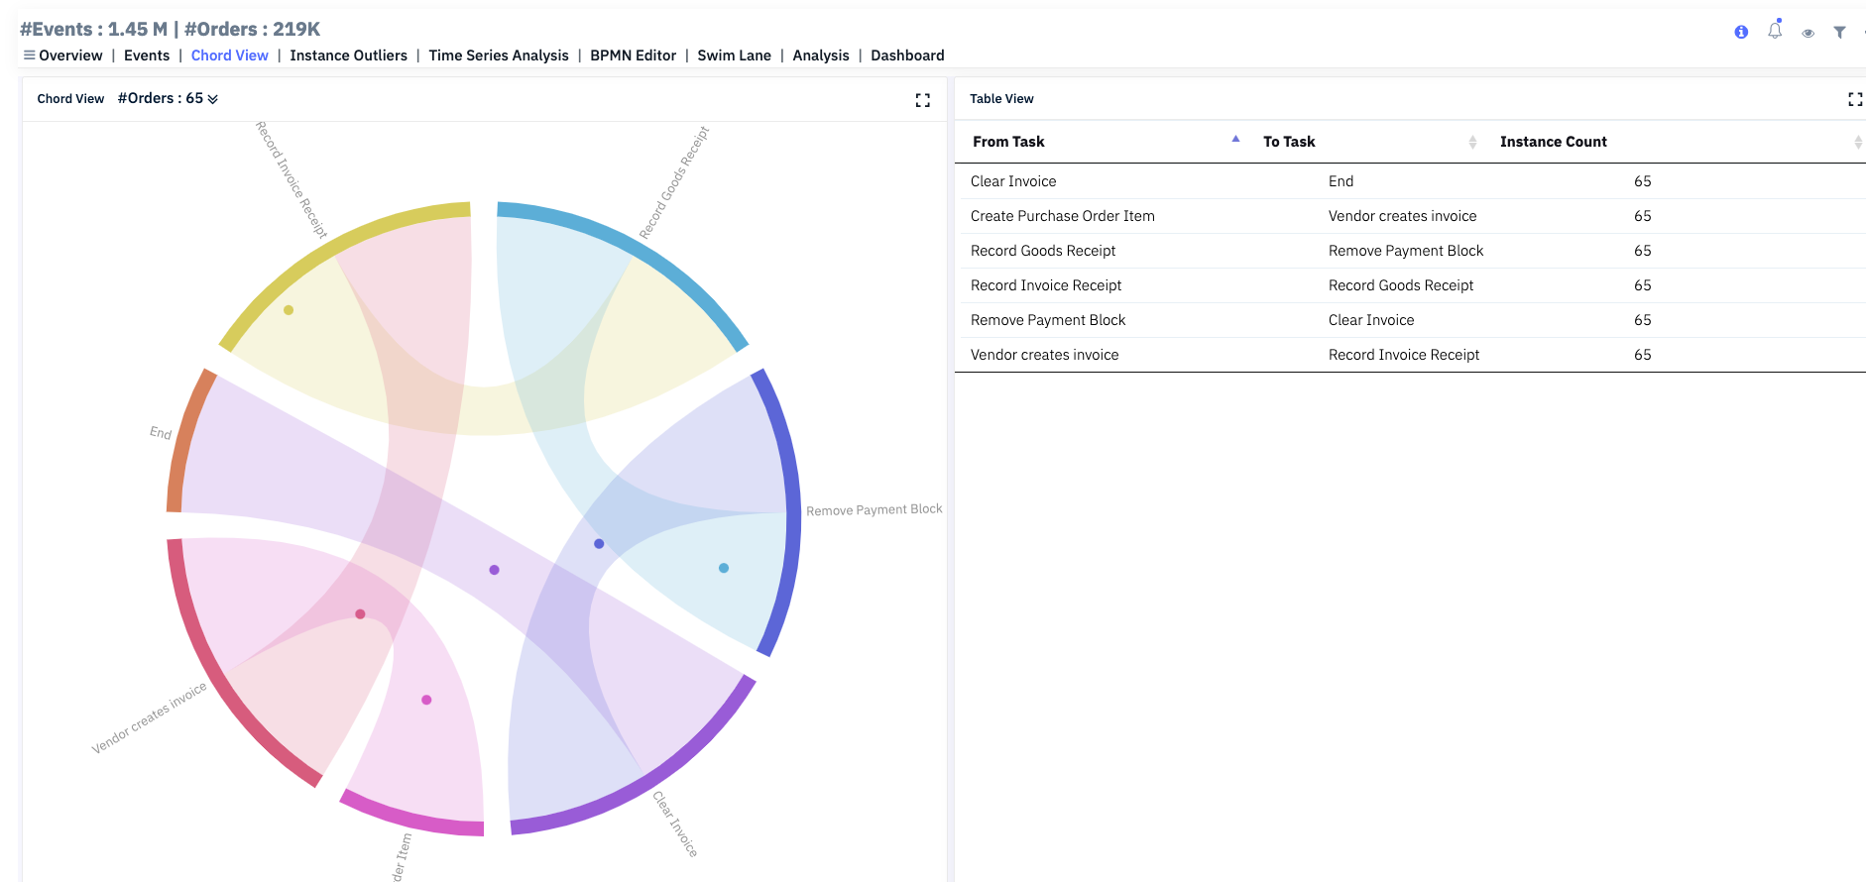

Slide 13
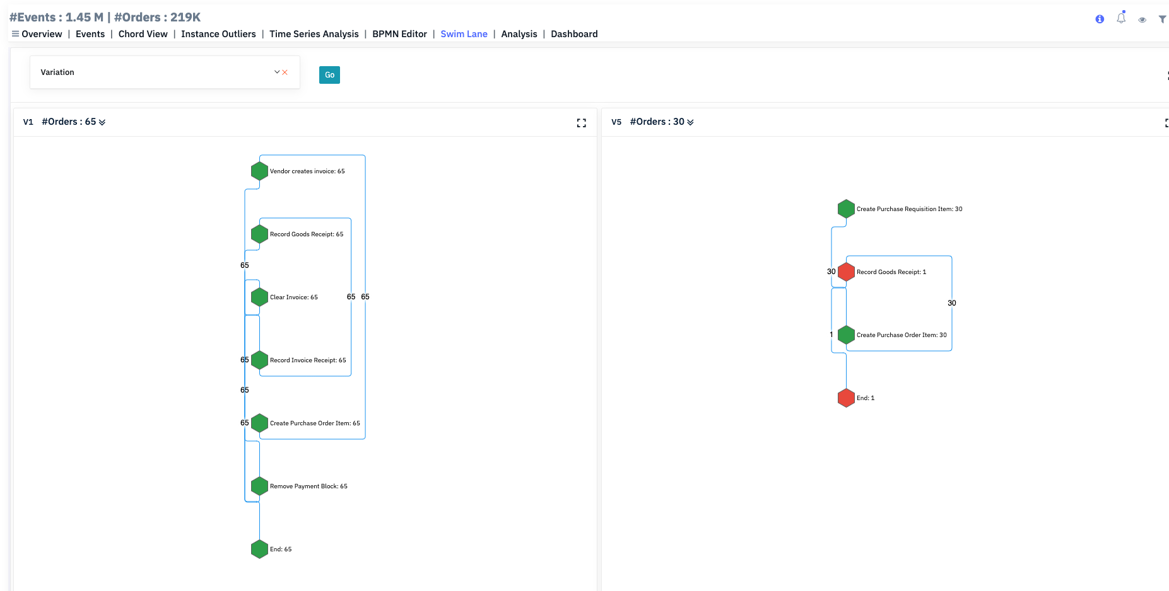

Slide 14
