Slide 1

BRAINWARE UNIVERSITY
School of Engineering | Department of CSE – Cyber Security & Data Science
DESIGN AND SIMULATION OF A
SECURE HOTEL NETWORK
VLANs • Trunking • Inter-VLAN Routing • DHCP • DNS • Guest Wi-Fi
SUBMITTED BY
PROJECT DETAILS
RANANJAY SARKAR — BWU/BCC/24/029
SOHAN SARKAR — BWU/BCC/24/027
SOUVIK PARAMANIK — BWU/BCC/24/030
Course: BTY59116 – Network Fundamentals and Practical Applications Lab
Supervisor: Dr. Suparna Panchanan
Assistant Professor, CSE-CS & DS
PROJECT-BASED LEARNING | 05 NOVEMBER 2026
BRAINWARE UNIVERSITY • BTY59116 • HOTEL NETWORK PBL

Slide 2
The Problem
3
Why does a hotel network need separation?
One flat network
A segmented hotel network
• Staff and guest devices share the same network
• Unnecessary broadcast traffic reaches many devices
• Guest devices may be able to reach internal systems
• Managing departments and adding devices becomes harder
• Each department gets its own VLAN and subnet
• A router controls communication between networks
• DHCP simplifies client IP configuration
• Guest Wi-Fi is separated from staff networks
BRAINWARE UNIVERSITY • BTY59116 • HOTEL NETWORK PBL

Slide 3
Key Words
4
Six ideas that make the design easier to understand
VLAN
Subnet
A logical group of devices on a switch. Each hotel department can have its own network.
An IP address range assigned to a VLAN, such as 192.168.10.0/24.
Trunk link
Default gateway
A switch link that carries traffic for multiple VLANs using 802.1Q tags.
The router address a device uses to reach another network.
Router-on-a-Stick
DHCP
One physical router link uses sub-interfaces to route between VLANs.
A service that automatically gives devices an IP address and network settings.
BRAINWARE UNIVERSITY • BTY59116 • HOTEL NETWORK PBL

Slide 4
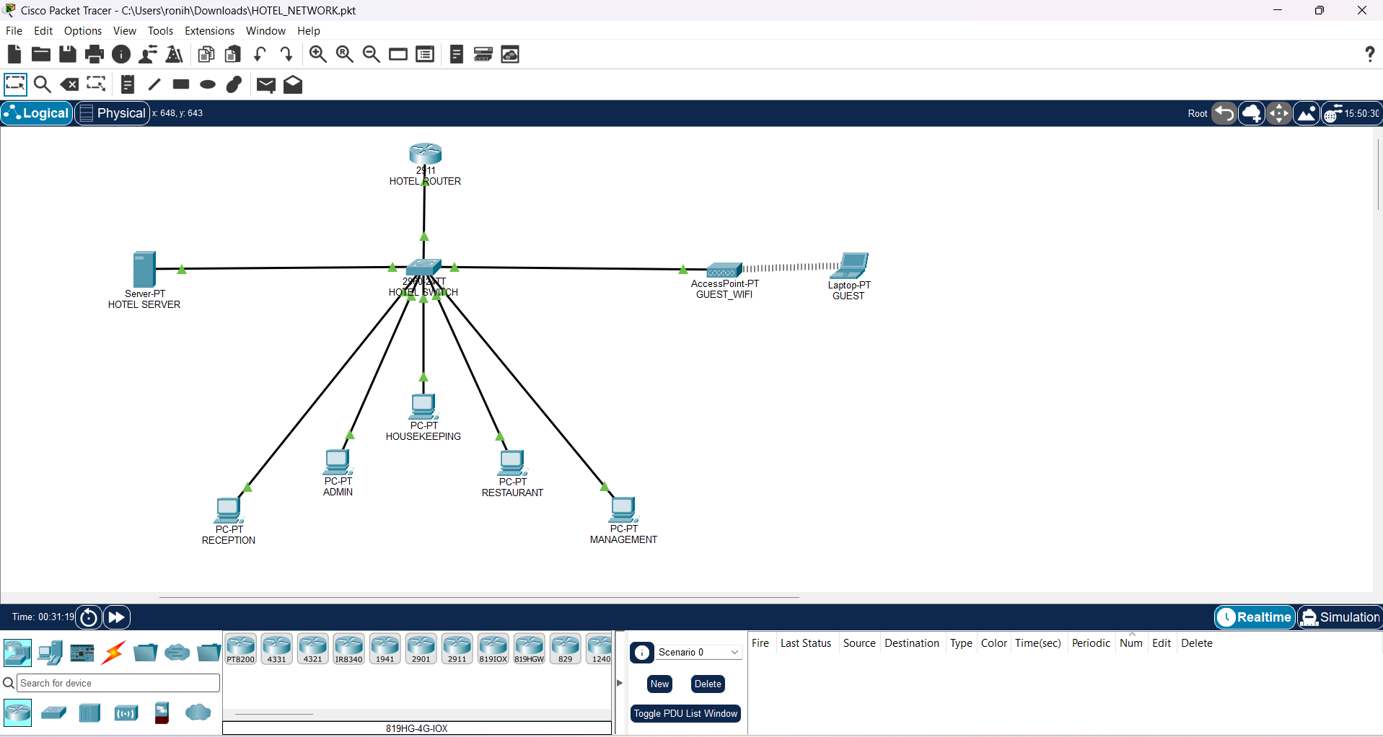
Network Topology
6
Logical view of the hotel network described in the report
BRAINWARE UNIVERSITY • BTY59116 • HOTEL NETWORK PBL

Slide 5
Hotel Departments and VLAN Architecture
7
Each department or service group has a separate broadcast domain
VLAN ID | NAME | NETWORK | GATEWAY
10 | RECEPTION | 192.168.10.0/24 | 192.168.10.1
20 | ADMIN | 192.168.20.0/24 | 192.168.20.1
30 | HOUSEKEEPING | 192.168.30.0/24 | 192.168.30.1
40 | RESTAURANT | 192.168.40.0/24 | 192.168.40.1
50 | MANAGEMENT | 192.168.50.0/24 | 192.168.50.1
60 | SERVERS | 192.168.60.0/24 | 192.168.60.1
70 | GUEST_WIFI | 192.168.70.0/24 | 192.168.70.1
80 | CCTV_IOT | 192.168.80.0/24 | 192.168.80.1
999 | NATIVE | No user subnet | —
BRAINWARE UNIVERSITY • BTY59116 • HOTEL NETWORK PBL

Slide 6
IP Addressing Plan
8
The server uses a fixed address; client networks use DHCP pools
GROUP | SUBNET | DEFAULT GATEWAY | ADDRESSING
Reception | 192.168.10.0/24 | 192.168.10.1 | DHCP
Admin | 192.168.20.0/24 | 192.168.20.1 | DHCP
Housekeeping | 192.168.30.0/24 | 192.168.30.1 | DHCP
Restaurant | 192.168.40.0/24 | 192.168.40.1 | DHCP
Management | 192.168.50.0/24 | 192.168.50.1 | DHCP
Servers | 192.168.60.0/24 | 192.168.60.1 | Static: .10
Guest Wi-Fi | 192.168.70.0/24 | 192.168.70.1 | DHCP
CCTV / IoT | 192.168.80.0/24 | 192.168.80.1 | Reserved
Hotel server
192.168.60.10/24 | Gateway 192.168.60.1 | DNS 192.168.60.10
BRAINWARE UNIVERSITY • BTY59116 • HOTEL NETWORK PBL

Slide 7
Step 3 | Build the Trunk Link
12
The router uplink carries multiple VLANs over one physical connection
Trunk design
Why a trunk?
Switch uplink: Gi0/1
Native VLAN: 999
Allowed VLANs: 10,20,30,40,50,60,70,80,999
Encapsulation: IEEE 802.1Q
A trunk avoids needing one physical router link for every department. VLAN tags identify which logical network each frame belongs to as it travels across the shared link.
The report describes Gi0/1 as the switch trunk port; verify the physical router interface against the actual Packet Tracer cabling.
BRAINWARE UNIVERSITY • BTY59116 • HOTEL NETWORK PBL

Slide 8
Step 4 | Inter-VLAN Routing
13
Router sub-interfaces act as gateways for the VLANs
VLAN 10
192.168.10.1
VLAN 20
192.168.20.1
VLAN 30
192.168.30.1
Other VLANs
.40 / .50 / .60 / .70 / .80
Cisco 2911 Router
Sub-interfaces on one link
A device sends traffic for another subnet to its default gateway; the router then forwards it to the destination VLAN according to its routing table.
BRAINWARE UNIVERSITY • BTY59116 • HOTEL NETWORK PBL

Slide 9
Step 5 | Configure DHCP
14
Automatic addressing reduces manual work on client devices
DHCP pools in the report
What a client receives
RECEPTION
ADMIN
HOUSEKEEPING
RESTAURANT
MANAGEMENT
GUEST_WIFI
The router provides the client IP settings.
• IP address
• Subnet mask
• Default gateway
• DNS server address
The server VLAN uses a static address so hotel services remain at a predictable IP.
The report lists DHCP pools, but the supplied evidence does not confirm a successful lease on every client.
BRAINWARE UNIVERSITY • BTY59116 • HOTEL NETWORK PBL

Slide 10
Hotel DNS and Web Server
15
The server is planned to host a simple hotel portal
Server addressing
Hotel portal configuration
IP address: 192.168.60.10
Subnet mask: 255.255.255.0
Gateway: 192.168.60.1
DNS: 192.168.60.10
Server VLAN: 60
DNS service: ON
A record: www.hotel.local → 192.168.60.10
HTTP service: ON
Client test URL:
http://www.hotel.local
These are the configuration steps and intended service settings documented in the report; end-to-end DNS and HTTP success still needs testing.
BRAINWARE UNIVERSITY • BTY59116 • HOTEL NETWORK PBL

Slide 11
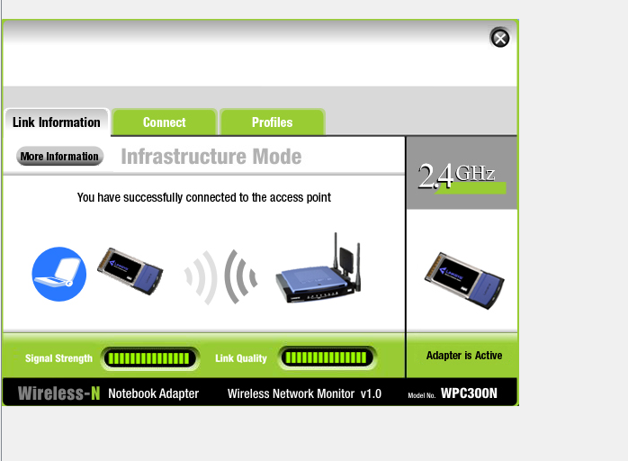
Guest Wi-Fi
16
Guest wireless devices are assigned to a dedicated VLAN
Wireless settings
SSID: HOTEL-GUEST
Guest VLAN: 70
Subnet: 192.168.70.0/24
Gateway: 192.168.70.1
Security: WPA2-PSK if supported by the selected AP model
Report screenshot: wireless adapter associated in Infrastructure Mode.
BRAINWARE UNIVERSITY • BTY59116 • HOTEL NETWORK PBL

Slide 12
Guest Network Isolation
17
The guest policy is intended to protect internal hotel networks
Guest access policy
Important limitation
• Permit DNS queries to the hotel server.
• Permit HTTP access to the hotel portal.
• Deny guest traffic to internal 192.168.x.x networks.
• Permit other traffic as defined by the lab example.
The report includes a sample extended ACL for VLAN 70. It is a teaching-lab example, not a complete production firewall policy. The supplied screenshots do not prove that the ACL was applied and tested.
Guest isolation should be confirmed with tests from a guest client to internal and permitted destinations.
BRAINWARE UNIVERSITY • BTY59116 • HOTEL NETWORK PBL

Slide 13
How We Checked the Network
18
Useful commands and client-side checks
Switch and router checks
Client and service checks
show vlan brief
show interfaces trunk
show ip interface brief
show ip route
show ip dhcp binding
show access-lists
• Set a client to DHCP and inspect its IP settings.
• Ping the expected gateway.
• Test the hotel server address.
• Open http://www.hotel.local in a browser.
• Check that guest devices cannot reach staff networks.
BRAINWARE UNIVERSITY • BTY59116 • HOTEL NETWORK PBL

Slide 14
What We Observed
19
Separate confirmed evidence from checks still required
Evidence included in the report
Further validation required
• VLAN list and switch port membership screenshot.
• Trunk configuration screenshot.
• DHCP pool summary screenshot.
• Wireless adapter associated with the access point.
• Confirm client DHCP leases.
• Verify router sub-interfaces and routing.
• Test DNS resolution and HTTP portal access.
• Confirm ACL is applied and guest isolation works.
BRAINWARE UNIVERSITY • BTY59116 • HOTEL NETWORK PBL

Slide 15
Conclusion
20
A segmented design for hotel departments and guest access
The project presents a hotel network design that separates departments and guest wireless users into dedicated VLANs.
Organisation
Connectivity
Services
Department-wise VLANs and IP subnets
Trunking and router sub-interfaces
DHCP, DNS, web portal and guest Wi-Fi
The design provides a foundation for a more manageable and secure hotel network; the remaining end-to-end tests should be completed before claiming full operational validation.
BRAINWARE UNIVERSITY • BTY59116 • HOTEL NETWORK PBL

Slide 16
THANK YOU
Questions and Discussion
Design and Simulation of a Secure Hotel Network Using Cisco Packet Tracer
BRAINWARE UNIVERSITY • BTY59116 • HOTEL NETWORK PBL

