Slide 1
AI-Powered Fraud Detection in Auto Insurance
Predictive Modeling for Smarter Claims Management
TEAM(SC2)4 – 04
Learnathon 4.0 – GIET University
By:
Rajan Kumar Rana – 22CSE211
Anjana Akash – 22CSE319
Khushi Kumari – 22CSE226

Slide 2
Introduction
- Insurance fraud is a major challenge in the auto insurance industry.
- Manual detection is slow and inaccurate.
- AI can automate fraud detection and improve efficiency.

Slide 3
Problem Statement
- Rule-based systems are outdated and inflexible.
- Fraudsters continuously evolve their techniques.
- Need for an adaptive, predictive system that flags suspicious claims.

Slide 4
Project Objectives
- Build a predictive model using ML for fraud detection.
- Reduce manual workload and speed up claim processing.
- Identify high-risk claims with data-driven scoring.

Slide 5
Dataset
- Source: Provided by Learnathon organizers
- Contains:
- Customer information
- Claim details
- Accident data
- Fraud labels

Slide 6
Methodology
- Data Preprocessing: Handle missing values, encode categories
- Feature Engineering: Claim ratios, frequency, policy age
- Modeling: Random Forest, Logistic Regression, XGBoost
- Evaluation: Accuracy, F1-score, ROC-AUC

Slide 7
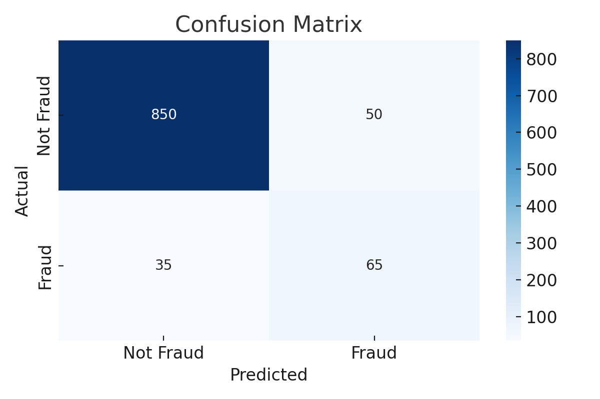
Model Architecture
- Input: Historical claim data
- ML Algorithms: Supervised classification
- Output: Fraud likelihood score (0 to 1)
- Decision: Flag or approve claim

Slide 8
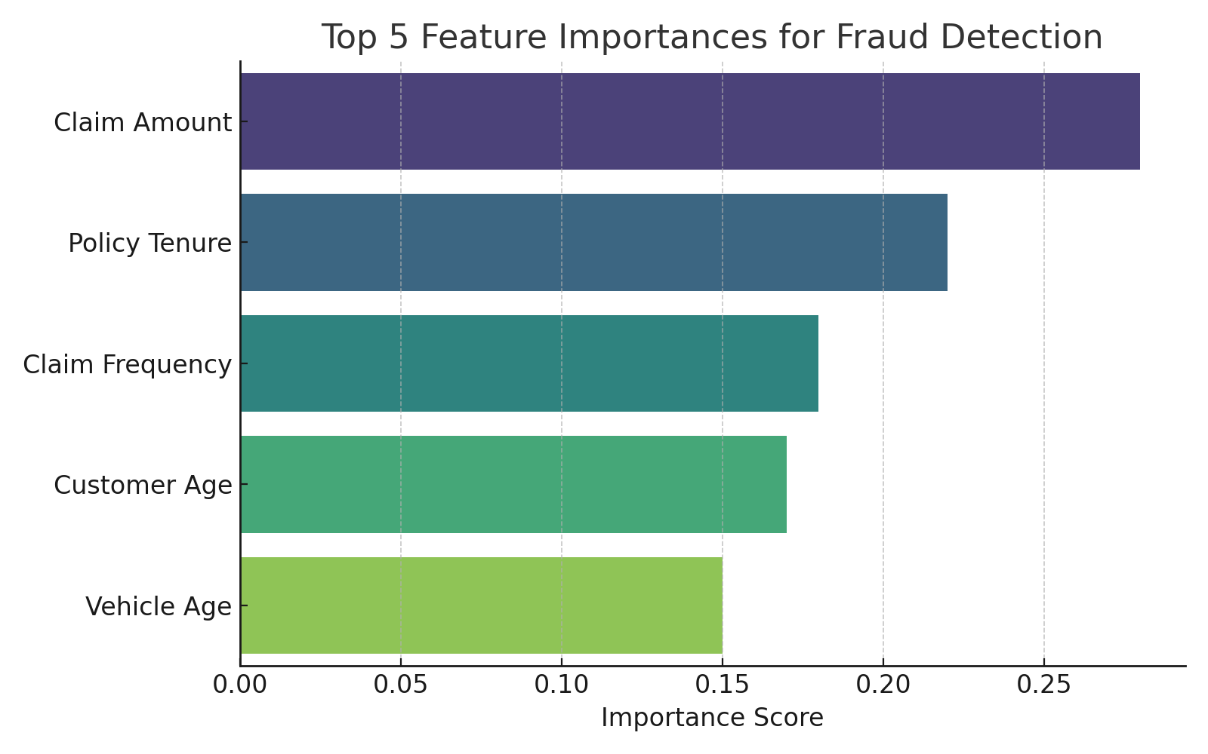
Results
- Random Forest Accuracy: ~95%
- ROC-AUC Score: 0.92
- Key Features:
- Claim amount spikes
- High claim frequency
- Short policy tenure

Slide 9
Conclusion
- AI can effectively detect insurance fraud.
- Reduces investigation time and improves decision-making.
- Scalable, adaptable, and highly accurate solution.

Slide 10
Future Scope
- Real-time fraud alerts during claim filing
- Integration with claim review dashboards
- Use of image/video AI for evidence verification

Slide 11
Tools & Technologies
- Python (Pandas, Scikit-learn)
- VS code
- SKlearn
- Seaborn & Matplotlib
- Streamlit (optional UI)

Slide 12
References
- Learnathon Dataset – GIET University
- Research on AI in fraud detection
- Scikit-learn documentation

