Slide 1


PROJECT EVALUATION
SmartShip
Logistics Management System
Microservices Architecture · ASP.NET Core · RabbitMQ · SQL Server · React · Docker
Presented by: Saurabh Rana
B.Tech Computer Science and Engineering
Reg. No. : 12214994
Full Stack Web Development (Analyst)

Slide 2
PROJECT OVERVIEW & PROBLEM STATEMENT
The Challenge
SmartShip Solution
Manual paper-based shipment booking & tracking
SmartShip is a microservices-based logistics management platform providing end-to-end automation of shipment booking, payment handling, real-time tracking, administrative analytics, and centralized gateway-based access.
Built with ASP.NET Core services, SQL Server, RabbitMQ with MassTransit, JWT authentication, Serilog logging, Docker Compose orchestration, and Jenkins-based CI/CD.
No real-time visibility into package status or location
Fragmented payment handling — no unified verification
Zero automation for notifications and admin reporting
No scalable architecture for growing logistics demand
6
12+
2
100%
No standardized document upload or delivery proof
Microservices
Events
User Roles
Containerized
3

Slide 3







SERVICE LANDSCAPE & RESPONSIBILITIES
IdentityService :5001
AdminService :5004
Authentication, JWT issuance, user lifecycle, UserCreated/Deleted events
Hub mgmt, reports, dashboard metrics, event-driven admin projections
ShipmentService :5002
NotificationService :5006
Shipment creation, rate calc, pickup scheduling, cancellation, status transitions
Async user alerts — email/SMS/push driven by shipment & payment events
PaymentService :5005
API Gateway :5000
Payment orders (Online/COD), Razorpay verify, saga correlation, payment events
Single entry point: routing, JWT forwarding, service composition
TrackingService :5003
Tracking timeline, doc uploads, delivery proof, event-driven history entries
5

Slide 4



API DESIGN & SECURITY
RESTful JSON APIs · JWT Bearer · Role-Based Authorization
Key API Endpoints
JWT Bearer Auth
Issuer: SmartShipGateway · Audience: SmartShipClients · Symmetric signing key shared across all services
POST
/api/shipments
JWT
Create shipment
PATCH
/api/shipments/pickup/{id}
JWT
Schedule pickup
Role-Based Access
PATCH
/api/shipments/{id}/cancel
JWT
Cancel shipment
[Authorize] for authenticated routes · [Authorize(Roles="ADMIN")] for admin-only operations
GET
/api/shipments/rate
Public
Rate calculator
POST
/api/payment/create-order
JWT
Create payment
Ownership Checks
POST
/api/payment/verify
JWT
Verify Razorpay
ClaimTypes.NameIdentifier extracted to verify resource belongs to caller — prevents cross-user access
GET
/api/tracking/{trackingNo}
JWT
Shipment timeline
POST
/api/tracking/delivery-proof
JWT+ADMIN
Upload proof
Error Middleware
ExceptionMiddleware centralizes error handling — returns structured 400/401/403/404 responses
PUT
/api/admin/shipments/status
JWT+ADMIN
Update status
7

Slide 5
EVENT-DRIVEN COMMUNICATION
RabbitMQ + MassTransit · Async Messaging · Shared Event Contracts
Event
Publisher
Consumers
Purpose
ShipmentCreatedEvent
ShipmentService
TrackingService, AdminService
Init tracking timeline + admin metrics
ShipmentStatusUpdatedEvent
ShipmentService
TrackingService
Append status change to timeline
ShipmentDeliveredEvent
ShipmentService
TrackingService, AdminService
Mark delivered + update admin stats
ShipmentCancelledByCustomerEvent
ShipmentService
TrackingService
Record cancellation with refund context
PaymentCreatedEvent
PaymentService
TrackingService
Append PaymentCreated tracking event
PaymentCompletedEvent
PaymentService
TrackingService, AdminService
PaymentSuccessful entry + metrics
PaymentFailedEvent
PaymentService
TrackingService
Append PaymentFailed tracking event
UserCreatedEvent
IdentityService
AdminService
Sync user record to admin DB
8

Slide 6
DATA MODELS & ENTITIES
DB-per-Service Pattern · EF Core · SQL Server
Shipment Domain
Payment Domain
Tracking Domain
⬡ Shipment
⬡ ShipmentPayment
⬡ TrackingEvent
Id, CustomerId, TrackingNumber, ShipmentType, Status, ShippingRate, PickupScheduledAt, DeliveredAt
ShipmentId, TrackingNumber, Amount, PaymentMethod, PaymentStatus, RazorpayOrderId
ShipmentId, TrackingNumber, Status, Location, Description, EventTime, UpdatedBy
⬡ Address
⬡ SagaCorrelation
⬡ DeliveryProof
FullName, Phone, Street, City, State, PostalCode, Country (Sender & Receiver)
ShipmentId, CorrelationId — links async actions across Shipment & Payment services
ShipmentId, ReceiverName, SignatureImagePath, PhotoPath, Notes, DeliveredAt
⬡ Package
⬡ Document
WeightKg, LengthCm, WidthCm, HeightCm, Description, DeclaredValue
ShipmentId, FileName, FilePath, DocumentType, FileSizeBytes, UploadedByUserId
Patterns: Repository + Unit of Work + DTO contracts · TrackingNumber indexed · DeliveryProof unique per shipment · Enum-to-string conversion
9

Slide 7
SHIPMENT LIFECYCLE FLOW
End-to-end sequence from booking to delivery
Draft
Booked
PickedUp
InTransit
OutFor
Delivery
Delivered
1
Customer authenticates
5
Payment Verify
IdentityService issues JWT token → used in all subsequent requests
POST /api/payment/verify → marks Paid → publishes PaymentCompletedEvent → TrackingService appends PaymentSuccessful entry
2
Create Shipment
6
Schedule Pickup
POST /api/shipments → validates customer → saves Shipment+Address+Package → publishes ShipmentCreatedEvent → returns TrackingNumber
PATCH /api/shipments/pickup/{id} → ShipmentService checks payment Paid → sets status Booked → publishes ShipmentStatusUpdatedEvent
3
Event Propagation
7
Transit Updates
RabbitMQ → TrackingService creates Draft TrackingEvent · AdminService updates metrics
Admin updates status (InTransit, OutForDelivery) → ShipmentStatusUpdatedEvent → TrackingService appends new timeline entries
4
Payment Order
8
Delivery & Proof
POST /api/payment/create-order → PaymentService validates shipment · saves Pending record · publishes PaymentCreatedEvent
Status → Delivered → ShipmentDeliveredEvent → Admin uploads delivery proof (signature + photo) via /api/tracking/delivery-proof
10

Slide 8
DEPLOYMENT: DOCKER & CI/CD (JENKINS)
Containerized microservices with health-aware orchestration
🐳 Docker & Docker Compose
⚙ Jenkins CI/CD Pipeline
Multi-stage Dockerfile
Selective Rebuild Logic
.NET SDK build → ASP.NET runtime, port 8080 exposed
Only changed services are rebuilt — not the entire platform
DB-per-Service
Full Rebuild Trigger
Each service gets its own SQL Server connection string
Triggered when: docker-compose.yml, nuget.config, Jenkinsfile, shared packages modified
Health-aware Startup
Pipeline Stages
depends_on with health checks prevents race conditions
1. Source checkout 2. Change detection 3. Conditional restore
Container Topology
Build & Deploy
SQL Server :1434 · RabbitMQ :5672/:15672 · Jenkins :8080
4. Service-specific Docker build 5. docker compose up --no-deps
Port Allocation
Status Reporting
Gateway:5000 · Identity:5001 · Shipment:5002 · Track:5003
6. Build result & affected services reported in final stage
Environment
Efficiency Goal
DockerJenkins runtime env · EF Core migrations on startup
Reduces build time by targeting only impacted microservices
SmartShip LMS | Capgemini Project Evaluation | Confidential
11

Slide 9
TEST STRATEGY & KEY ALGORITHMS
Unit tests · Integration tests · Business logic rules
Test Strategy
Key Business Algorithms
ShipmentService Tests
Rate Calculation
Route protection, role restrictions, rate calculations by shipment type & weight, payment preconditions for pickup, state transition validation, outbound event publication
Deterministic pricing by ShipmentType × WeightKg with minimum-rate enforcement for low-weight domestic shipments
PaymentService Tests
Duplicate Event Guard
Mocked HTTP clients/context, JWT generation, authentication failures, ownership validation, not-found handling, payment state transitions, saga-correlation behavior
Prevents repeated tracking entries: checks TrackingNumber + Status + Location within 1-minute time window
Integration Tests
Status Transition Validation
Controller authorization checks, route behavior, structured error response format (400/401/403/404)
Enforces legal shipment state machine (Draft→Booked→PickedUp→InTransit→OutForDelivery→Delivered/Cancelled)
Test Infra
Ownership Validation
Custom ShipmentServiceFactory, mock publish endpoints, in-memory DB replacements, mocked IHttpClientFactory
JWT claim (ClaimTypes.NameIdentifier) compared to resource owner — blocks cross-user access in Shipment & Payment services
SmartShip LMS | Capgemini Project Evaluation | Confidential
12

Slide 10

OUTCOMES & CAPGEMINI ALIGNMENT
6
12+
2
100%
1
Microservices
Deployed
Async Event
Types
User Roles
(JWT-secured)
Containerized
(Docker)
CI/CD Pipelines
(Jenkins)
Capgemini Engineering Values — Demonstrated in SmartShip
Agile Delivery:
Modular, independently deployable services
sprint-friendly architecture
Clean Architecture:
Repository + UoW + DTO + SOLID — maintainable and testable codebase
Scalability:
DB-per-service + RabbitMQ async model enables
horizontal scaling per service
Security by Design:
JWT + Role-based + claim ownership checks across all service boundaries
DevOps Culture:
Docker Compose + Jenkins CI/CD with selective
rebuild = production-grade pipeline
Observability:
Serilog structured logging + health endpoints for all
services
13

Slide 11
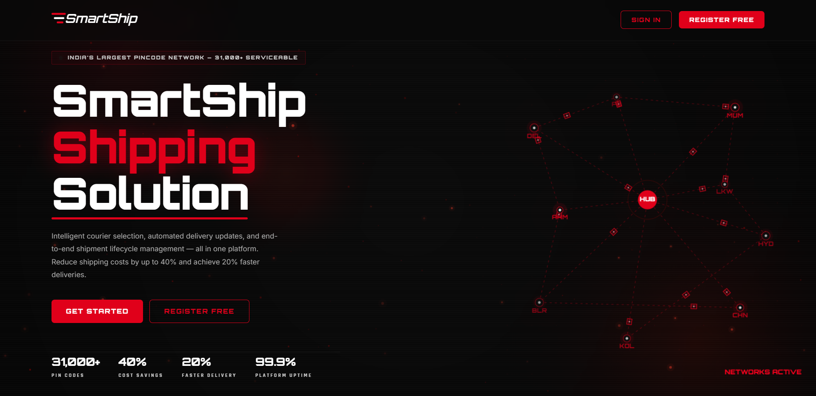

Slide 12
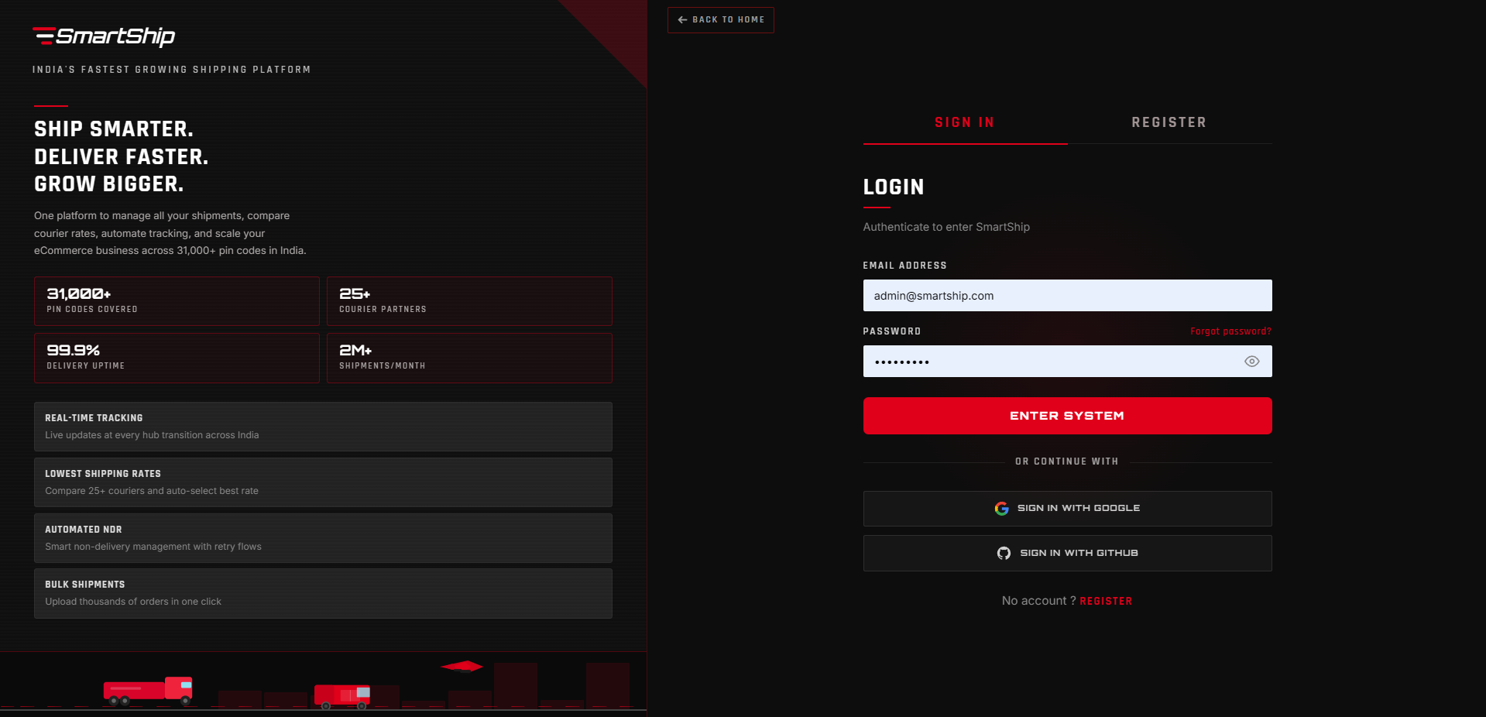

Slide 13
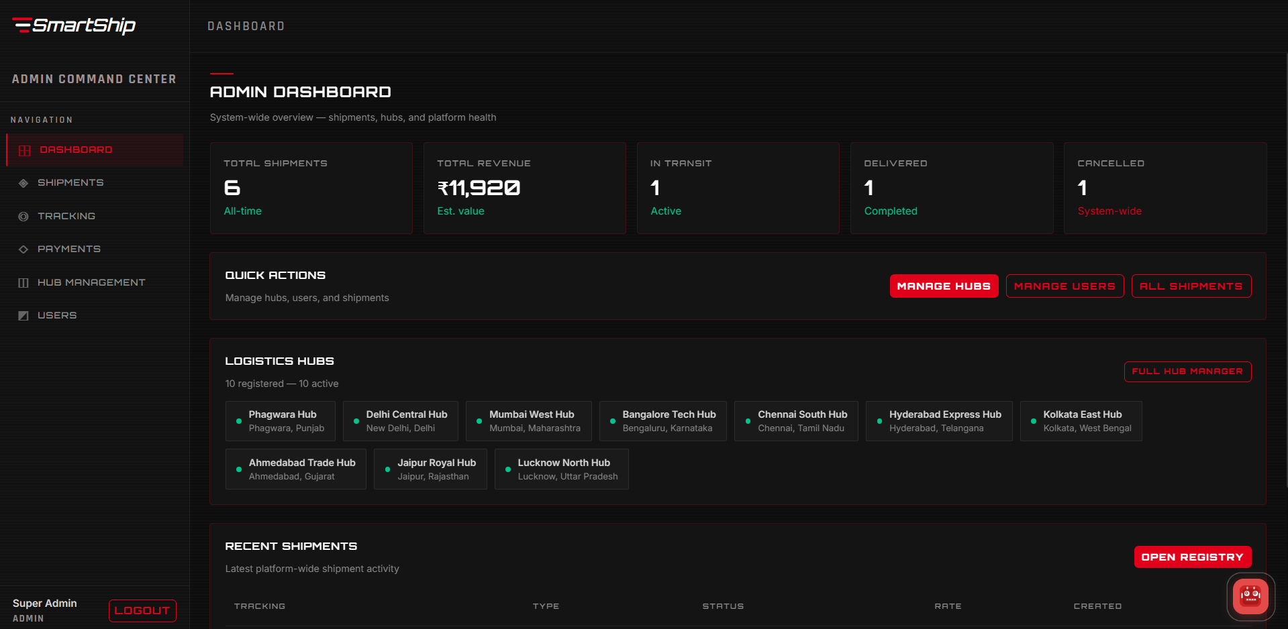

Slide 14
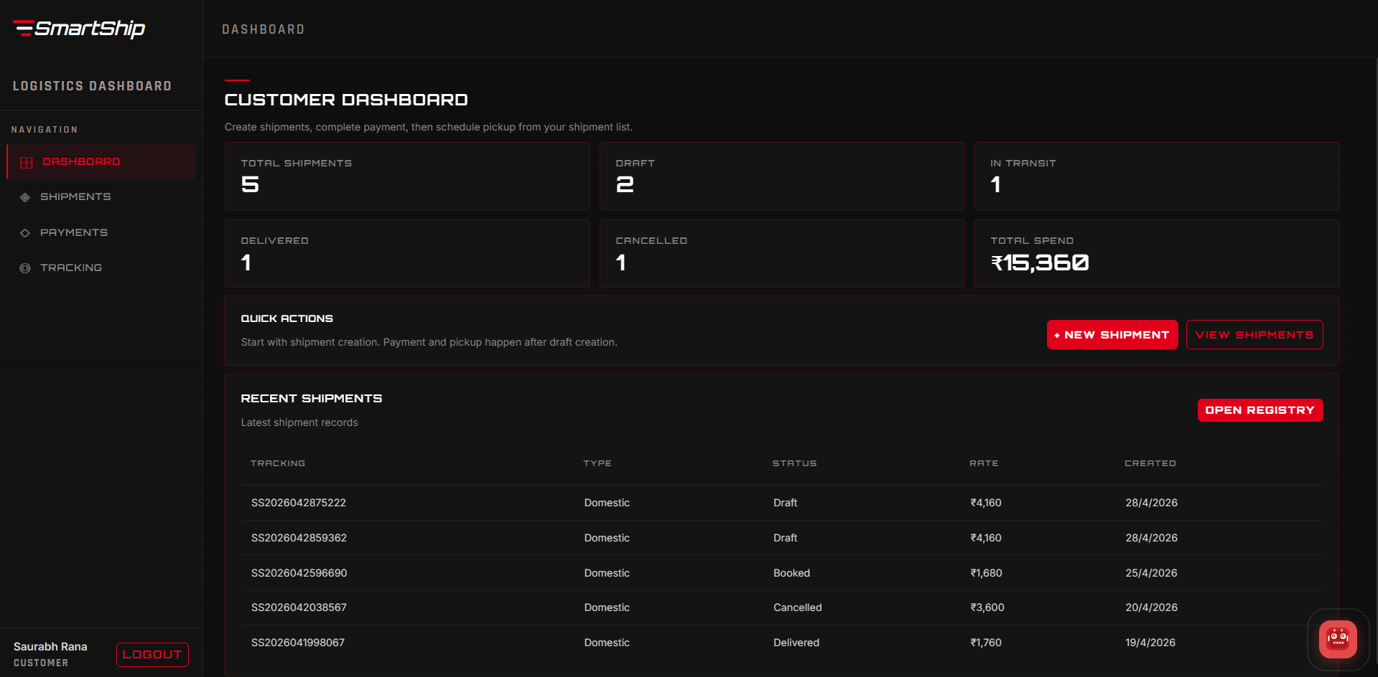

Slide 15
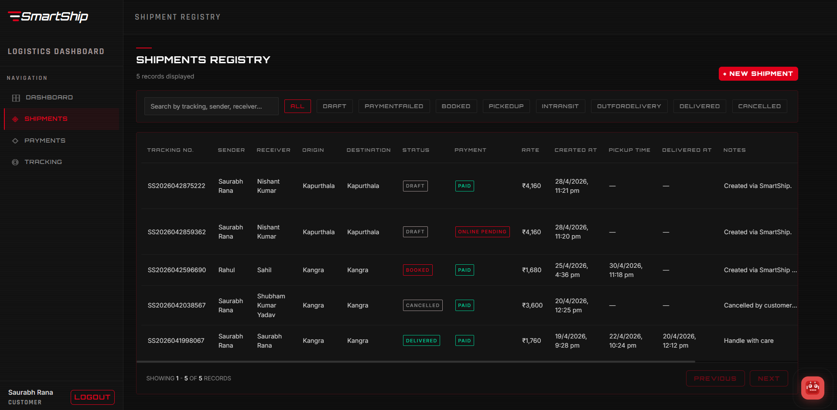

Slide 16
Thank You
SmartShip — Engineered for scale, designed for clarity.

