Slide 1
ZS Data Science Challenge – NetMeds
Submission Format

Slide 2
Submitting “Section A”
Please find attachment in zip file with following name
data_original.csv
data_cleaned_after_missingvalue.csv
rana_singh_070194_code_1.ipynb

Slide 3
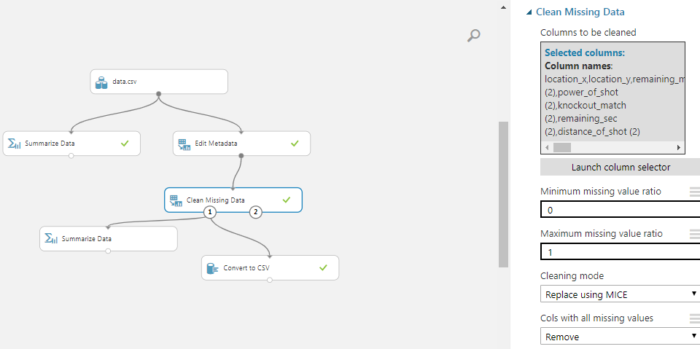
Missing data
Missing value filled using Microsoft Azure Machine learning studio
Missing data filled using MICE i.e. multiple imputaiton by chained equations.
missing data is predicted by observed data, using a sequential algorithm that is allowed to proceed to convergence.
Start by filling in the missing data with plausible guesses at what the values might be
for each variable, predict the missing values by modeling the observed values as a function of the other variables. At each step, update the predictions of the missing values.
Final cleaned data is “data_cleaned.csv” after filling missing value.
Notes:
https://datascience.stackexchange.com/questions/19649/what-is-pca-and-mice

Slide 4
Problem definition:
Here dependent variable is “is_goal”
The test dataset contain missing value in “is_goal” variable and rest is in train dataset.
Train dataset further divided in 7:3 ration for training and cross validation.
Some of variable having ID, position and same value in column are not used in model since they are not affective.(ex. match_event_id, date_of_game, lat/lng, Column 0, team_id, team_name)
Data cleaning done to replace ‘ ’ to _ in categorical variable.
Data preprocessing
one hot encoding for all categorical variable(7 categorical variable)
Normalization for all numerical variable(11 numericalvariable)
Merge both numerical and categorical( total 178 variable)
Above 178 variable use for modeling

Slide 5

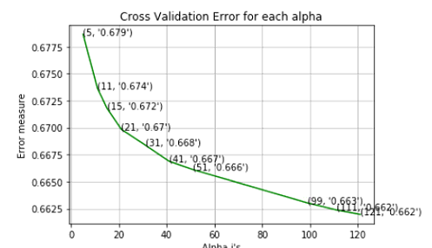
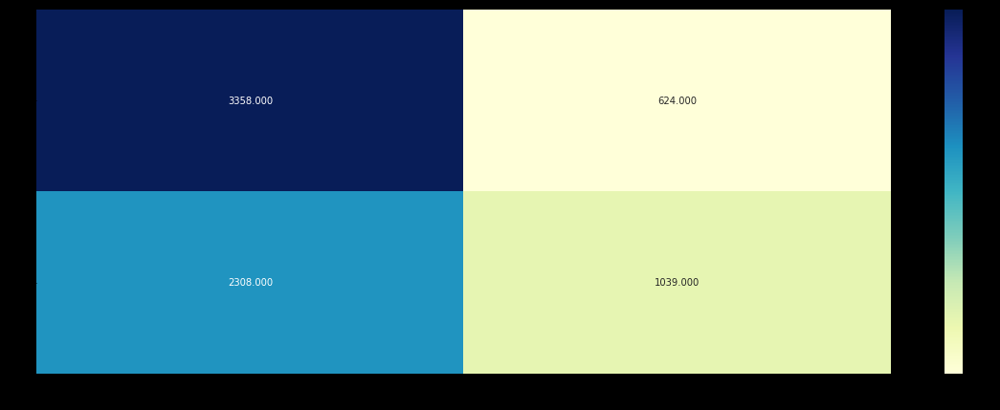
Modeling test data used only for final prediction to avoid data leak train and cv data used for modeling
KNN
For values of best k = 99 The train log loss is: 0.6514433649094883
For values of best k = 99 The cross validation log loss is: 0.6630278957134396
Number of mis-classified points : 0.4000545777050075 means 40% mis classified
Confusion matrix

Slide 6

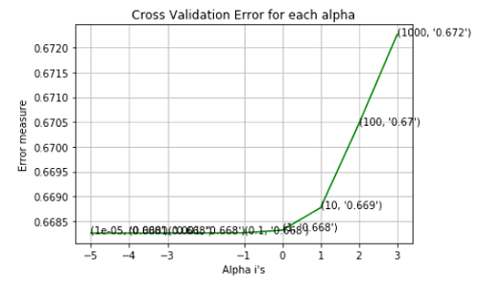
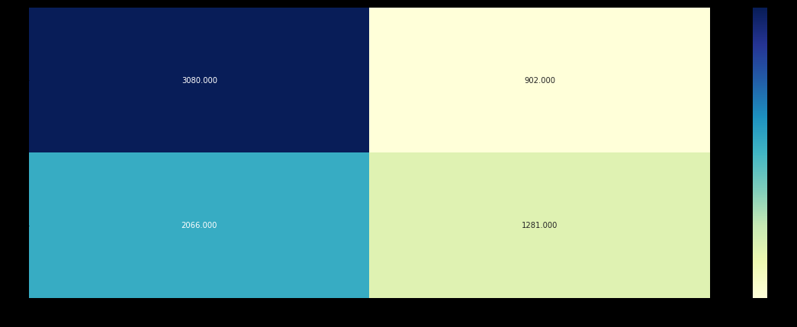
Naive base
For values of best alpha = 1e-05 The train log loss is: 0.663
For values of best alpha = 1e-05 The cross validation log loss is: 0.66
Log Loss : 0.6682607950125213
Number of missclassified point : 0.4049665711556829

Slide 7
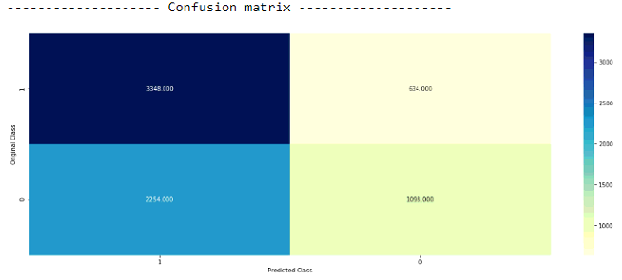
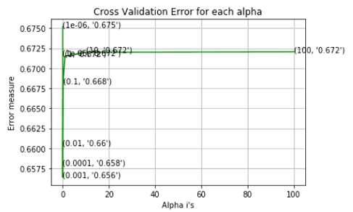
Logistic Regression
For values of best alpha = 0.001 The train log loss is: 0.64752
For values of best alpha = 0.001 The cross validation log loss is: 0.6563
Log loss : 0.6563624868776768
Number of mis-classified points : 0.394051

Slide 8
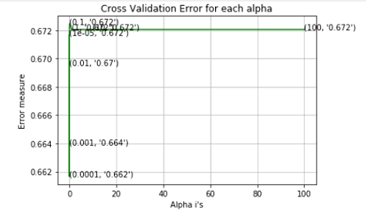
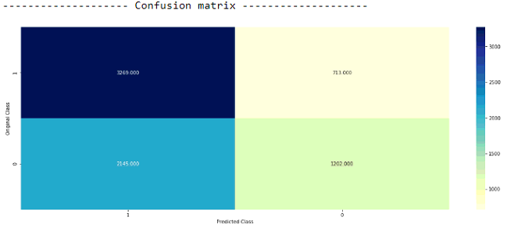
Linear Support Vector Machines
clf = SGDClassifier(class_weight='balanced', alpha=alpha[best_alpha], penalty='l2', loss='hinge', random_state=42)
clf.fit(x_train_bow, y_train)
sig_clf = CalibratedClassifierCV(clf, method="sigmoid")
sig_clf.fit(x_train_bow, y_train)
For values of best alpha = 0.0001 The train log loss is: 0.6524008378480008
For values of best alpha = 0.0001 The cross validation log loss is: 0.661650
Log loss : 0.6616501823180456
Number of mis-classified points : 0.38995

Slide 9
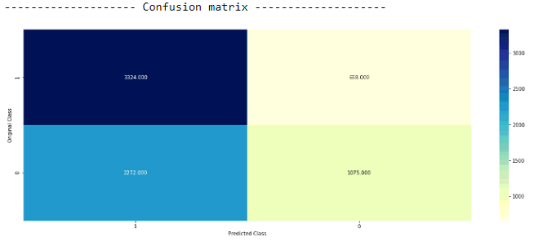
Random Forest Classifie
clf = RandomForestClassifier(n_estimators=alpha[int(best_alpha/2)], criterion='gini', max_depth=max_depth[int(best_alpha%2)], random_state=42, n_jobs=-1)
clf.fit(x_train_bow, y_train)
sig_clf = CalibratedClassifierCV(clf, method="sigmoid")
sig_clf.fit(x_train_bow, y_train)
For values of best estimator = 1000 The train log loss is: 0.6311846477599238
For values of best estimator = 1000 The cross validation log loss is: 0.6582103760041045
Log loss : 0.6582103760041045
Number of mis-classified points : 0.39978168917997

Slide 10
Stack the all above models
clf2 = KNeighborsClassifier(n_neighbors=99)
clf2.fit(x_train_bow, y_train)
sig_clf2 = CalibratedClassifierCV(clf2, method="sigmoid")
sig_clf2.fit(x_train_bow, y_train)
clf3 = MultinomialNB(alpha=1e-05)
clf3.fit(x_train_bow, y_train)
sig_clf3 = CalibratedClassifierCV(clf3, method="sigmoid")
sig_clf3.fit(x_train_bow, y_train)
clf4 = SGDClassifier(class_weight='balanced', alpha=0.001, penalty='l2', loss='log', random_state=0)
clf4.fit(x_train_bow, y_train)
sig_clf4 = CalibratedClassifierCV(clf4, method="sigmoid")
sig_clf4.fit(x_train_bow, y_train)
clf5 = SGDClassifier(class_weight='balanced', alpha=0.0001, penalty='l2', loss='hinge', random_state=0)
clf5.fit(x_train_bow, y_train)
sig_clf5 = CalibratedClassifierCV(clf5, method="sigmoid")
sig_clf5.fit(x_train_bow, y_train)
clf6 = RandomForestClassifier(n_estimators=1000, criterion='gini', max_depth=10, random_state=0, n_jobs=-1)
clf6.fit(x_train_bow, y_train)
sig_clf6 = CalibratedClassifierCV(clf6, method="sigmoid")
sig_clf6.fit(x_train_bow, y_train)

Slide 11
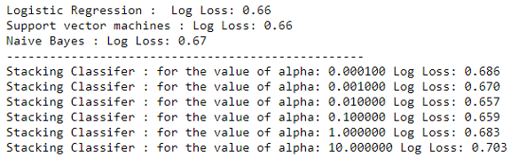
continue
lr = LogisticRegression(C=0.01)(minimum loss at c=0.01)
sclf = StackingClassifier(classifiers=[sig_clf2, sig_clf3, sig_clf4,sig_clf5,sig_clf6], meta_classifier=lr, use_probas=True)
sclf.fit(x_train_bow, y_train)
Final logistic regression used for all models

Slide 12
Submitting “Section C”
Please find attachment
rana_singh_070194_prediction_1.csv
Note:
In case you face any error while submitting the model prediction for evaluation even after following the submission format, share the following with your query:
Snapshot of the error faced
Submission csv file

