Slide 1
Cognitive e-commerce
Opportunities to leverage AI in retail

Slide 2
Understanding AI
What is AI?
Simulation of human intelligence processes by computer systems including learning (the acquisition of information and rules for using the information), reasoning (using rules to reach approximate or definite conclusions) and self-correction.
Why a sudden explosion of AI?
Exponential growth of (BIG)data.
Cheap computing power.
Evolution and maturity in the field of Machine Learning and Deep Learning.

Slide 3
AI opportunities in ecommerce
Product Recommendation –based on customer behaviour, customer segmentation and profiling.
Intelligent Search - move beyond simple text based search to image and voice based search based on natural language.
Anomaly Detection – detect unusual buying pattern.
Customer Support – Digital Assistant, Chatbot.
Price & Product Optimization – Predict product demand, maximize probability of relevant items in stock, leaner inventory and faster fulfilment., dynamic pricing..
Personalization – Customization of shopping recommendation, m-commerce and e-commerce layout and promotions.
Cognitive Ecommerce
Personalization
Product Recommendation
Intelligent Search
Anomaly Detection
Customer Service
Price & Product Optimization

Slide 4
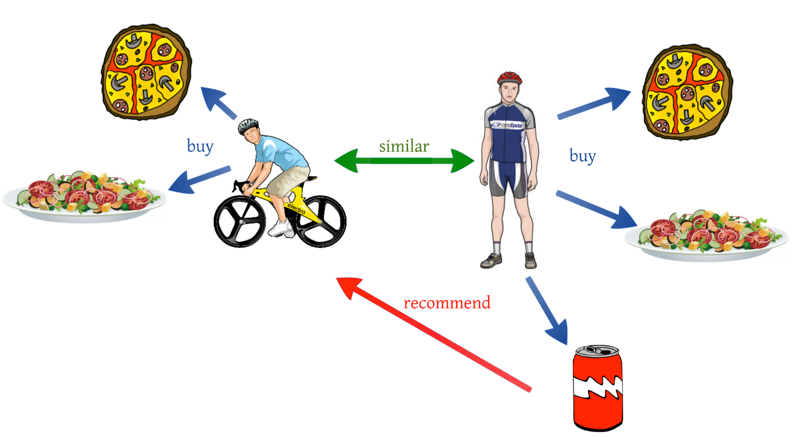
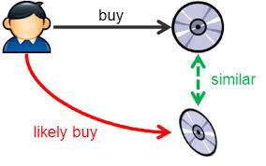
Product Recommendation
Filtering system that seeks to predict and show items that a user would like to purchase.
Collaborative Filtering
Past purchase pattern and activity
Identify customers with “similar interest/behaviour”
Recommend based on common interest.
Content Based Filtering
Build user profile
Identify associated/clustered set of products based on product interest/purchase and user profile.
Hybrid System
Combination of both the approaches
Image source: Medium

Slide 5
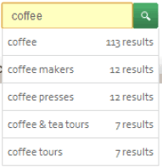
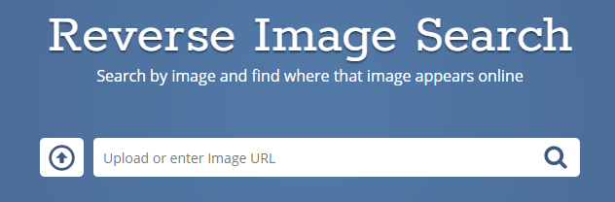

Intelligent Search
Help users to find and discover items that they will purchase
Text Based
Typeahead to complete query
Probable items based on sequence of characters
Image Based
Given images of items, recommend similar visually appealing images (based on texture, colour, shape etc).
Upload/key in image URL of image to search for relevant products matching the image.
Voice Based
Given a voice input, reply with a list of relevant items
“what’s the best 43 inch SONY LED TV under $400
Spell Correction
Understand what user wants to type based on query formation.
Based on attributes/features of item(s) in the image
“Show me deal of the day”

Slide 6

Anomaly Detection
Identify behaviour, events, observations that deviate from normal or expected pattern.
Identity Theft:
entails a situation in which a scammer breaches a user account, alters personal data, and tries to get money or goods from a retailer using this semi-fake personal information.
Merchant Scams:
prevention through behaviour analytics involving smart algorithms to uncover suspicious activities, analyze them, and find inconsistencies in the historical sets of personal data.
related to fraudulent companies or merchants operating through marketplaces by creating fake reviews for their accounts to attract customers.
can eliminate the influence of such fraudsters through conducting sentimental and behavior analytics and detecting suspicious activities linked to merchants or their products.

Slide 7
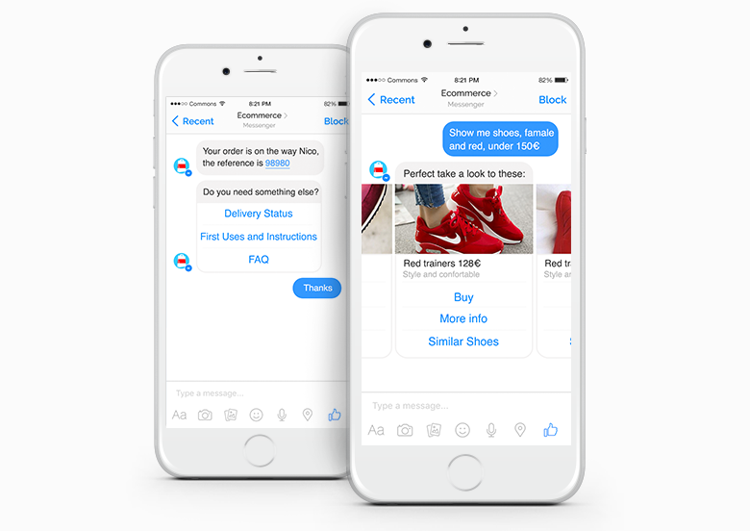
Customer Service
Cognitive digital assistants to help customers make informed decisions, address his/her queries and concerns
Site visitor
Welcome message and greetings.
Customer Experience
Eliminate wait time inherent in human based interactions - always on.
Help navigate and direct to specific page based on request.
Offer real-time support (FAQs, help blogs, reports).
Help customer take informed decisions based on interest and behavior pattern
Recommendation
Product suggestions
Promotional offers, discounts and coupons.
Image source: commons.fm

Slide 8

Price & Product Optimization
Flexible pricing strategy and real time sales forecast to optimize sales
Demand Prediction
Automated demand prediction based on multiple factors (weather forecast, perishability, day of week, holiday, events, stock availability etc.)
Dynamic Pricing
Automatically adjusting price real-time based on demand, product shelf life, seasonality, competitor pricing, events etc.
AI e-commerce strategy helps develop a greater understanding of buying trends. It helps to identify patterns in data to reveal pricing gaps in the market and opportunities that may have been missed.
Help in recommending inventory using approximate localized demand along with factors contributing to predictions.

Slide 9
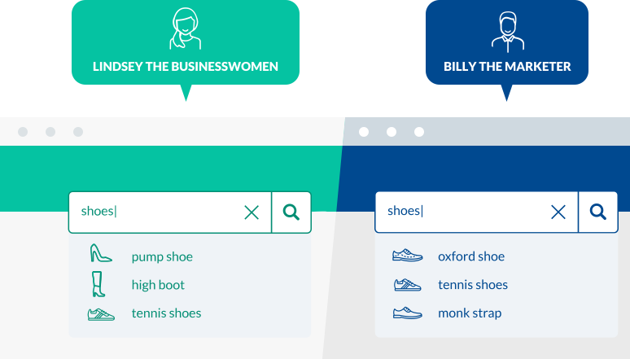
Personalization
Present content and products that are relevant and engaging to each individual user
Fluid Experience
Personalized website/app based on individual shoppers’ preferences. Learns from shoppers’ browsing and shopping histories and displays items that match their preferences and provides personalized shopping recommendations
Recommendation
Help user to explore product assortment learning from:
Left Hand Navigation (LHN) – Best set of facet and facet values increasing stickiness and effective user interaction.
actions on websites/apps - searches, clicks, browsing behavior.
product – purchase preference, history, reviews, ratings, return rates.
Image Source: coveo.com

Slide 10
Getting Started
Approach to starting AI in the organization

Slide 11
AI journey
Stage 1
Stage 2
Maturity Assessment
Data Collection
Model Maintenance
Stage 3
Data driven insights & Recommendation
Pilot Prediction App
Production rollout
Data Exploration, Visualization & ML Model
New opportunity
Integrate ML with existing Systems

Slide 12
Stage 1 – Data Maturity Assessment
Transformation
Outcome
Analysis of Current State
Opportunity identification
Future state recommendations
IT Team
Domain Expert
Data Team
Domain Data Analyst
Vehicle:
Workshop(s)
Collaborative Interaction
Questionnaire/Surveys
Key focus:
Structure
Stitching
Enhancement
Enrichment
Data Evangelist
Data Explorer

Slide 13
Stage 2 – Exploration & Learning
Outcome
Insights, Trend Analysis, Recommendations
ML Model(s)
Pilot Prediction App
Data Team
Domain Data Analyst
Exploratory Data Analysis
Validation by domain expert
Develop insights
Data Explorer

Slide 14
Stage 3 - Institutionalizing AI
TBD

Slide 15
Machine Learning Process
Steps involved in ML process

Slide 16
Machine Learning Process flow
EDA
Model Training & Tuning
Launch and monitor (Pilot)
Frame the Problem
Get Data
Validate Assumptions
Understand data attributes.
visualize data
Gain Insights
Data Cleaning
Transformation
Data Encoding
Creating Training, validation and test sets.
Training Model
Hyper Parameter Tuning
Validation performance
Ensemble Models
Model Scoring
Benchmarking
Performance monitoring
Baselining
Recalibration
Big Picture – Understanding the Problem
Data Preparation
Model Evaluation (Test Set)

Slide 17
Big Picture – Understanding the problem
Formulate the problem
Get Data
Validate Assumption
What do you want to predict (# of purchases, inventory threshold)?
Understanding problem type - how many (regression); what category (classification), Is there a pattern (clustering).
What’s the business objective?
How is it currently done?
How much labeled data is available
Variability in examples.
Accuracy of prediction (absolute number, range, prediction confidence).
Example of relevant features and attributes and the target
Source and reliability of data and target labels.
Measure of performance.

Slide 18
Exploratory Data Analysis
Understand Data
Visualize
Gain Insights
Data profiling - summarizing dataset through descriptive statistics.
Trends & Patterns in data
Relationships between attributes and targets.
Correlation between attributes.
Quality and variability of data for relevance to business problem.
Missing values, outliers
Variable-target correlations.
Categorical versus numeric attributes.
.
Univariate - each attribute summary statistics.
Bivariate – each attribute with target variable.
Multi-variate – understand interaction between different attributes.

Slide 19
Data Preparation
Clean Data
Transform
Encode
Separate non-numeric (categorical/Text) attributes from numeric data.
Feature Engineering – decomposition/aggregation of attributes.
Select subset of data and features relevant for modelling.
Handle missing values.
Handle sensitive attributes.
Feature Scaling - change the values of numeric attributes in the dataset to use a common scale.
Encode categorical/text attributes (one-hot encoding, entity embeddings etc.)
Training, Validation & Testing Sets
Identifying Sampling methods (simple, stratified, most recent for testing)
Create Datasets

Slide 20
Training the Model
Select Algorithm
Train Model
Evaluate Performance
Algorithm
Choose one or more algorithms relevant for the problem.
Define parameters for each model.
Train
Train the models using the defined parameters
Evaluate
Evaluate Training and validation performance.
Choose a subset of models for tuning.

Slide 21
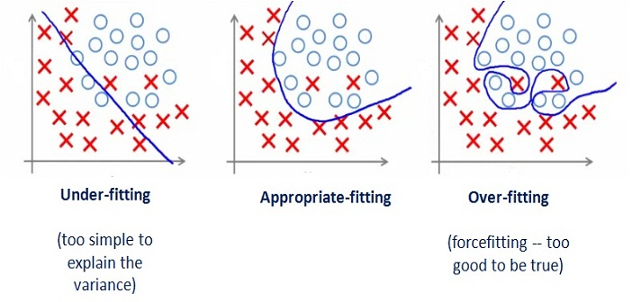
Model Tuning & Evaluation
Tuning
Bias (Underfitting)
Choice of Model
Feature Engineering
Training Set Diversity
Variance (Overfitting)
More Data
Cross-validation
Early-stopping
Regularization
Ensemble
Combine two or more models for better overall performance.
Model | Precision | Recall | F1 Score (HM) | Running Time (ms)
A | 95% | 90% | 92.4% | 90
B | 98% | 85% | 91.0% | 80
C | 97% | 96% | 96.5% | 1500
Evaluation
Model Accuracy
Satisficing metric (e.g, 100 ms)

Slide 22
Launch and Monitor
Launch
Monitor
Recalibrate
Launch
Plug the production input data sources into ML system and write tests.
Monitor
Deploy monitoring code to check the system’s live performance at regular interval.
Sample system’s predictions and evaluate manually by domain experts.
Recalibrate
Automate training the models regularly on fresh data.
Trigger alerts when performance drops
Write code to check the system’s live performance.
Setup performance benchmark/threshold for updating live models.
Evaluate input data quality.

