Slide 1
IBM University Engagement Project Submission
“Exploring the Power of Agentic AI with IBM Granite and LangFlow”

Slide 2
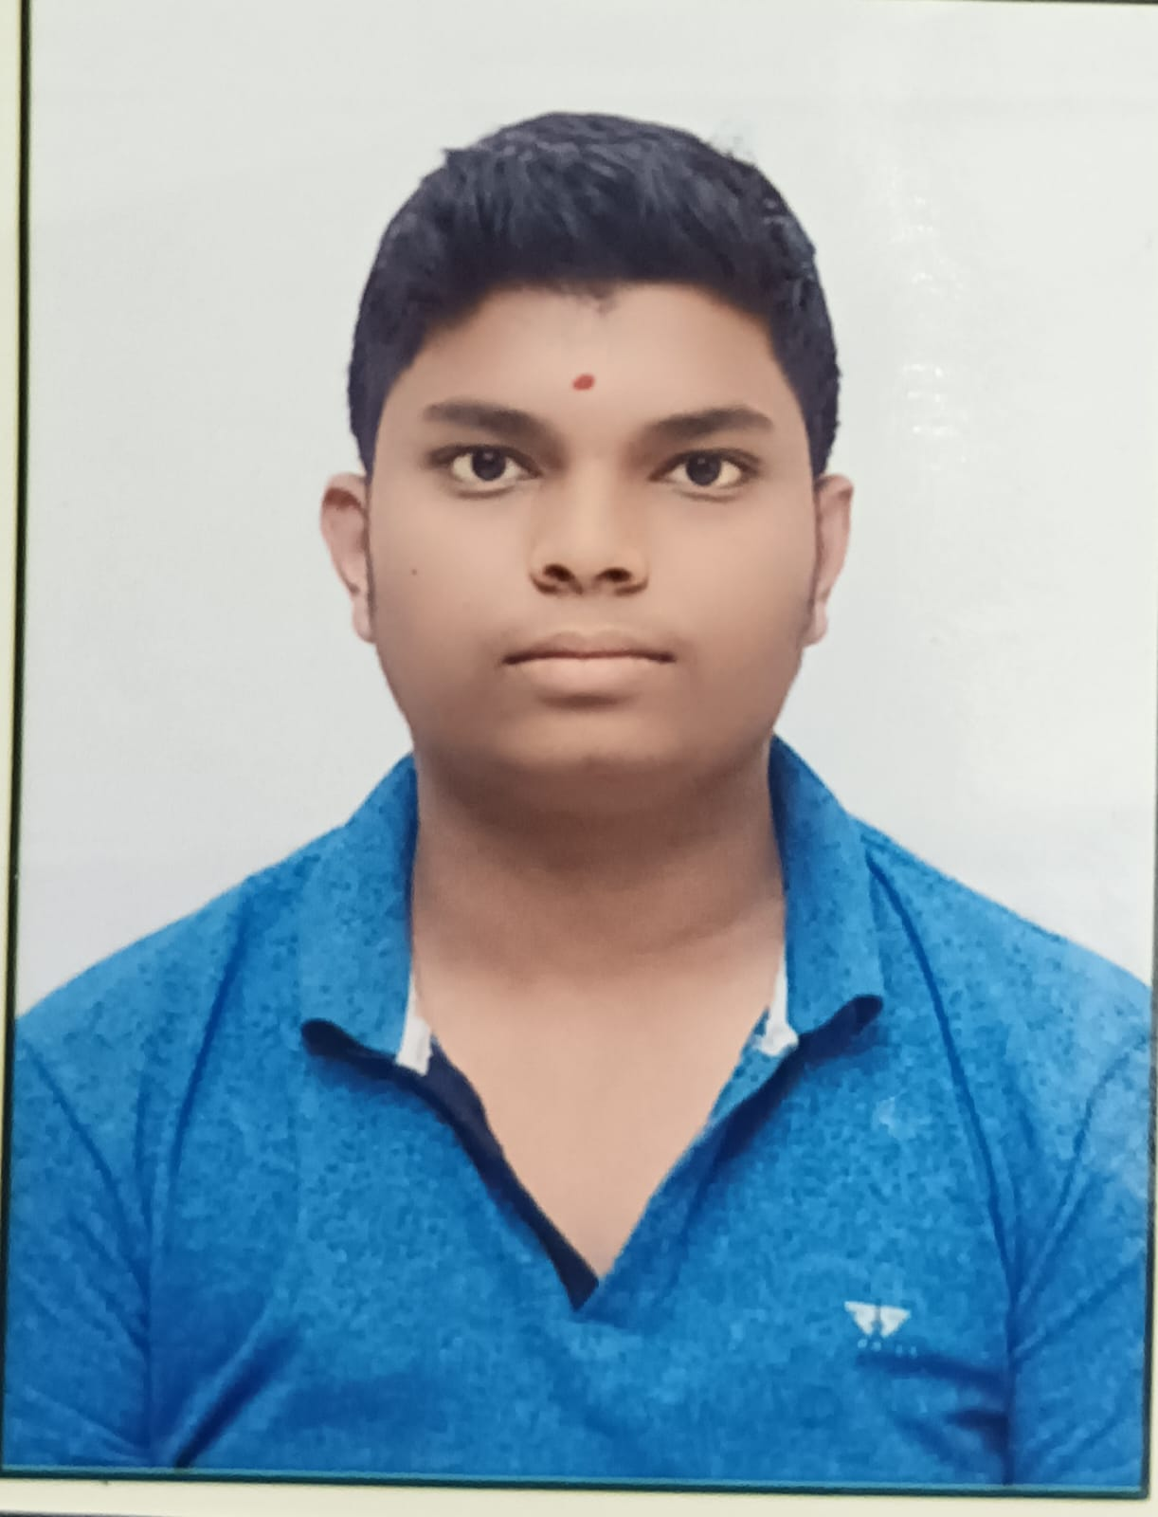
Project Tile – Research Agent
Domain of Project – Education
Student Name | Recent Passport Photo | Email ID | Mobile number [WhatsApp]
Ranaveer Gangarapu |  | gangarapuranaveer5@gmail.com | 8074257268

Slide 3
Problem Statement - Research Agent
The Challenge
Researchers and students spend significant time searching for relevant papers, summarizing findings, managing citations, and identifying research gaps. With the growing volume of academic literature, finding accurate and reliable information has become increasingly difficult.
The Objective
Build an AI-powered Research Agent that assists users in conducting efficient academic and scientific research. The solution should:
Literature Search – Retrieve relevant research papers and articles.
Paper Summarization – Generate concise summaries of research documents.
Citation Management – Create and organize references in standard formats.
Research Gap Analysis – Identify limitations and future research opportunities.
Hypothesis Generation – Suggest innovative research ideas.
Report Generation – Generate literature reviews and research reports.

Slide 4
Technology Used
IBM Watsonx Orchestrate – Used to design and manage the multi-agent research workflow, coordinating different research tasks efficiently.
IBM Granite Model (Granite 3.x) – Used for natural language understanding, research paper summarization, hypothesis generation, and report writing.
IBM Cloud – Provides a secure, reliable, and scalable platform for deploying and managing the Research Agent.
Retrieval-Augmented Generation (RAG) – Retrieves relevant information from research papers and knowledge sources before generating accurate responses.
IBM Watsonx.ai – Used for model deployment, prompt engineering, embeddings, and AI-powered research assistance.
Technology Stack Summary
IBM Watsonx Orchestrate
IBM Granite 3.x
IBM Watsonx.ai
IBM Cloud
RAG (Retrieval-Augmented Generation)

Slide 5
Proposed Solution - AI-Powered Research Agent
The proposed solution is a multi-agent AI-powered Research Agent built using IBM Watsonx Orchestrate, IBM Granite Models, IBM Watsonx.ai, and RAG to simplify academic and scientific research. The system helps users search research papers, summarize findings, manage citations, identify research gaps, and generate research reports efficiently.
The solution uses a RAG-based knowledge retrieval system to fetch relevant information from research papers and academic sources before generating responses. IBM Granite models are used for reasoning, summarization, and content generation.
The system consists of five key agents:
Literature Search Agent – Retrieves relevant research papers and articles.
Research Summarization Agent – Generates concise paper summaries.
Citation Management Agent – Creates and organizes references.
Research Gap Analysis Agent – Identifies limitations and future opportunities.
Report Generation Agent – Produces literature reviews and research reports.
IBM Watsonx Orchestrate manages agent workflows, while IBM Watsonx.ai provides AI services and embeddings. Overall, the solution delivers an intelligent research assistant that improves research efficiency, accuracy, and innovation for students, researchers, and professionals. 🚀🔬

Slide 6
Watsonx Orchestrate Components Used
1) Chat Input – Interface where users enter research questions, paper topics, keywords, or upload research documents.
2) IBM Watsonx AI Agent – Processes user queries using IBM Granite models and generates research insights, summaries, and recommendations.
3) Name of IBM Granite Model – Granite-3.3-8B-Instruct → Used for research paper summarization, reasoning, citation generation, and report creation.
4) Chat Output – Displays AI-generated responses such as paper summaries, literature reviews, research gaps, citations, and reports.
5) File Component – Stores and retrieves research papers, journals, academic articles, and knowledge-base documents for RAG-based retrieval.
6) Knowledge Base / RAG Component – Retrieves relevant information from uploaded research documents and trusted academic sources before generating responses.

Slide 7
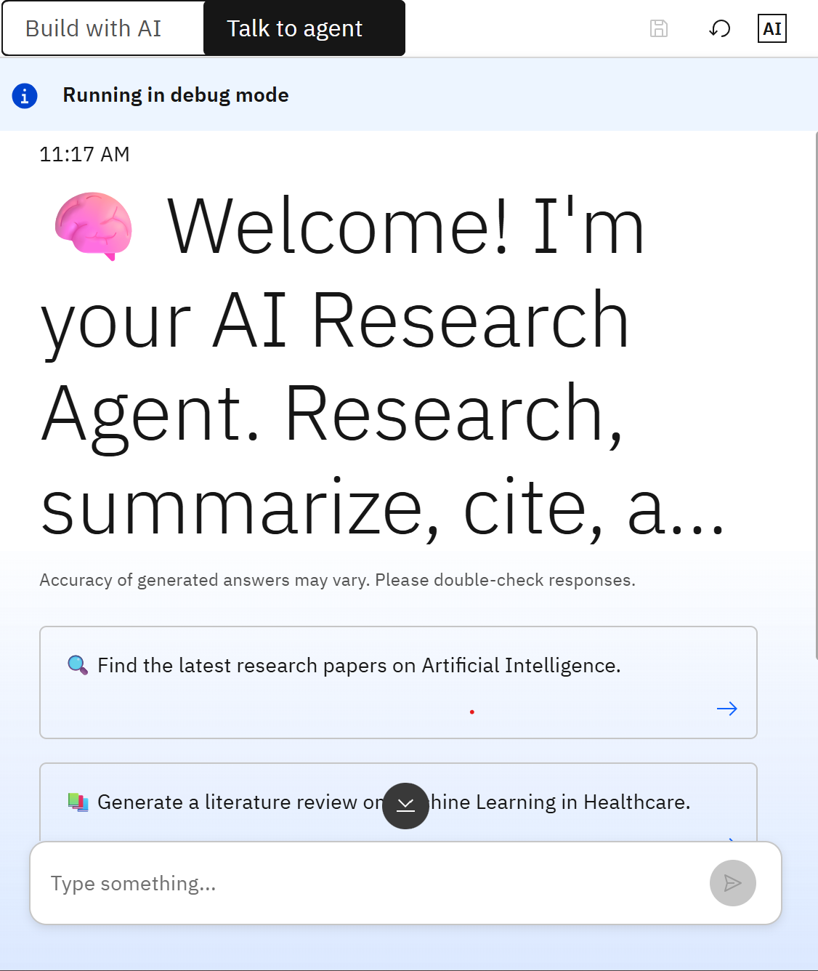
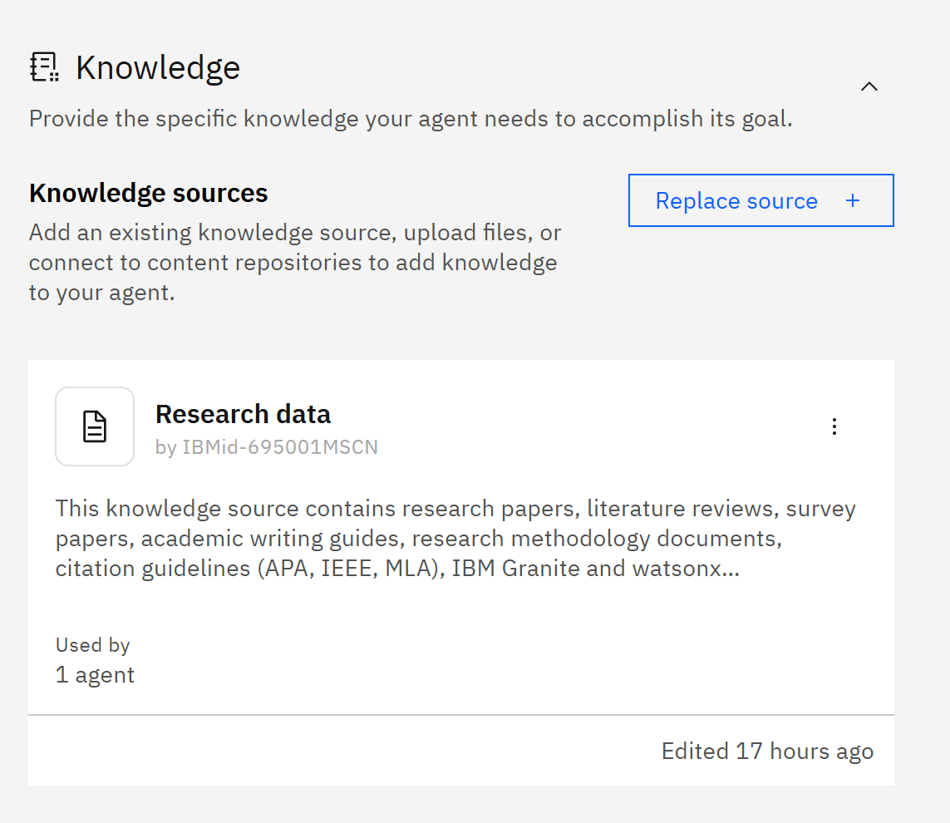
Screenshots –
Research Agent Created & Knowledge Base

Slide 8
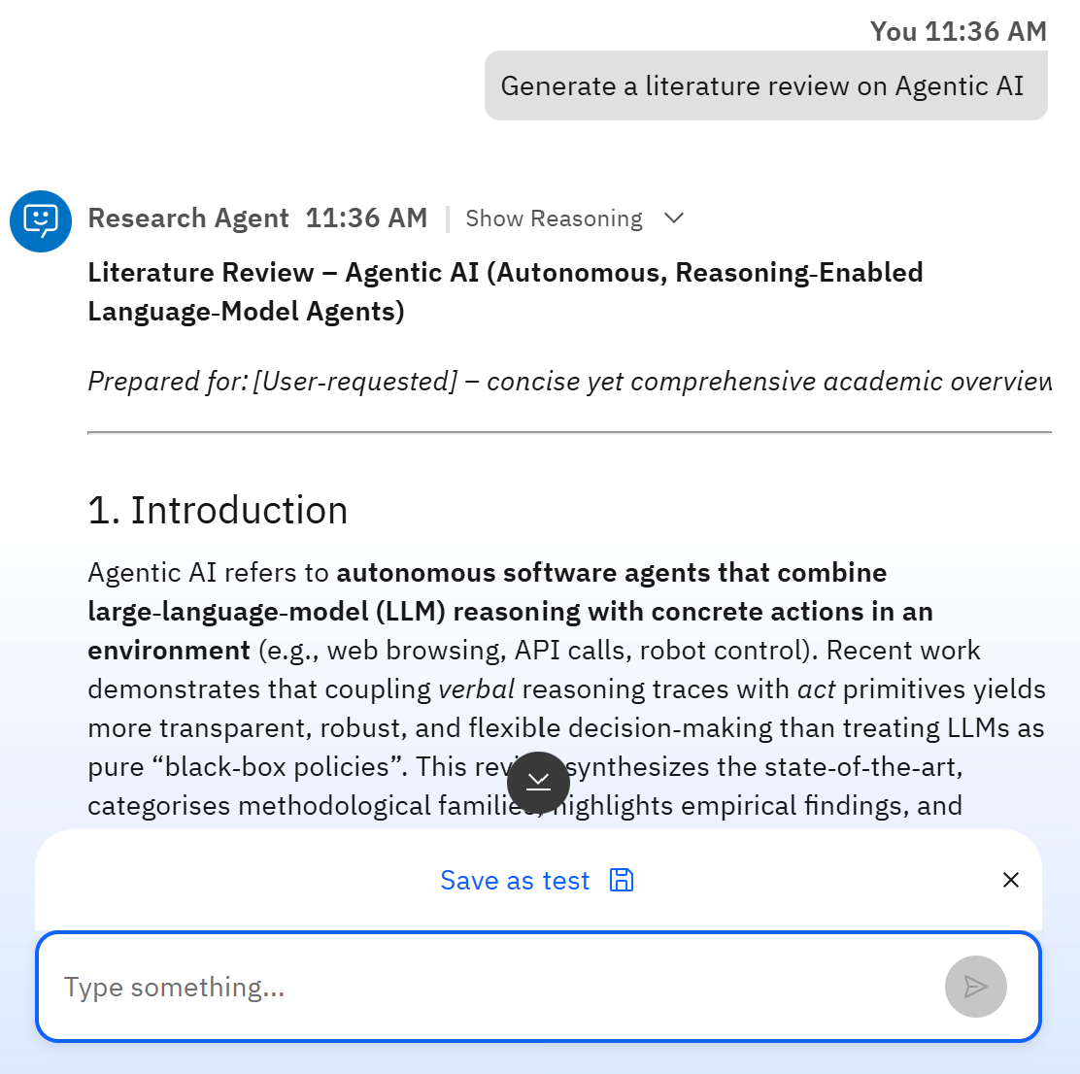
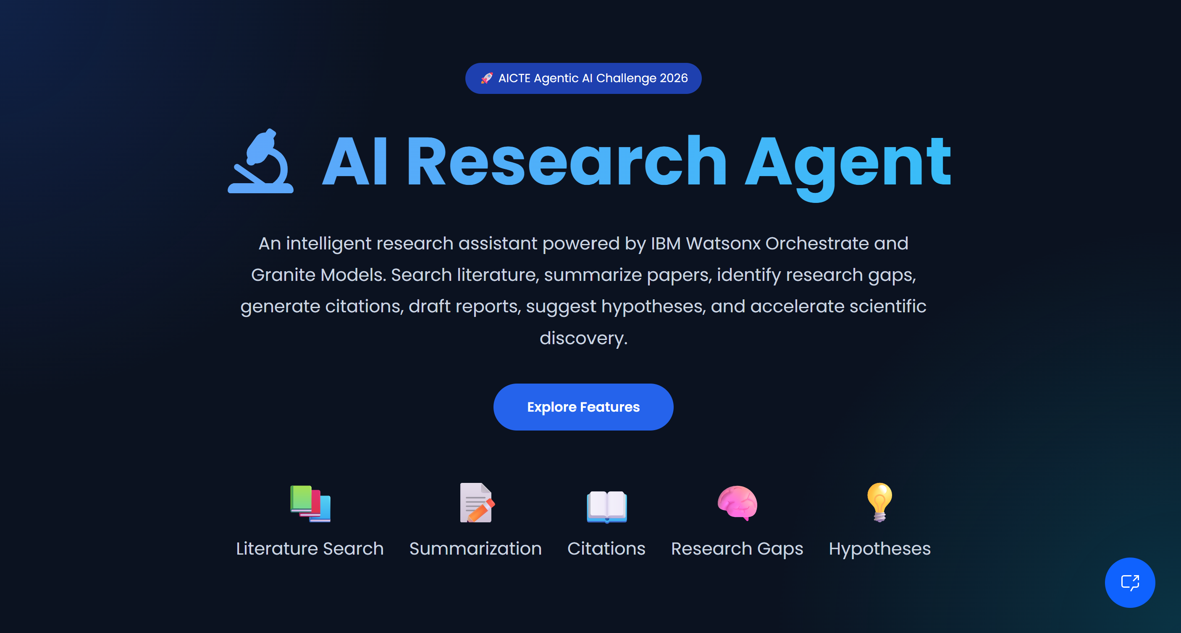
Agent Preview & Deployment :

Slide 9
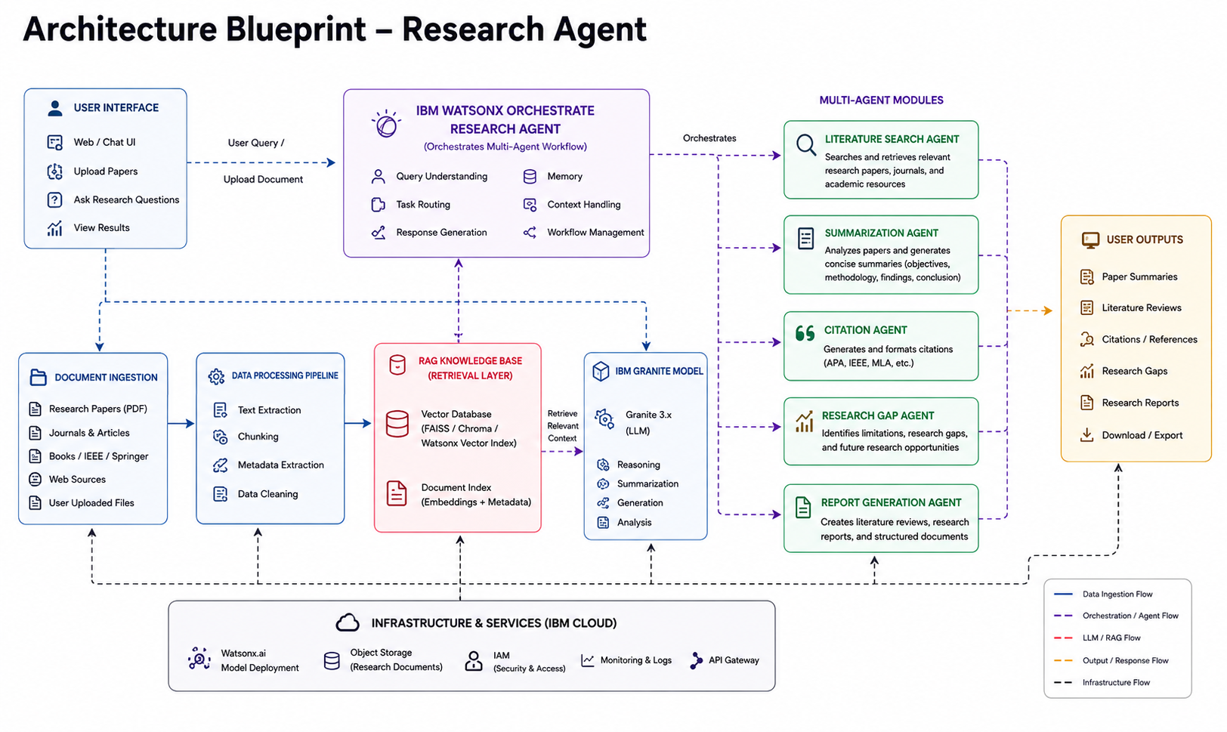
Architecture blueprint

Slide 10

Role of Agentic AI in Research Agent
Agentic AI enables the Research Agent to function as an intelligent, autonomous system rather than a simple chatbot. Using IBM Watsonx.ai and IBM Granite Models, it coordinates multiple specialized agents to perform research-related tasks efficiently.
Each agent handles a specific responsibility such as literature search, paper summarization, citation generation, research gap analysis, and report creation while collaborating with other agents to deliver accurate results.
This multi-agent approach improves task execution, enhances reasoning, and reduces the time required for academic and scientific research. Agentic AI also provides context awareness by understanding user queries, research domains, and document content to generate relevant responses.
It supports real-time adaptation by continuously refining outputs based on user feedback and newly available information. Through collaboration between agents, the system can make better decisions and provide more comprehensive research insights.
Overall, Agentic AI transforms the Research Agent into a proactive and goal-driven research assistant that accelerates knowledge discovery, improves productivity, and supports evidence-based innovation.

Slide 11
Novelty and Uniqueness
The proposed Research Agent stands out by combining Agentic AI, Retrieval-Augmented Generation (RAG), and IBM Granite Models into a single intelligent research platform. Unlike traditional search tools, the system not only retrieves information but also understands, analyzes, and generates meaningful research insights.
Multi-Agent Intelligence – Multiple specialized agents collaborate to perform literature search, paper summarization, citation generation, research gap analysis, and report creation.
RAG-Based Accuracy – Integrates real-time knowledge retrieval from research papers, journals, and uploaded documents before generating responses, ensuring reliable and evidence-based outputs.
Research Gap Identification – Helps researchers discover limitations, unexplored areas, and future research opportunities from existing literature.
Automated Research Assistance – Reduces manual effort by automating time-consuming tasks such as literature review, citation management, and report generation.
Scalable & Enterprise-Ready – Built on IBM Watsonx Orchestrate, IBM Watsonx.ai, and IBM Granite Models, ensuring security, scalability, and reliability.
This makes the solution a smart, autonomous, and efficient research assistant that accelerates knowledge discovery and improves research productivity.

Slide 12
Git Hub Link
·
Github URL – https://github.com/ranaveer53/AI-Research-Agent.git
·
·
·

Slide 13
Future Scope
1. Integration with Academic Databases
The Research Agent can be integrated with academic databases such as IEEE Xplore, Springer, ScienceDirect, and Google Scholar to access the latest research publications and improve literature retrieval.
2. AI-Powered Voice Assistant & Multilingual Support
Future versions can support voice-based interactions and multiple languages, allowing researchers worldwide to access research assistance more conveniently and efficiently.
3. Advanced Research Gap Detection
The system can be enhanced to automatically identify emerging trends, unexplored research areas, and potential opportunities for innovation.
4. Collaborative Research Workspace
Researchers can collaborate, share documents, generate joint reports, and track research progress within a unified platform.
5. Automated Paper Writing Assistance
The agent can assist in drafting research papers, generating abstracts, formatting citations, and preparing publication-ready documents.
·
·
·

Slide 14


