Slide 1

VIJAYA RANA
UB:50419571
Email- vrana3@buffalo.edu
Linkedin-linkedin.com/in/ranavijaya
Github-github.com/ranavijaya

Slide 2
Topics Covered
Dataset Modification
Methodology used
Top 10 predictors
Visualizing Important features
Key Brand Insights- 1
Key Brand Insights - 2

Slide 3
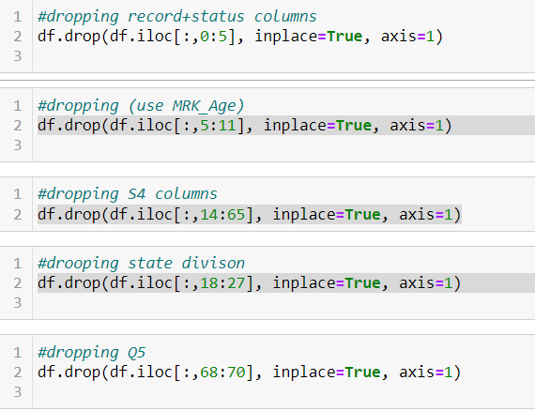
Dataset Modification
Few columns are dropped for the analysis shown below

Slide 4
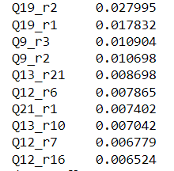
Methodology used
Used RandomForestClassifier for finding the top features model
Found feature importance for Top 10 predictors
Used matplotlib and sns for visualization of the predictors

Slide 5
Top 10 predictors
'Q19_r2’- Pack Type:Can
'Q19_r1’- Pack Type: Bag
'Q9_r3’- Category: Coffee Pod or Capsule
'Q9_r2’- Category: Ground Coffee
'Q13_r21’-Product Attributes: It's affordable
'Q12_r6’- Benefits: It's a premium brand
'Q21_r1’-Price Tier: Under $10
'Q13_r10’-Product Attributes: It's strong
'Q12_r7’- Benefits: It's a high-quality brand
'Q12_r16’-Benefits : It has good aroma

Slide 6
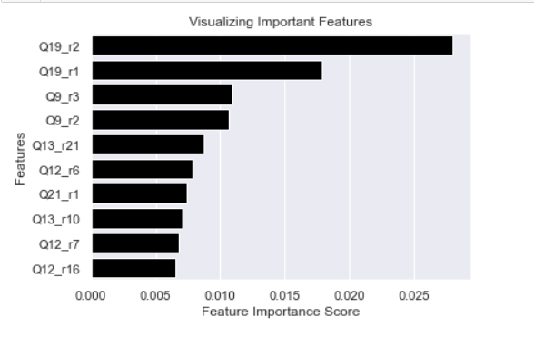
Visualizing Important Features

Slide 7
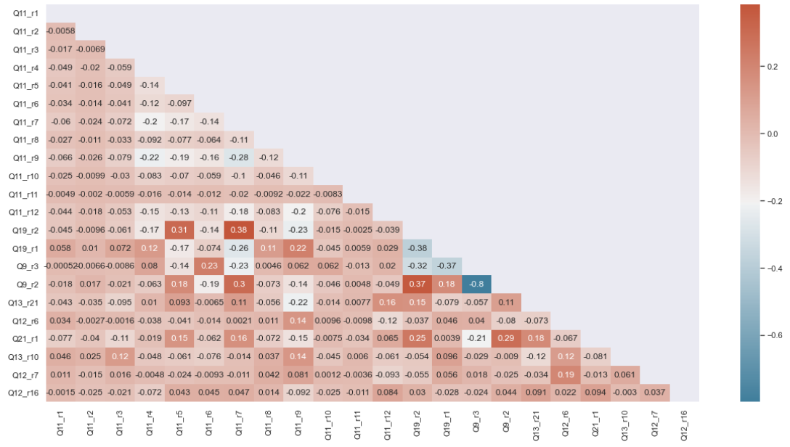
Key Brand Insights
Pack Type : Can & Brand : Maxwell House have positive 0.31 correlation
Pack Type : Can & Brand : Folgers have positive 0.38 correlation
Category : Ground Coffee & Pack Type : Can have positive 0.37 correlation
Category : Ground Coffee & Category: Coffee Pod or Capsule has highest negative -0.8 correlation

Slide 8
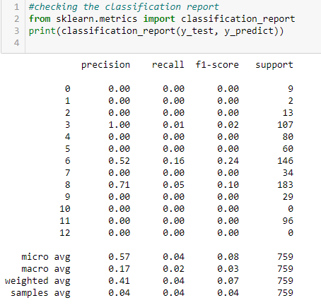
Summary
Classification report was generated consisting of performance evaluation metrics.

Slide 9
THANK YOU

