Slide 1
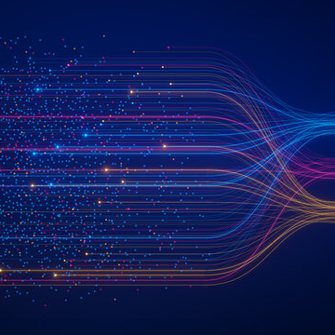
Introduction to Deep Learning
Ran Avner
1/8/2024

Slide 2

Can you write a simple sentence explaining what deep learning using neural network is?
"Deep learning is a type of machine learning that uses neural networks with many layers to analyze and learn from large amounts of data.”
OpenAI. (2024). ChatGPT response. Retrieved from [ChatGPT]

Slide 3
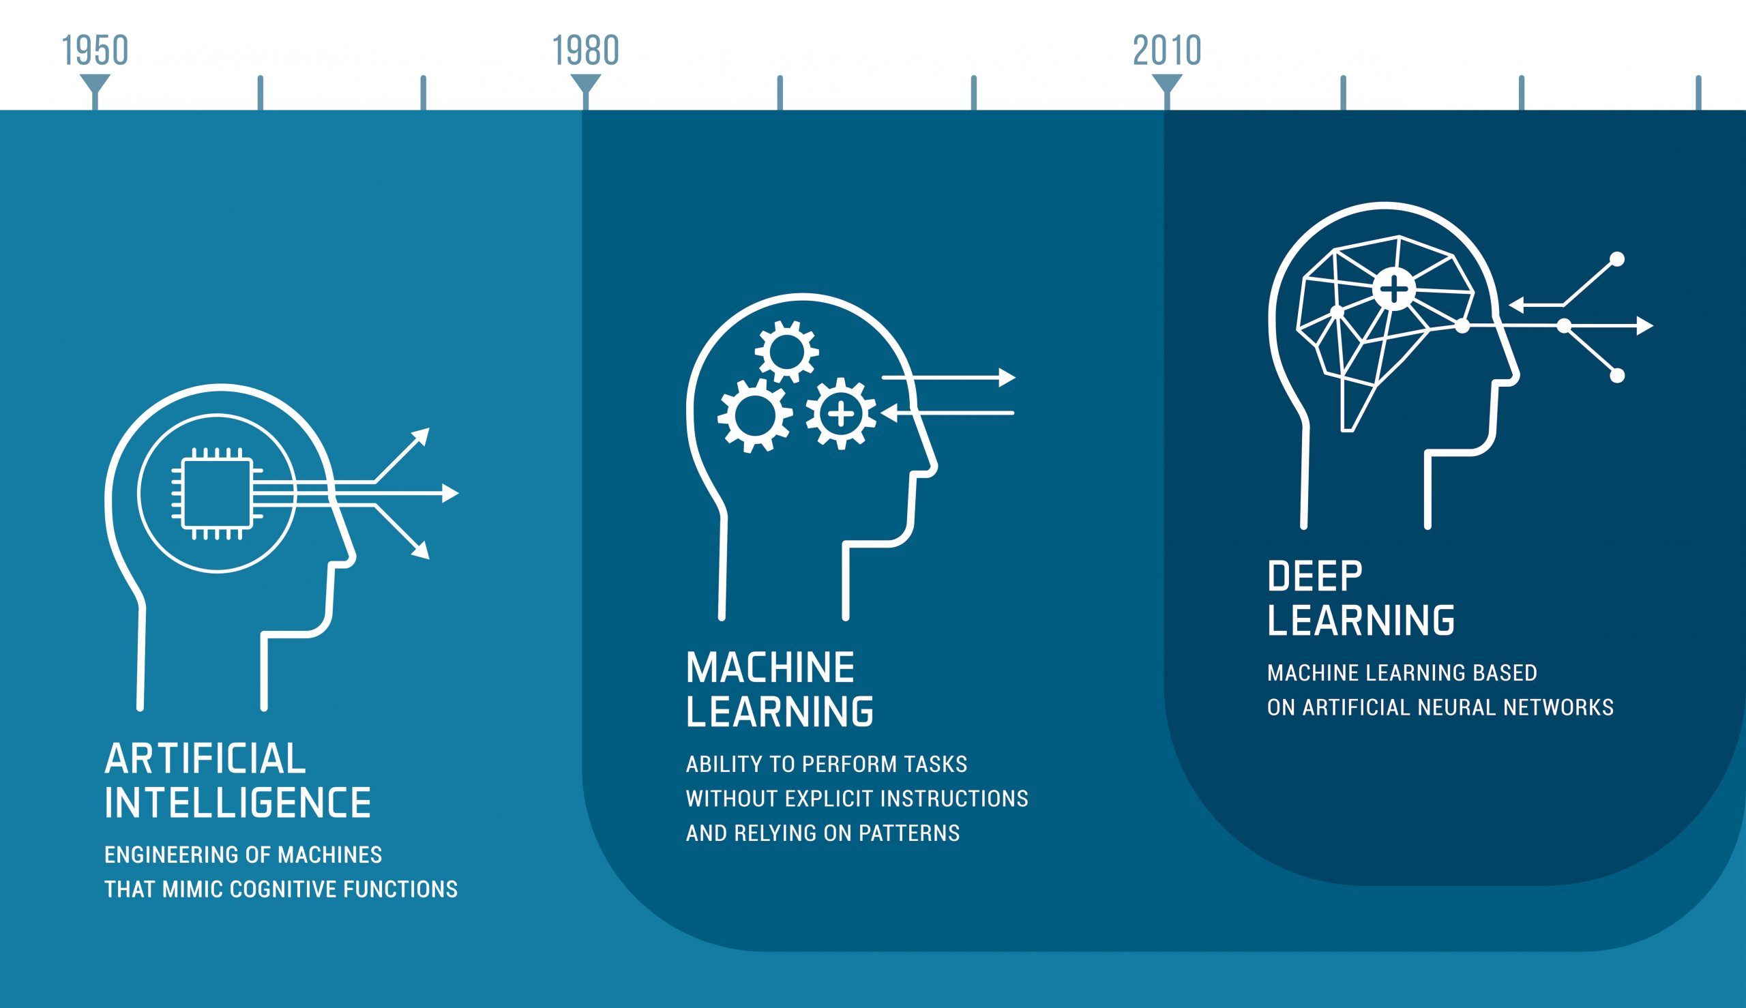
Deep learning has its roots in the 1940s and 1950s with the development of early neural network models, but it gained significant momentum in 2012 with the AlexNet neural network, that amazed everyone in the ImageNet competition, and was able to classify images much better than any other algorithm .This improvement was mainly because of the power and the availability of large datasets, leading to breakthroughs in various AI applications. Computational

Slide 4
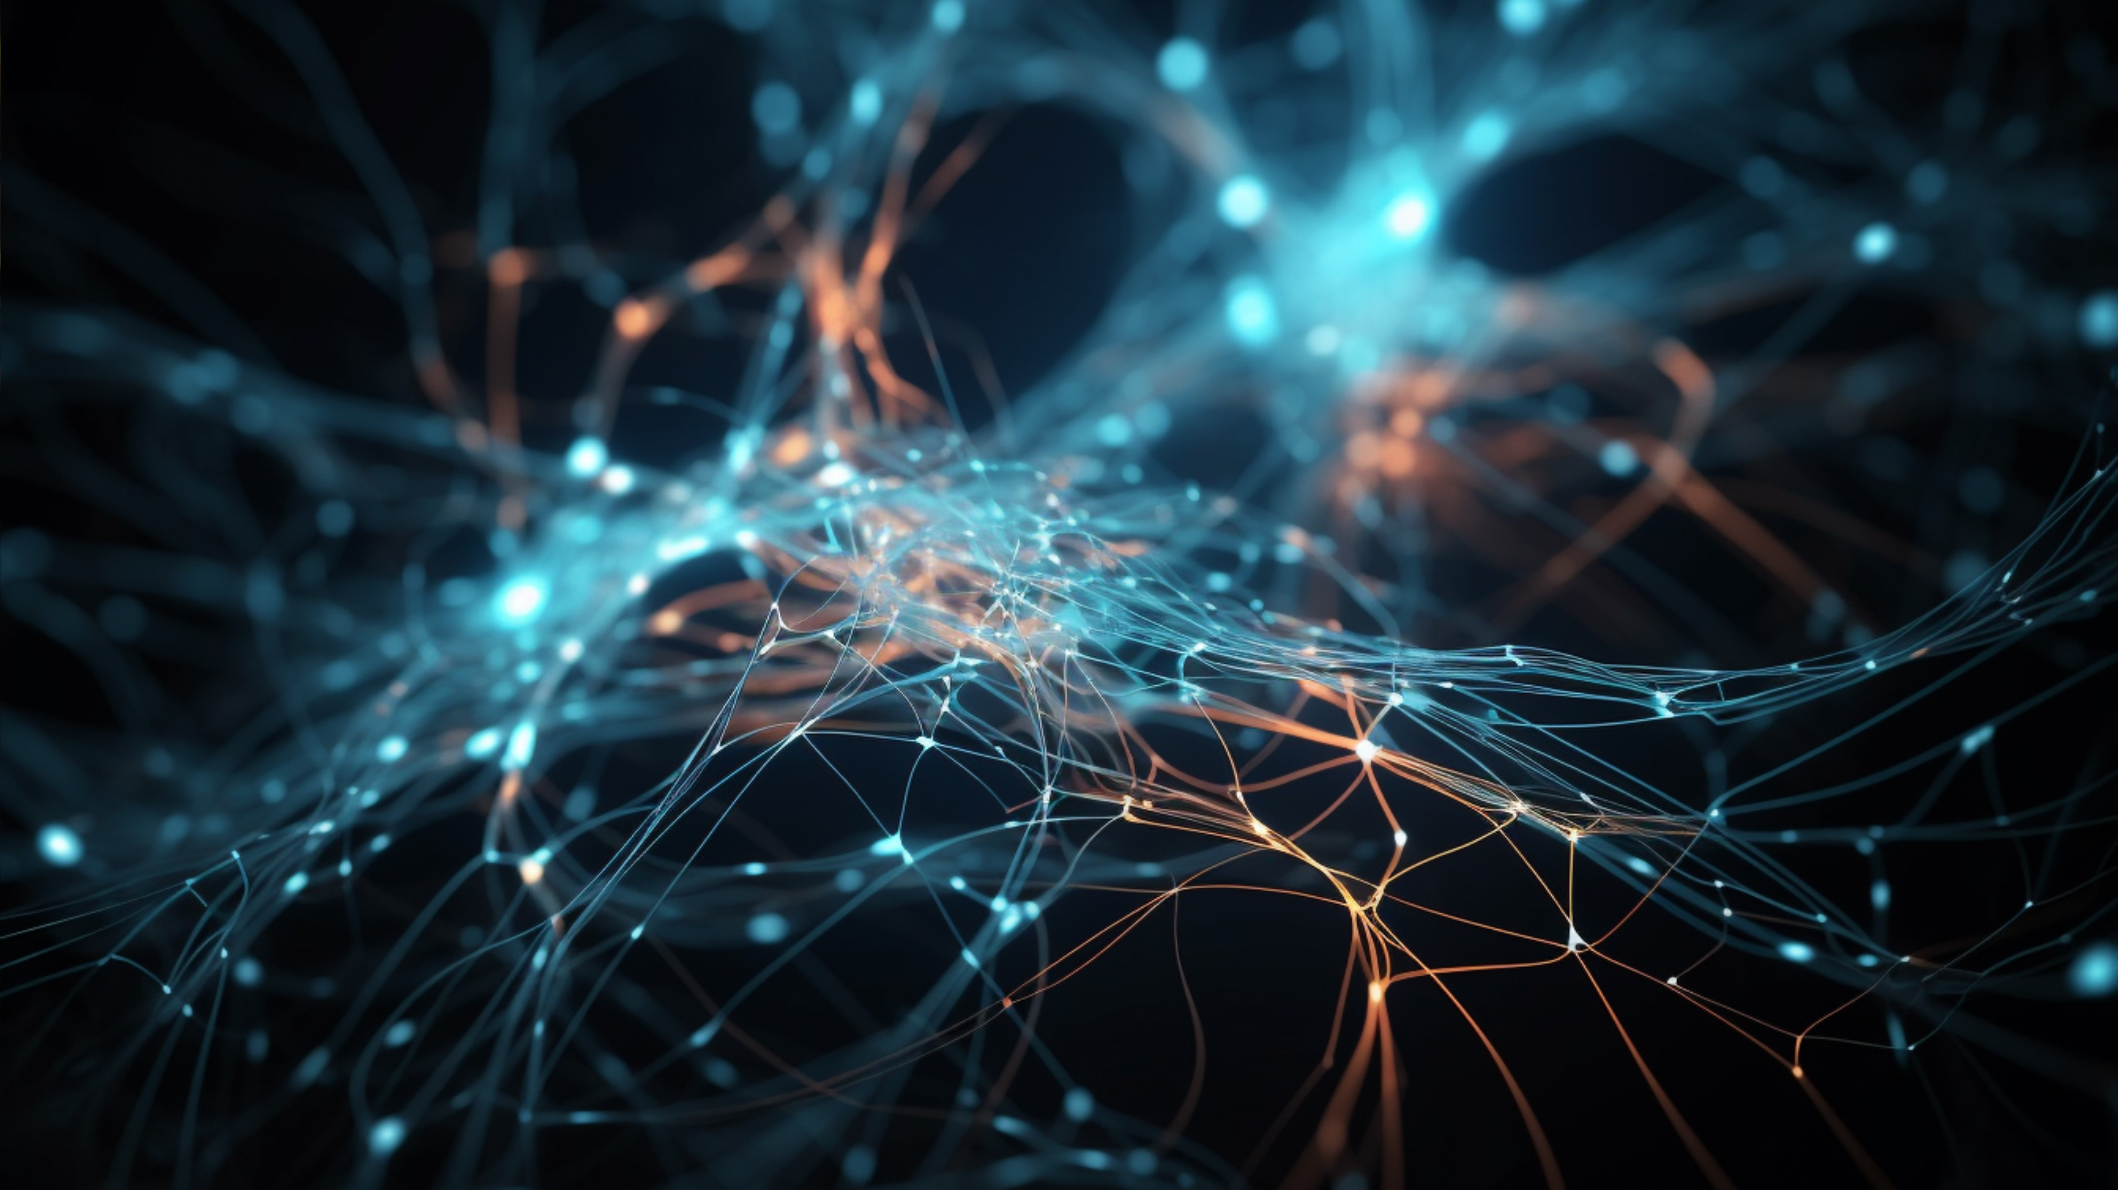
How does it look?

Slide 5
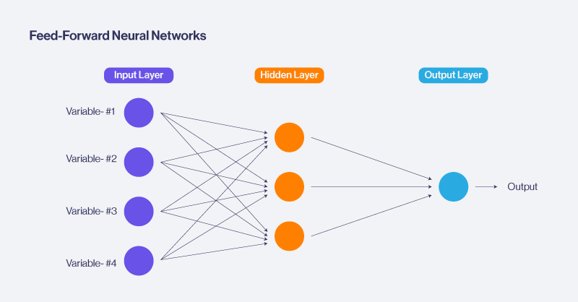
Shallow Network: 1 - 2 hidden layers
Deep Networks: 3 - 100 hidden layers

Slide 6
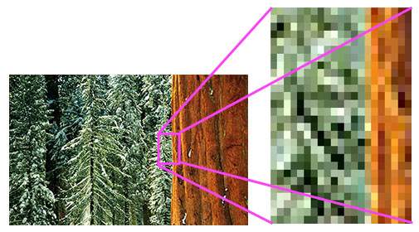
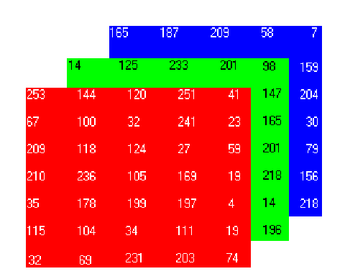
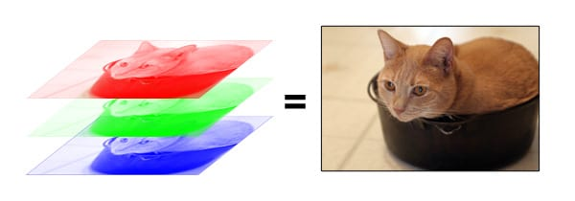
What is an Image?

Slide 7
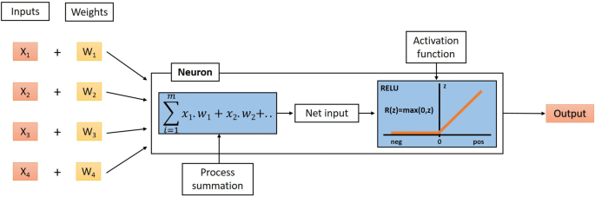

Slide 8
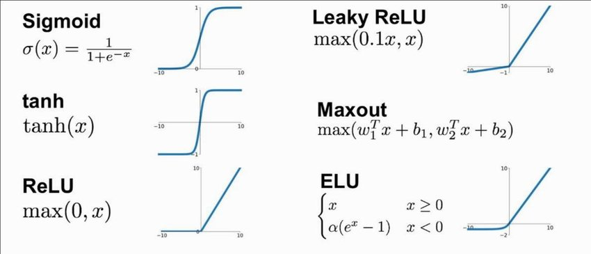

Slide 9
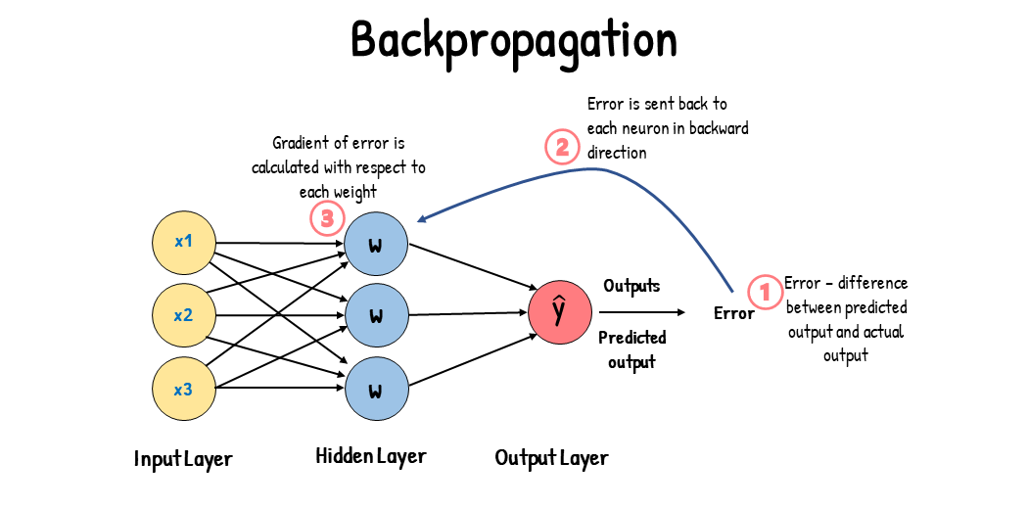
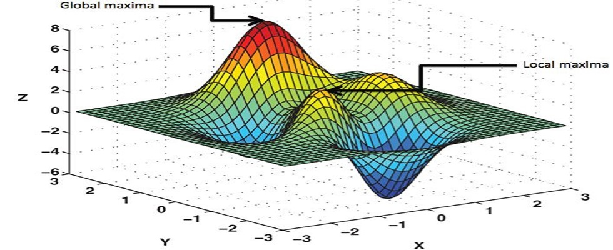
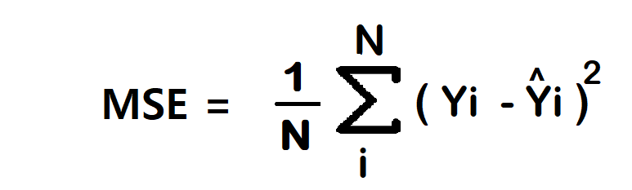

Slide 10
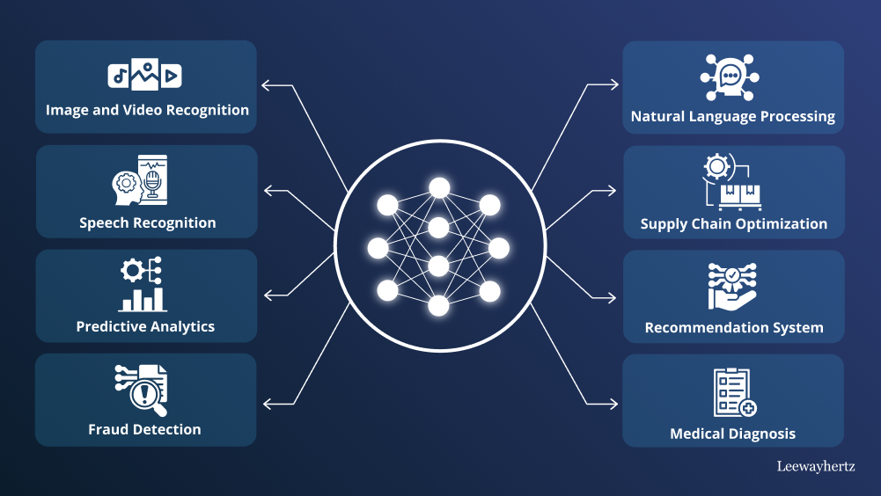

Slide 11
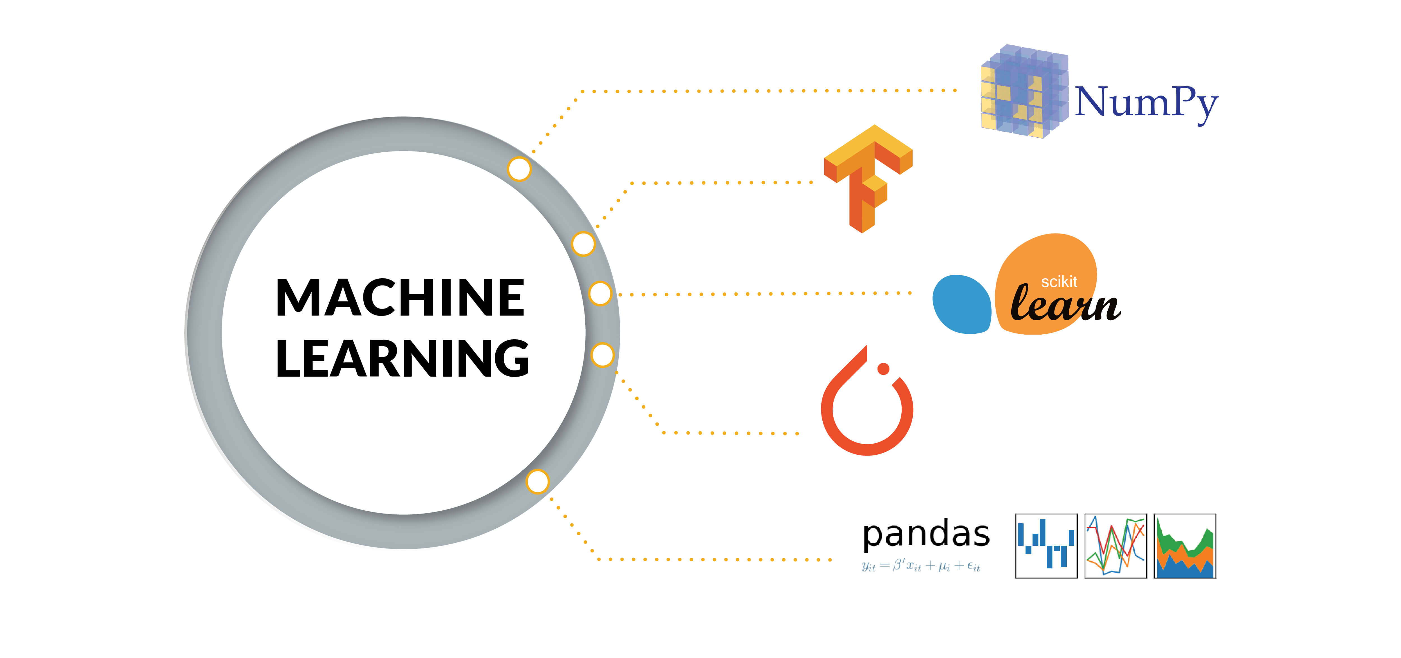

Slide 12
The Code

