Slide 1

carer
A little light, kept.
A warm, private, non-clinical wellbeing companion for unpaid family carers.
Non-clinical
18+
Free
Wellnetix Ltd · United Kingdom
Notes:
CARER — a warm, private, non-clinical wellbeing companion for unpaid family carers. Wellnetix Ltd, UK.

Slide 2

THE PROBLEM
63%
Carers hold everyone together, and quietly fall apart.
of carers say caring has harmed their mental health
~1 in 5
Unpaid carers are exhausted, isolated and under-supported. The work is relentless — and almost entirely invisible.
is at risk of burnout
Many don’t even call themselves a carer.
Sources: Carers UK, State of Caring 2024 · Umbrella review of caregiver mental-health meta-analyses (2025)
carer
02 · 21
Notes:
63% say caring harms their mental health; roughly 1 in 5 at risk of burnout; many never even call themselves a carer.

Slide 3
THE SCALE
A vast, invisible, growing population.
UNITED KINGDOM
UNITED STATES
5.8M
£184bn
63M
$1.01T
unpaid carers
of care each year
family caregivers · +45% since 2015
of care each year
About a second NHS.
Around 1 in 4 adults.
Sources: Carers UK, Key Facts & Figures (2025) · AARP & NAC, Caregiving in the US 2025 · AARP, Valuing the Invaluable (2026 update)
carer
03 · 21
Notes:
UK: 5.8M carers, £184bn a year — about a second NHS. US: 63M caregivers, up 45% since 2015, $1.01 trillion a year, about 1 in 4 adults.

Slide 4
WHO CARERS ARE
Every kind of carer.
Caring for a parent through dementia
Caring for a partner through cancer
A parent of a disabled or autistic child
The parent of an adult child living with mental illness
A young-adult carer, just turned 18
Someone in the after of loss
Different lives, the same quiet weight.
carer
04 · 21
Notes:
Six kinds of carer — different lives, the same quiet weight.

Slide 5
WHY TODAY’S SUPPORT FAILS THEM
Nothing is built for the carer.
Clinical apps
Wellness apps
Carer services
Feel medical and judgy — built around symptoms and diagnoses, not a carer’s life.
Pile on streaks, scores and guilt — one more thing to fail at on a hard day.
Fragmented and hard to reach — postcode lotteries, waiting lists, forms.
Carers don’t need another to-do list.
carer
05 · 21
Notes:
Clinical apps feel medical; wellness apps guilt-trip with streaks and scores; carer services are fragmented. Nothing is built for the carer.

Slide 6

THE SOLUTION
You look after them. CARER looks after a little of you.
A companion that listens
Remembers your words — never verdicts
Never scores you
Points to real help, when you want it
A little light, kept.
carer
06 · 21
Notes:
CARER: a warm, private, non-clinical AI companion. Listens, remembers your words — never verdicts — never scores you, and points to real help when you want it.

Slide 7
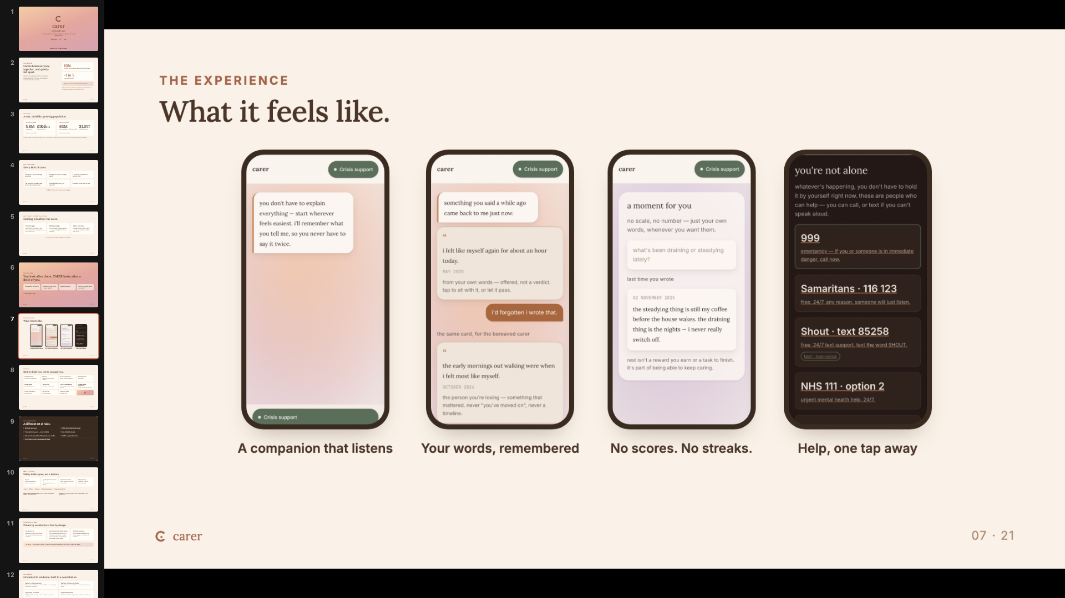

THE EXPERIENCE
What it feels like.
app screen
app screen
app screen
app screen
A companion that listens
Your words, remembered
No scores. No streaks.
Help, one tap away
carer
07 · 21
Notes:
Four moments from the product — screenshots to be dropped into the placeholders.

Slide 8

PRODUCT
Built to hold you, not to manage you.
Companion chat
Memory
No-score reflection
A private space
A warm voice that listens
Holds your words, never verdicts
Notice, without measuring
Yours alone
A grief space
Your journey
Crisis & safeguarding
Disease-aware signposting
For the after of loss
Your story, in your words
Four directions · free · offline · one tap
To real charities and real help
Gentle notifications
On-device AI
Export or delete
With quiet hours
Private by design
Anytime, in full
carer
08 · 21
Notes:
Eleven features, one principle: built to hold you, not to manage you.

Slide 9

OUR CONSTITUTION
A different set of rules.
1
We never score you.
5
Safety sits outside the AI model.
2
Your words stay yours — never verdicts.
6
Non-clinical by design.
3
We never build a profile of the person you care for.
7
Built for every kind of carer.
4
No streaks, no guilt, no engagement traps.
carer
09 · 21
Notes:
Seven written, enforced promises. This is the product's spine.

Slide 10
SAFETY & ETHICS
Safety is the spine, not a feature.
For you
For the person you care for
Harm from others
Safeguarding
When the weight is too much to carry alone
When someone in your life is the danger
Protecting a child or vulnerable adult
When they are the one in danger
Free
Offline
One tap
Works before sign-in
Independent of the AI
Region-aware crisis resources. UK + US now; a safe global fallback everywhere else.
Governed. UK GDPR, consent-first, clinical-safety + DPO governance.
carer
10 · 21
Notes:
Four-directional crisis support — free, offline, one tap, before sign-in, independent of the AI. Region-aware resources: UK + US live, safe global fallback. UK GDPR, consent-first, clinical-safety and DPO governance.

Slide 11
TECHNOLOGY & MOAT
Private by architecture. Safe by design.
On-device AI
A deterministic safety spine
Portable backend
Runs on the phone. Works offline. Your words don’t leave the device by default.
The crisis gate and classifiers run outside the warm model — safety can’t be bypassed. Independently red-teamed; all tests green.
All-API architecture with end-to-end encryption — no lock-in, no data lake.
THE MOAT
Carer-specific design · a safety architecture competitors don’t have · privacy by default
carer
11 · 21
Notes:
On-device AI, a deterministic safety spine outside the warm model — independently red-teamed, all green — portable all-API backend, end-to-end encryption.

Slide 12
THE SCIENCE
Grounded in evidence, built to a constitution.
Research + lived experience
A written, enforced constitution
Built on carer-wellbeing research and PPIE — carers shaping the product throughout.
Non-clinical and consent-first — rules the product cannot break.
Signposting, not advice
Independently tested
CARER points to real help — it never diagnoses, treats or prescribes.
Red-teamed safety and grounding, verified by outside eyes.
A privacy-preserving, consent-based foundation for carer-wellbeing research at scale.
carer
12 · 21
Notes:
Carer-wellbeing research plus lived experience; an enforced constitution; signposting not advice; independently red-teamed. A consent-based foundation for research at scale.

Slide 13
MARKET SIZE
A large market meeting a vast need.
TAM · DIGITAL MENTAL HEALTH
~$33bn → ~$180bn
TAM
2025 → 2035, ~18.5% CAGR · mental-health apps ~$9bn → ~$23bn by 2030
SAM · LAUNCH MARKETS
SAM
~69M adult carers
SOM
UK 5.8M + US 63M
SOM · THE WEDGE
An early, reachable wedge of UK adult carers — via early access and carer-organisation & employer partnerships.
Sources: Market Research Future, Digital Mental Health Market (2025) · MarketsandMarkets, Mental Health Apps Market (2025) · Carers UK (2025) · AARP & NAC (2025)
carer
13 · 21
Notes:
TAM: digital mental health ~$33bn 2025 to ~$180bn 2035 (~18.5% CAGR); apps ~$9bn to ~$23bn by 2030. SAM: ~69M adult carers in launch markets. SOM: early UK wedge via early access and partnerships.

Slide 14
GO-TO-MARKET
UK first, then the world, safely.
01
02
03
Launch UK
→
United States
→
More countries
Adults, 18+
Crisis resources localised
Localisation gates each market
CHANNELS
Carer charities — Carers UK, Carers Trust
NHS & local authorities
Employer carer-benefit schemes
App stores
Organic & social
Free removes all friction.
carer
14 · 21
Notes:
UK first, then US, then more countries — crisis localisation gates each market. Channels: carer charities, NHS and local authorities, employers, app stores, organic. Free removes all friction.

Slide 15
BUSINESS MODEL
Free for carers. Sustainable by design.
ALWAYS FREE
SUSTAINED BY
The core is free — for accessibility, and for trust. Crisis support is always free, for everyone.
An optional supporter tier and donations, plus partnerships with the NHS, councils, employers and charities.
Never by charging carers. Never by selling data.
carer
15 · 21
Notes:
Core is free — accessibility and trust; crisis support always free. Sustained by an optional supporter tier, donations and partnerships. Never by charging carers or selling data.

Slide 16

COMPETITIVE LANDSCAPE
Where CARER sits.
Non-clinical · Generic
Non-clinical · Carer-specific
Headspace
Calm
carer
Alone here — private, on-device, safety-first
THE WEDGE
Carer-specific
Non-clinical
Clinical · Generic
Services · Carer-specific
Private & on-device
Wysa
Mobilise
Safety-first
Woebot
Carers UK tools
Anti-guilt
carer
16 · 21
Notes:
CARER sits alone in the carer-specific, non-clinical, private quadrant. Wedge: carer-specific, non-clinical, on-device privacy, safety-first, anti-guilt.

Slide 17
STATUS
Built, safe, and ready.
Product feature-complete
Safety gates green — crisis red-team + grounding
Region-aware crisis support live
Marketing website ready
Full App Store + Google Play asset kit ready
In early access
Pre-launch — a real, reviewable product. No vanity metrics.
carer
17 · 21
Notes:
Feature-complete, safety gates green, region-aware crisis live, website and store kits ready, in early access. Pre-launch — a real, reviewable product.

Slide 18
ROADMAP
What’s next.
NOW
NEXT
LATER
Launch UK
US market
More countries
Bundle the on-device model
Carer-org & employer partnerships
Deeper personalisation
Solicitor / ICO + clinical-safety sign-off
Research validation
A platform for carer-wellbeing research
carer
18 · 21
Notes:
Now: UK launch, bundle the on-device model, sign-offs. Next: US, partnerships, research validation. Later: more countries, deeper personalisation, a research platform.

Slide 19

TEAM & GOVERNANCE
Who’s behind CARER.
Wellnetix Ltd · United Kingdom
A small, mission-driven team.
Clinical-safety lead
Data-protection officer
Lived-experience panel
Named accountability for safety decisions
Guardian of consent and privacy
PPIE — carers shaping every decision
Roles shown; names to be added.
carer
19 · 21
Notes:
Wellnetix Ltd, UK — a small mission-driven team, governed by a clinical-safety lead, a DPO and a PPIE panel. Names to be added.

Slide 20

Help us keep a little light for the people who hold everyone else.
INVESTORS
ACADEMICS
EVERYONE
Partner with us.
Collaborate on carer-wellbeing validation.
Join early access.
Funding ask to be set.
A little light, kept.
nimind@wellnetixltd.com
20 · 21
Notes:
Investors: partner with us. Academics: collaborate on validation. Everyone: join early access. A little light, kept.

Slide 21
REFERENCES
The numbers, sourced.
UK: 5.8M unpaid carers · £184bn/yr value of care
UK: 63% say caring harms their mental health
Carers UK, Key Facts & Figures / Facts About Carers (2025) · carersuk.org
Carers UK, State of Caring 2024
US: 63M family caregivers, +45% since 2015
US: $1.01 trillion/yr value of unpaid care
AARP & National Alliance for Caregiving, Caregiving in the US 2025
AARP, Valuing the Invaluable (2026 update) · aarp.org
~1 in 5 carers at risk of burnout
Digital mental health: ~$33bn (2025) → ~$180bn (2035), ~18.5% CAGR
Umbrella review of informal-caregiver mental-health meta-analyses (2025) · sciencedirect.com
Market Research Future, Digital Mental Health Market (2025) · marketresearchfuture.com
Mental-health apps: ~$9bn (2025) → ~$23bn (2030)
Market figures are third-party estimates; ranges reflect differing methodologies.
MarketsandMarkets, Mental Health Apps Market (2025)
carer
21 · 21
Notes:
Every cited figure mapped to its source. Market figures are third-party estimates.

