Slide 1

Health Monitor
By Group 4
Yuwei Jiang, Xinyu Li, Chenfan Xiao, Chenyao Wen, Jianing Xu

Slide 2


Slide 3
Pre-Requirements
Laptop or mobile device
Fitbit account
Fitbit wearable equipment
Extra function:
Facebook
Email account

Slide 4




System Architecture
User login & requirements
{Fitbit}
{DailyMile}
{MyFitnessPal}
Reading & writing

Slide 5
Personal Health

Slide 6
How many of you have ever had wearable devices like fitbit, jawbone up, or health app in your phone?
How many of you used to see your activity every day?
How many of you are still tracking your activity / wear wearable devices?
Did they change your lifestyle?

Slide 7
Goals of HealthOn
Easy to access

Slide 8
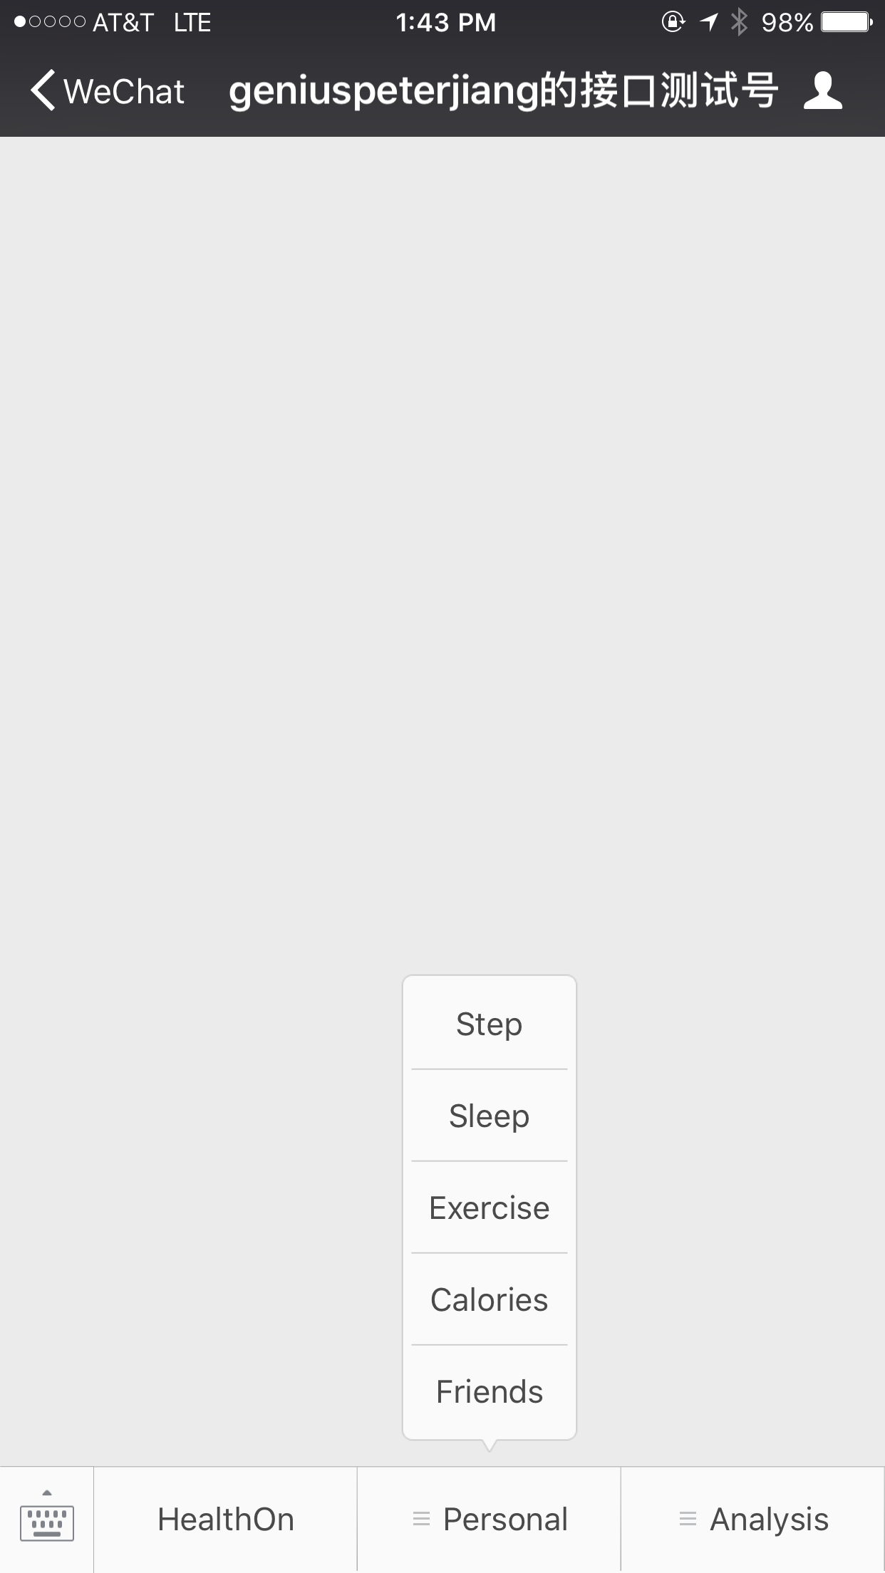
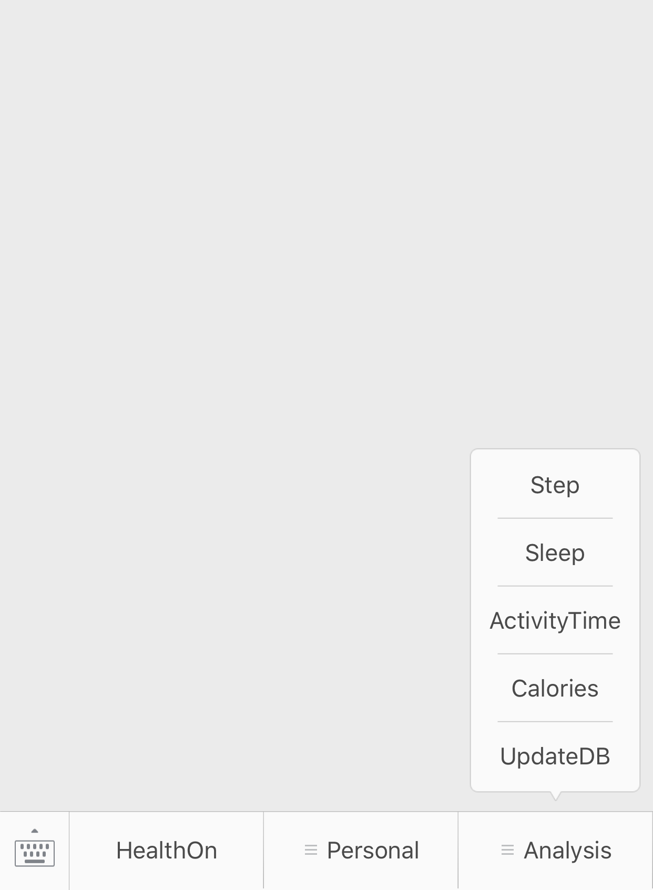
Easy to access
Notes:
It’s impossible to expect your users to log in your website everyday. But they’re willing to visit it on their phone.

Slide 9
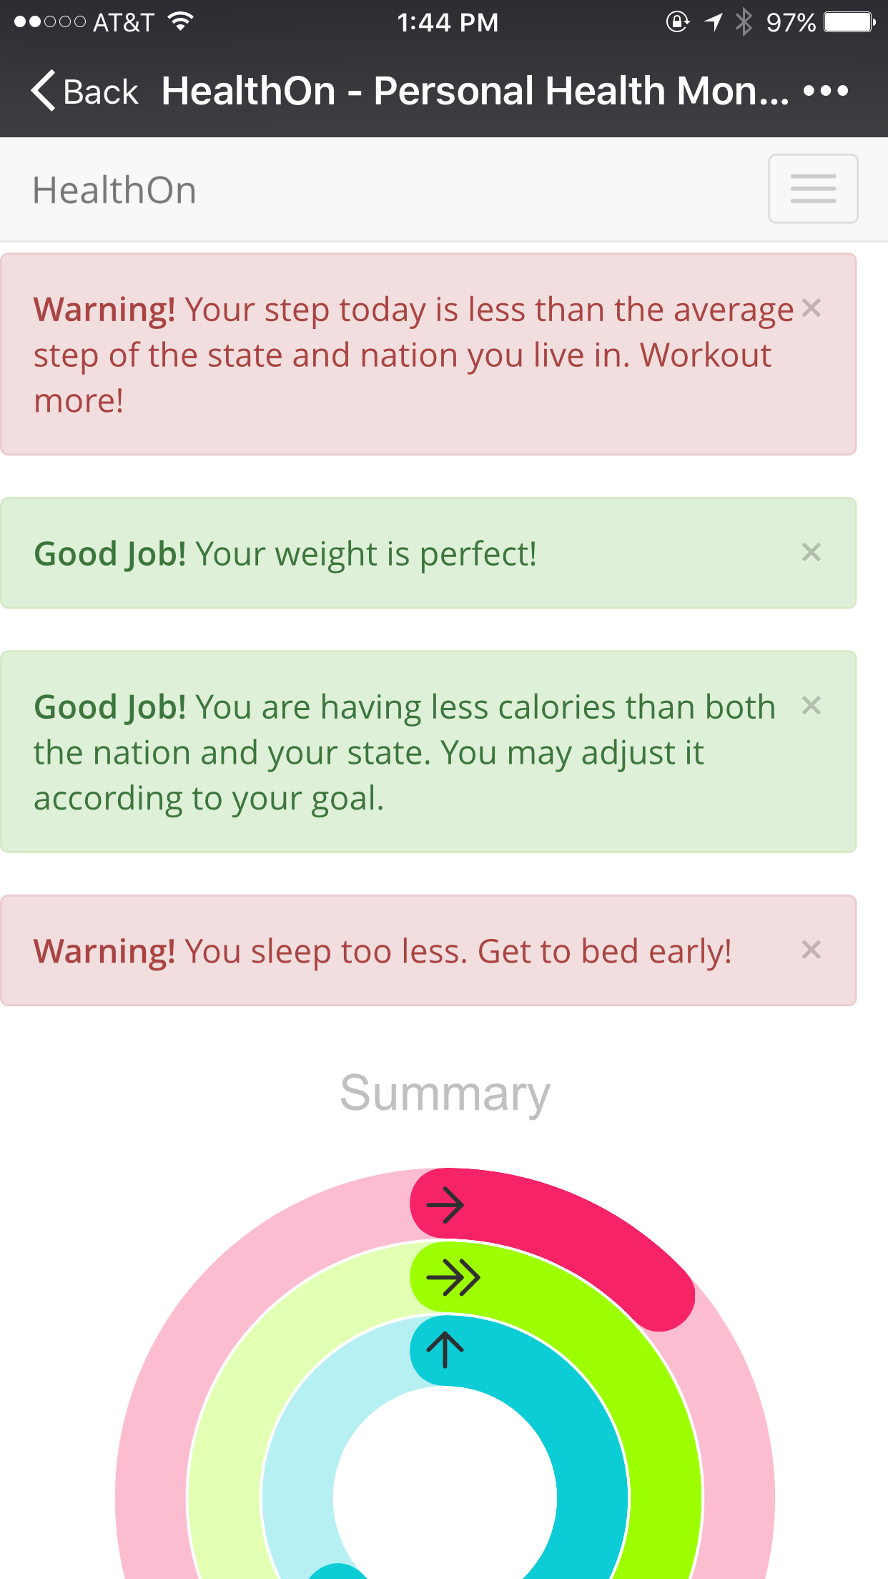
Access with your phone
No need for your laptop
Fully responsive

Slide 10
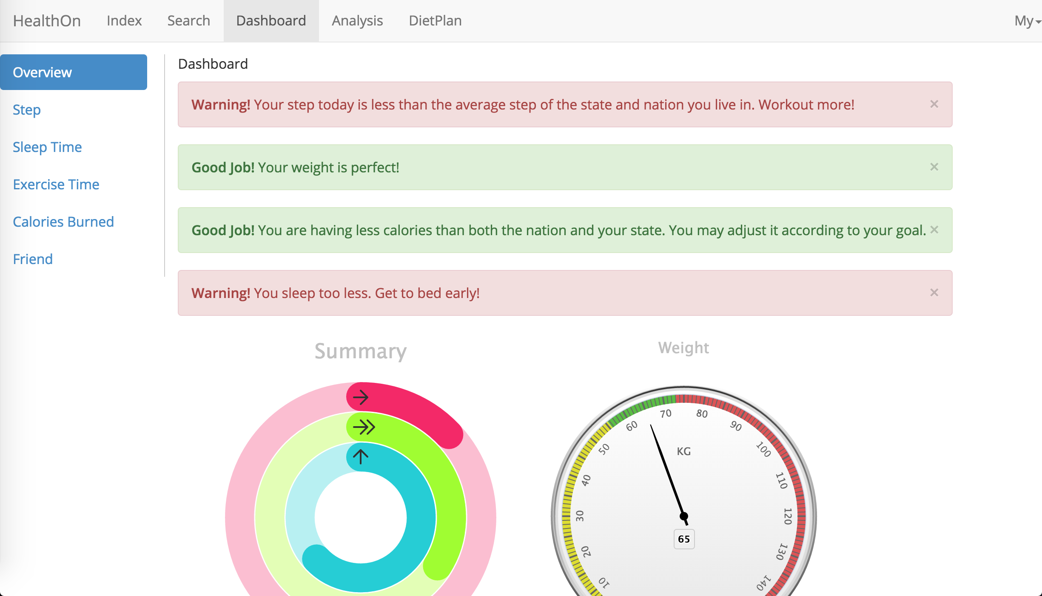

Slide 11
How many of you have ever set yourself some goal?
Go to gym three times a week? Walk 10,000 steps a day? Etc…

Slide 12
How many of you have ever set yourself some goal?
Go to gym three times a week? Walk 10,000 steps a day? Etc…
How many of you still doing so?

Slide 13
Problems of other health system
Motivation
They present you your goal, your diet plan, everything that you should do.
BUT, YOU ARE JUST NOT GOING TO DO THEM.
Notes:
Show you your goal, a set of data. It’s meaningless. You know you should walk 10,000 steps a day, you know you haven't yet, but you are not going to do it.

Slide 14
Goals of HealthOn
Easy to access
Motivation

Slide 15
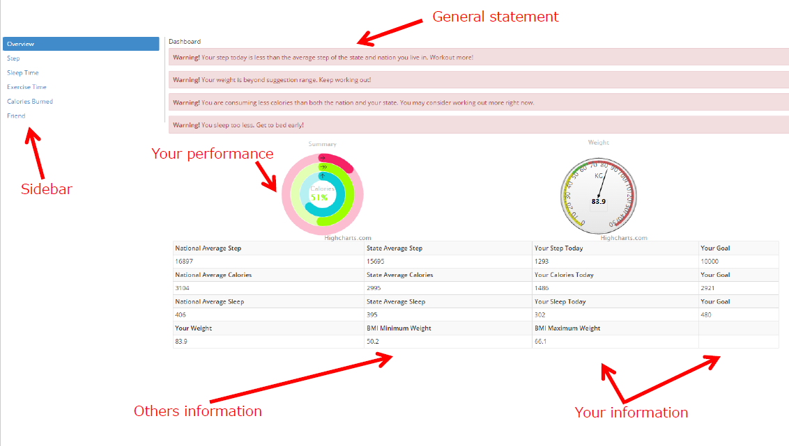
Dashboard

Slide 16
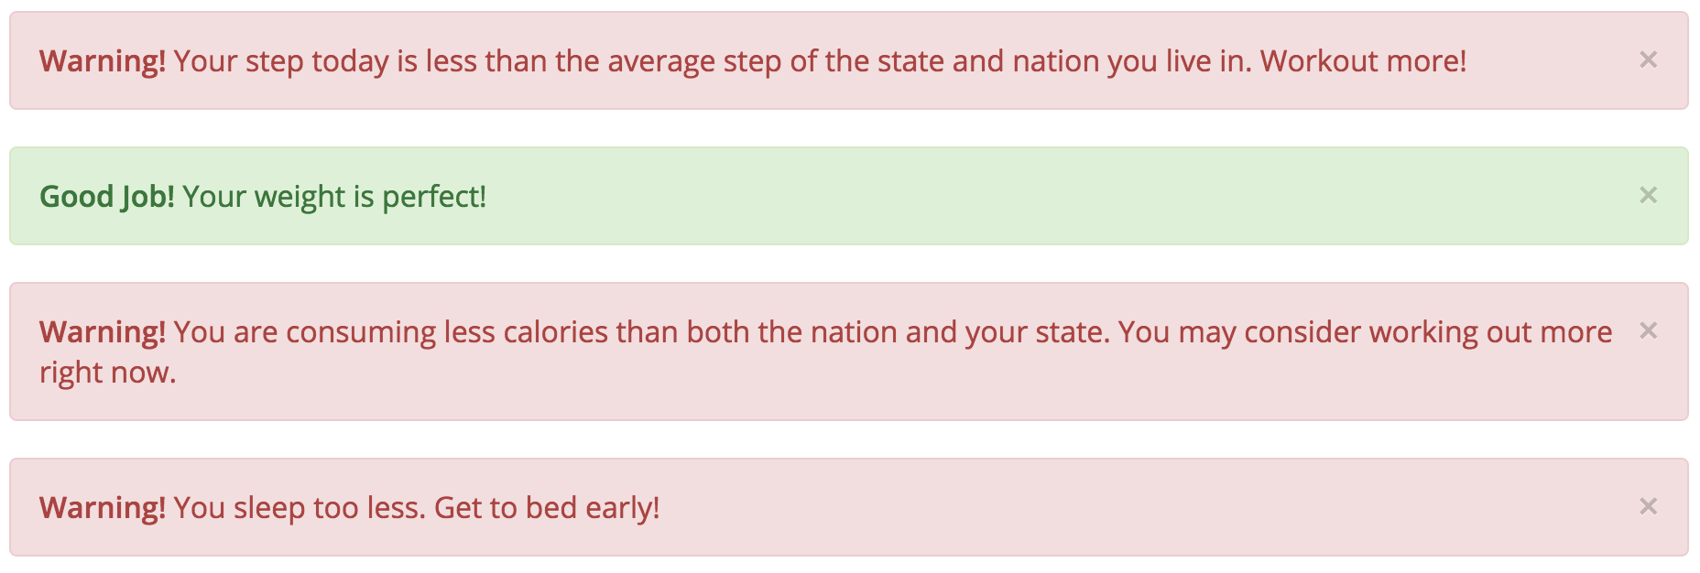
Motivation
Advise:

Slide 17
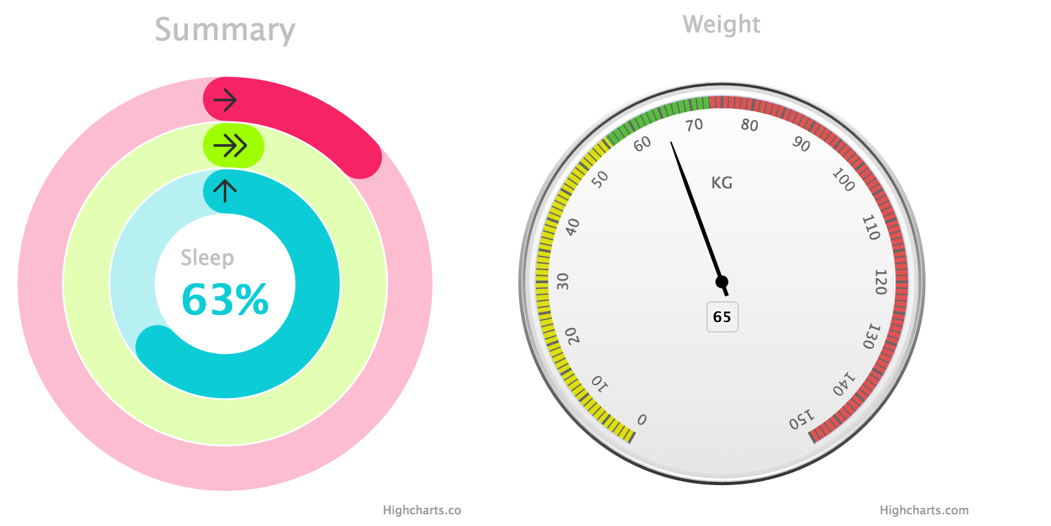
Motivation
Performance Chart:

Slide 18
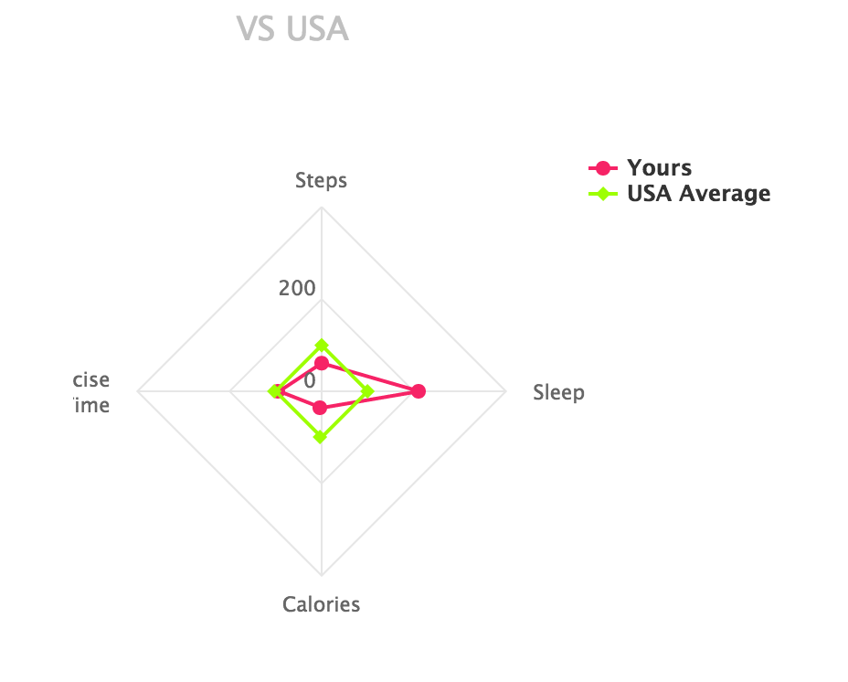
Motivation
Comparing Chart:
Notes:
When you heard that you did not finish your goal today. It’s easy to ignore that, because you probably are not gonna finish that tomorrow. And you haven’t been finishing that for a week.
But we show you how much the guys around you workout, how much they sleep. Probably it’s gonna be different.

Slide 19
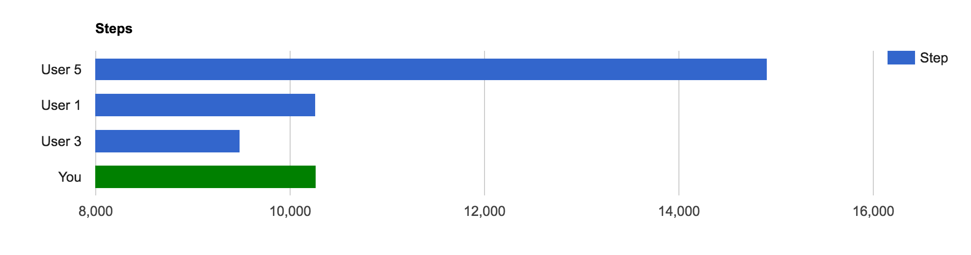
Motivation
Friends step rank:
Notes:
More than that, we will show you a rank of your friends. Perhaps, when you see how healthy your friends are, it’s gonna make a difference.

Slide 20
What do you see from this email?

Slide 21
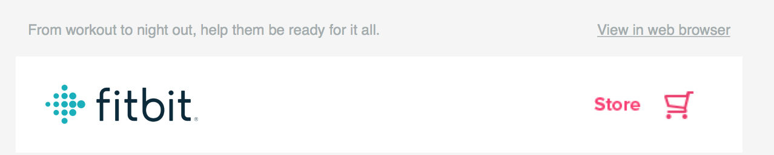
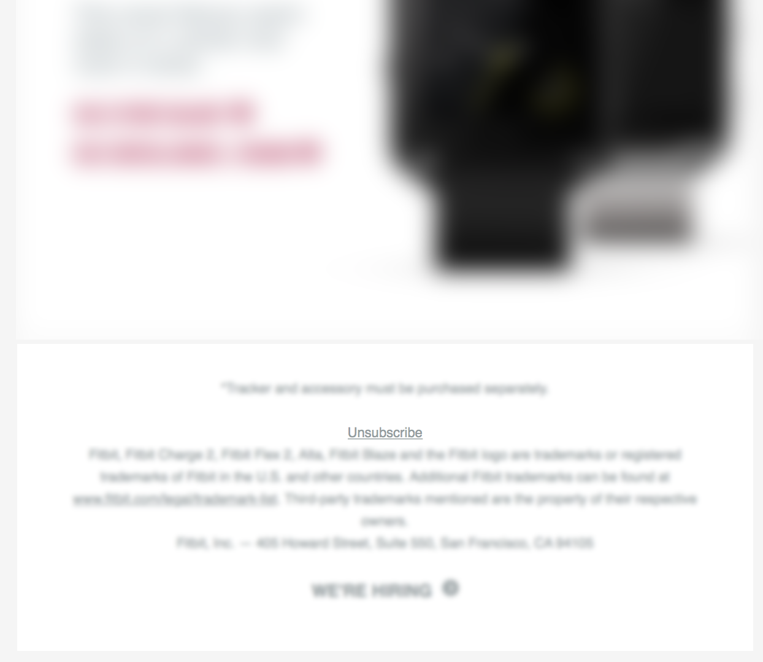

Slide 22
Unsubscribe
Notes:
Why is that? Except for I blurred other part?
The emails sent to you, have nothing really to do with you, nothing useful for you.

Slide 23
Goals of HealthOn
Easy to access
Motivation
Reminder

Slide 24
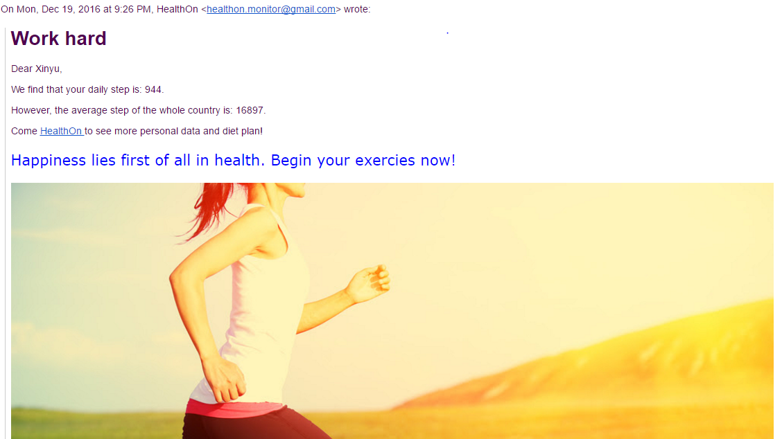
Supervise user step
If the user’s steps is less than the averager steps, we will send an email to user to encourage him doing more exercise.
Notes:
Q Xinyu

Slide 25
Analyst

Slide 26
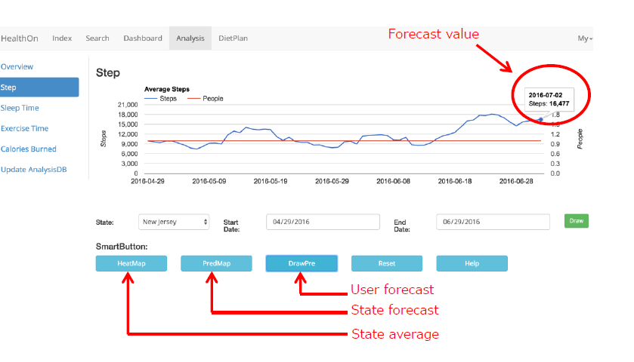
Analysis

Slide 27
Forecast Algorithm
SVM - Regression
Taking national average into consideration
State average and National average
Highly likely it keeps less in the future
Adjust up to 10% depending on the difference between state average and national average

Slide 28
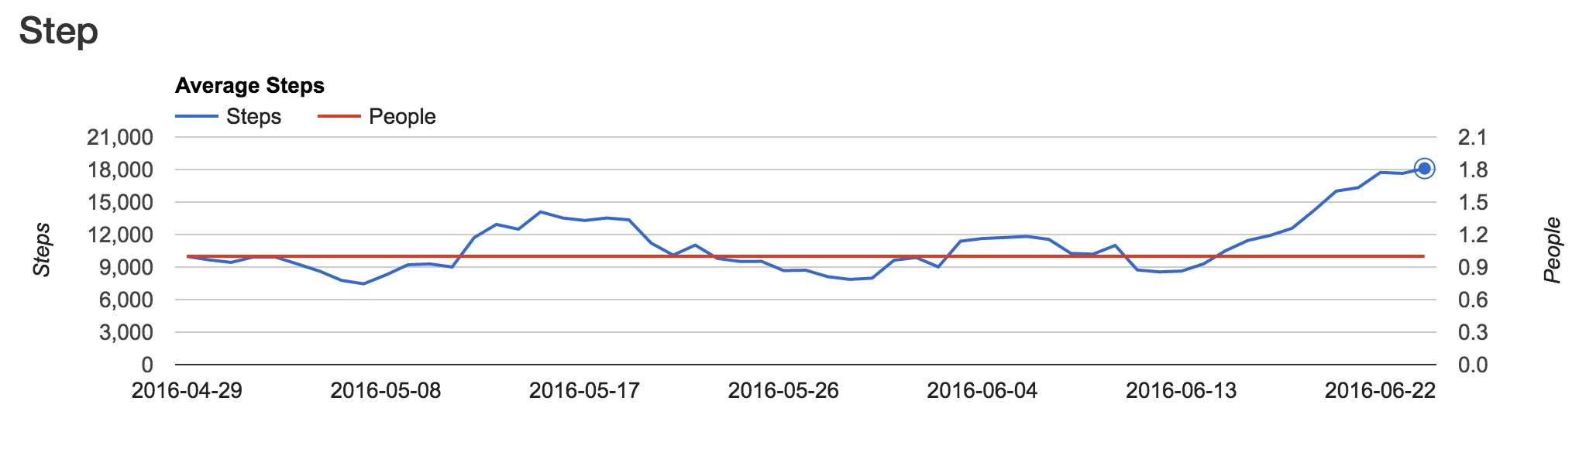
Forecast Algorithm
Accurate
Original

Slide 29
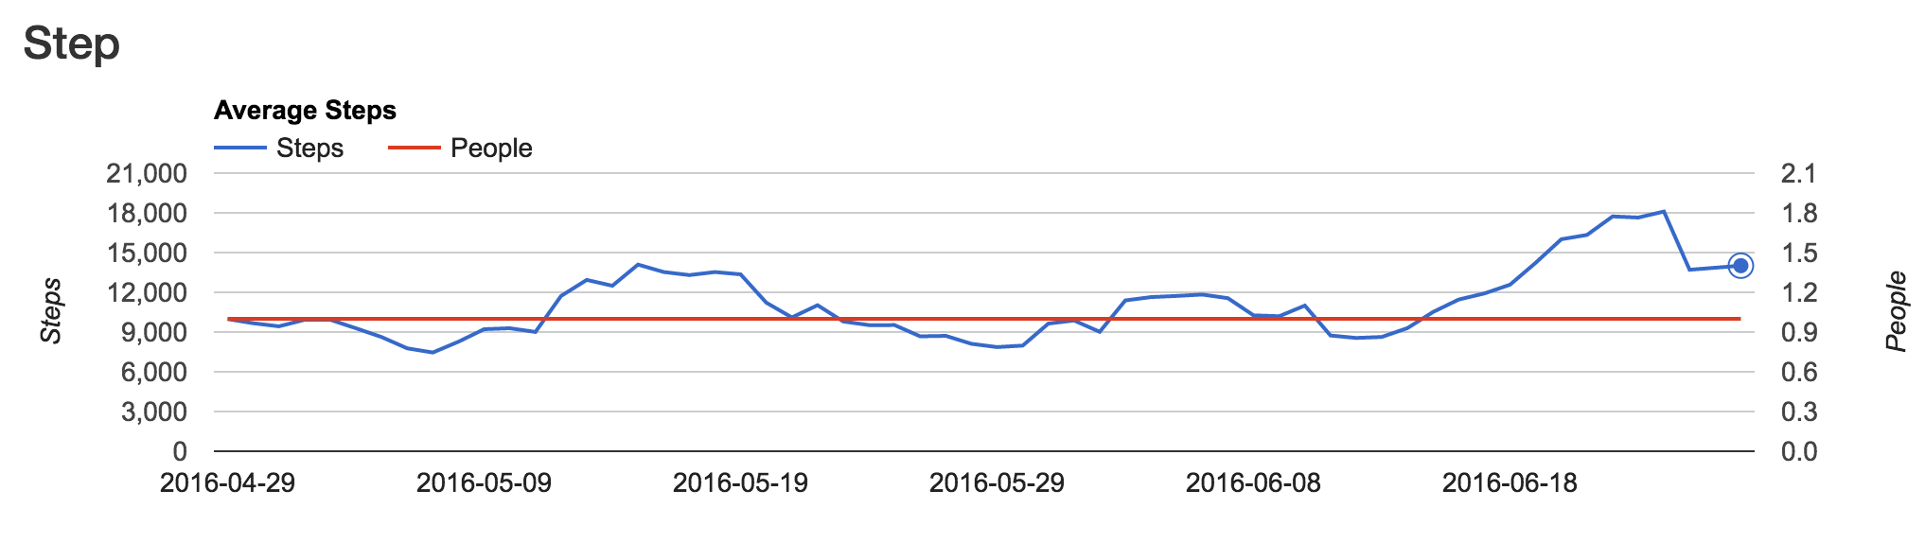
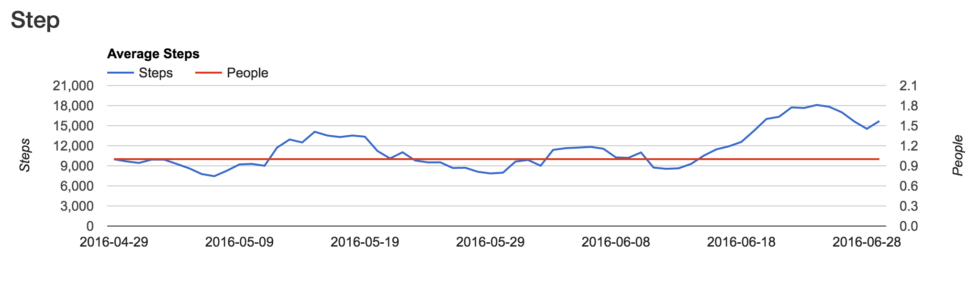
Forecast Algorithm
Predicted:
Actual:

Slide 30
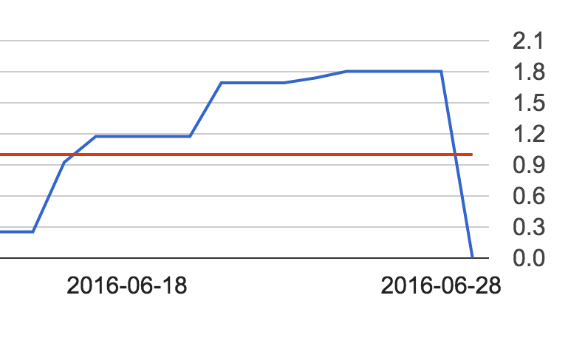
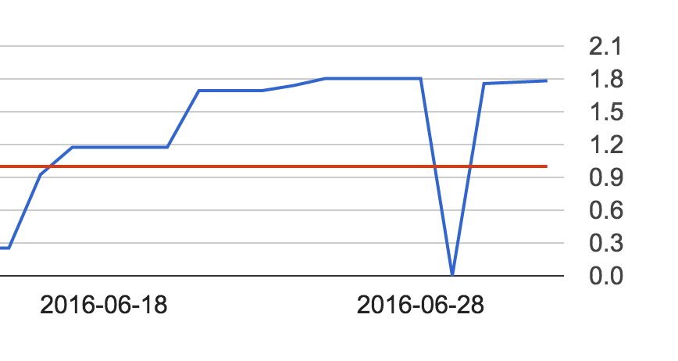
Forecast Algorithm
Original:
Predicted:

Slide 31
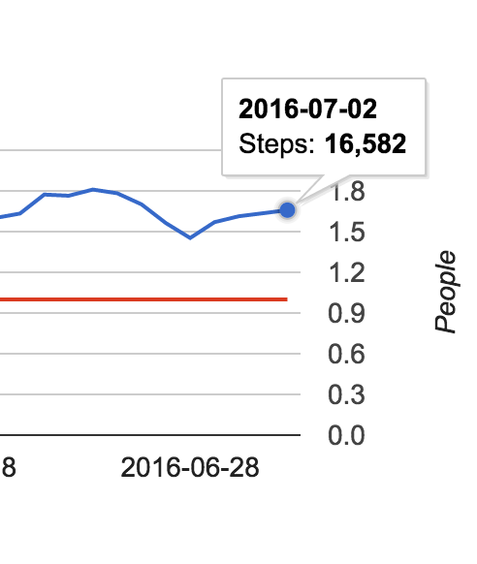
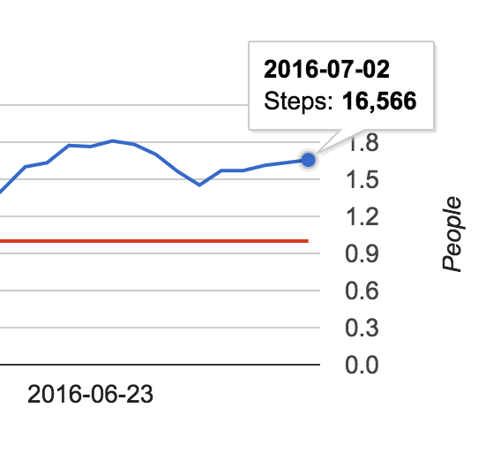
Forecast Algorithm
Taking national average into consideration
Without modification
With modification

Slide 32
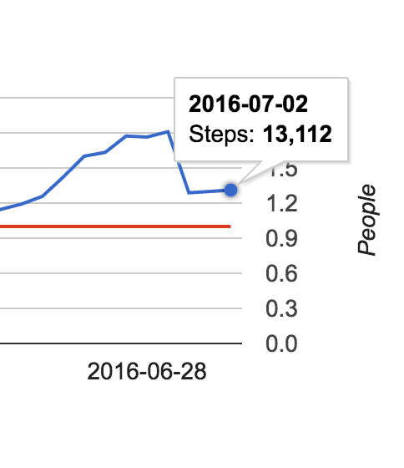
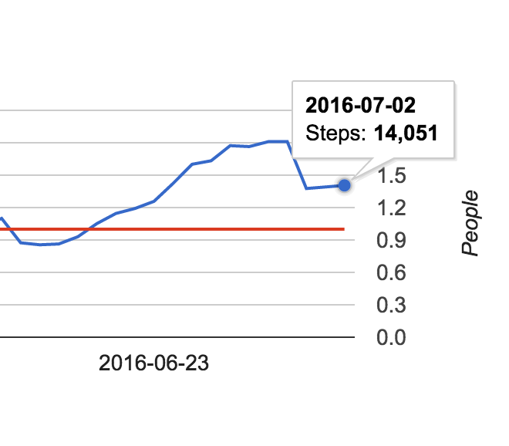
Forecast Algorithm
Taking national average into consideration
Without modification
With modification

Slide 33
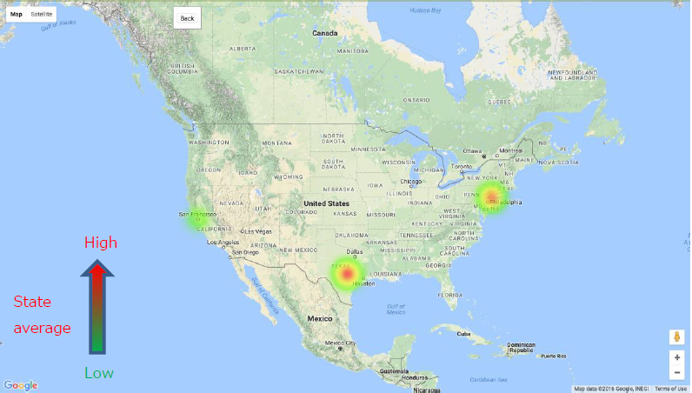
Heatmap
Actual Data:

Slide 34
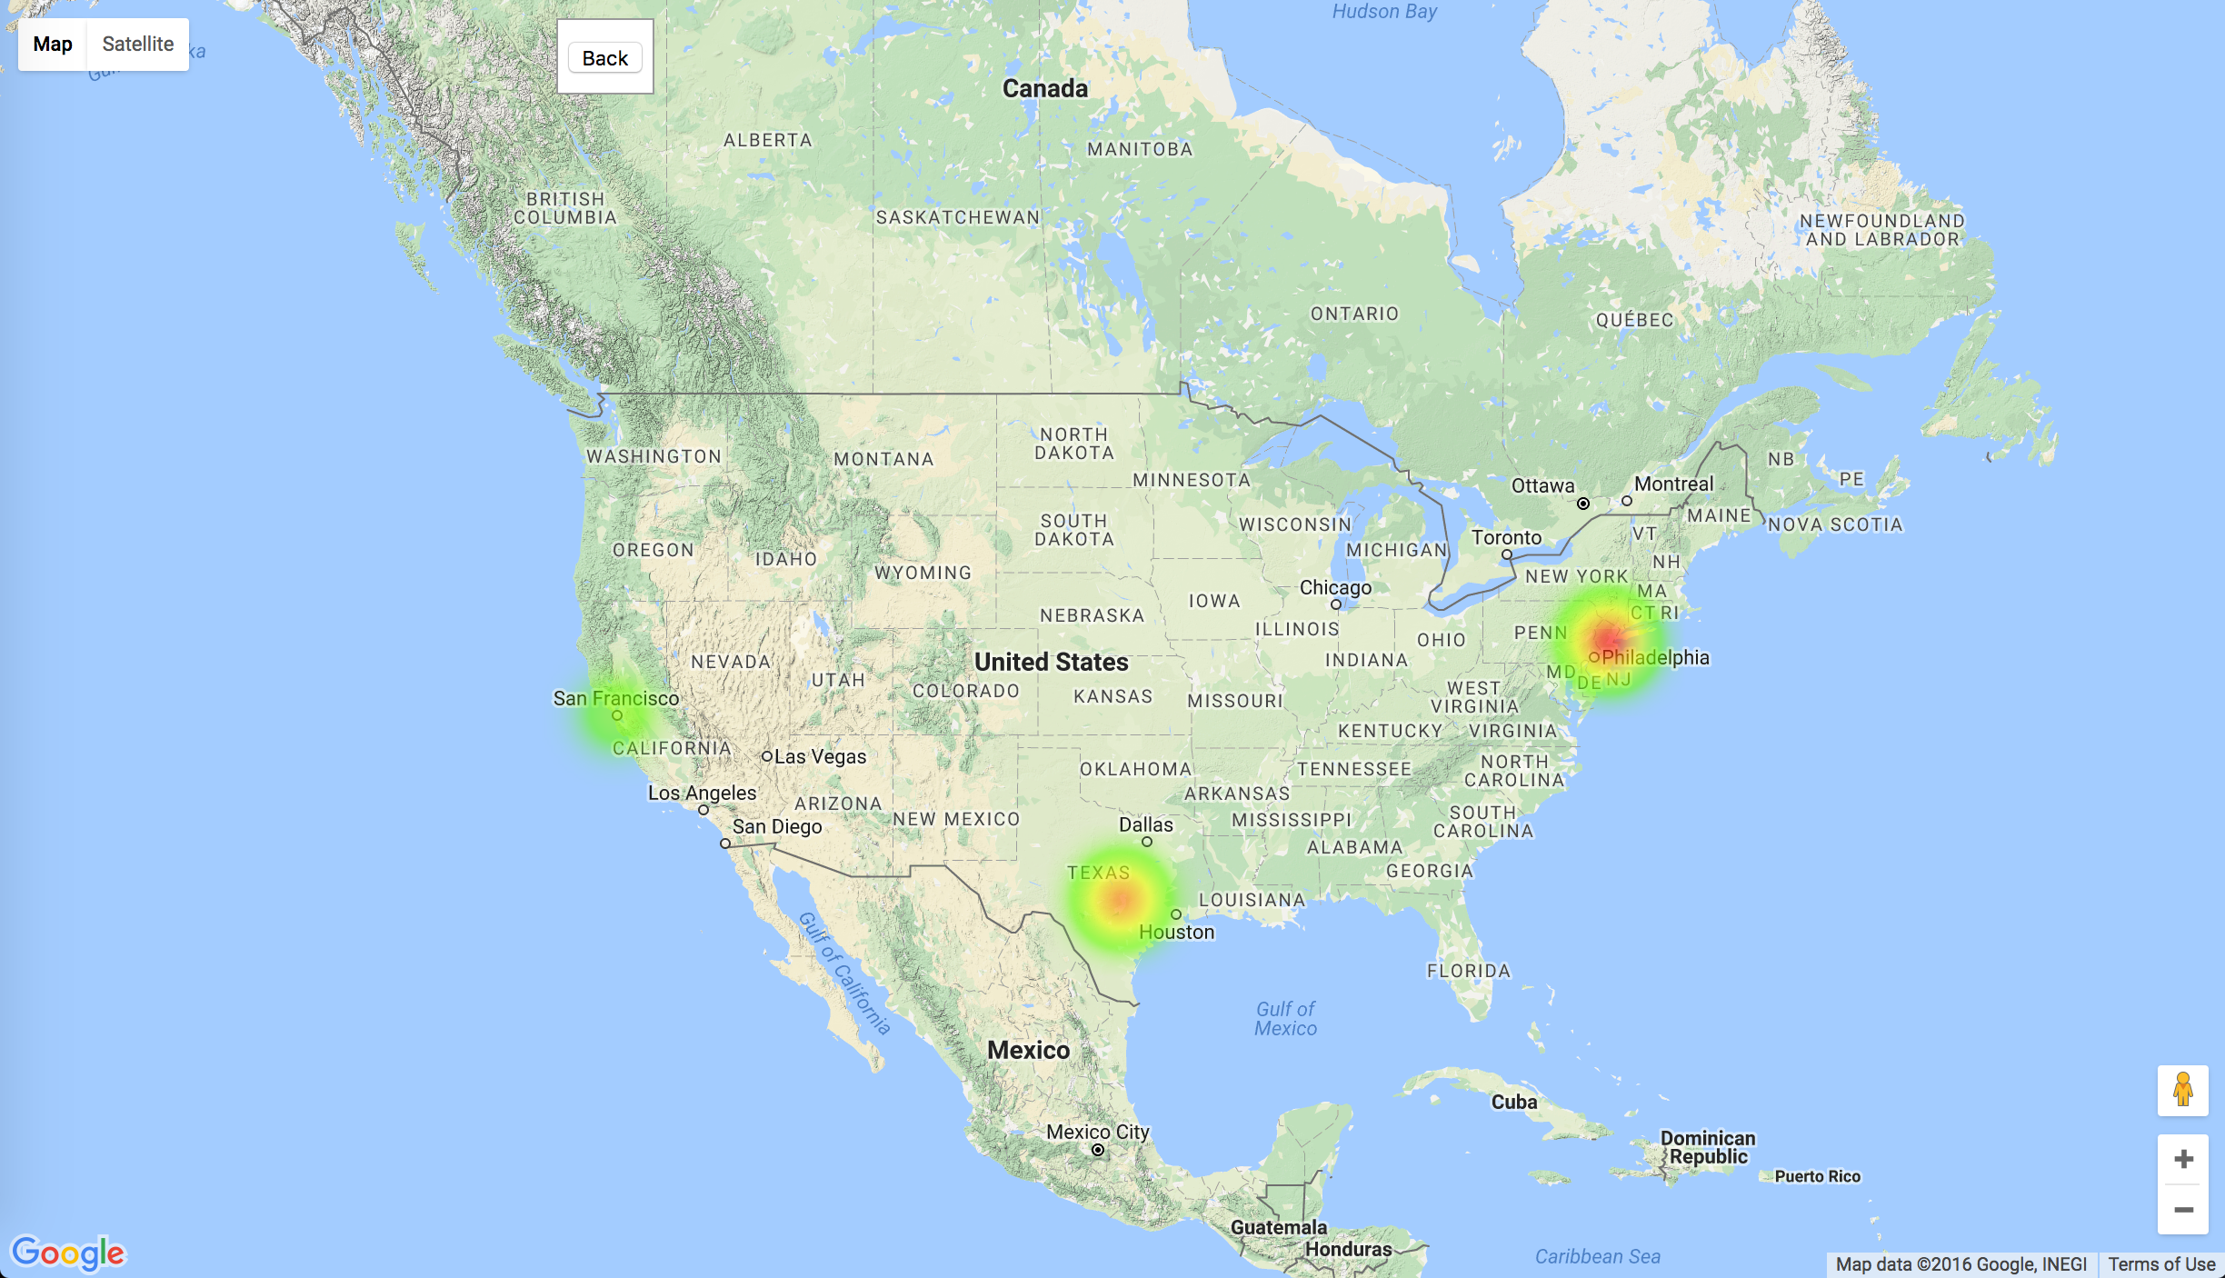
Heatmap
Prediction Data:

Slide 35
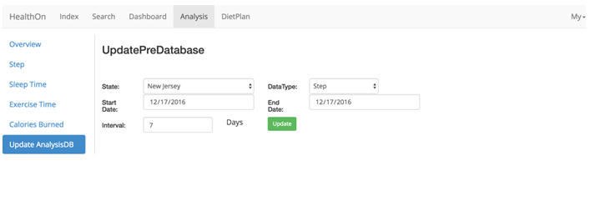
Update Database

Slide 36
Functions
Monitor & Analysis
Steps
Sleep time
Exercise time
Calorie burned
Friend
Recommend
Customized diet
Search food

Slide 37
DietPlan
Customized diet
Search food

Slide 38
Thank you!
Question?

