Slide 1





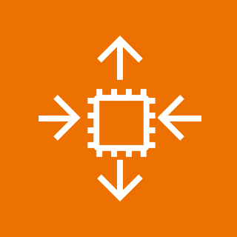
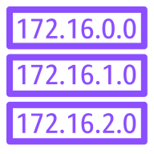



AWS account
us-east-1a
DNS
us-east-1b
igw
Virtual private cloud (VPC)
Public subnet
Public subnet
Security Group A
10-200-13-199
10.200.0.0/20
EC2
Private subnet
Private subnet
ec2-rds-3
rds-ec2-3
Security Group B
10.200.32.128
Multi-AZ
RDS
10.200.32.0/25

