Slide 1
MyTweet
Cuong Cu
Ran Chen
Rishabh Bhojak
Vishnu Chelle

Slide 2
Introduce
In the project. We collected tweet’s comment. And analysis the comments through sever ways. Finally, we got topic in the comments and the topic frequency for the graph

Slide 3
Technology
Backend(Java)
Stream processing
Spring Framework
NLP(coreNLP)

Slide 4
Technology
Frontend
Jquery
Highchart
React.js

Slide 5
Processing
Connect tweet’s stream
Library:Twitter4j
Pipe tweets to storm topology
Send results to users

Slide 6
Analysis data
Extract the topic of tweets in hashtag.
Count the number of topic appeared in the comments.(Form part)
Frequency is number of tweets collected every 1 second.(Graph part)

Slide 7
URL for Project
Video Url: https://youtu.be/iV9bLYmPG-k
Code Url: https://github.com/cnsgcu/Tidercartxe

Slide 8
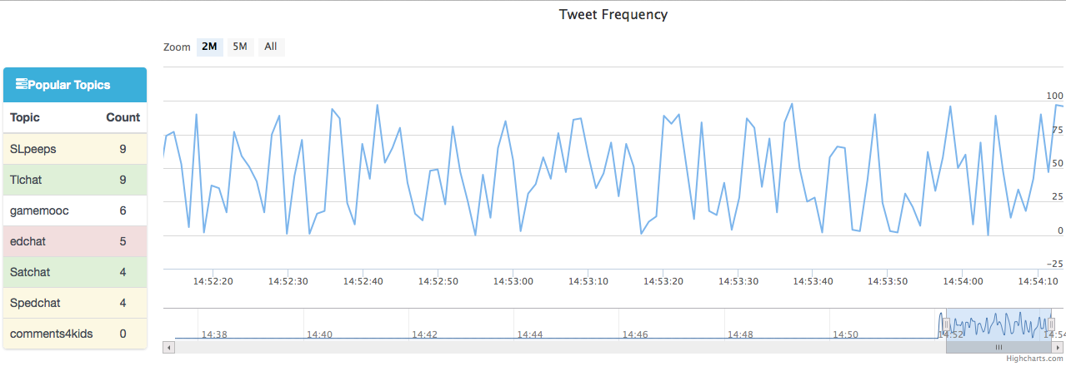
Screenshot

Slide 9
Thanks

