Slide 1
MyTweet
Cuong Cu
Ran Chen
Rishabh Bhojak
Vishnu Chelle

Slide 2
Introduce
In the project. We collected tweet’s comment. And analysis the comments through several ways. Finally, we got topic in the comment and output the count of topic and the frequency of the topic.

Slide 3
Technology
Backend(Java)
Stream processing
Spring Framework
NLP(coreNLP)

Slide 4
Technology
Frontend
Jquery
Highchart
React.js

Slide 5
Processing
Connect tweet’s stream
Library:Twitter4j
Pipe tweets to storm topology
Send results to users

Slide 6
Analysis data
Extract the topic of tweets in hashtag.
Count the number of topic appeared in the comments.(Form part)
Frequency is number of tweets collected every 1 second.(Graph part)

Slide 7
URL for Project
Video Url: https://youtu.be/iV9bLYmPG-k
Code Url: https://github.com/cnsgcu/Tidercartxe

Slide 8
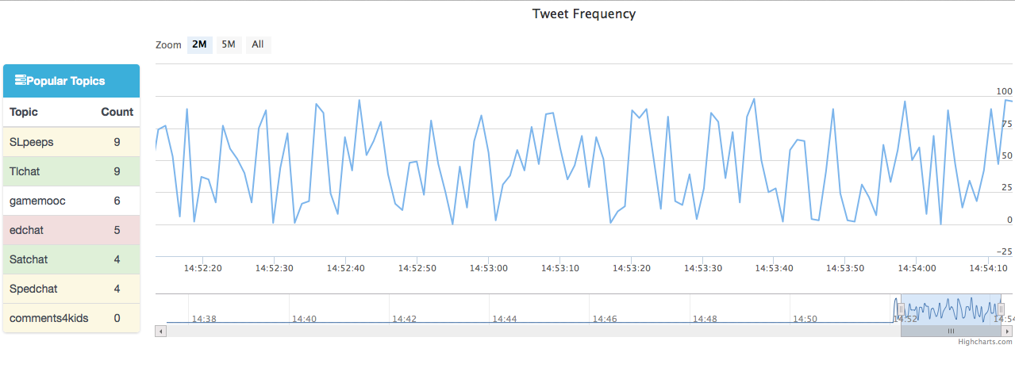
Screenshot

Slide 9
Thanks

