Slide 1
语音自监督学习
Wav2vec系列论文解读

Slide 2
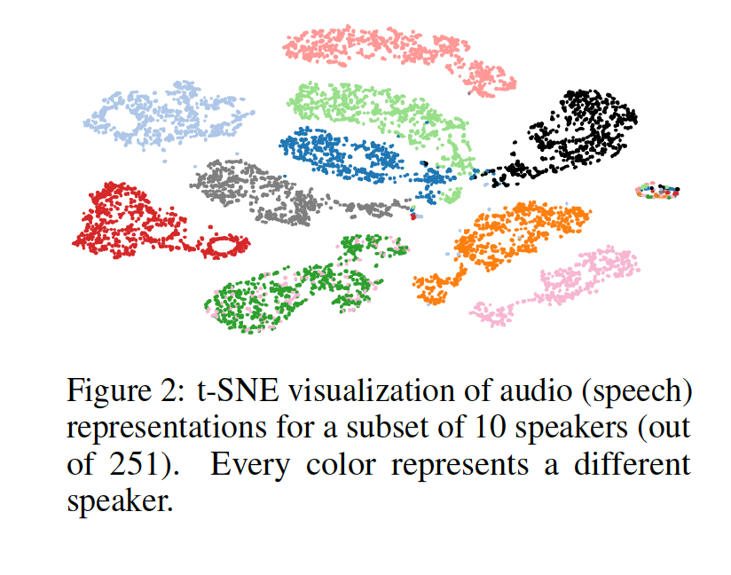
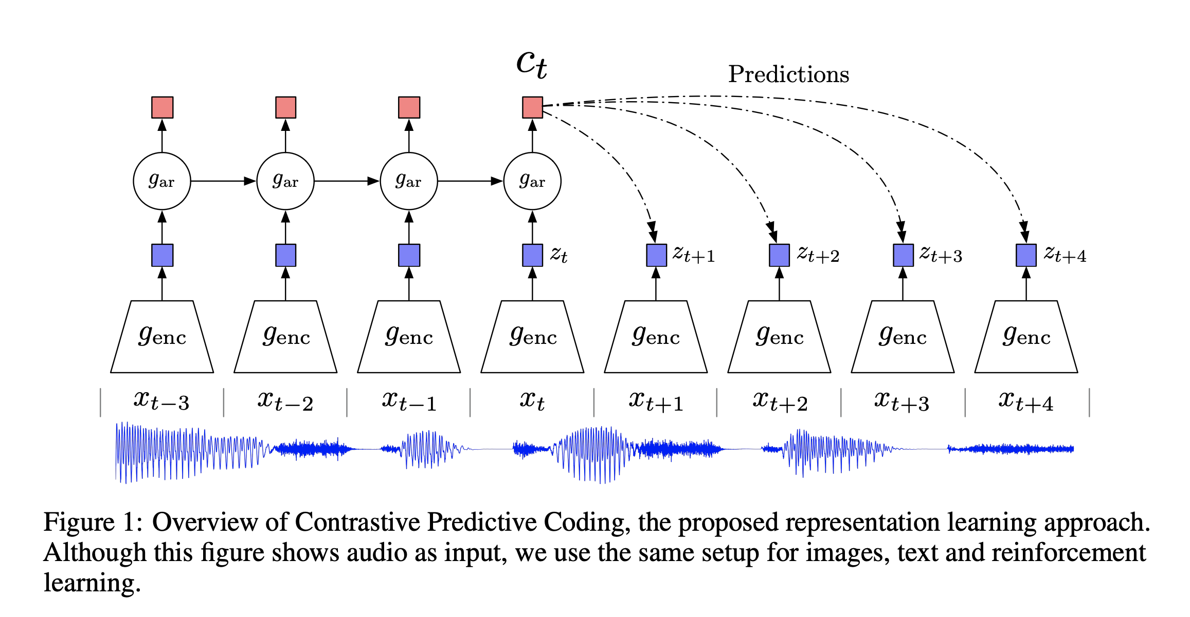
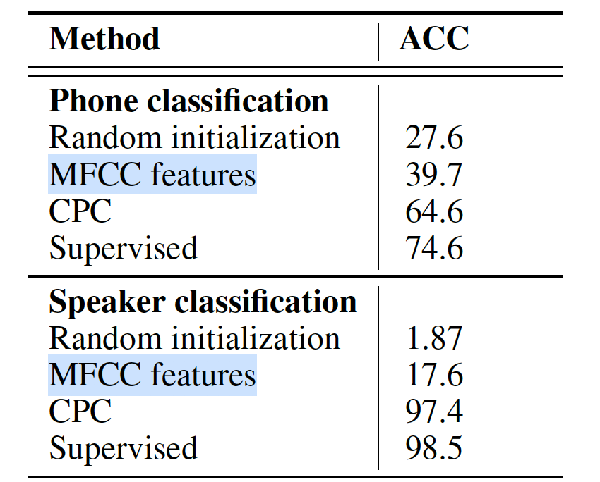

Contrastive Predictive Coding
Oord, Aaron van den, et al. “Representation Learning with Contrastive Predictive Coding.” ArXiv Preprint ArXiv:1807.03748, 2018.

Slide 3
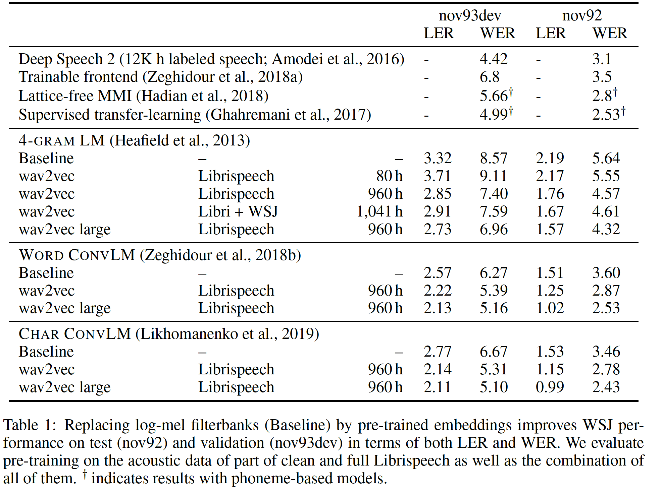
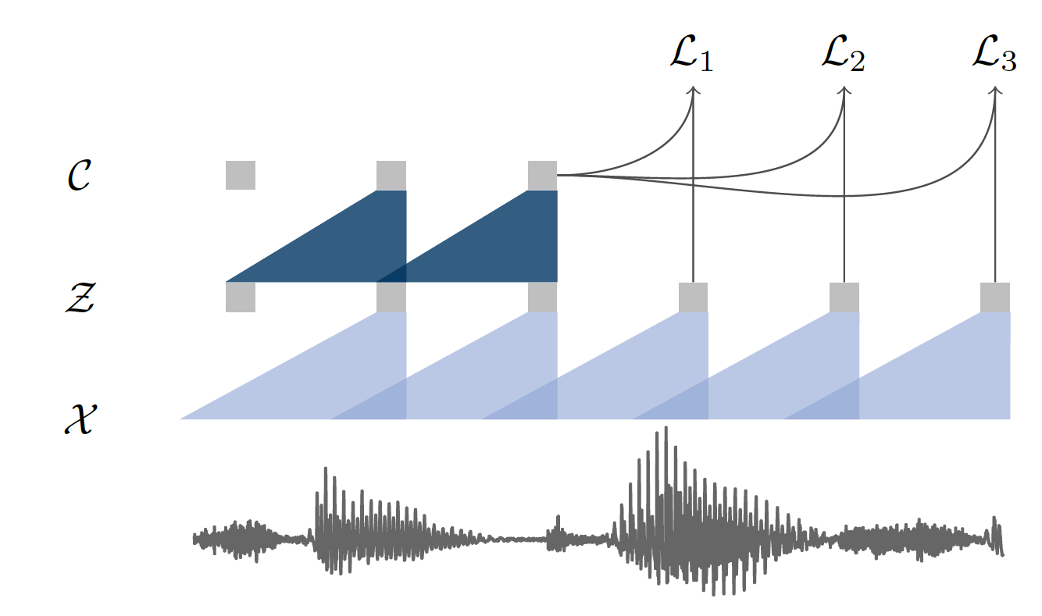
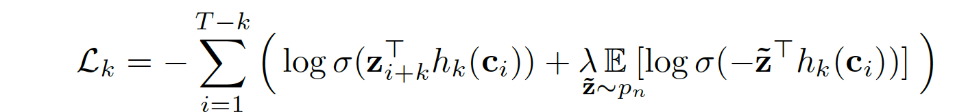


Wav2vec
﻿S. Schneider, A. Baevski, R. Collobert, and M. Auli. wav2vec: Unsupervised pre-training for speech recognition. In Proc. of Interspeech, 2019

Slide 4
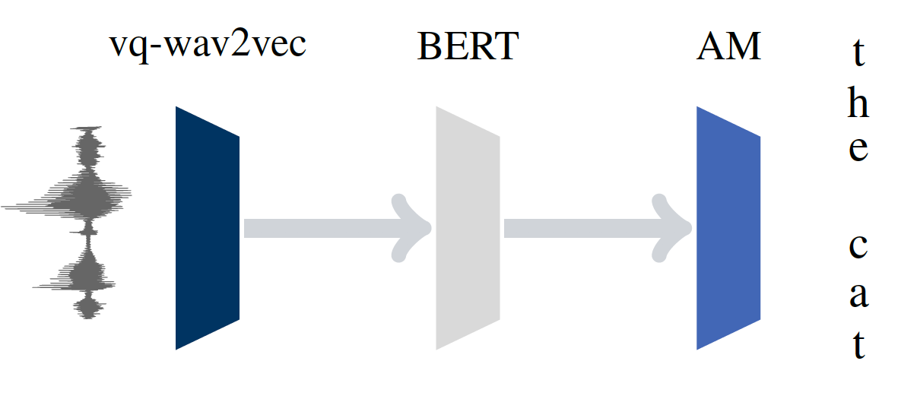
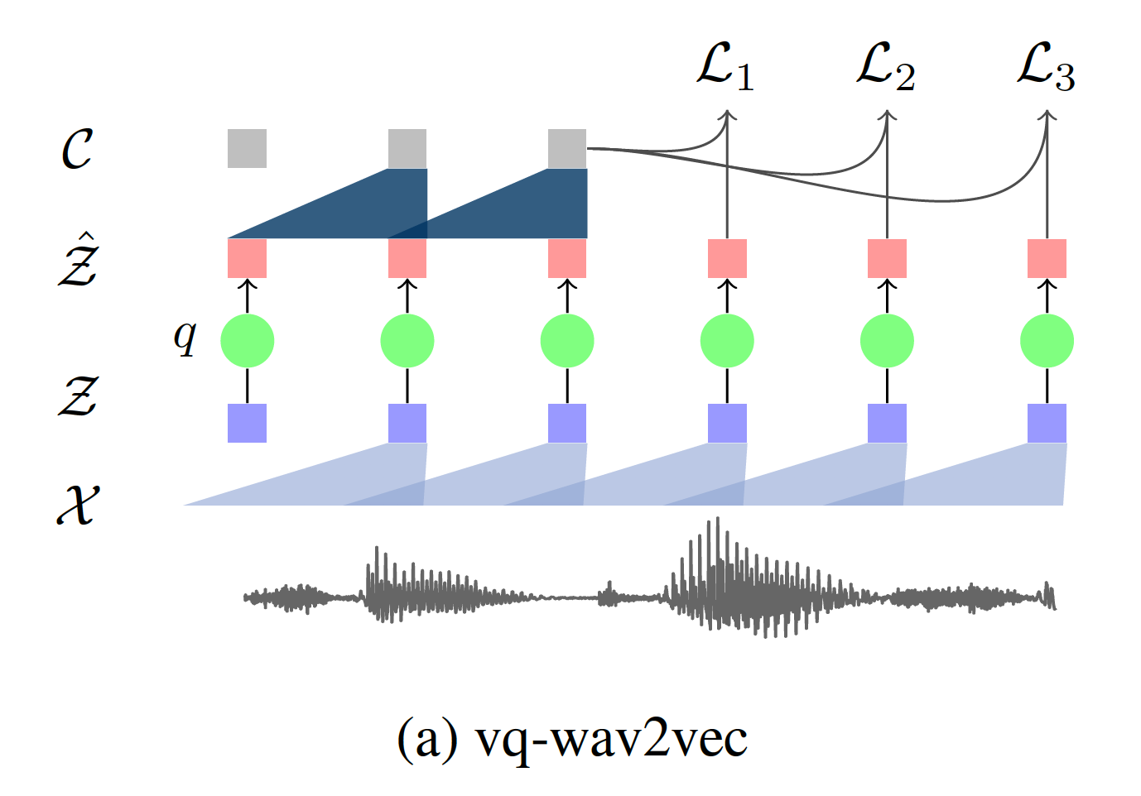
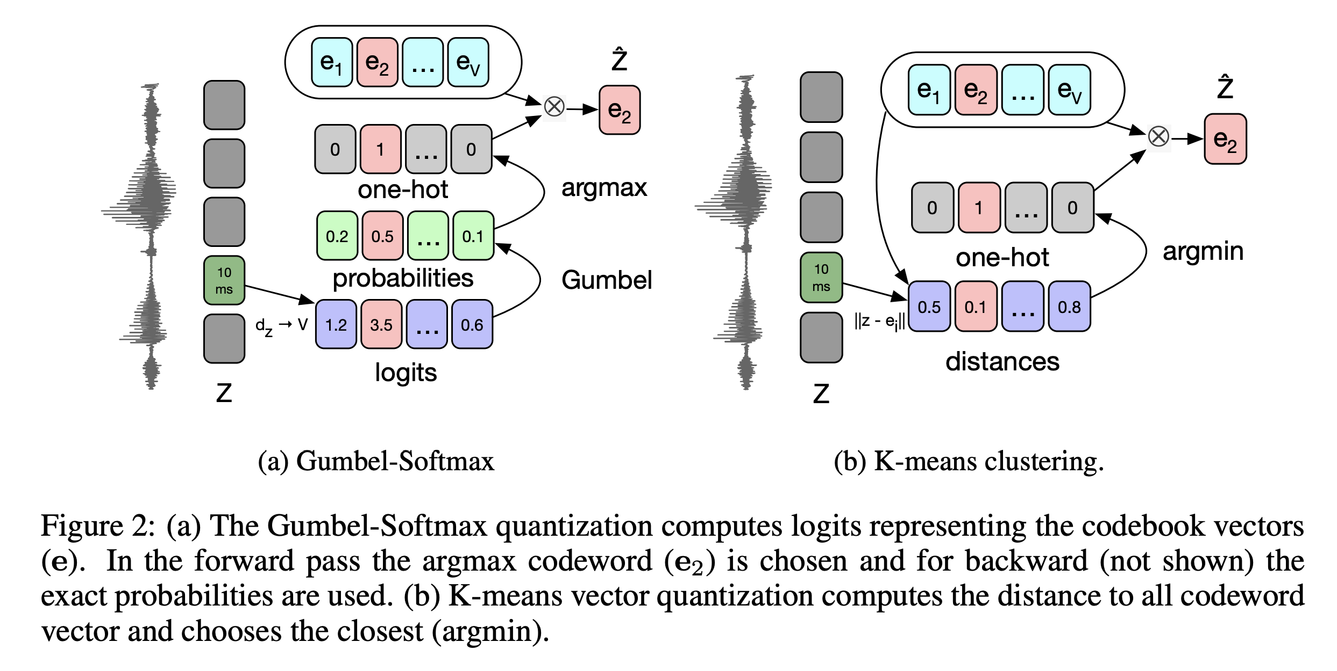
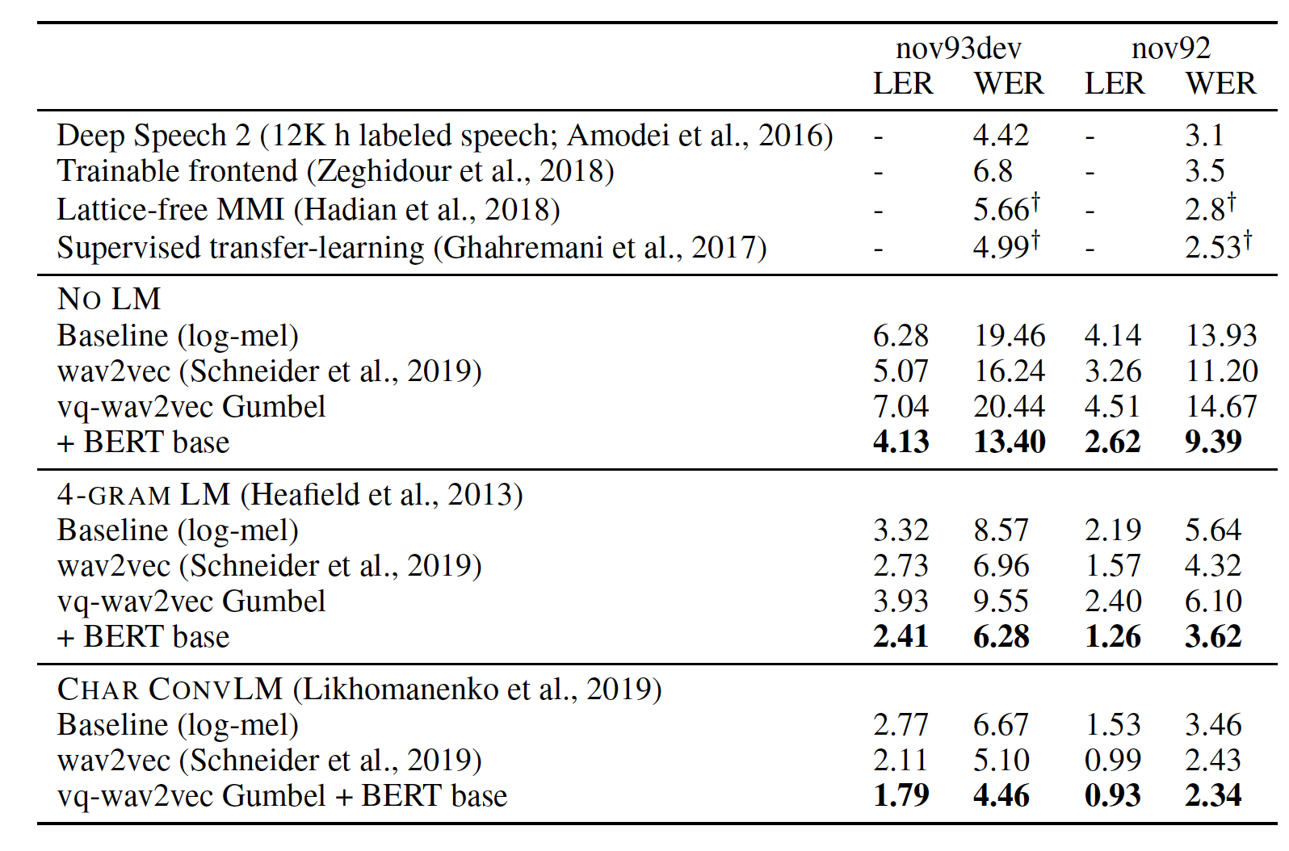


Vq-Wav2vec
Baevski, Alexei, et al. “Vq-Wav2vec: Self-Supervised Learning of Discrete Speech Representations.” ICLR 2020

Slide 5
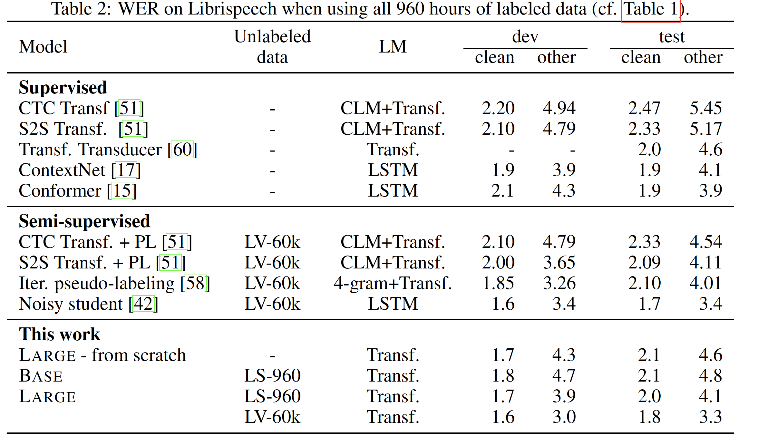
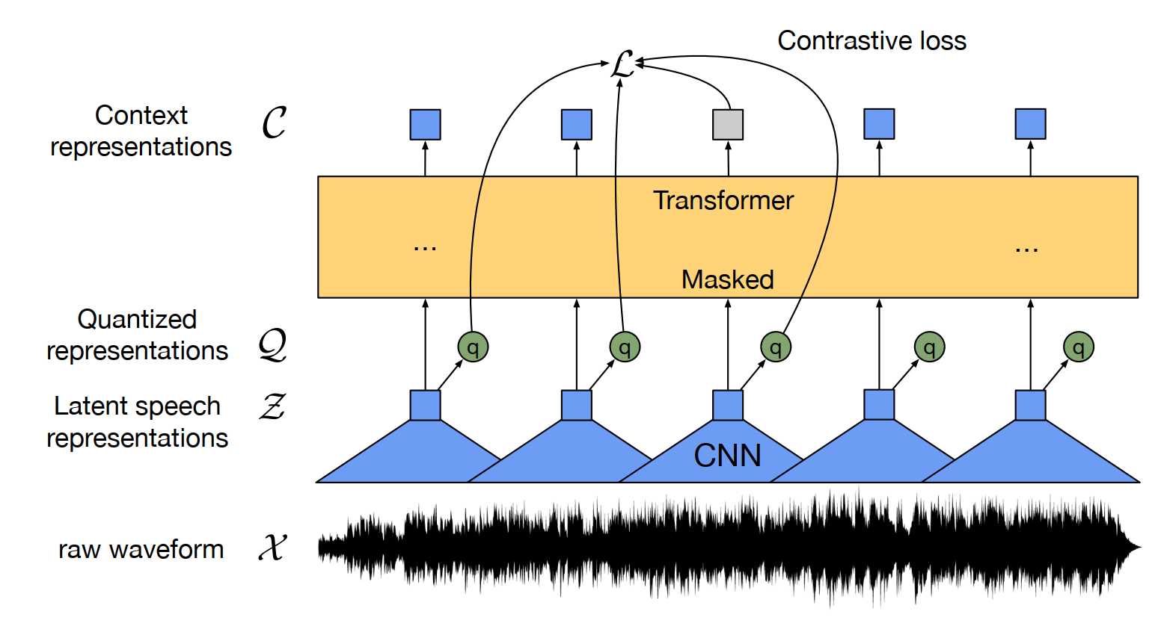

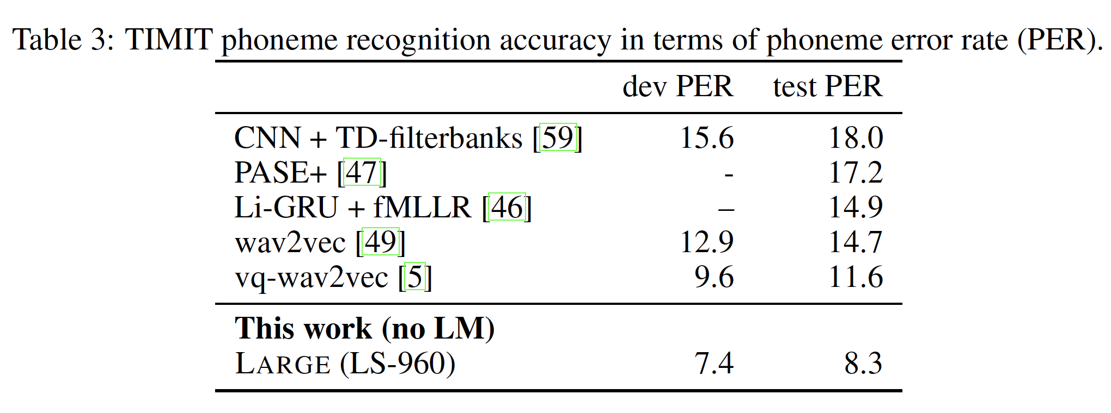


Wav2vec 2.0

