Slide 1
Inflow parameters considered in this dataset as shown in the table:
15MW turbine diameter is 240m. Add the basic configuration information of the IEA-15MW offshore reference wind turbine from NREL to your report(you will find it online).
Here we applied the power law profile in the wind data generator, the relevant parameter is the shear exponent.
The veer is determined by the direction change in degree per meter in vertical axis, as is shown below.
The turbulence intensity level follows the IEC standard, where the C level is 12%, and the A level is 16%.
The integrated impact of the three parameters is tested by setting arbitrary combinations of two parameters. You will see from the subfolder’s names, for example, noveer_shear0.2_TIA means in this case the veer is zero, while the shear exponent is 0.2 and turbulence intensity is A level.
The single parameter cases and the uniform case(benchmark) are also given for you to make comparisons.
15MW turbine | Inflow parameter combinations
 | None | Low | Moderate | High
Shear exponent [-] | 0 | 0.12 | 0.2 | 0.3
Veer [°/m] | 0 | 0.05 | 0.2 | 0.4
Wind direction over the rotor disc [°] | - | (-6,6) | (-24,24) | (-48,48)
TI [-] | 0 | 0.12 / C | - | 0.16 / A

Slide 2
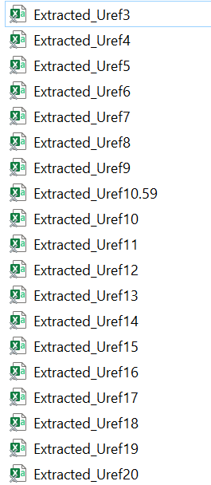
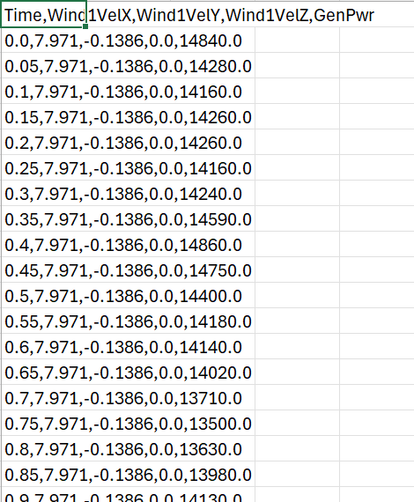
Click into a folder, you will see a set of files with a certain reference wind speed from cut-in speed 3m/s(Uref3).
Click into one data file, you will see the time column with an interval of 0.05s and 1 hour in total. The other columns are wind speed in three directions, whereas the rotor disc is in the yz plane. The final column is the output generator power.

Slide 3
What you need to do is:
Observe how the wind speed in the inflow direction and the generator power vary over the entire simulation time, and calculate the mean generator power in the second half of the simulation time.
Make power curves for each case and compare the relevant cases in the same plot.
Analyze the power curves, by observing how they deviate from the benchmark case in certain regions(for example, low speed region, near rated speed region, region after reaching rated power). Try to give explanations.
Analyze the deviation of each case from the benchmark at each reference wind speed. Compare the integrated impact of inflow parameters and the superposition of the deviation of single parameters. Try to give some illustration.
(Not compulsory) choose two turbulent cases and calculate the turbulence intensity by hand, see if it is aligned with the setting figure.

