Slide 1
Precision Medicine – Oncology Patient Benefits
Personalized analysis of Patient Cancers
Patient Benefits:
Effective Chemo regimen (no more switching medicines).
Reduced time to achieve effectiveness (no more wasted time)
Healthier Outcomes (increased PFS)
Reduced costs

Slide 2
Precision Medicine – Oncology Process
Patient cancer biopsies from Hospitals (CPMC – ‘Sutter’)
Cell Studies on metastatic melanoma(“skin cancer”); colorectal cancer (”colon cancer”) and glioblastoma multiforme (“Brain cancer”)
Pharmacology (Drug effects: Tested against 50-60 chemo agents)
DNA – SNP mutational analysis – Deep sequencing
RNA – seq. Expression analysis
Machine Learning
Deep Learning AI → to direct to appropriate clinical trials
Drug results for Oncologists → for appropriate chemo therapy regimen
Patient Direction to appropriate clinical trials

Slide 3
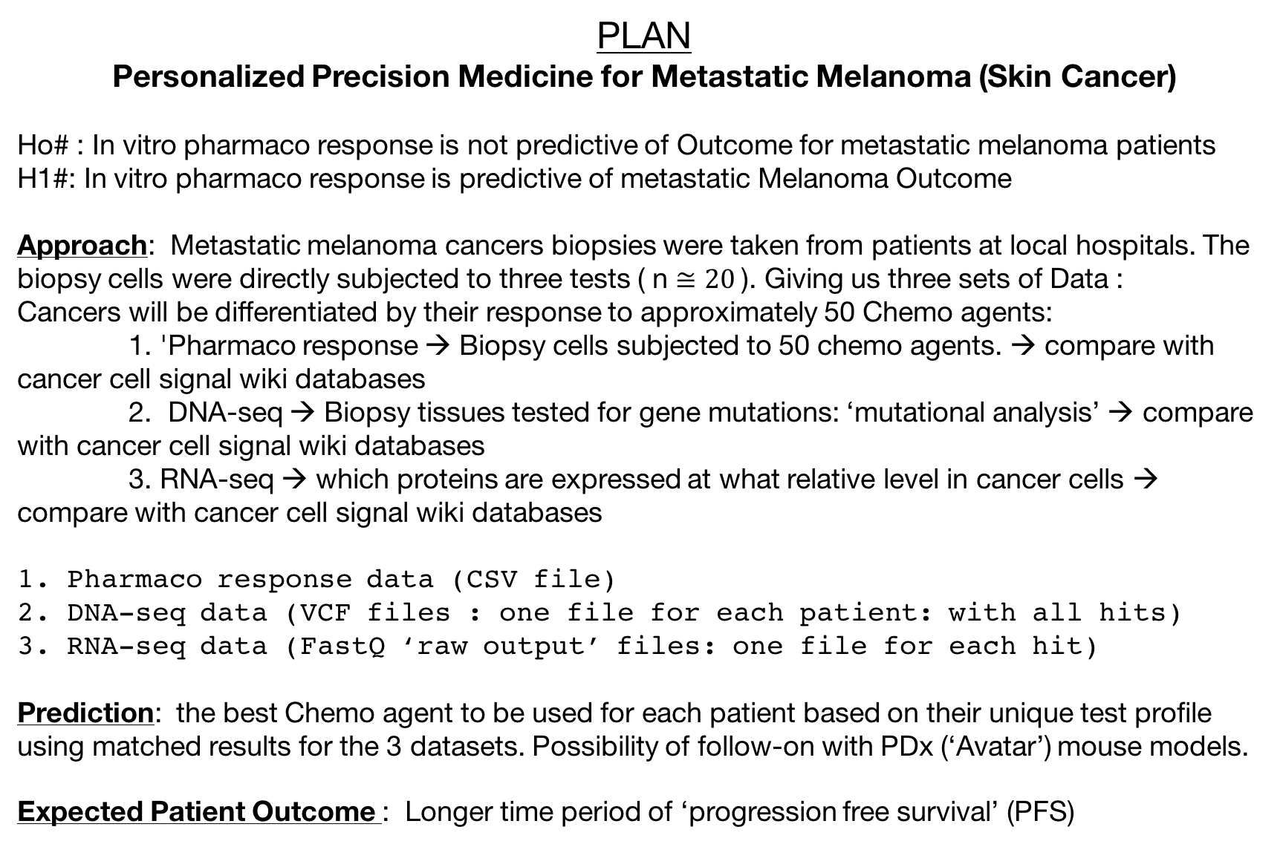
PLAN
Personalized Precision Medicine for Metastatic Melanoma (Skin Cancer)
Ho# : In vitro pharmaco response is not predictive of Outcome for metastatic melanoma patients
H1#: In vitro pharmaco response is predictive of metastatic Melanoma Outcome
Approach: Metastatic melanoma cancers biopsies were taken from patients at local hospitals. The biopsy cells were directly subjected to three tests ( n $≅20$). Giving us three sets of Data :
Cancers will be differentiated by their response to approximately 50 Chemo agents:
1. 'Pharmaco response → Biopsy cells subjected to 50 chemo agents. → compare with cancer cell signal wiki databases
2. DNA-seq → Biopsy tissues tested for gene mutations: ‘mutational analysis’ → compare with cancer cell signal wiki databases
3. RNA-seq → which proteins are expressed at what relative level in cancer cells → compare with cancer cell signal wiki databases
1. Pharmaco response data (CSV file)
2. DNA-seq data (VCF files : one file for each patient: with all hits)
3. RNA-seq data (FastQ ‘raw output’ files: one file for each hit)
Prediction: the best Chemo agent to be used for each patient based on their unique test profile using matched results for the 3 datasets. Possibility of follow-on with PDx (‘Avatar’) mouse models.
Expected Patient Outcome : Longer time period of ‘progression free survival’ (PFS)

Slide 4
Cell Signalling cascade

Slide 5
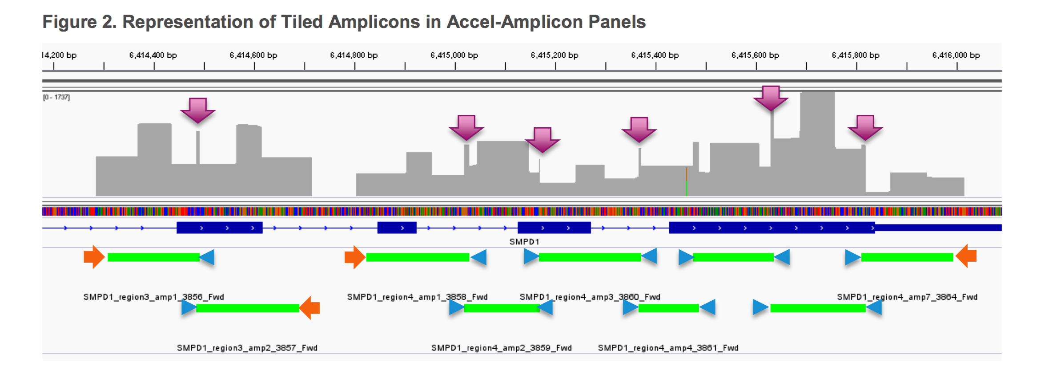
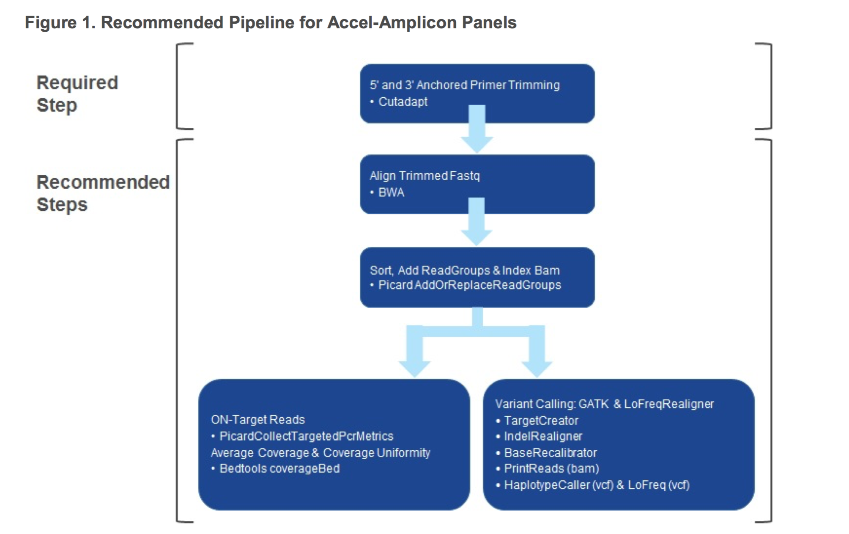
Data Conversion
‘Raw machine level’
‘VCF’

Slide 6
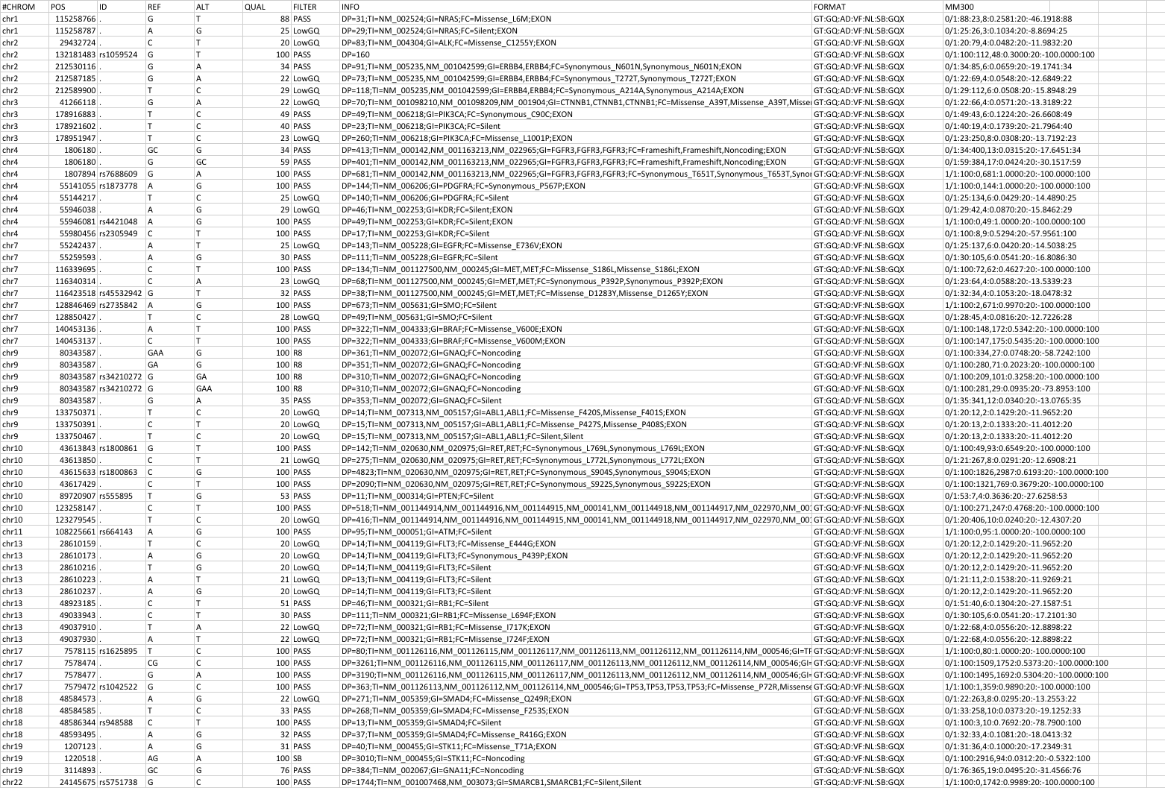
Example: ‘variant call format’ (‘VCF’)
NM####: needed to compare with gene sequence from national genome database

