Slide 1
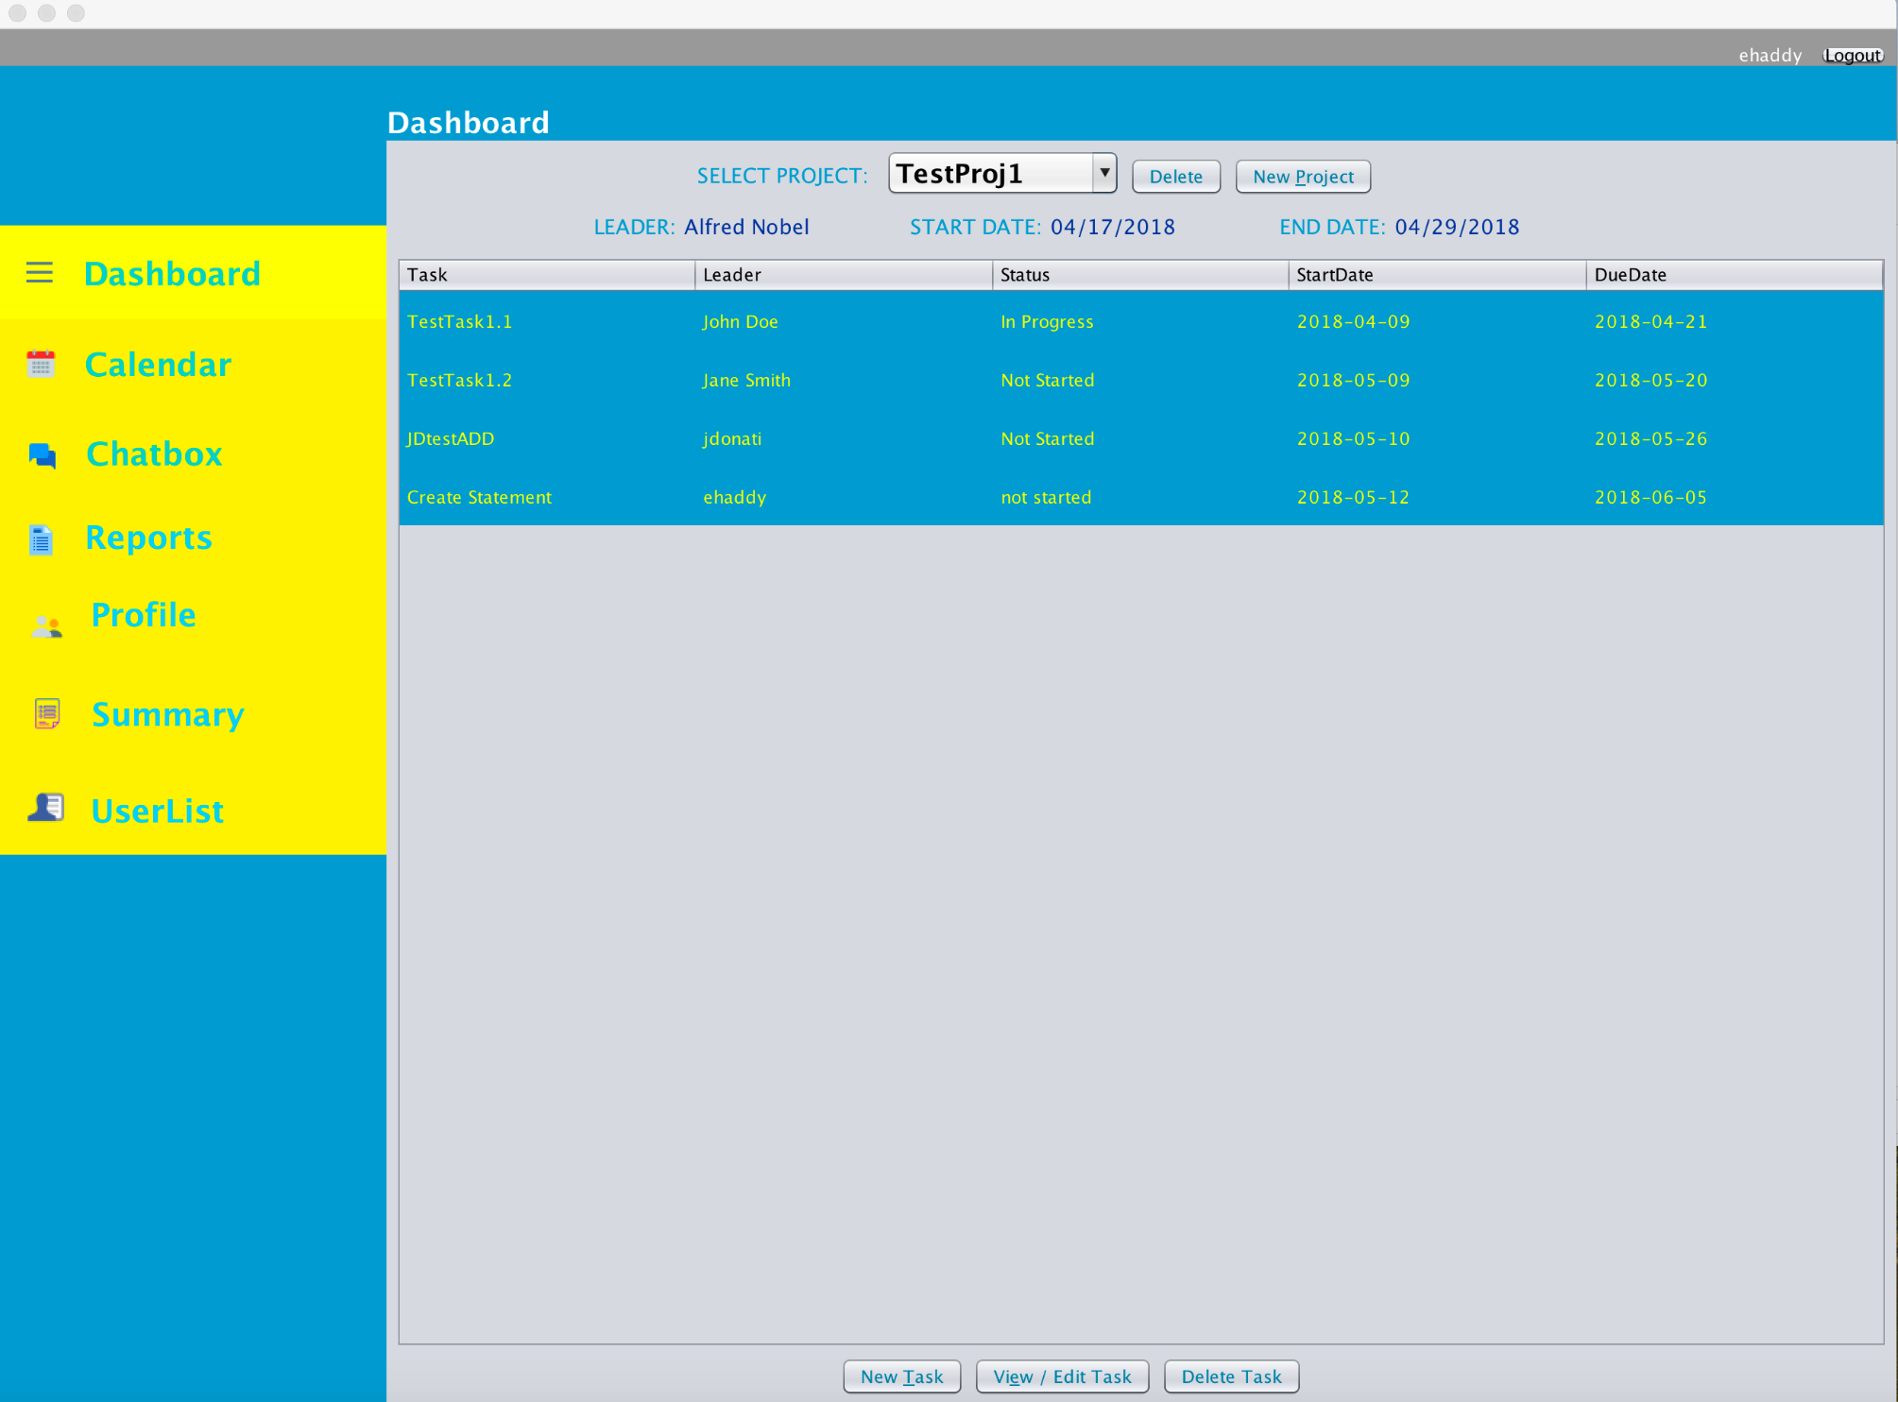
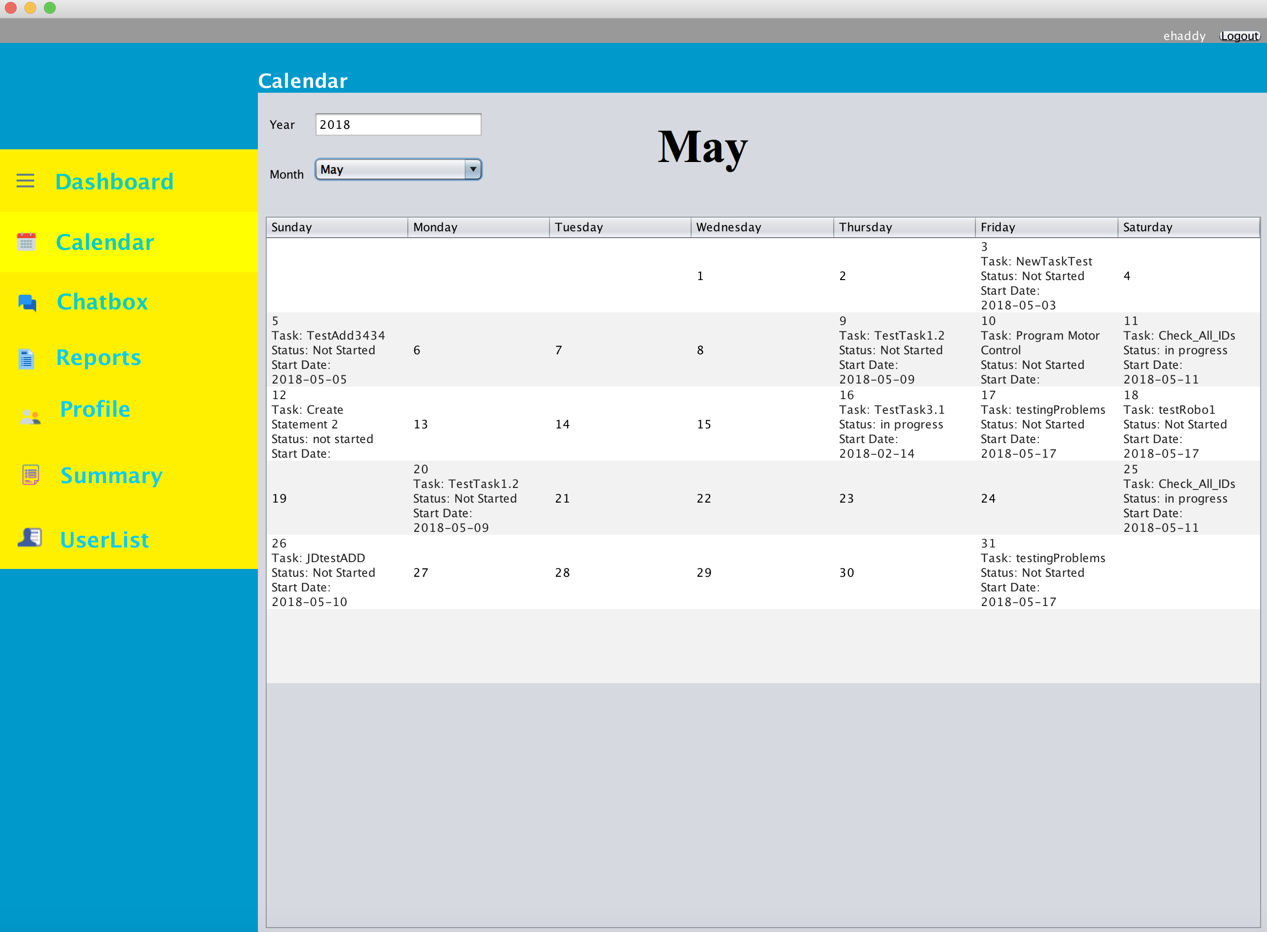
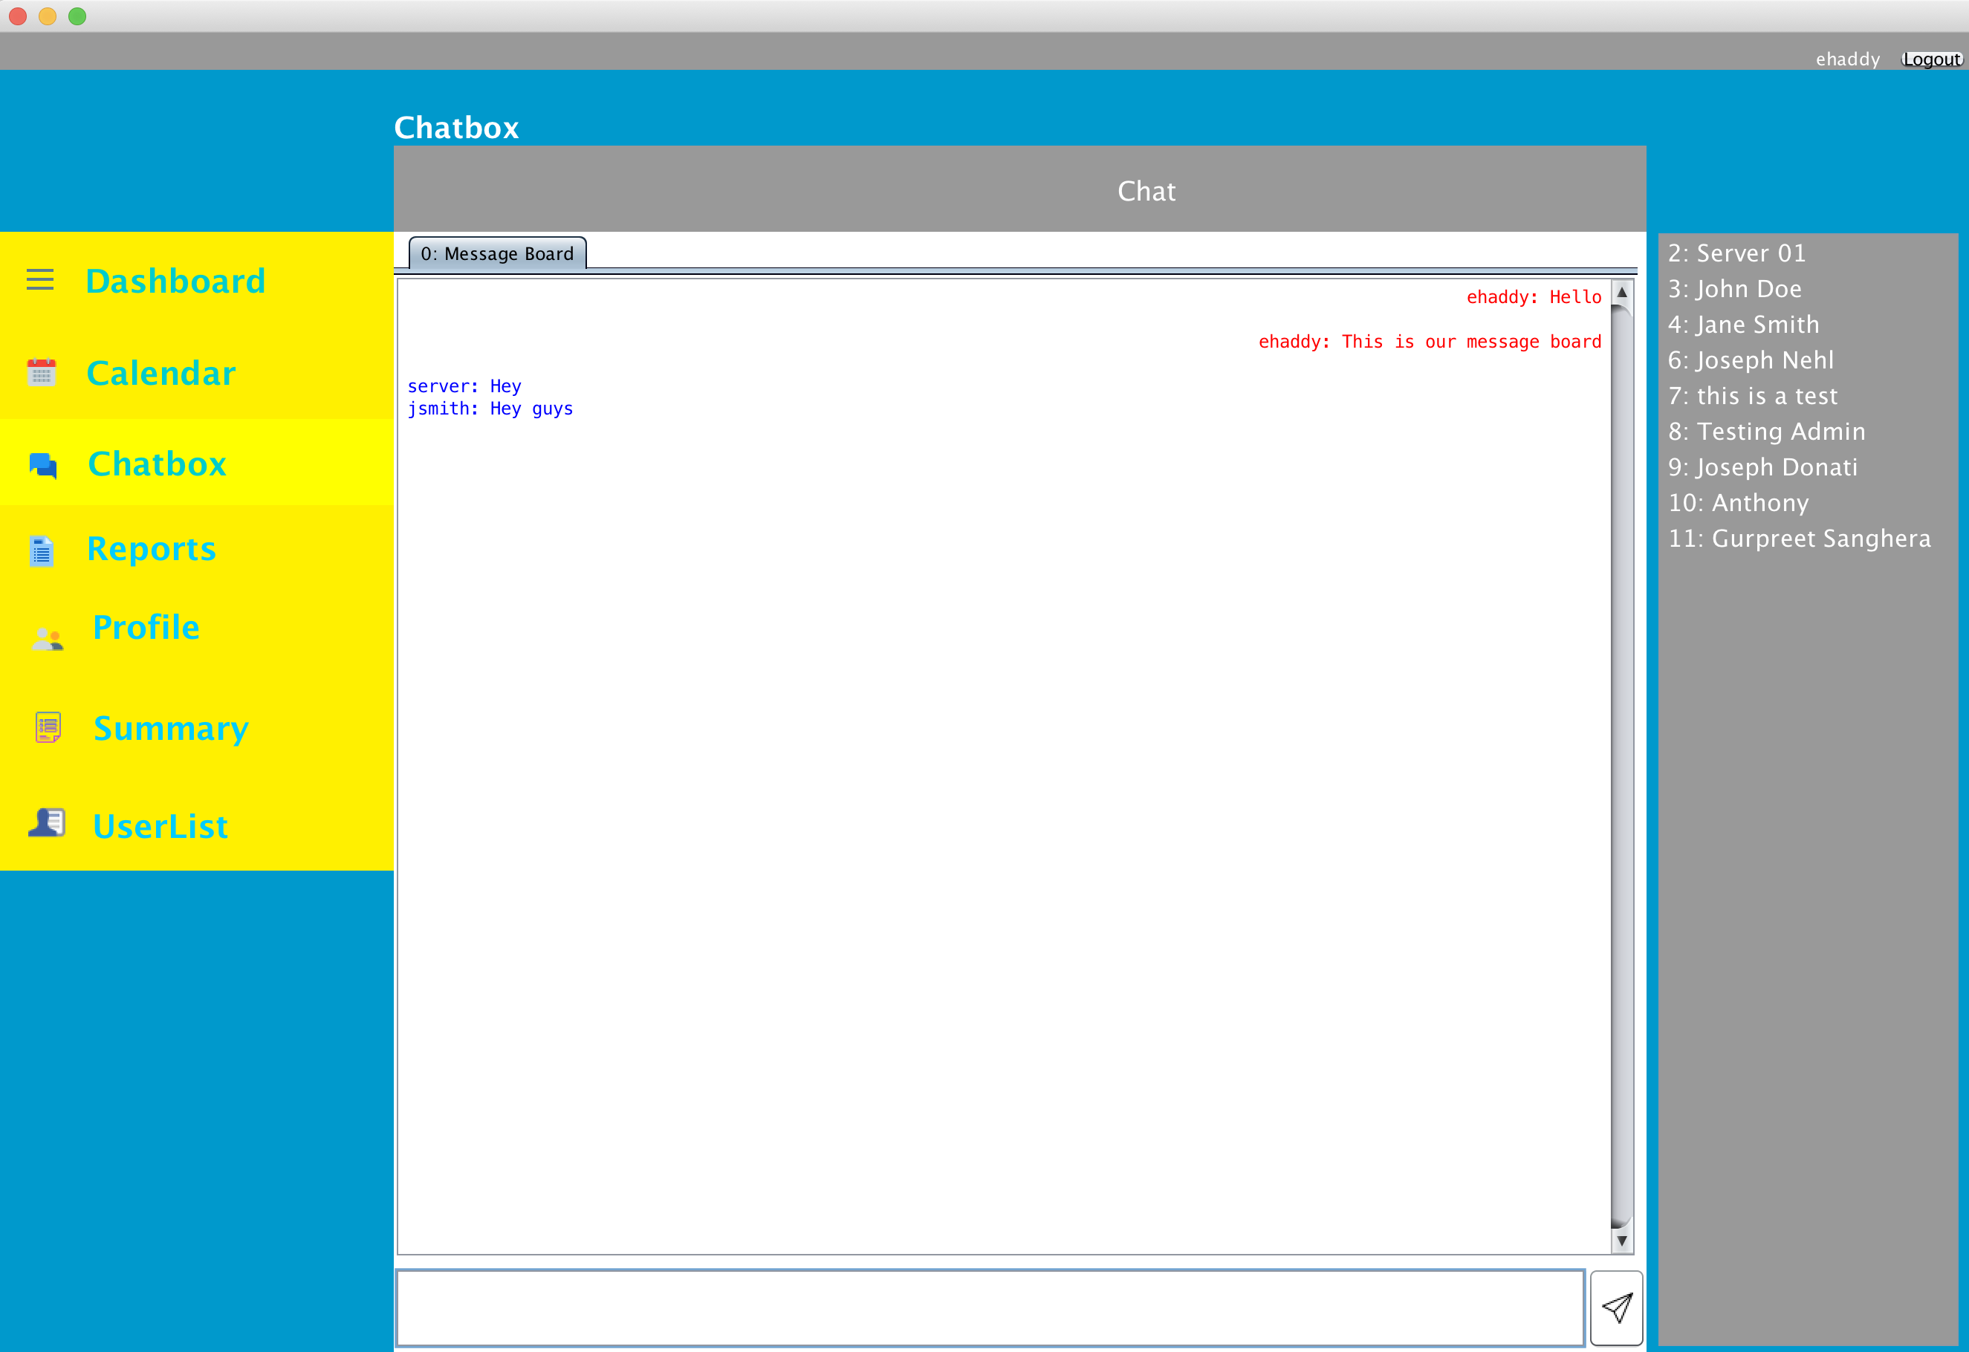
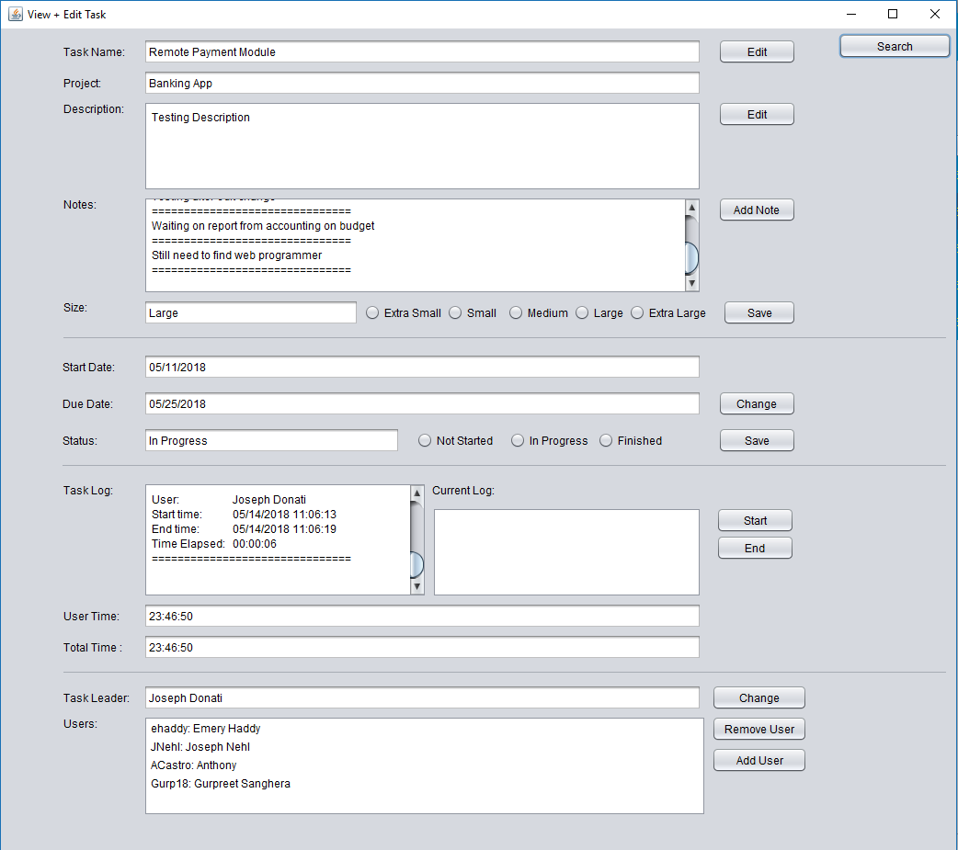
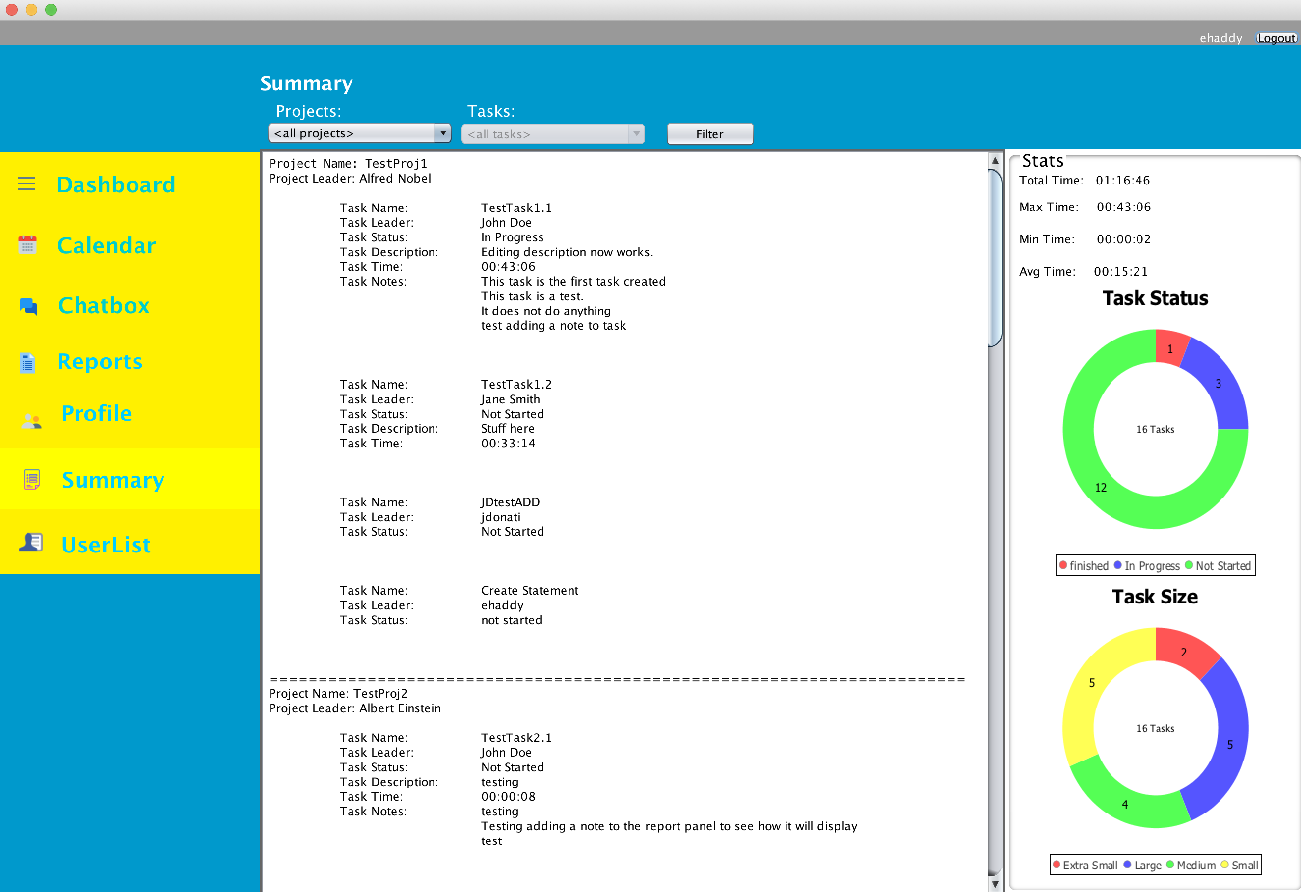
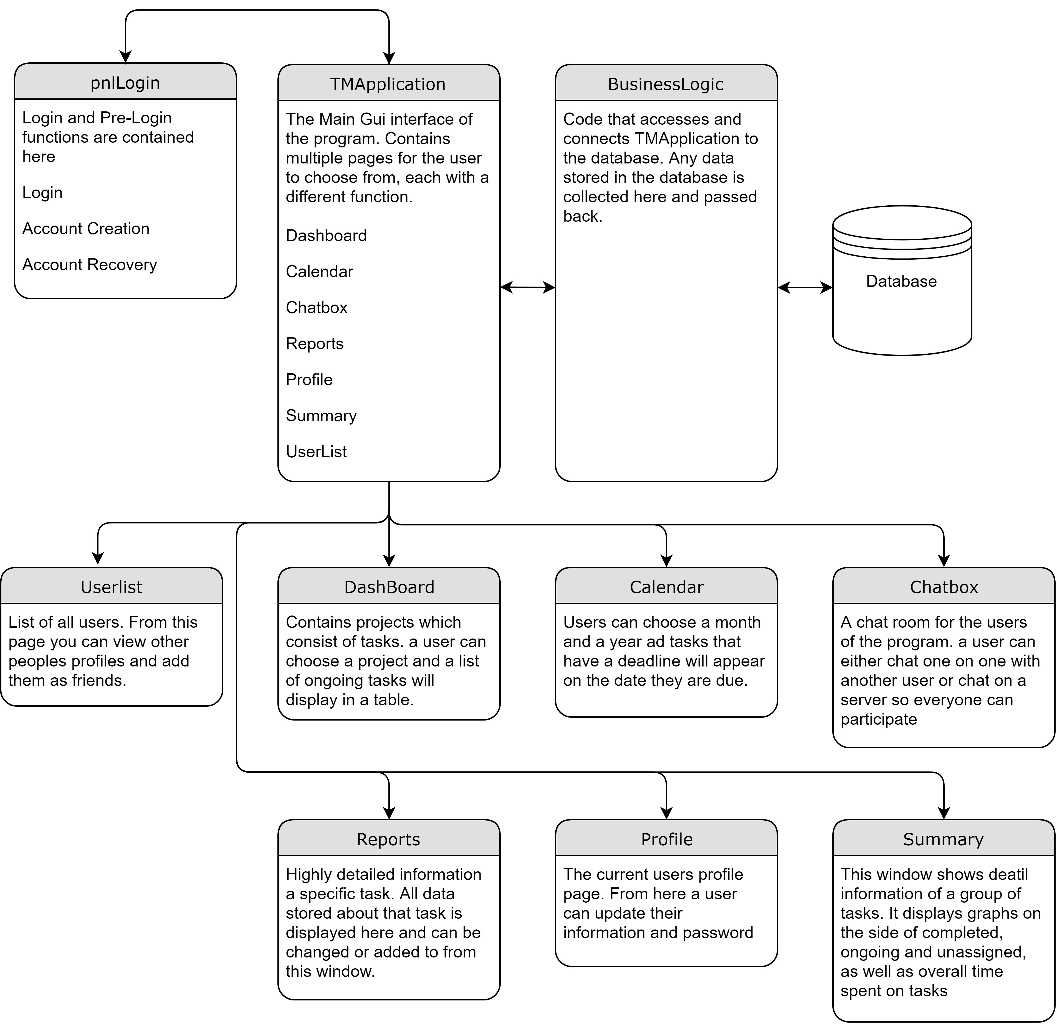
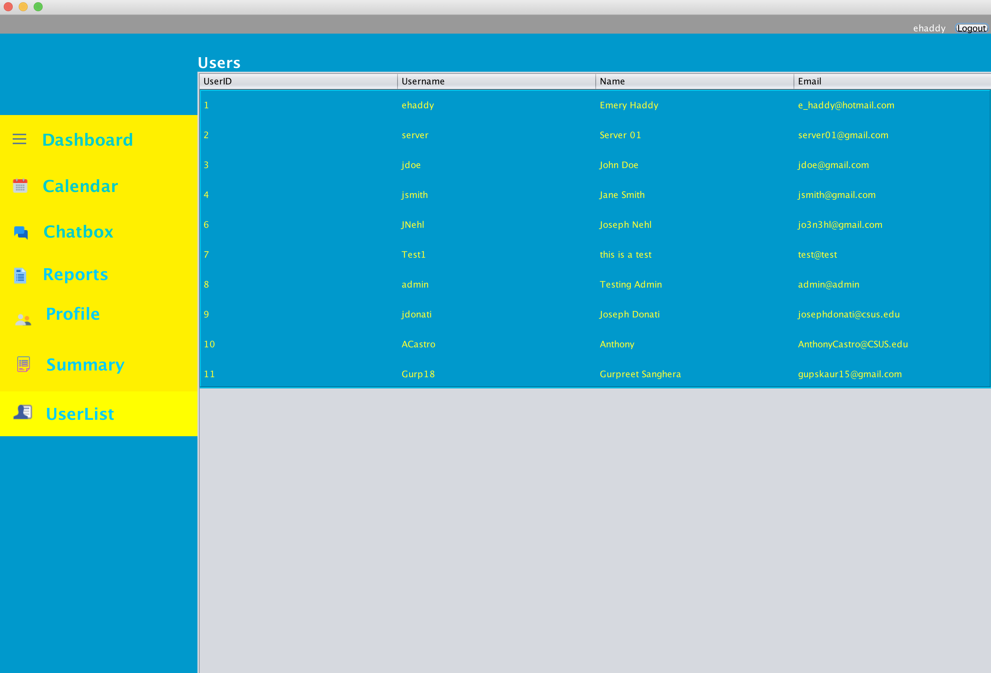
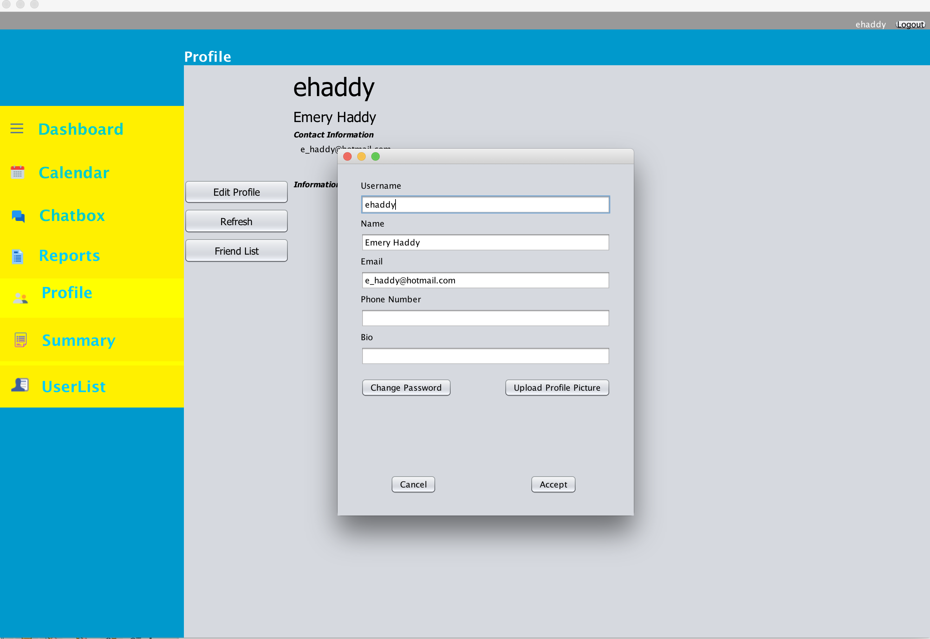
Project Master 5000
Anthony Castro, Joseph Donati, Emery Haddy, Joseph Nehl, Gurpreet Sanghera
California State University, Sacramento
DESIGN GOALS
PROJECT MANAGEMENT FEATURES
USER INTERFACE
DATABASE ARCHITECTURE
Our software aims to provide a simple, intuitive task management utility for agile software development teams. Project Master (PM) allows teams to plan projects, organize tasks, and track progress. A simple, refined user interface displays only as much information as necessary, keeping the user focused on working, not coordinating.
Communication and flexibility are both key in an agile environment and will be two of the primary focuses of PM beyond simple task planning. PM will be accessible from anywhere with cloud connectivity, keeping teams on track even when working remotely. To communicate about tasks and projects, multiple paths of connection will be found throughout the software. With message feeds for conversations and embedded notepads for tasks, teams will be able to collaborate and plan in the same application. Fewer applications running reduces overhead time and distraction for each user, and TM will create more informed, more efficient teams.
Dashboard
The dashboard provides the main interface for browsing projects and their associated tasks. The information provided in the dashboard is minimal, as the focus is to make switching between projects and tasks quick and painless, to better support the fast pace of agile development. The dashboard contains functions for adding and deleting tasks and projects, and allows the user to select tasks for a more detailed view. Selecting a task leads directly to the Task Report for that task.
Task Reports
The main function of task report is to view and edit tasks. Users can view task name, associated project name, description, notes, size, start date, due date, overall status, task log, and assigned user list once the task has been selected from the dashboard. Certain features are available to certain kinds of users (project leader, task leader, and assigned users). Assigned users can edit task name, description, and task size as well as add notes. Project and task leaders can add and remove users to a task and change task start and due dates. Project leaders can also change the task leader. Task report can also log the date, time, and user for when a task is worked on by an assigned user. Task report additionally generates a task log which displays when a task was worked on and by whom. Users can view total time spent on a task by all assigned users as well as view total time the current user has spent on a task.
Summary
The summary can get broken down to three different levels. The user can request a summary of all the projects, one project and all the tasks in the given project, or one specific task in a project. This diversity breaks down the information and gives the user a friendly way to view the data. This can be helpful in determining the progress and productivity of the selected items.
Summary Stats
The summary also displays stats for the given project or all projects. If a summary is being requested of a specific task then this information isn’t show. The starts get broken down in showing you the total time from all tasks, the max time, the minimum time, and the average time. There are also two graphs a Task Size graph and a Task Status graph. This gives a breakdown of the tasks different sizes and status. The graph is a ring graph and gives the user a nice breakdown of the summary.
Calendar
The calendar panel provides a calendar view of important dates to give the user one more way to view the details of their project. The traditional view is helpful for viewing dates across multiple projects at once.
APPLICATION FEATURES
Login and Account
This is the main entry point to the program. To log in and get access, a user first makes an account. From here, the program checks the database to make sure that a user with the same email and username does not already exist. If a user loses track of their password, there is a recovery system that works through their email to reset it. As an extra security bonus, an account is locked and cannot access the program after 10 consecutive fails. The account restriction is lifted after a successful password reset.
Users and Profile
On the profile panel information like email, username, name, phone number and a small biography are displayed. This is to help keep track of different members in the company and to be able to find their contact information. A user may edit their own information at anytime to update their profile. The User List contains a list of all users currently registered in the database. From this page, you can add people as friends to be able to find them without searching through the full user list.
Chatbox
The chatbox has two functions. One is a message board that acts like a broadcast message for all users. Users can communicate immediately to all active users. The second function is a direct message system that allows one to one communication for private conversations between users. The main feature for both of these applications are threads. Both these features utilize threads that constantly sweep the database looking for new messages. The main function of this is to allow quick communication within the program so users can stay on top of their tasks and work that needs to be done.
Message Board
The Message Board allows a user to post a message for all users to be seen. This gives the users the power to communicate to every user at once in a quickly manner. It’s like a broadcast message to everyone. Allowing swift communication for everyone to see is extremely helpful for keeping everyone on the same page for a project.
User Messages
This is a direct messaging system. Users can send private messages to any other user. This is helpful in collaborating with another person to stay in touch about projects, tasks, and what needs to be done.
Challenges: The threads were the main challenge with this project. Figuring out when to stop or kill a task caused some problems. Once this was figured out, the rest was much simpler. When a message gets sent it goes to the database to a table that acts like a queue. The thread checks for messages in this table, when one is received it moves the message from the queue table to a past message table.
APPLICATION ARCHITECTURE

