Slide 1

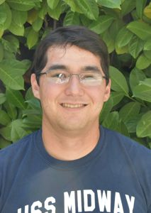

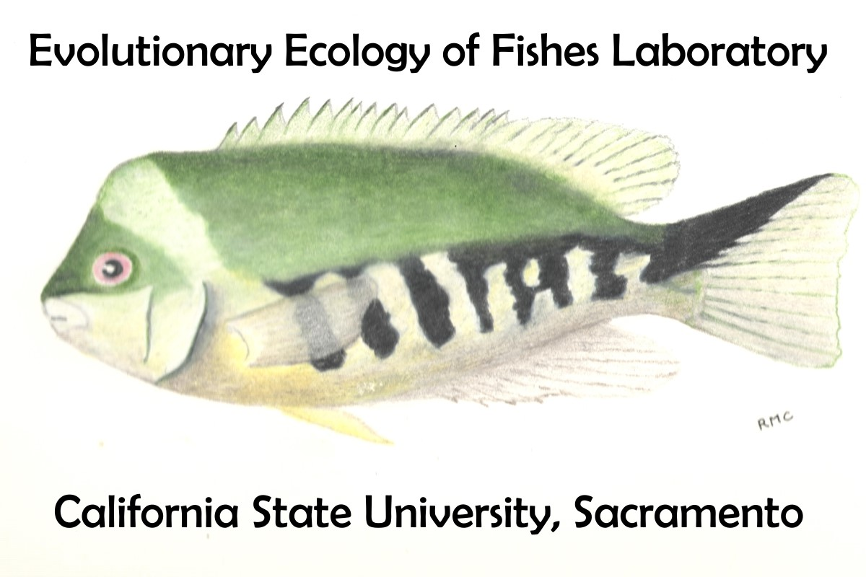
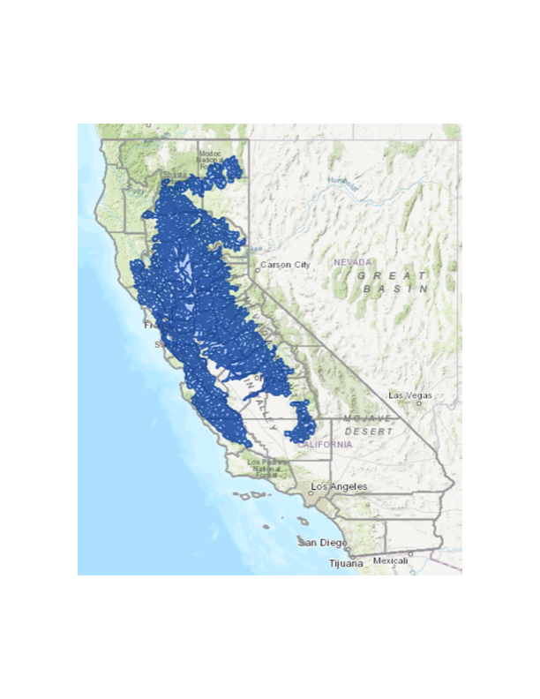
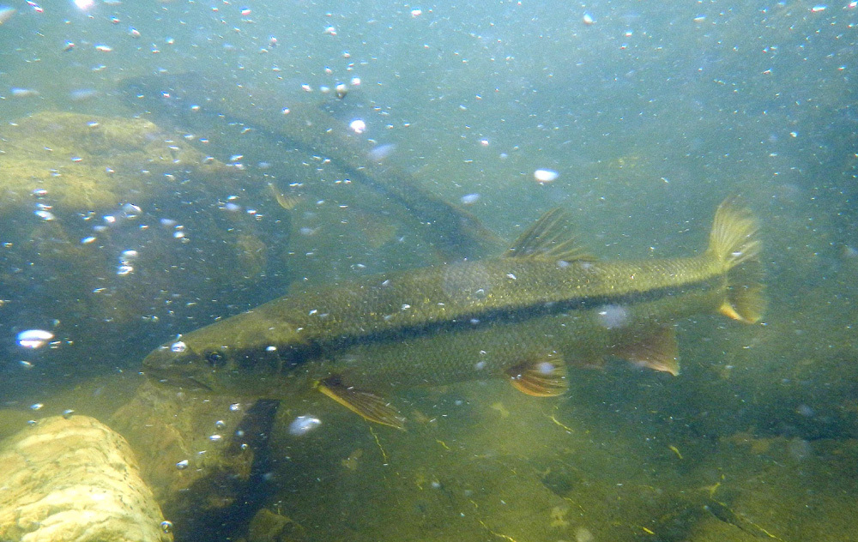
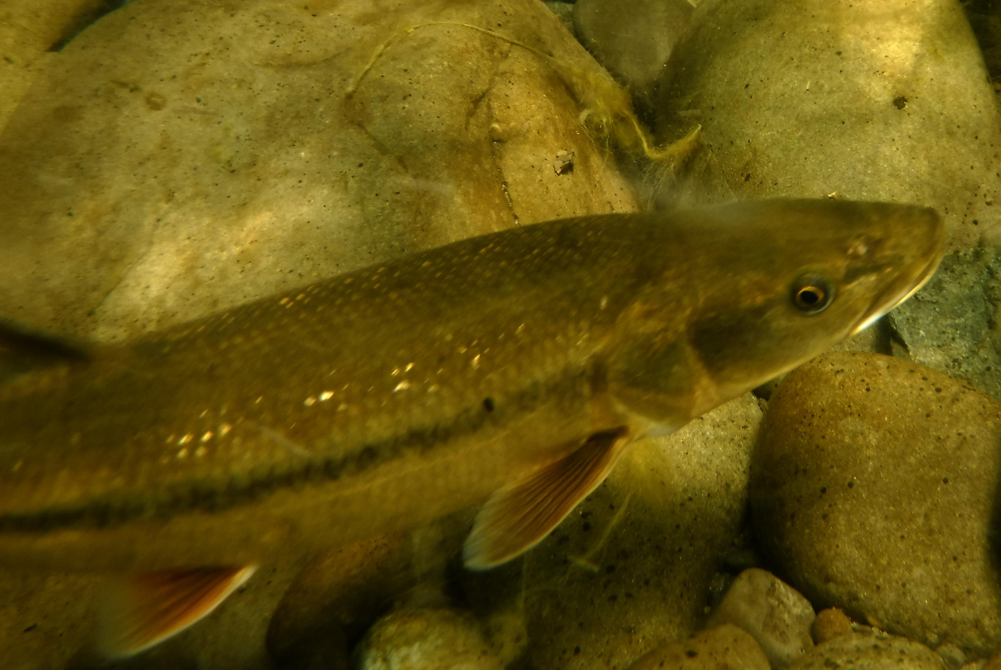
Sacramento Pikeminnow Predation of Juvenile Salmonids in the Sacramento River and Tributaries
Chad Hirano
Advisor: Dr. Ron Coleman
Department of Biological Sciences California State University, Sacramento
Introduction
Sacramento pikeminnow (Ptychocheilus grandis) are a member of the family Cyprinidae and are native to California in the Sacramento-San Joaquin, Pajaro-Salinas, upper Pitt and Russian rivers as well as the Clear Lake basin. Pikeminnow typically occupy mid to low elevation streams and favor sections of river with deep pools and runs and are are not commonly found in polluted waters (Moyle 2002)
Before the introduction of non-native piscivorous fishes, large pikeminnow were likely the dominant predatory fish in the Central Valley of California (Moyle 2002). However, introduction of non-native piscivores and large scale changes and diversions of water within the watersheds have led to a rapid decline in the abundance of native fishes and if current trends continue it is likely that many of these species will disappear in California (Moyle et al. 2011). Even though Sacramento pikeminnow are likely experiencing declines in populations, they have maintained greater abundance than other native fishes despite changes in natural hydrology and introduction of non-native fishes.
Problem
Sacramento pikeminnow have a reputation as being voracious predators of migrating juvenile salmonids and often viewed as a threat to native Chinook salmon (Oncorhynchus tshawytscha) and Steelhead trout (Oncorhynchus mykiss). Despite the possibility of significant predation of juvenile salmonids, few ecological studies exist on this issue.
Of the literature pertaining to predation, two different results emerge. In more natural sections of streams and rivers, stomach content analysis of Sacramento pikeminnow contain little to no salmonids, while areas of more reservoir type water have shown that salmonids are being consumed by pikeminnow, particularly at the Red Bluff diversion dam (Brown and Moyle 1981). However, this dam was decommissioned in 2013 to aid the passage of migratory fishes.
Research Plans
I plan to focus my research on predation of Sacramento pikeminnow, specifically of native salmonids. I would like to be able to sample in tributaries of the Sacramento River to analyze the levels of predation occurring of juvenile salmon in more natural flowing waters compared to conditions seen near dams. The first year of research will likely be observational and the goal will be to obtain` adequate sample size in order to identify if predation is occurring and where levels seem to be the highest.
While sampling I also plan on using catch per unit effort as a way of being able to quantify a relative abundance of both pikeminnow and other piscivorous fish that could be consuming juvenile salmonid. With this information manipulation can then be conducted in the laboratory to study interspecific interactions that could influence predation levels on salmonids.
A.
B.
C.
Photo from iNaturalist
Acknowledgments
I want to thank Dr. Coleman for his guidance so far with initial thesis designs and for encouraging me to begin the process of collecting data.
Photo courtesy KZYX
Map from CDFW BIOS database
References:
Brown, L. R., & Moyle, P. B. (1981). The impact of squawfish on salmonid populations: a review. North American Journal of Fisheries Management, 1(2), 104-111.
Moyle, P. B. (2002). Inland fishes of California: revised and expanded: Univ of California Press.
Moyle, P. B., Katz, J. V., & Quiñones, R. M. (2011). Rapid decline of California’s native inland fishes: a status assessment. Biological Conservation, 144(10), 2414-2423.

