Slide 1
Project # 1
COVID-19 Death Analysis
30 October, 2021

Slide 2
Agenda
1
Analysis Overview
2
Age Group Analysis
3
Geographical Analysis
4
Gender Analysis
5
Monthly Covid Death Analysis
TEAM
Hannah Harrison
Randall Weaver
Yang Yu
Abishua Prashanth

Slide 3




Analysis Overview
Analyze what?
Questions to Answer
Data Sources
Data Cleaning
COVID-19 Deaths in the United States from the beginning of the pandemic
What age group is most susceptible?
Is geographic location a factor in the number of deaths?
What effect does gender have on covid mortality?
Was there a peak and how many?
Covid-19 Death Report: https://data.cdc.gov
US Population by state: https://www.census.gov
Latitude and Longitude for the states: http://developers.google.com
Duplicates:
The CDC data for COVID-19 deaths needed to be filtered for duplicates
After the filtering, the value counts by State were all the same
Census data had the genders represented as integers and had to be converted to String values (Male/Female)

Slide 4
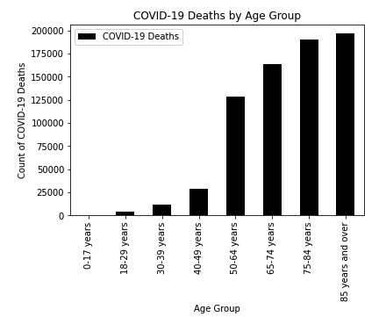
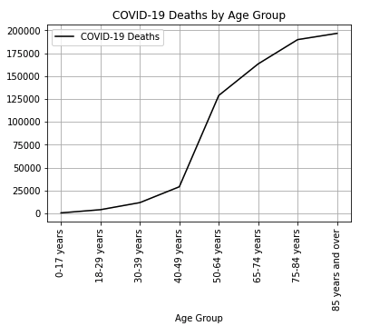
Age Group Analysis
Analysis to determine if there were more deaths in a certain age group
Analysis Summary
It is evident from the charts that the people over 85 years old had the highest number of deaths
There were close to 196,633 deaths in this age group
There are a total of ~700,000 in the entire US until now

Slide 5
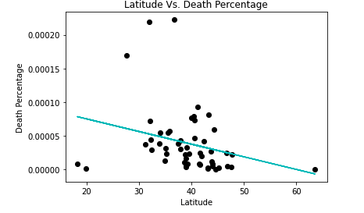
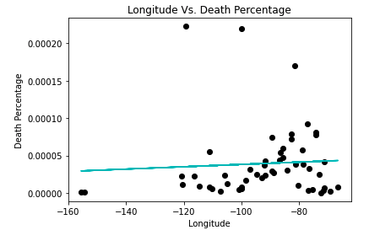
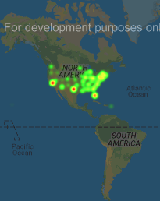
Geographical Analysis
Analysis to determine if there were more COVID-19 deaths in the certain part of the country compared to other parts
Analysis Summary
The line of regression displays a negative relationship between Latitude and COVID-19 deaths in the United States, the Southern states seems to have more deaths than the northern states
The line of regression displays a positive relationship between Longitude COVID-19 deaths in the United States, the East of the United States seems to have more deaths than the West
Finally, it is evident from the heat map that the COVID-19 deaths were more prominent in the South East

Slide 6
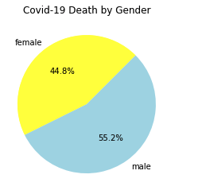
Gender Analysis
Analysis to determine if there is a correlation between Covid-19 deaths and gender.
Analysis Summary
The chart shows 55.2% of deaths were male, a 10% increase compared to 44.8% of females.
The data displayed in the chart spans across all age groups but does not account for underlying health conditions.
We can infer men have a higher likelihood of dying from Covid-19

Slide 7
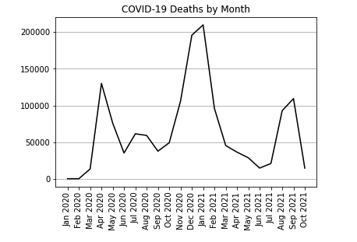
Monthly Covid Death Analysis
Analysis to determine if there were peak months during the COVID-19 pandemic in the United States and the number of peaks
Analysis Summary
There were 3 peaks in COVID-19 deaths in the United States
Following are the peak months and the number of deaths
April 2020 – 130,144 deaths
Jan 2021 – 209,928 deaths
Sep 2021 – 109,295 deaths
As we don’t have the data for all of October 2021, it is possible that the number of deaths may be higher than in September 2021
The peak in January 2021 which spans 2 months (Dec-Jan) account for 28% of the deaths
105,229 deaths
65,474 deaths
54,961 deaths

