Slide 1
Project # 3
Group-2 Proposal
04 January, 2022

Slide 2
Agenda
Proposal
TEAM
1
Jennifer Long
Danelle Cook
Chineze Okpala
Hari Somayajula
Abishua Prashanth
Randy Weaver

Slide 3
Project Proposal
Summary
Study of interaction between consumption of fuel across the world and its relation to carbon emission. The analysis will also compare the GDP for each country to the amount of carbon emitted by that country. The analysis may include the atmospheric temperature in relation to carbon emissions.
Data Sources
https://www.bp.com/en/global/corporate/energy-economics/statistical-review-of-world-energy.html
Data source for the fuel production and CO2 emissions by country
GitHub - owid/co2-data: Data on CO2 and greenhouse gas emissions by Our World in Data
Data source for GDP, CO2 and greenhouse gas emissions by country
Data will be parsed and persisted in the postgresql database
Visualization
Filter by country and view the information on GDP vs. Fuel Consumption vs. CO2 Emission
Chart displaying different types fuel produced by volume
Temperature heatmap across the world, ability to view the data by year and by country
Fuel consumption heatmap across the world, ability to view the data by year and by country

Slide 4
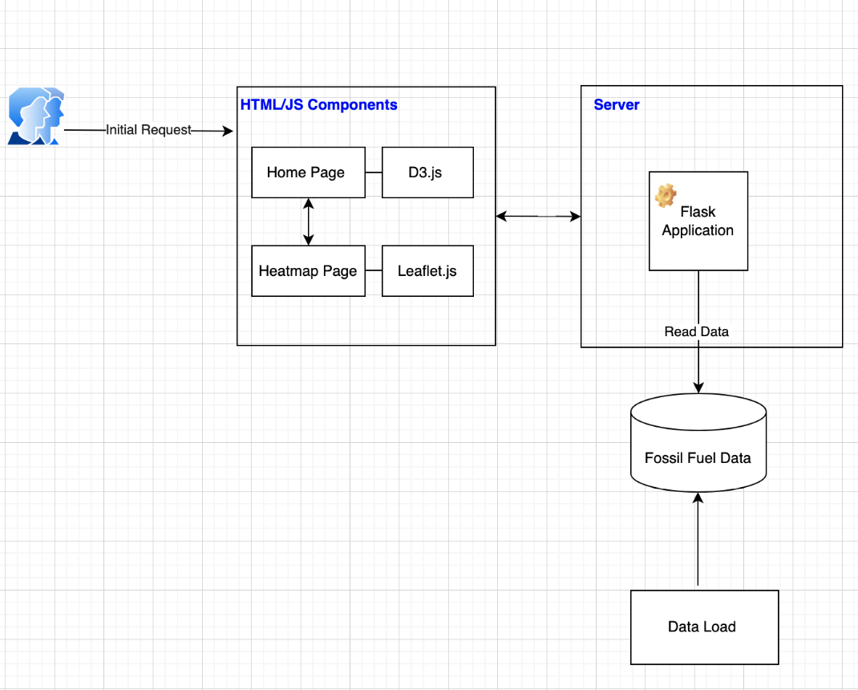
High Level Architecture

