Slide 1

impact of Fuel consumption and production
Abishua Prashanth
Chineze Okpala
Danelle Cook
Hari Somayajula
Henry White
Jennifer Long
Randy Weaver

Slide 2
Impact of Fuel consumption and production
Abishua Prashanth
Chineze Okpala
Danelle Cook
Hari Somayajula
Henry White
Jennifer Long
Randy Weaver

Slide 3
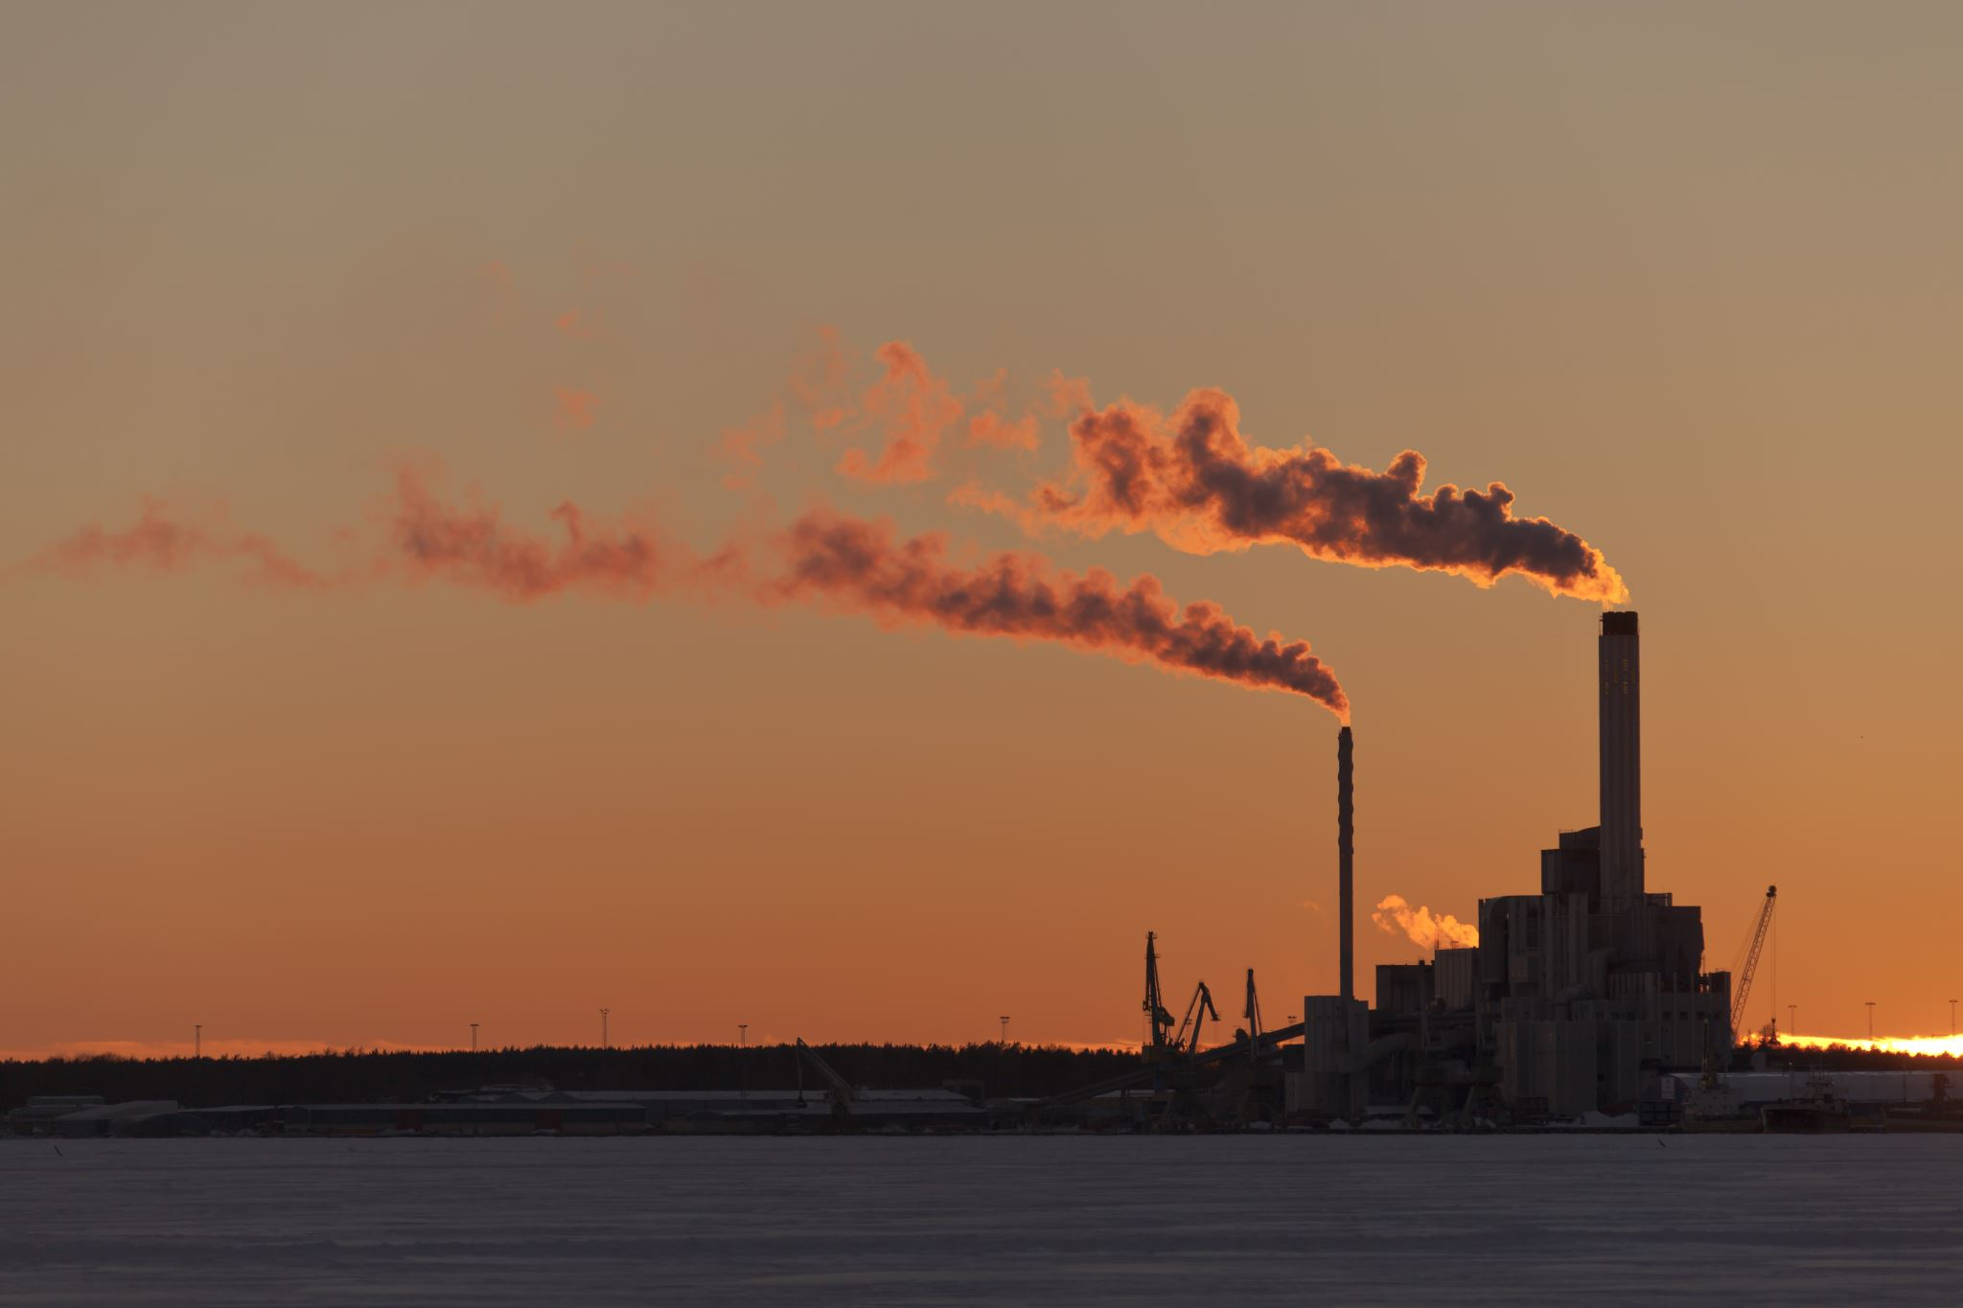
What fueled this project?
Summary
Data Sources
Study the interaction between consumption and production of fuel across the world and its relation to carbon emission.
Compared the GDP for each country to the amount of carbon emitted by that country
Demonstrate the comparison of carbon emissions across the world in 2020
Fuel production and CO2 emissions by country
https://www.bp.com/en/global/corporate/energy-economics/statistical-review-of-world-energy.html
GDP, CO2, and greenhouse emissions by country
GitHub - owid/co2-data: Data on CO2 and greenhouse gas emissions by Our World in Data

Slide 4
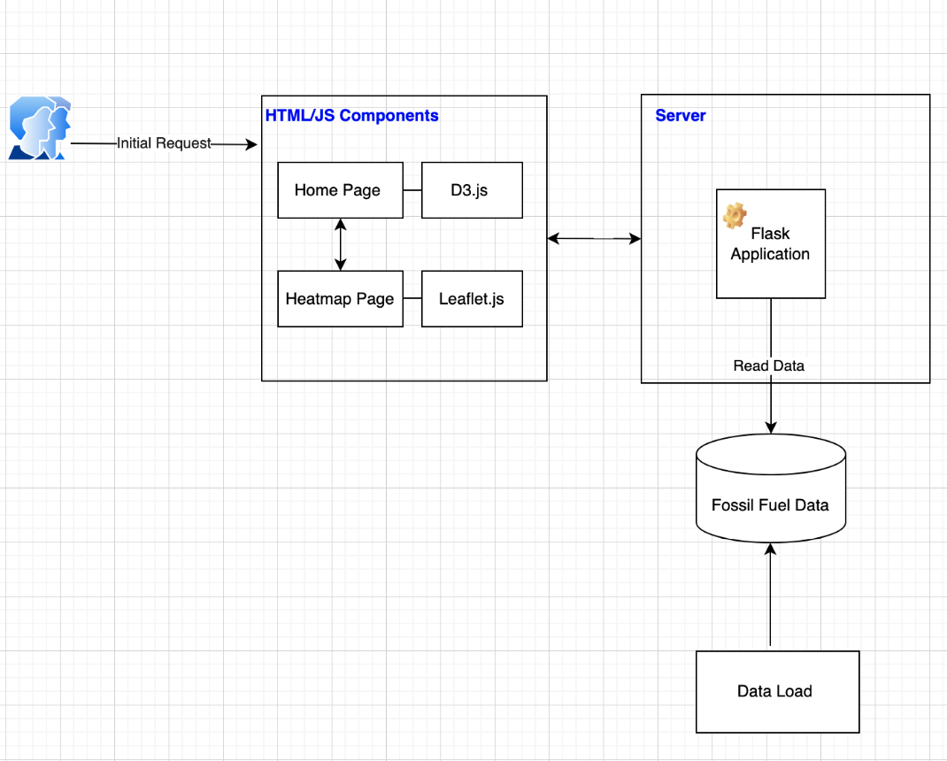
High Level Architecture

Slide 5
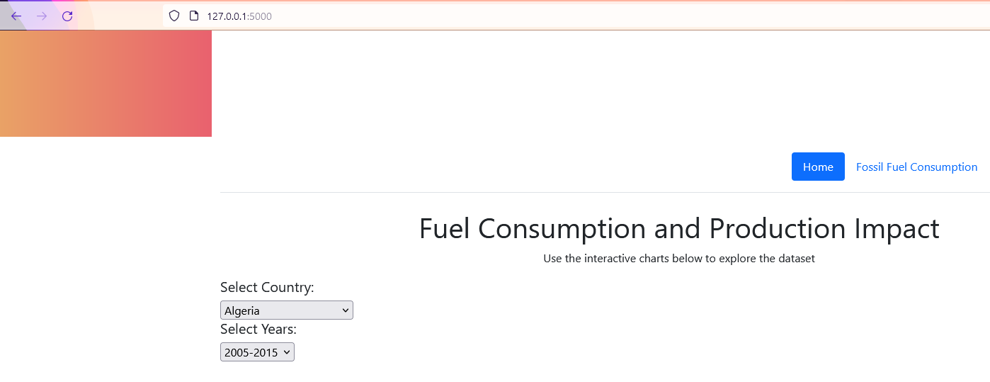
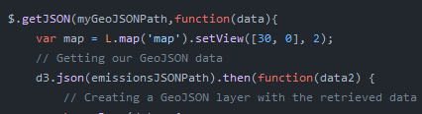
Running Out of Gas: A story about researching JavaScript libraries
Which JavaScript library to choose?
Chart.js
Adding animations to the charts
Granim.js
Create fluid and interactive gradient animations
Bideo.js
Add full screen background videos
jQuery
Navigate and manipulate HTML and JSONs

