Slide 1
DHCP & PXE SERVERS
And the configuration overview
Presented by:
Salma Mohamed
Randa Shereef
Ahmad Naeem

Slide 2
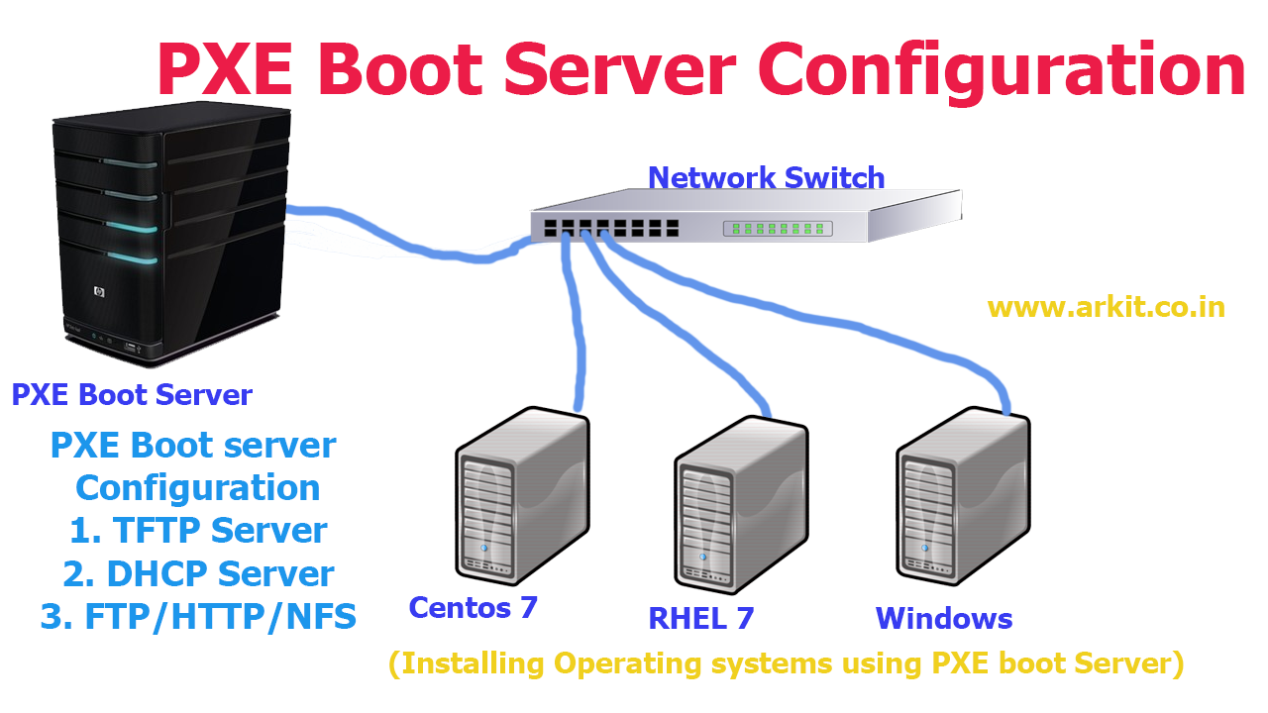
What is (PXE)?
Preboot execution environment (PXE), pronounced pixie, is a set of standards that enables a computer
to load an operating system (OS) over a
network connection.
PXE can be used to quickly install an OS
and is commonly used for both servers and
clients. It may also be called PXE boot,
boot from network,network boot or
local area network boot.

Slide 3
PXE Use Case, What problem does it solve?
PXE solves a problem large enterprises face. How do you automate provisioning or installation of operating systems on large quantities of machines?

Slide 4
PXE Use Case, What problem does it solve?
Operating system such as Windows or Linux have mechanisms to automate installation. Typically you create a seed file or configuration. The seed file provides answers to the questions asked by the OS installer. In the linux world examples of this are debian preseed files or Redhat kickstart files. But still you need access to the installation media on CD/DVD-ROM or a USB drive. A human running around with the usb drive touching every server does not scale. Its time consuming and error prone.
Let's imagine a world where a human puts a server in the rack, powers it on and is done. This has many benefits:
Installers can be less technical.
Reduced time spent per server.
Less error prone due to automation.
OS installation tools are centralized and easier to update.

Slide 5
PXE Use Case, What problem does it solve?
This is where PXE comes in. PXE is a standards based approaches to solving the problem of getting the OS onto the system without a human being putting media (USB, CD/DVD-ROM) in the system. It does this by bootstrapping the machine over the network.
In a fully automated environment the human installing the server does the following:
Installs server in the rack.
Connects power and network.
Walks away.

Slide 6
PXE boot components
A typical PXE environment has the following components.
DHCP Server
TFTP Server

Slide 7
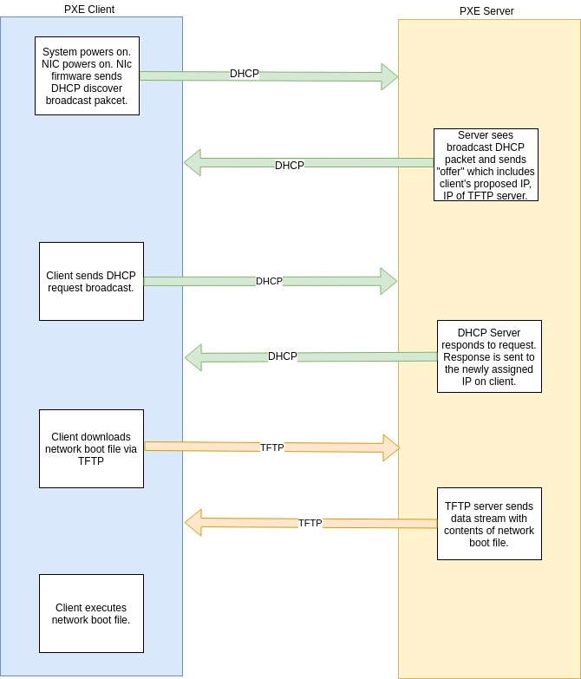
How does the PXE boot process work?
Here are the steps in the PXE boot process:
The client basic input/output system (BIOS) initiates PXE boot. This may be selected by the client operator or may be a fallback option when other boot media fails.
The client broadcasts a DHCP request and a PXE request.
The DHCP server responds with the DHCP response so the client can set an IP address, and it replies with the IP address of the TFTP server and the file name of the NBP.
The client downloads and boots the NBP.

Slide 8
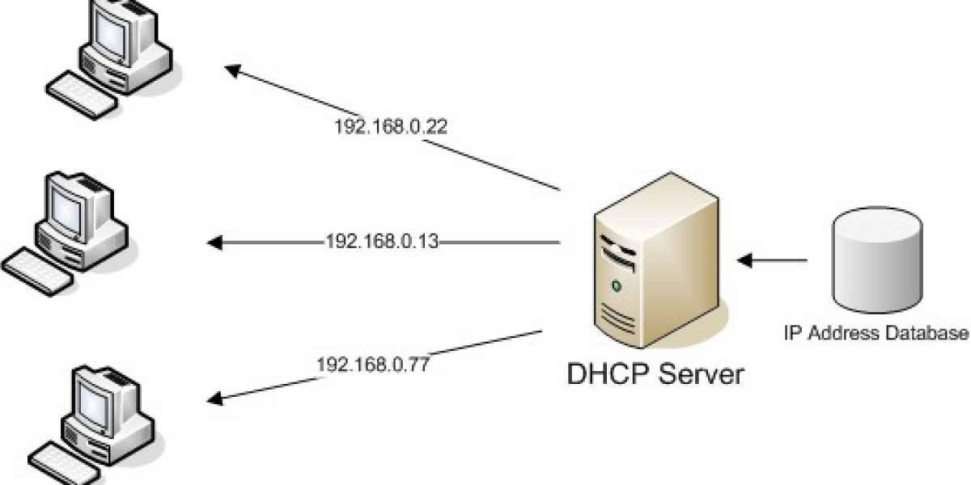
What is DHCP?
DHCP (Dynamic Host Configuration Protocol) is a network protocol that enables a server to automatically assign an IP address and provide other related network configuration parameters to a client on a network, from a predefined IP pool.

Slide 9
How Does DHCP Work?
When a client computer (configured to use DHCP) and connected to a network is powered on, it forwards a DHCPDISCOVER (Broadcast) message to the DHCP server.
And after the DHCP server receives the DHCPDISCOVER request message, it replies with a DHCPOFFER (Broadcast) message.
Then the client receives the DHCPOFFER message, and it sends a DHCPREQUEST (Broadcast) message to the server indicating, it is prepared to get the network configuration offered in the DHCPOFFER message.
Last but not least, the DHCP server receives the DHCPREQUEST message from the client, and sends the DHCPACK (Broadcast) message showing that the client is now permitted to use the IP address assigned to it.

Slide 10
TFTP Server
TFTP stands for trivial file transfer protocol. It is a simple UDP based protocol for getting or sending a file. It’s simplicity lends well to being implemented in firmware environments where resources are limited. Getting and putting files are supported, that’s it. There is no directory listing, you must know the exact path of the file you want to download. Additionally there is no authentication or authorization.

Slide 11

PXE TFTP Steps
NIC firmware makes a TFTP request to the server using the IP or name specified in the next-server option of the DHCP lease.
TFTP server sends the requested file in a udp data stream.
NIC firmware receives the file storing it in memory.
Server then executes the downloaded file.

Slide 12

Next steps after Dhcp and TFTP
What happens at this point will vary depending on the environment and goal of the PXE boot configuration.
And we will use pxe to install Cenots 7 on a remote host .

Slide 13
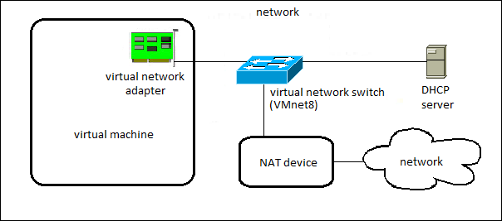
PXE Configuration
Before configuration
You should configure two network card in your server:
NAT for connecting to the internet
Custom in the same virtual network
with the client and to isolate local
Network from the internet.

Slide 14
PXE Configuration
Before configuration
configure the network card by static ip in the same subnet with client.

Slide 15
PXE Configuration
Step:1 Install required packages for PXE Setup:
dhcp
tftp-server
tftp
syslinux
vsftpd
xinetd

Slide 16
PXE Configuration
Step 2:Configuring DHCP Server in CentOS
The first step is to create the dhcpd.conf configuration file, and the main DHCP configuration file is normally /etc/dhcp/dhcpd.conf (which is empty by default), it keeps all network information sent to clients.However, there is a sample configuration file /usr/share/doc/dhcp*/dhcpd.conf.example, which is a good starting point for configuring a DHCP server.
2) open the main configuration file and define your DHCP server options.

Slide 17
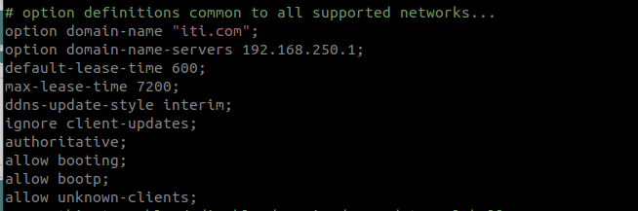
PXE Configuration
Step 2:Configuring DHCP Server in CentOS.
3) Set global parameters which will apply to all the subnetworks.

Slide 18
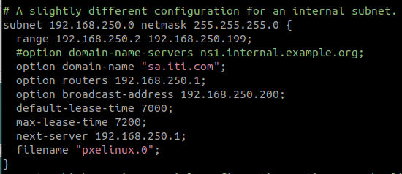
PXE Configuration
Step 2:Configuring DHCP Server in CentOS.
4) Define a internal subnetwork.
5) Finally, enable and start the service.

Slide 19
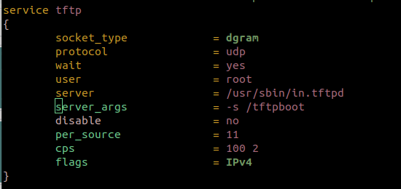
PXE Configuration
Step:3 Edit and Config tftp server
Edit its configuration file ‘ /etc/xinetd.d/tftp’,
change the parameter ‘disable = yes‘ to ‘disable = no’ and leave the other parameters as it is.

Slide 20
PXE Configuration
Step:4 Edit tftp root directory
1) All the network boot related files are to be placed in tftp root directory “/var/lib/tftpboot”
We will copy required network boot files in ‘/var/lib/tftpboot/’

Slide 21
PXE Configuration
Step:4 Mount CentOS 7.x ISO
2) We will mount the CentOs 7.iso file from cdrom to the ftp server’s directory ‘/var/ftp/pub’, In ower case we mount permanently in /etc/fstab
3) After that will create 2 dirs. /var/lib/tftpboot/pxelinux.cfg
and /var/lib/tftpboot/networkboot

Slide 22
PXE Configuration
Step:4 Mount CentOS 7.x ISO
4) Copy Kernel file (vmlimz) and initrd file from mounted iso file to ‘/var/lib/tftpboot/networkboot/’

Slide 23
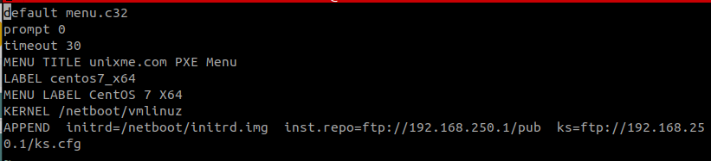
PXE Configuration
Step:4 Mount CentOS 7.x ISO
5) Create a PXE menu file under the folder /var/lib/tftpboot/pxelinux.cfg/default with the name ‘default’

Slide 24
PXE Configuration
Step:5 Creating a new kickstart
A kickstart file is a simple text file that contains configuration information for a Linux installation. The system reads this configuration information at boot time and carries out the installation process without any further input from you. You can also use a kickstart file to upgrade your system to a new release.

Slide 25
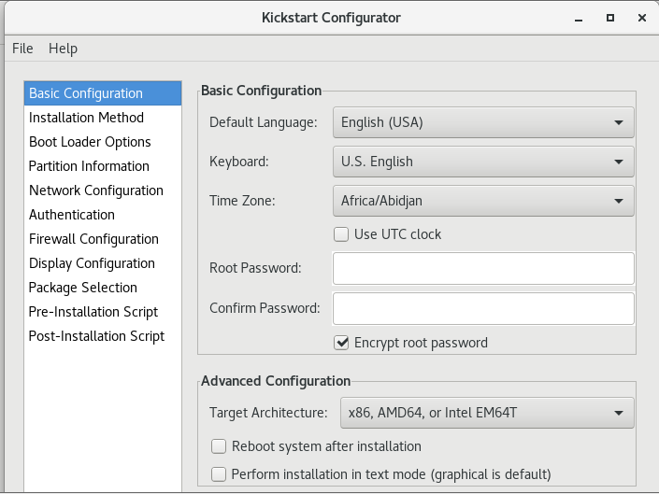
PXE Configuration
Step:5 Creating a new kickstart
We make a kickstart file using system-config-kickstart

Slide 26
PXE Configuration
Step:6 Enable and start every thing
After finishing the configuration we will enable and start: xinetd, dhcpd, vsftpd.

Slide 27
PXE Configuration
Final step:
After set the selinux rule for ftp server:
and enable the following ports and services on firewall

Slide 28
And now ..
PXE is ready to use

Slide 29
PXE vs IPXE
iPXE is an open source network-boot firmware. iPXE is based on gPXE, which is an open-source PXE client firmware and bootloader derived from Etherboot. Standard PXE clients use TFTP to transfer data whereas gPXE supports more protocols.
iPXE has another features such as:
boot from a web server via HTTP
boot from an iSCSI SAN
boot from a Fibre Channel SAN via FCoE
boot from an AoE SAN
boot from a wireless network
boot from a wide-area network
boot from an Infiniband network
control the boot process with a script

Slide 30
Thanks

