Slide 1





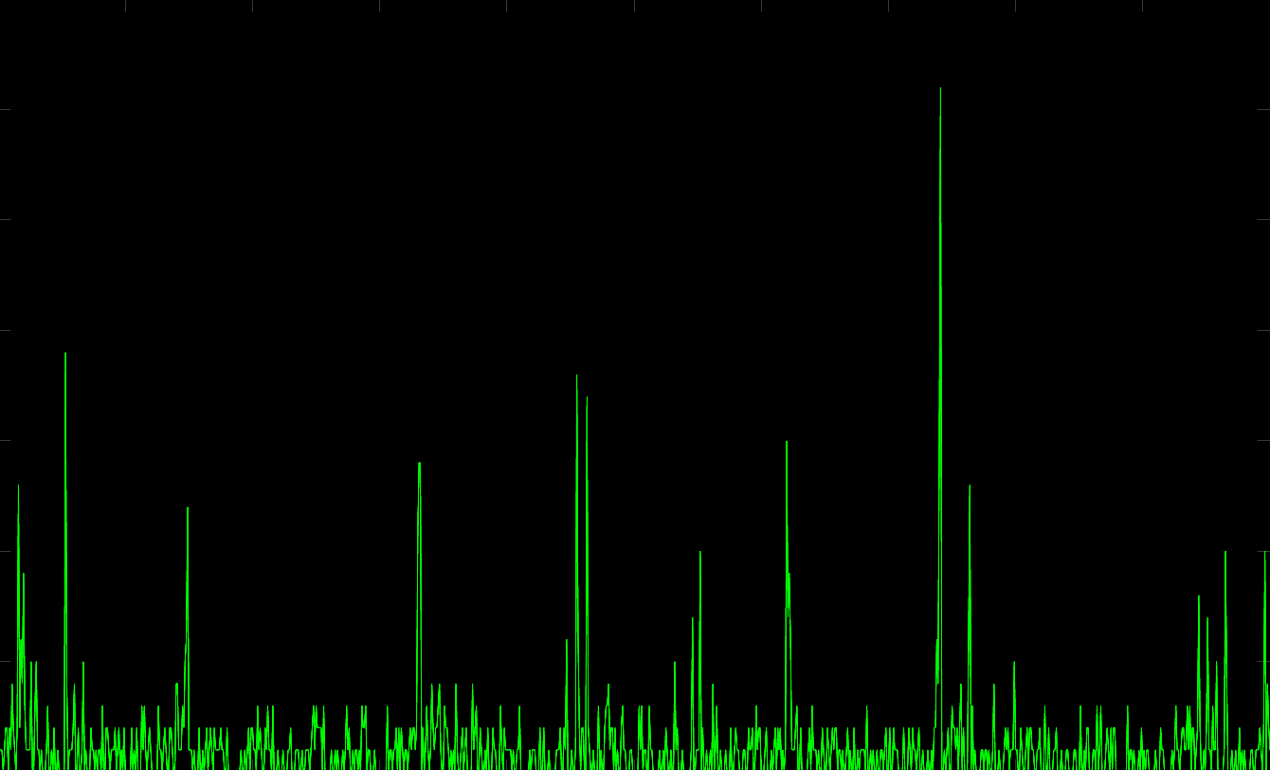
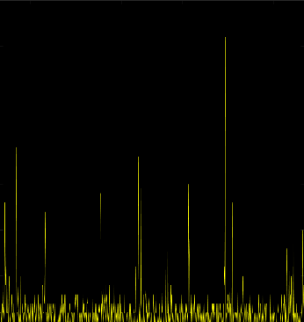
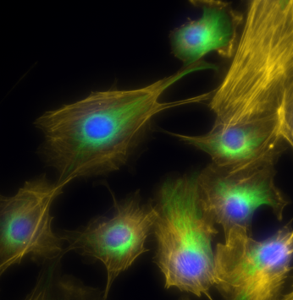
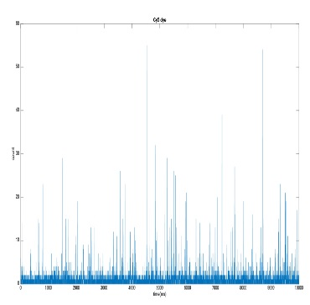

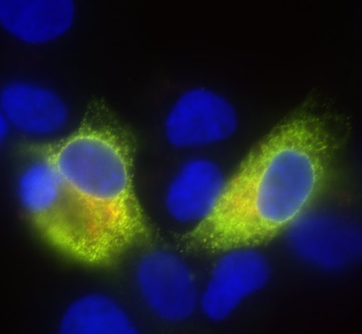
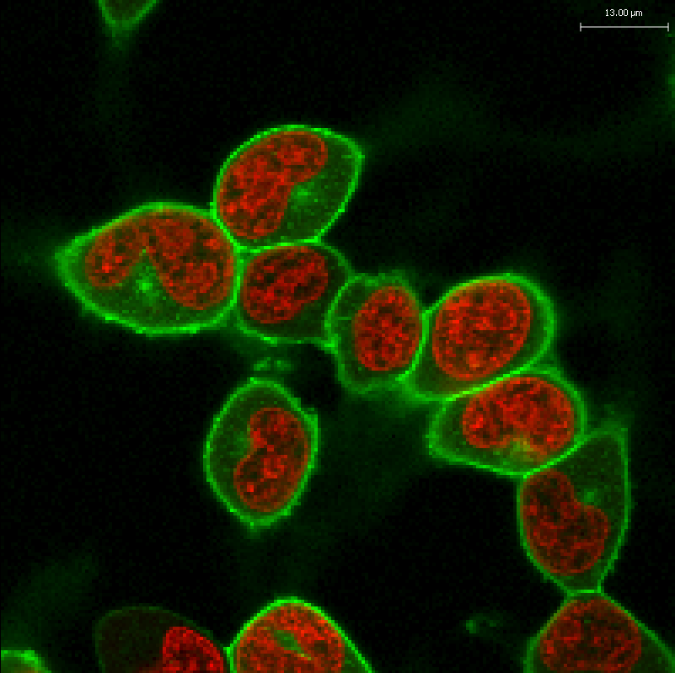
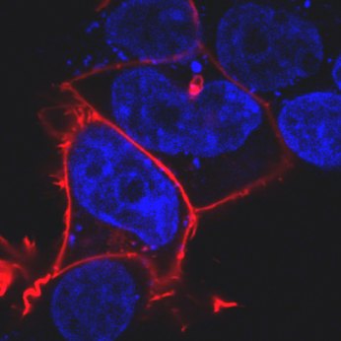
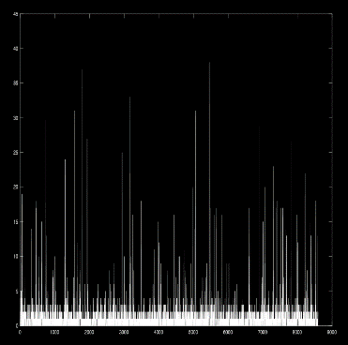

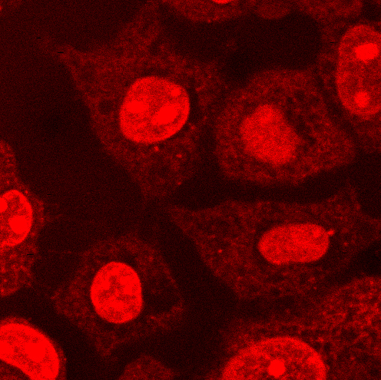


Chemical and Translational Biology/ CSE-SBS & CMVM-SBMS
The Auer Lab
An Introduction to Supervised and Unsupervised Learning Methods Using Python
Randeep Samra
r.samra@sms.ed.ac.uk
14/12/2018

Slide 2
What is machine learning?
‘Machine learning’ has been given a range of different definitions by different theoreticians and practitioners.
It was defined in 1959 by one of its early pioneers, Arthur Samuel as
“The field of study which gives computers the ability to learn without being explicitly programmed”
Tom Mitchell later provided a more technical definition in 1998:
“A computer program is said to learn from experience E with respect to a task T and some performance measure P, if its performance on T as measured by P improved with experience E.”
I prefer Jason Brownlee’s observation: “through experience, we’ll learn that machine learning is really a mess of methods and choosing a perspective is the key to making progress”.

Slide 3
The three main types of machine learning
The following four slides will, in turn, address each of the three main types of machine learning:
Supervised learning
Unsupervised learning
Reinforcement learning

Slide 4
Supervised learning
Supervised learning aims to take labelled data and train a classifier or a regressor (depending on the target variable) to predict the target variable’s value for any given unlabelled instance.
Most of us will have done supervised learning manually in secondary school when we drew lines of best fit.
The second to the fourth Jupyter notebooks explore examples of supervised learning.

Slide 5
Unsupervised learning
Unsupervised learning to the practise of learning from unlabelled data.
In practise, ‘unsupervised learning’ tends to be synonymous with clustering/segmentation; we’ll use these terms interchangeably as well.
Some examples:
Customer segmentation (supermarkets, online retailers, social media)
Clustering time series (e.g. corporate bonds)
Clustering phenotypic response in drug discovery
Anomaly detection (fraud detection, operational risk detection)

Slide 6
Reinforcement learning
Reinforcement learning generally refers to algorithms which train machines to perform a task (as opposed to extracting insights).
Reinforcement learning is a takes a bit longer to get started with than the other two types of ML, and therefore won’t be covered in this workshop.
Some examples:
Training a machine to play games (e.g. IBM DeepBlue, AlphaGo)
Training a self-driving car (hundreds of startups)
Modelling behaviour

Slide 7
Practice makes perfect
The best way to get good at machine learning is to actually do it.
The following sites are well-known sites among the ML community for acquiring datasets. They are of course not exhaustive.
Kaggle.com
UCI Machine Learning repository

Slide 8
Some useful resources and courses
Non-machine learning
The essence of linear algebra (series of YouTube videos)
HackerRank and Codewars
ML and AI
Learning from Data (Caltech course)
Andrew Ng’s courses on Coursera.org (particularly the Deep Learning series)
Many courses on edX.org (Columbia’s courses “Machine Learning” and “Artificial Intelligence” are both strong.
Udacity’s “Machine Learning Engineer Nanodegree”

