Slide 1
Final Project Presentation
Randeep Chahal

Slide 2
Bias/Trust Analysis in Healthcare AI Summaries
Topic: Alzheimer’s Disease
Article #1: “Stepwise Approach to Alzheimer’s Disease Diagnosis in Primary Care Using Cognitive Screening, Risk Factors, Neuroimaging and Plasma Biomarkers”
Article #2: “A Review of the Current Status of Disease-Modifying Therapies and Prevention of Alzheimer’s Disease.”
Article #3: “Recent Advances in Alzheimer’s Disease: Mechanisms, Clinical Trials and New Drug Development Strategies.”

Slide 3
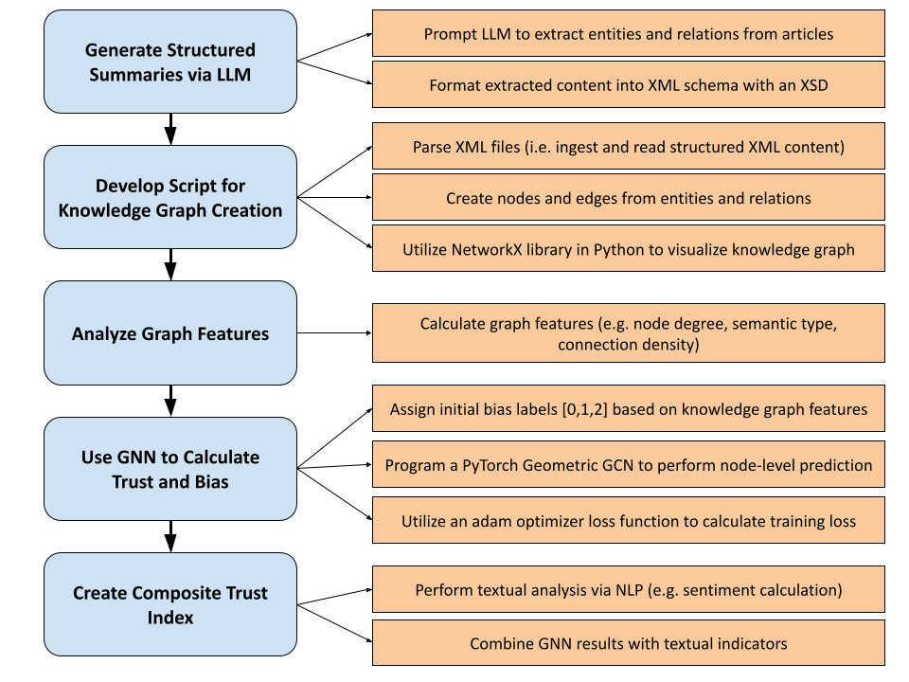
Project Pipeline

Slide 4
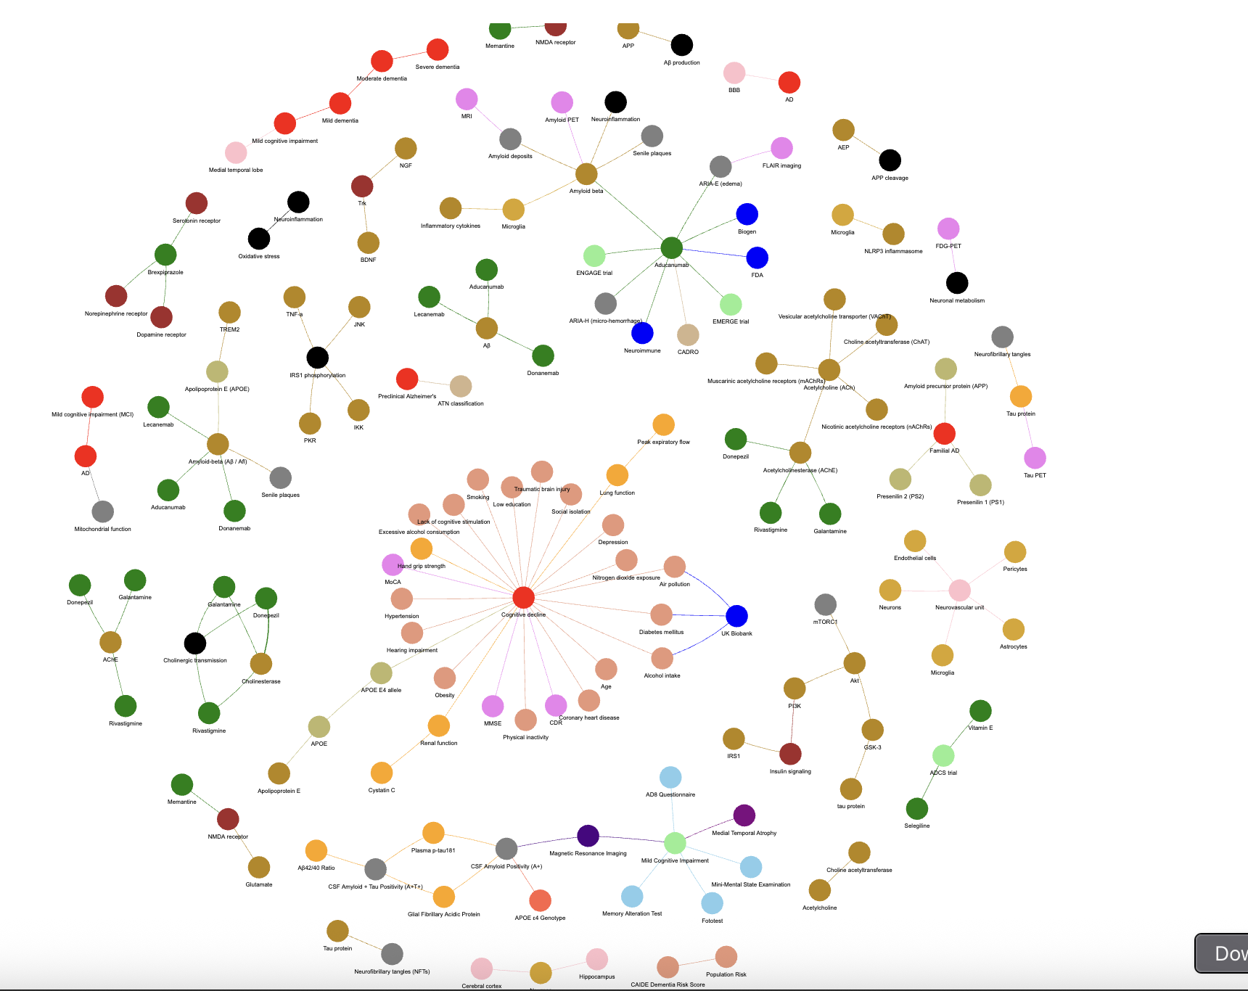
Knowledge Graph
Most Frequent Node Types –
  Drugs
  Cells
  Proteins
  Risk Factors

Slide 5
Knowledge Graph Features
Node types with the highest total node degrees →
  Protein (54)
  Drug (34)
  Condition / Disease (33)
  Risk Factor (20)
  Biomarker (15)
Node types with highest average connection density →
  Clinical Trials (1.0)
  Cognitive Tests (1.0)

Slide 6

GNN Bias Level Predictions
Node types with the highest proportion of “2” labels (i.e. high bias):
Drugs
Proteins
Cells
Conditions / Diseases
Biomarkers
Node types with the highest proportion of “1” labels (i.e. normal bias):
Risk Factors
Imaging
Cognitive Tests
Clinical Trials
Pathological Features

Slide 7
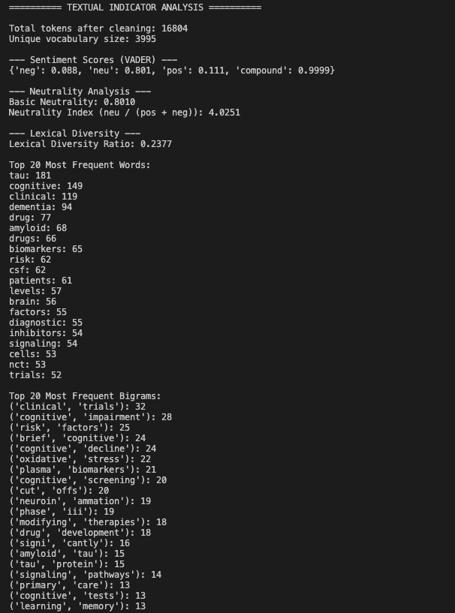
Textual Indicators (NLP Metrics)
Sentiment Scores →
  Positive: 0.111
  Negative: 0.088
  Neutral: 0.801
Coverage Analysis →
  Lexical Diversity Ratio: 0.2377

Slide 8
Most Frequent Words and Bigrams

Slide 9
Final Takeaways
Within the context of the Alzheimer’s articles →
  There was a higher bias towards the inclusion of drugs, cells, and proteins over cognitive testing, risk factors, and pathological features
General conclusion about A.I. Effectiveness →
  LLMs place a high precedence on the inclusion of technical subject matter
  Researchers utilizing A.I. risk getting caught up in medical jargon

Slide 10
Thank You!

