Slide 1
BRITISH AIRWAYS
CUSTOMER REVIEWS SENTIMENT ANALYSIS BY RANDELL MWANIA

Slide 2
British Airways Overview
Founded: 1974, London-based, with London Heathrow as its main hub.
Reach: Over 30 million passengers annually across Europe, North America, Asia, and Africa.
Focus: Known for premium service, safety, and innovation, with a strong customer loyalty program.
This analysis explores customer reviews to uncover sentiment trends, identify pain points, and gauge overall satisfaction.

Slide 3
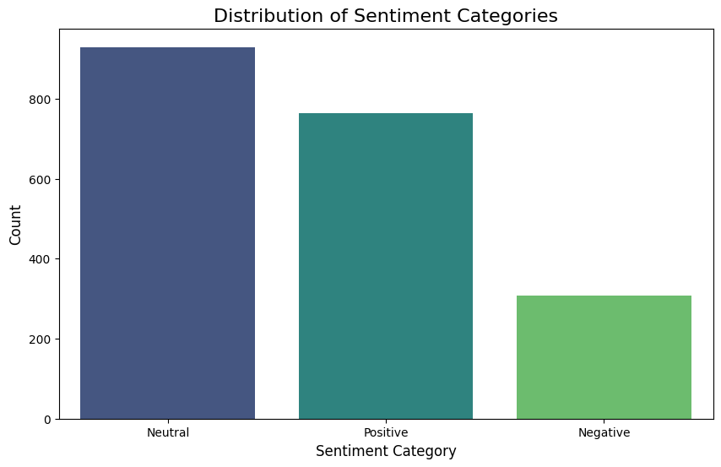
DISTRIBUTION OF SENTIMENT CATEGORIES
The histogram shows majority of the British Airways reviews fall under neutral category followed by positive then lastly negative.

Slide 4
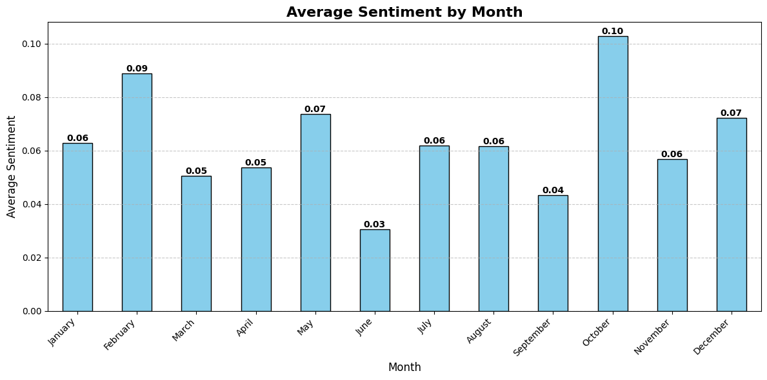
AVERAGE SENTIMENT BY MONTH
Below we can see the average sentiment by month with October having the highest sentiment overall and June having the lowest sentiment.

Slide 5
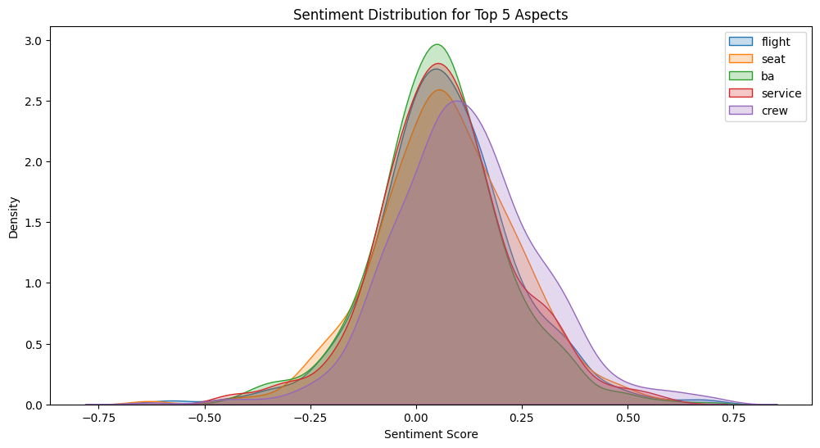
TOP 5 ASPECTS SENTIMENT DISTRIBUTION
The KDE plot shows the top 5 aspects in the reviews and their sentiment distribution.
From the distribution ba has the most positive sentiment score to density.

Slide 6
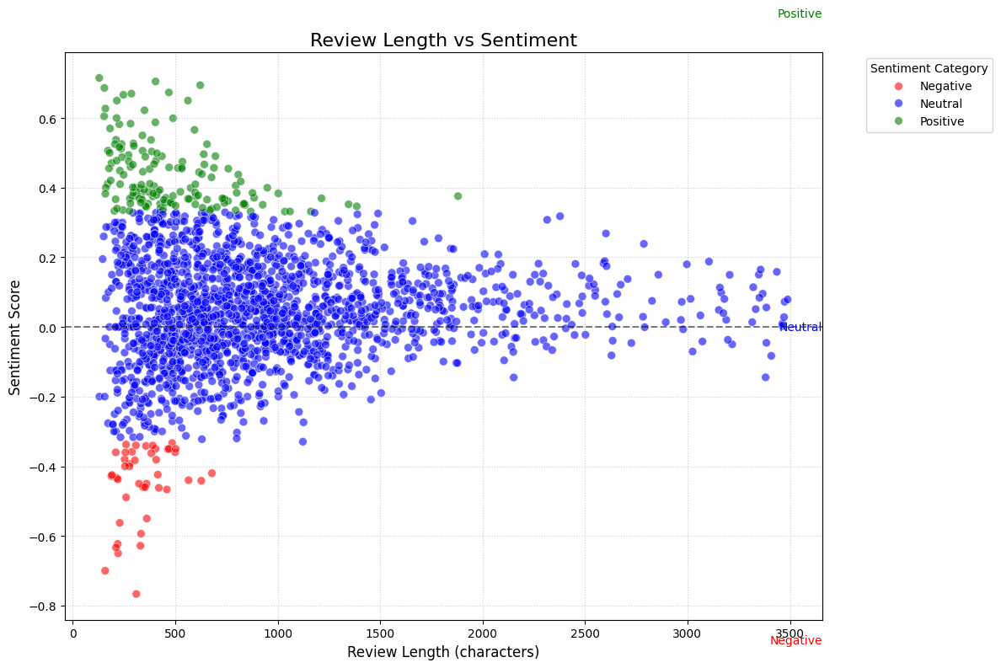
CUSTOMER REVIEW LENGTH VS SENTIMENT
The scatter plot shows the relationship between review length and sentiment scores. From the scatter plot we can see that majority of the sentiments are neutral.

Slide 7
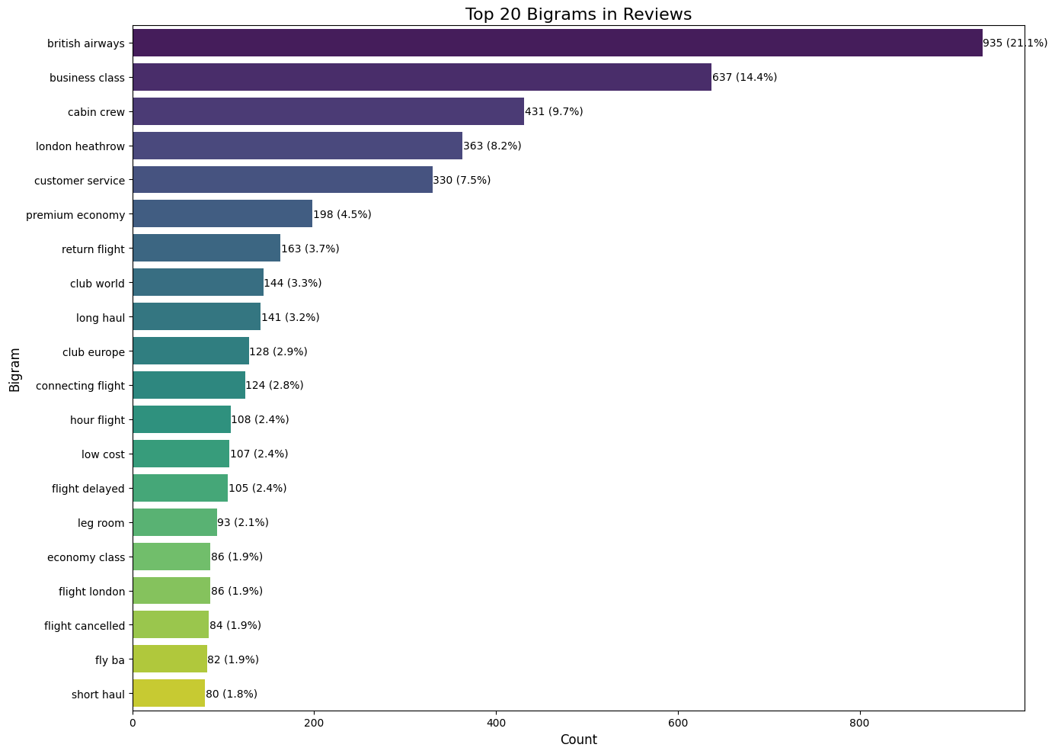
TOP 20 BIGRAMS IN REVIEWS
The most appearing bigram is “british airways” in the reviews followed by “business class” then “cabin crew”.

Slide 8
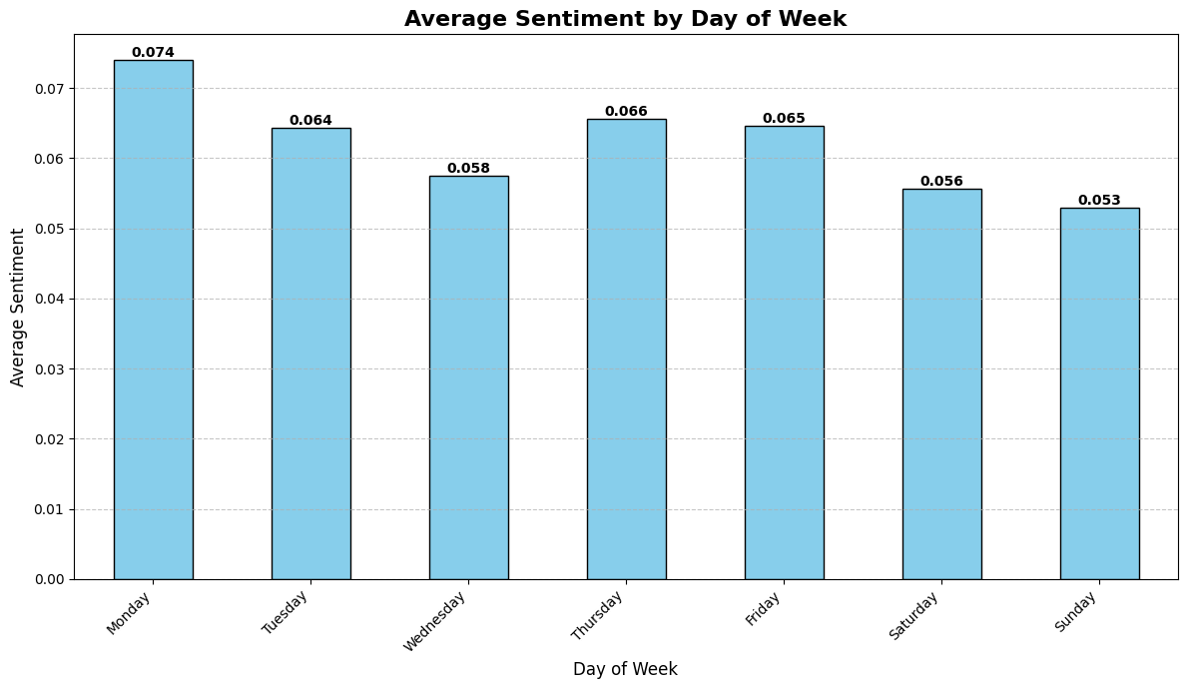
AVERAGE SENTIMENT BY DAY OF WEEK
The plot shows the relationship between the day of the week and their corresponding average sentiment. Monday has the highest average sentiment and Sunday having the least.

Slide 9
FINDINGS
From the analysis:
October has the most positive sentiments of all month and June having the least.
The most mentioned top 5 bigrams are “british airways”, “business class”, “cabin crew”, “London heathrow” and “customer service”.
Monday has the most positive sentiment among the days of the week with Sunday performing worst.
Majority of the sentiments are neutral which might be a cause for concern.

